Slide 1
Small Children/Big Data/Smart Cities?
Lia Karsten
University of Amsterdam
Cities4Kids, 2-02-2017, New Delhi

Slide 2
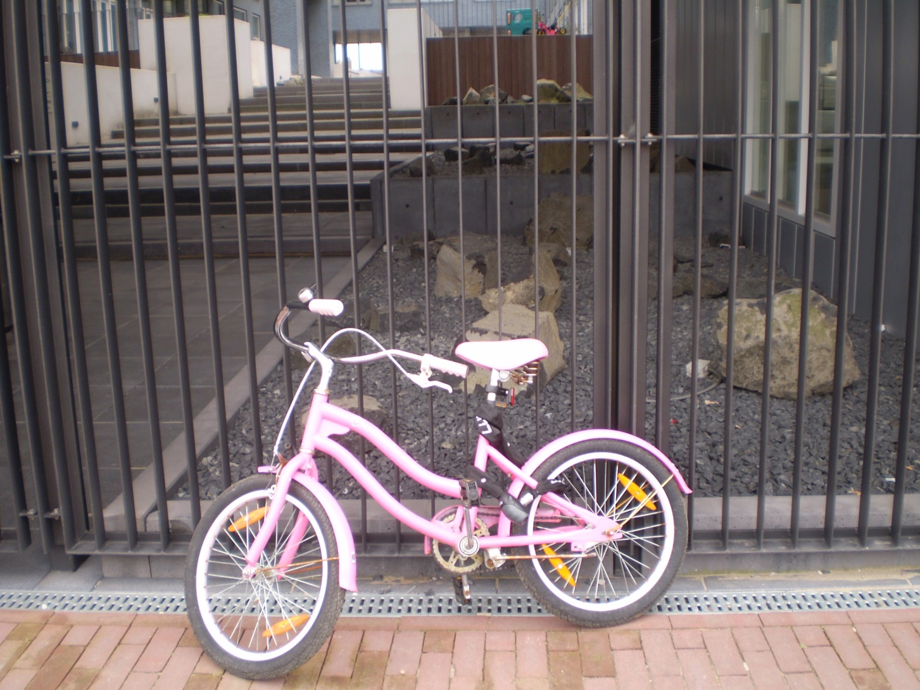
Research is important!

Slide 3
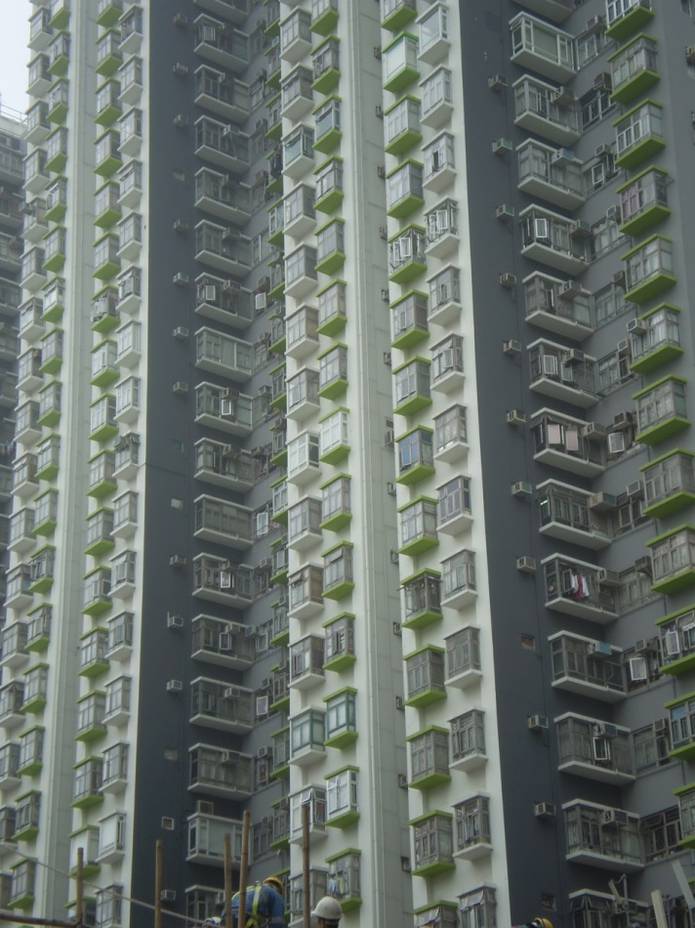
Secondary open access datasets (Holt, 2006)
No children (Karsten, 2015)
www.cbs.nl
www.scp.nl
www.scp.nl
www.ois.amsterdam.nl
www.Centerdata.nl
www.surgcontext.nl
www.woon.nl
www.censtatd.gov.hk/hkstat/

Slide 4

Newly planned high-rise Amsterdam

Slide 5
Big Data (Taylor, 2015)
Strengths
Weaknesses
Fast
Large
Cheap
Connectability
Mostly: numbers missing narratives/ meanings
Context?
Accuracy?
Informed cosent?
Ethics?
Inclusive?
Mostly: Commercial/ market driven

Slide 6

Implementing ICT based methods (Christensen et al, 2011)
Children as
co-researcher !

Slide 7
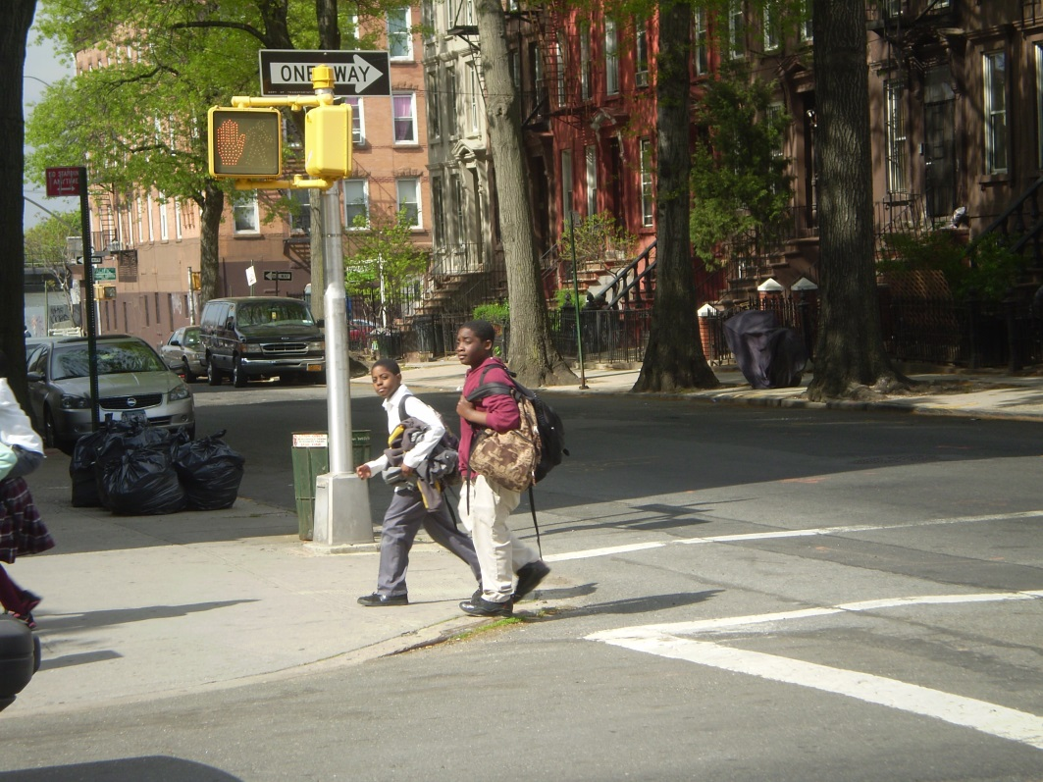
Summary
(non) Governamental organisations: inclusive datasets.
Connecting with Big Data and business world (pitfalls!)
Engaging children as ICT specialists and co-researchers

Slide 8

Knowledge Infrastructure: strategy Urban95
Educating future generations of urban designers/planners at academia
Applied research providing and exchanging evidence based knowledge
Making profit from academic research funding
Foto: Juliana Rosa

Slide 9
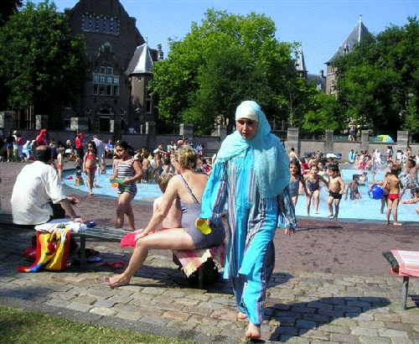
Smart Cities: Living Diversity (Putnam, 2015)

