Slide 1
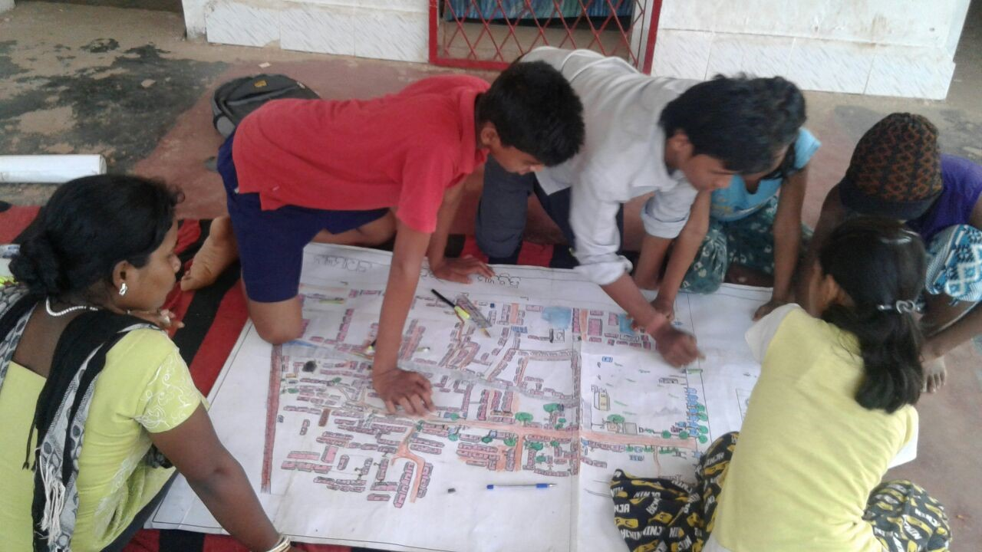

Child led planning – Humara Bachpan Campaign

Slide 2
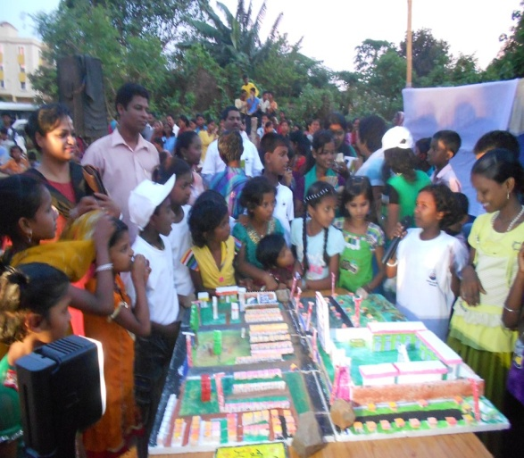
Child Led Planning
Is a participatory process of identifying, analysing, prioritising issues and planning for solutions with the use of participatory tools by children

Slide 3
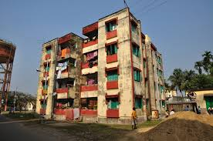
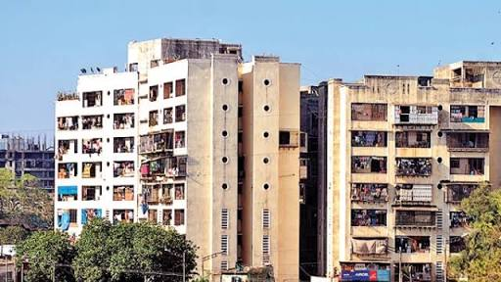
Why CLP
Houses like pigeon holes; unfit for human habitation let alone children
Lack of basic services in the buildings
Led to think if we were to design our own houses, how would they look like?
Hence child led planning

Slide 4
The process
Identify communities with good rapport, communities to be resettled or in-situ development
Secondary data collection
Identify and analyse the issues in the community by use of social and resource mapping tools, vulnerability analysis, problem analysis
Prioritising the issues and
Finally, developing the plan which are to be incorporated into the RFP or housing policies

Slide 5
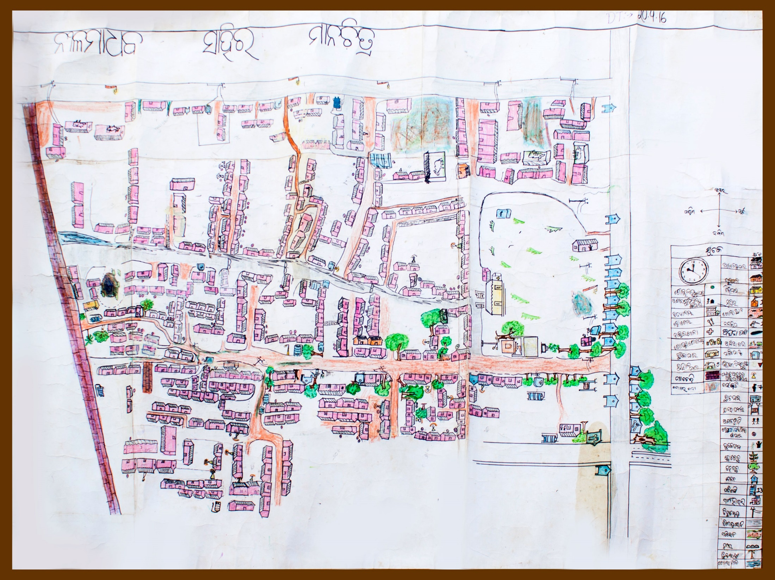

Slide 6
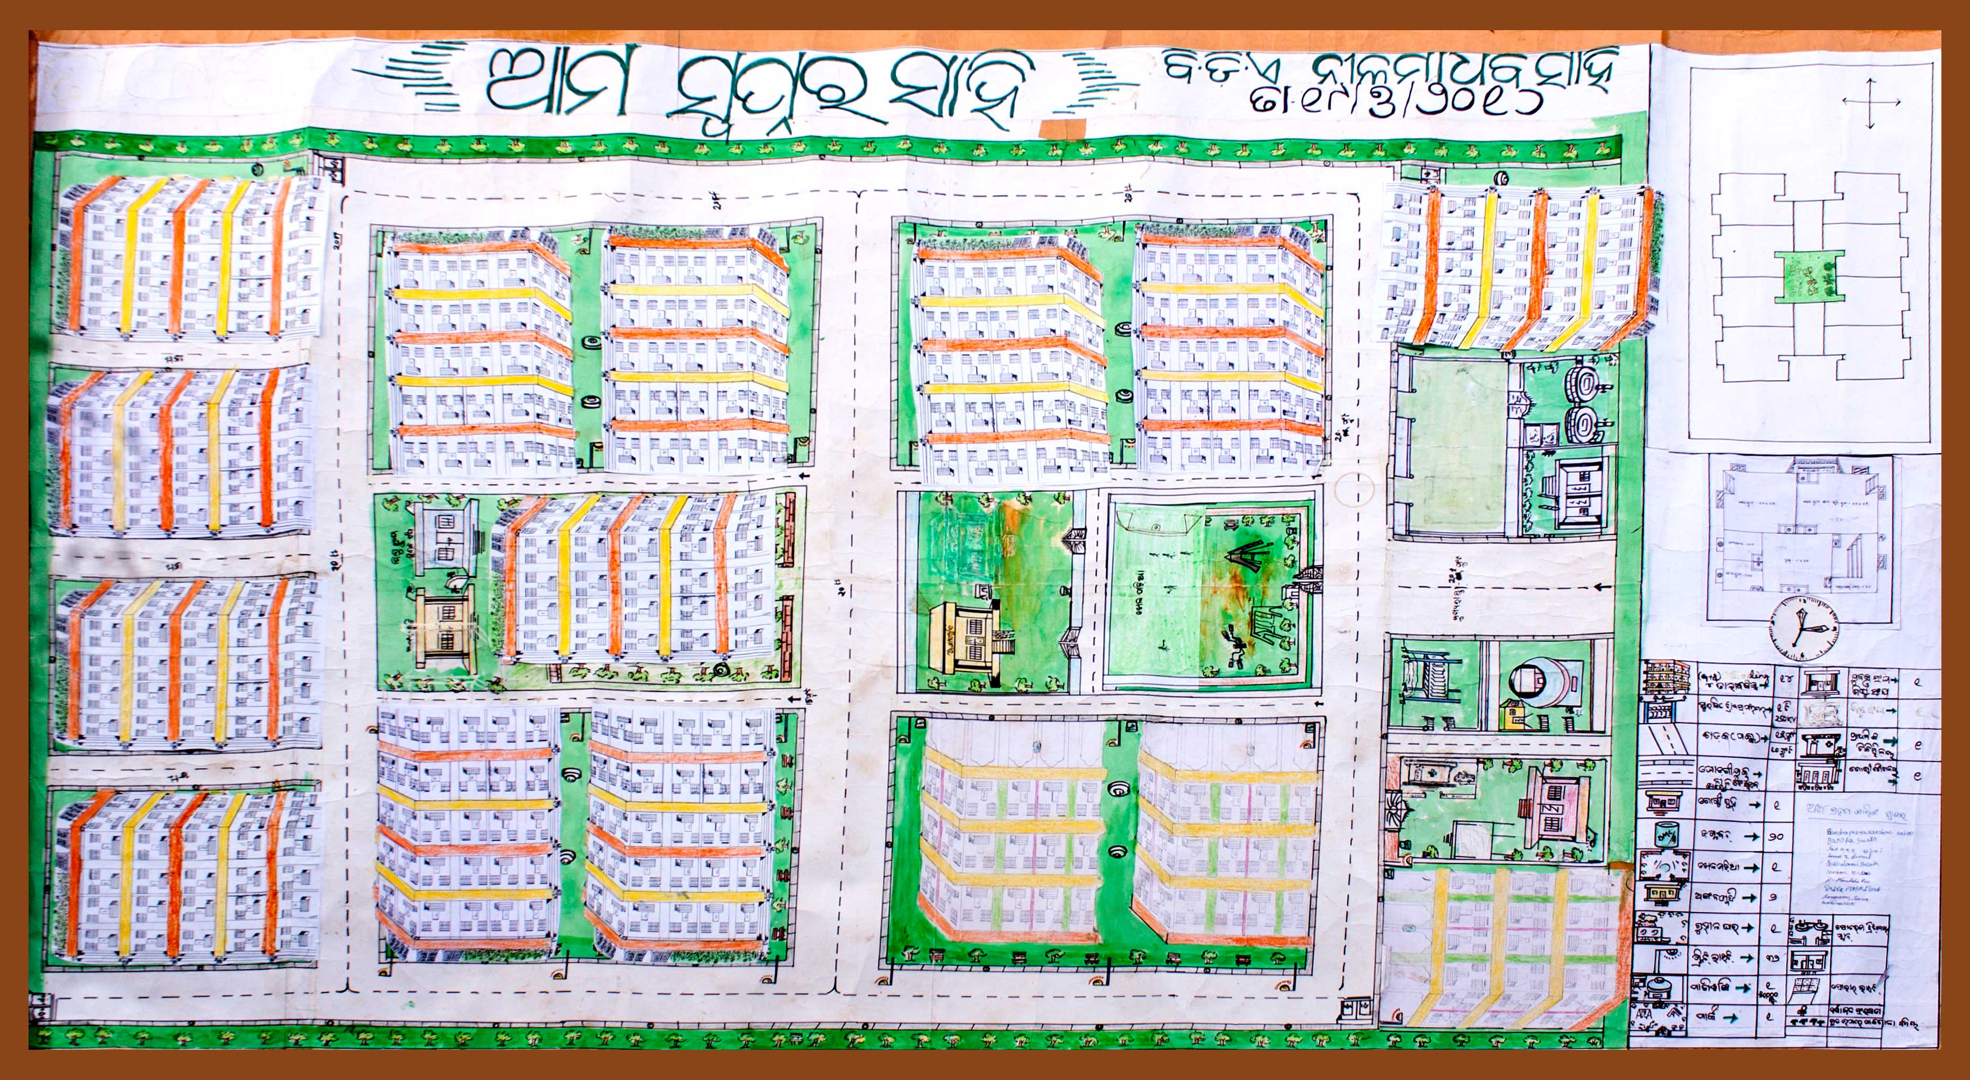

Slide 7
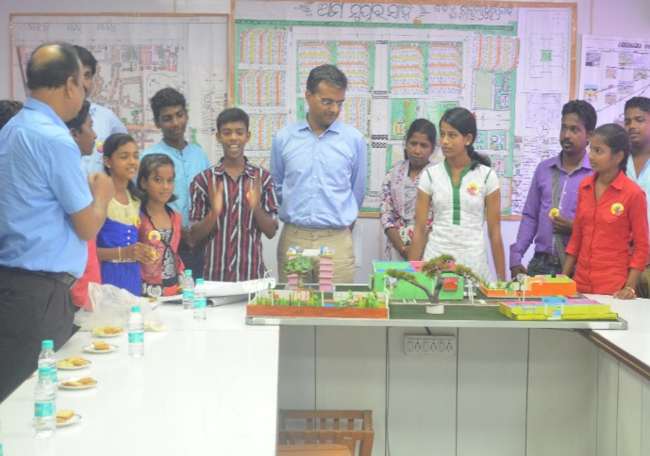
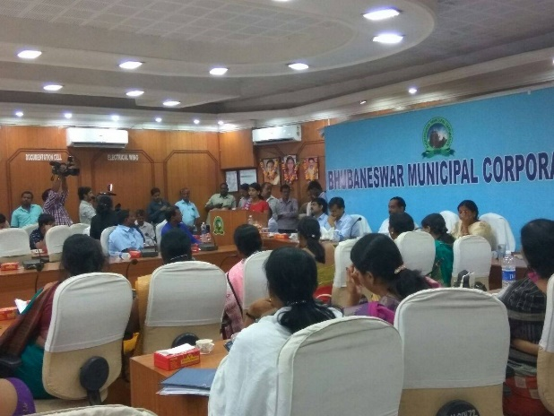
The Result
CLP was conducted in BDA Nilamadhav basti in Bhubaneswar
Children presented their plan before the government authorities
Various reccomendations of children on Anganwadi centres, creation of tot lots and reading rooms were taken into consideration by the development authority

Slide 8
THANK YOU!

