Slide 1
Optimizing vehicle charging stations
Team Shunya:
Ankur Limbashia
Shatakshi Pachori

Slide 2

Why optimize EV charging stations?
Speed up the transition from conventional gas vehicles to zero-emission vehicles
Social impact- help improve the environment

Slide 3
Our Solution

Slide 4
Information Flow: How it Works
Data Extraction
Extracted the data from OpenStreetMap using Overpass API
Data preprocessing
Preprocessed the extracted data
Eliminated the highways and buildings from data
Made a manual list of existing EV charging stations
Modeling
Calculated distance between 2 stations
Suggest a location for a new station at the mean distance between 2 stations with more than 2kms distance between them
Data Visualization
An interactive map that would show the locations of existing charging stations along with newly estimated ones
Deployment
Deployed the prepared Streamlit app on Heroku

Slide 5
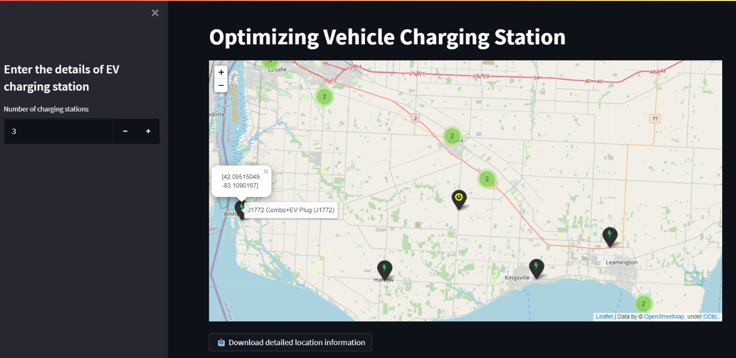
Web Application: How it Works

Slide 6
Future work
This work can be replicated for several ways/streets provided in the OpenStreetMap data
Improve functionality for better suggestions

Slide 7
OUR TEAM

Slide 8


Ankur Limbashia
Shatakshi Pachori

Slide 9



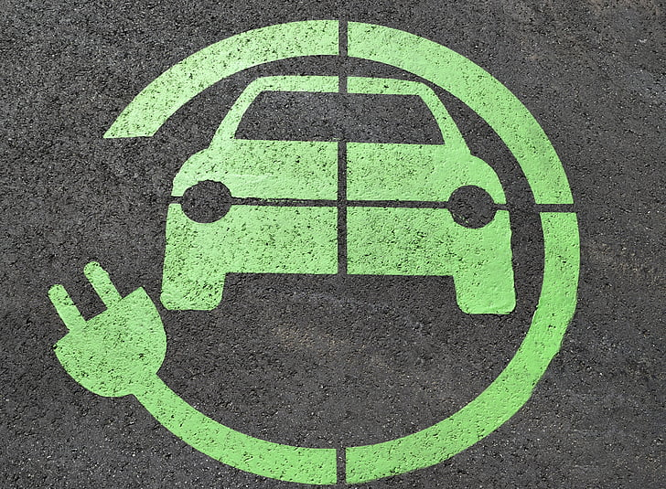
Thank you!☺

