Slide 1

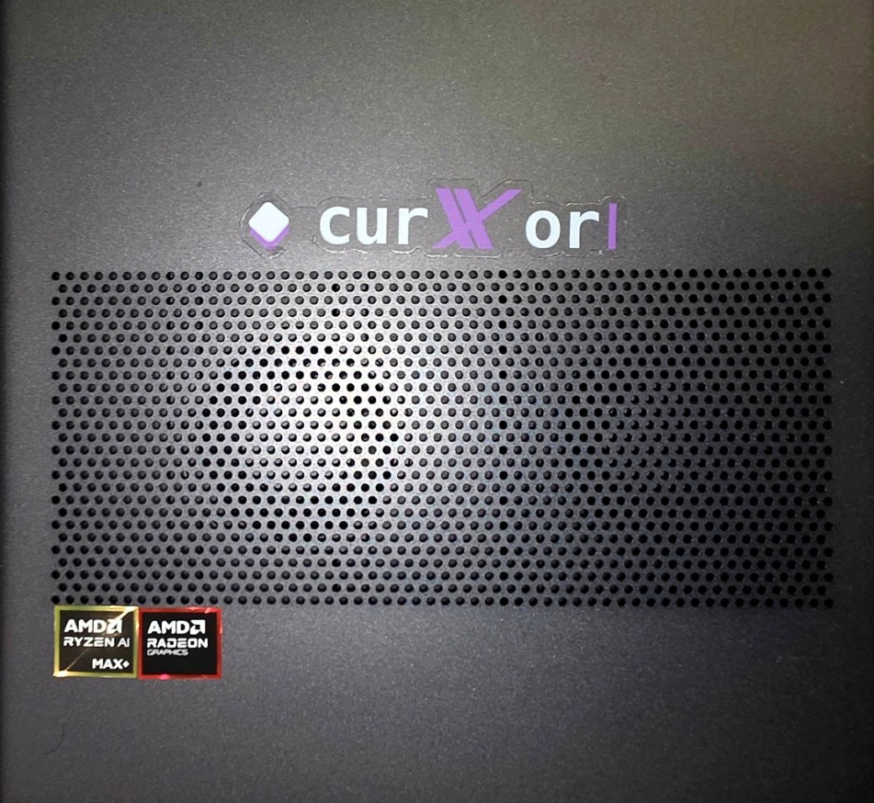
CurXor
v1.7.2 · August 5 2026
SOVEREIGN OPERATOR DESK
CurXor
A sovereign AI system on your desk — with digital employees that run wealth, creation, and work on metal you own.
RAISE
$3M seed SAFE · 18 months · ≤5 people
PROOF & PRICE
Working on MS-S1 MAX · 20 days · $3,999 once · pre‑revenue
Ankur Misra · Founder & CEO
The box on my desk today — validated MS-S1 MAX metal running CurXor OS.
Best next step — live Flight Command on metal you can touch. Not a cloud sandbox.
curxor.ai · Sovereign metal · desk crew · one invoice
1 / 29
Notes:
SPEAKER NOTES — practice from SCRIPT
────────────────────────────────────────────
TIMING · 30–45 sec
SCRIPT (practice aloud)
This is not another AI wrapper. CurXor is a sovereign AI system on your desk —
digital employees for wealth, creation, and work on metal you own.
We're raising a three-million-dollar seed SAFE — eighteen months, five people max.
Proof on the cover: working product on MS-S1 MAX in about twenty days —
three thousand nine hundred ninety-nine dollars once — pre-revenue by design.
I'm Ankur Misra, founder and CEO.
Best next step is a live box demo on your network — Flight Command you can touch —
not a cloud sandbox.
CUES
• Pause after “metal you own”
• Point at PROOF & PRICE chip — lead with evidence
• Offer film only if asked
HOLD
• No partnership cosplay · no “ChatGPT in a box”
• Port :3080 only if they ask how to connect

Slide 2
CurXor
Problem
THE ASPIRATION GAP
Operators want more AI. Setup stops them.
01 ASPIRATION
02 SETUP
Culture says use AI — operators stall after drafts and polish
Always-on still means repos, keys, scripts, five tabs
03 PRODUCT SHAPE
04 COMPUTE
Chat rent · cloud agents · home cloud · light boxes — not employees
Local inference on operator-grade hardware is finally real
curxor.ai · Sovereign metal · desk crew · one invoice
2 / 29
Notes:
SPEAKER NOTES — practice from SCRIPT
────────────────────────────────────────────
TIMING · 40–50 sec
SCRIPT (practice aloud)
Operators want more AI. Setup stops them.
Culture says use AI — they open the tab daily and stall after drafts and polish.
They feel under-leveraged, not behind.
Always-on still means repos, keys, scripts, five tabs —
weekend projects that die when life happens.
The market offers chat rent, cloud agents, home cloud, or light assistant boxes —
not employees.
Desk-ready local inference finally exists.
Our wedge is the appliance that turns the chat ceiling into an always-on desk crew.
CUES
• Walk the 2×2 · bridge: “Here’s what we built.”
HOLD
• Don’t dump demography here

Slide 3
CurXor
Why now
DATED · CHECKABLE
Why now — 2026, not 2023
01 MODELS
02 METAL
03 BEHAVIOUR
9B-class models finish work, not just drafts
64 GB unified memory arrived on desk-class boards
Operators already pay $200–800/mo for AI
Measured on our own box: 38 tok/s on Jul 4, 2026 (qwen3:8b) · today's pin runs qwen3.5:9b at ~36 tok/s
Operator-grade inference stopped needing a rack, a rented GPU, or a datacenter contract
The habit is daily and it still stalls at chat — the aspiration gap now has a bill attached
THE COUNTERFACTUAL
None of this was true in 2023 — the same appliance would have been a toy. It is buildable now, and the category has no default yet.
curxor.ai · Sovereign metal · desk crew · one invoice
3 / 29
Notes:
SPEAKER NOTES — practice from SCRIPT
────────────────────────────────────────────
TIMING · 35–45 sec
SCRIPT (practice aloud)
Why now, and not three years ago. Three things changed, and I can date all of them.
Models: nine-B-class models finish work now instead of drafting it.
On my own box I measured thirty-eight tokens a second on July fourth this year —
today’s pin runs qwen three-point-five nine-B at about thirty-six.
Metal: sixty-four gigs of unified memory landed on desk-class boards —
operator-grade inference stopped needing a rack, a rented GPU, or a datacenter contract.
Behaviour: operators already pay two to eight hundred a month for AI.
The habit is daily and it still stalls at chat — the gap now has a bill attached.
The counterfactual matters: none of this was true in twenty twenty-three.
The same appliance then would have been a toy. It is buildable now,
and the category has no default yet.
CUES
• Date each shift out loud — checkable beats confident
• Land on the counterfactual, then bridge to the box
HOLD
• Don’t claim a market-size number here — that’s two slides away
• Offer live System Health if they want to verify tokens per second

Slide 4
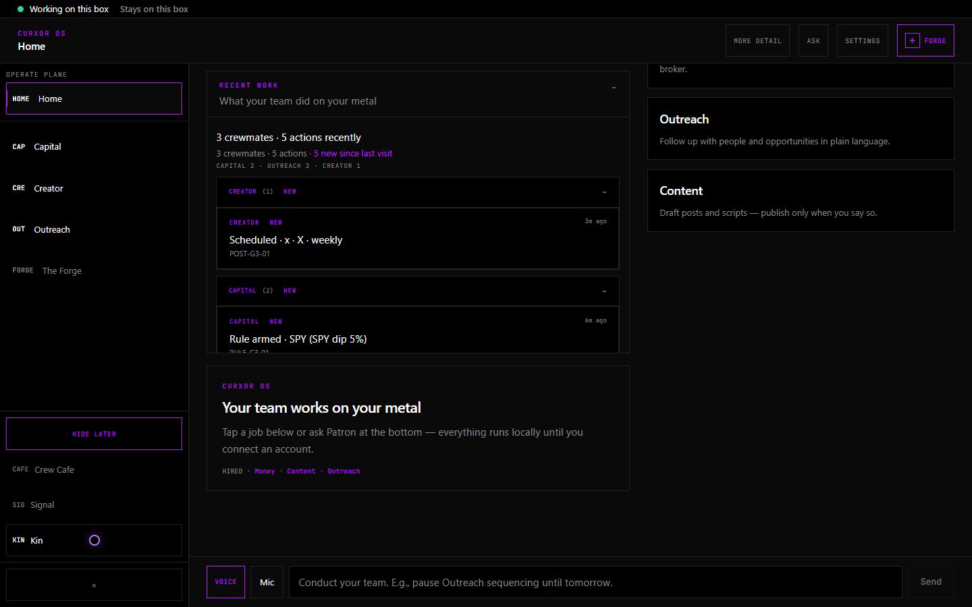
CurXor
Solution
WHAT WE BUILD
The CurXor box
HARDWARE
CurXor desk appliance — validated on MS-S1-class metal
OS
Four pillars — compute · engine · mesh · Flight Command
DESK CREW
Capital · Creator · Outreach · Forge · Crew Cafe + honest previews
FORGE
Mint custom crewmates in plain language — on the box
BOUNDARY
Local cognition · outbound you wire and can unplug
Flight Command — the operator home, running on the box on your own network.
curxor.ai · Sovereign metal · desk crew · one invoice
4 / 29
Notes:
SPEAKER NOTES — practice from SCRIPT
────────────────────────────────────────────
TIMING · 50–60 sec
SCRIPT (practice aloud)
We build the CurXor box — a desk appliance — running CurXor OS.
Four pillars: compute, engine, mesh, and Flight Command on your network.
A desk crew of ten digital employees.
Flagship today: Capital, Creator, Outreach, plus The Forge and Crew Cafe —
honest Coming Soon on the rest.
Forge mints custom crewmates in plain language on the box.
Cognition stays local — the AI can think on metal you own; no internet required to think.
Outbound crosses an egress boundary you wire and can unplug.
CUES
• CurXor box first — MS-S1 is validation metal
• Gloss once: digital employees = desk crew
HOLD
• Never lead with “AI agents”
• Don’t claim all ten crewmates are production-complete

Slide 5
CurXor
Market
BOTTOM-UP · NOT THEATER
Beachhead & market
BEACHHEAD
Solo operators 28–45 who already pay for AI and still feel under-leveraged
The appliance that turns the chat ceiling into an always-on desk crew — $3,999 once
TAM
SAM
SOM
People who already use AI daily and want always-on outcomes — not chat polish
English-first operators paying ~$200–800/mo · if ~50k buy at $3,999 ≈ ~$200M (illustrative)
Act I path: 1–5k boxes × $3,999 ≈ $4–20M option space — not a forecast
Millions use AI daily → under-leveraged → hardware at $4k → thousands of delighted operators
curxor.ai · Sovereign metal · desk crew · one invoice
5 / 29
Notes:
SPEAKER NOTES — practice from SCRIPT
────────────────────────────────────────────
TIMING · 50–60 sec
SCRIPT (practice aloud)
Beachhead: solo operators, roughly twenty-eight to forty-five,
who already pay for AI and still feel under-leveraged —
three thousand nine hundred ninety-nine dollars once for an always-on desk crew.
TAM — daily AI users who want always-on outcomes, not chat polish.
SAM — English-first operators already spending about two to eight hundred a month
on AI and tools. Bottom-up: if about fifty thousand of that band buy at three nine nine nine,
that’s roughly a two-hundred-million-dollar band — illustrative, not a forecast.
SOM — Act I path: one to five thousand boxes is roughly four to twenty million
in option space — again, not a forecast.
Funnel: millions use AI → under-leveraged → hardware at four thousand → thousands delighted.
CUES
• Beachhead card first · say “illustrative” on every dollar band
HOLD / IF ASKED
• Not “family thirty to fifty-five” as the open
• Household = expand after the desk is proven

Slide 6
CurXor
Traction
PRE-REVENUE · EVIDENCE OVER THEATER
Proof on metal
20 days
182
239
38 tok/s
Working product on MS-S1 MAX
Commits · v1.0.3
Smoke checks green
Local inference · films live
GREEN
Metal · smoke · films · founder-box bridges with real API receipts
YELLOW
Flagship desks proven · paper Capital on camera · invite-ready paths
RED
Paying customers · live broker fills · custom hardware — later
Proof-ready now · traction-ready after operators complete the path alone
curxor.ai · Sovereign metal · desk crew · one invoice
6 / 29
Notes:
SPEAKER NOTES — practice from SCRIPT
────────────────────────────────────────────
TIMING · 55–70 sec
SCRIPT (practice aloud)
Traction today is proof on metal — not ARR yet. I want to be precise.
Headline: twenty days to working product on MS-S1 MAX —
one hundred eighty-two commits, version one point oh three —
two hundred thirty-nine smoke checks — thirty-eight tokens per second local, films live.
Founder-box bridges with real API receipts — not a customer fleet.
Operator golden paths invite-ready. External design-partner intros in flight —
first smiles done; more sessions booking.
Green: metal, smoke, films, founder bridges.
Yellow: flagship desks proven, paper Capital on camera, invite-ready paths.
Red — I say this out loud: paying customers, live broker fills, custom hardware. Later.
Proof-ready now. Traction-ready after operators complete the path without me hand-holding.
CUES
• Four chips → Green → Yellow → Red
• Paper Capital out loud
HOLD
• No fake logos · bridges = founder box, not a fleet
IF ASKED · metric currency
• 38 tok/s is Jul 4 evidence on qwen3:8b — that is what the diligence still shows
• The box today runs qwen3.5:9b at ~36 tok/s (Ollama 0.32.5) — open live System Health
• Same claim, current metal — never let the live box contradict the slide

Slide 7
CurXor
Model
HOW WE MAKE MONEY & GROW
Business model
MAKE MONEY
GROW · SCOREBOARD
$3,999 once · Pro 128 $4,999 · $0/mo operate · frontier optional
Design partners → paid units → referrals → deeper desks
Revenue = hardware units × price — pre-revenue by design
Then Pro tier → custom CurXor metal
Illustrative: ~1k boxes ≈ $4M · ~5k ≈ $20M (not a forecast)
Win metric: delighted daily operator who refers a peer
curxor.ai · Sovereign metal · desk crew · one invoice
7 / 29
Notes:
SPEAKER NOTES — practice from SCRIPT
────────────────────────────────────────────
TIMING · 50–60 sec
SCRIPT (practice aloud)
Make money: three thousand nine hundred ninety-nine once —
Pro one-twenty-eight at four thousand nine ninety-nine —
zero monthly operate-plane API; frontier models optional bring-your-own-key.
Revenue is hardware units times price — pre-revenue by design.
Illustrative only: about a thousand boxes roughly four million;
about five thousand roughly twenty — option space, not a forecast.
Grow after proof: design partners, paid units, referrals, deeper desks —
then Pro tier, then custom CurXor metal.
Win metric: a delighted daily operator who refers a peer.
CUES
• Say “illustrative” before unit math
HOLD
• Never “we will do twenty million”

Slide 8
CurXor
GTM
FOCUSED PATH · NOT PAID SPRAY
Go-to-market
BEACHHEAD
Solo operators 28–45 who already pay for AI and still feel under-leveraged
CHANNELS
Founder X · product X · warm intros · FinTwit / creator communities
MOTION
Design-partner remote sessions on the live box
PATH
External operator win → pre-order → paid unit → referral
DISCIPLINE
Beachhead only first · household expand later · no paid spray before the path is proven
curxor.ai · Sovereign metal · desk crew · one invoice
8 / 29
Notes:
SPEAKER NOTES — practice from SCRIPT
────────────────────────────────────────────
TIMING · 45–55 sec
SCRIPT (practice aloud)
Go-to-market is focused, not paid spray.
Beachhead: solo operators twenty-eight to forty-five
who already pay for AI and still feel under-leveraged —
every cold line is written for that buyer.
Channels: founder X, product X, warm intros, FinTwit and creator communities.
Motion: design-partner remote sessions on the live box.
Path: external operator win, then pre-order, then paid unit, then referral.
Discipline: beachhead only first — household expand later —
no paid spray before the path is proven.
Ten percent of the raise buys onboarding and GTM for those wins.
CUES
• Walk Beachhead → Channels → Motion → Path → Discipline
• Live box is the close
HOLD
• No “family” as cold segment
• “Alex” = notes only

Slide 9
CurXor
Competition
ALTERNATIVES
Why CurXor wins
ALTERNATIVE
FALLS SHORT
CURXOR
Personal cloud
Apps and storage — not vertical outcomes
Desk crew for trades, content, outreach
DIY agent kits
200 hours assembly · unfinished
Plug in · mint · run
Assistant boxes
Chat layer · light compute
Operator-grade depth at $3,999
SaaS / cloud agents
API rent · their retention
Local cognition · controlled egress
curxor.ai · Sovereign metal · desk crew · one invoice
9 / 29
Notes:
SPEAKER NOTES — practice from SCRIPT
────────────────────────────────────────────
TIMING · 40–50 sec
SCRIPT (practice aloud)
We’re an operator desk — not a home cloud, not a chat appliance.
Personal cloud: apps and storage — not vertical outcomes.
DIY kits: about two hundred hours assembly, still unfinished.
Light assistant boxes: chat layer on light compute.
SaaS and cloud agents: API rent and their retention.
CurXor: desk crew on metal you own — local cognition, controlled egress, kill switch.
The cultural competitor isn’t another logo —
it’s free agent runtime plus a Mac Mini.
We win with a complete OS, a desk crew of ten, egress control, and two hundred hours back.
CUES
• Walk the three columns · land on cultural competitor
HOLD
• No named logo fights · never Abacus

Slide 10
CurXor
Moat
STRUCTURAL DEFENSIBILITY
What compounds
01 WORKFLOW LOCK-IN
02 DATA GRAVITY
The Forge — every crewmate an operator mints is their own workflow encoded on the box. Leaving means re-minting the desk.
Rules, context, brand voice and alpha accumulate locally and never leave. A cloud rival cannot import what it never sees.
03 INTEGRATION SURFACE
04 DISTRIBUTION
Desk crew of ten · egress boundary · OTA on metal they own. A competitor has to ship an operating system, not a feature.
One invoice, one install. Once the box is on the desk it becomes the default compute surface — no per-app churn.
SAID OUT LOUD
Not a moat: the enclosure. We run validated third-party metal today and custom CurXor hardware is post-raise. The moat is the OS and what the operator builds inside it.
curxor.ai · Sovereign metal · desk crew · one invoice
10 / 29
Notes:
SPEAKER NOTES — practice from SCRIPT
────────────────────────────────────────────
TIMING · 40–50 sec
SCRIPT (practice aloud)
Here is what compounds, and I’ll be precise about which part is defensible.
Workflow lock-in: the Forge. Every crewmate an operator mints is their own workflow
encoded on the box. Leaving means re-minting the whole desk.
Data gravity: rules, context, brand voice and alpha accumulate locally and never leave.
A cloud rival cannot import what it never sees.
Integration surface: a desk crew of ten, an egress boundary, OTA on metal they own.
A competitor has to ship an operating system, not a feature.
Distribution: one invoice, one install. Once the box is on the desk
it becomes the default compute surface — there is no per-app churn.
And what is not a moat: the enclosure. We run validated third-party metal today,
custom CurXor hardware is post-raise. The moat is the operating system
and what the operator builds inside it.
CUES
• Four cards, then say the not-a-moat line without flinching
• If they push on hardware, agree first — then return to the OS
HOLD
• Never call the box itself proprietary
• Don’t claim network effects between operators — we don’t have them yet

Slide 11
CurXor
Team
FOUNDER-MARKET FIT
Why this founder
Ankur Misra
Founder & CEO · solo founder
OPERATOR
Markets operator · builds Capital for his own desk · already pays for AI, still stuck at chat
CONVICTION
Companion interface that extends thought and execution — years in the making
BUILD
Agent-assisted · named Jun 18 · first commit Jun 19 · 20 days to metal
PRINCIPLE
≤5 people through this raise — depth over headcount
curxor.ai · Sovereign metal · desk crew · one invoice
11 / 29
Notes:
SPEAKER NOTES — practice from SCRIPT
────────────────────────────────────────────
TIMING · 40–50 sec
SCRIPT (practice aloud)
Team is lean on purpose. I’m Ankur Misra — founder and CEO, solo founder.
I’m a markets operator building the Capital desk I actually run —
and a customer for the problem: AI every day, still stuck at chat until the desk.
I’ve chased a companion interface that extends thought and execution for years.
June eighteenth I named CurXor in public; June nineteenth first commit.
The build is agent-assisted — that’s how one founder ships an appliance in twenty days —
not a fake ten-person team slide.
Headcount stays at five or fewer through this raise. Depth over headcount.
CUES
• Own solo + agent-assisted — don’t apologize
• One sentence on conviction — don’t turn into memoir
HOLD
• No invented co-founders · no SpaceX / Cursor partnership claims

Slide 12
CurXor
Ask
AMOUNT · MILESTONES · USE OF FUNDS
The ask
THE ASK
$3M seed SAFE · 18 months · ≤5 people · warm intros to sovereign-compute angels and funds
MILESTONES THIS RAISE
External operator wins · first paid units · custom CurXor hardware exploration started
USE OF FUNDS
PEOPLE
HARDWARE
GTM
BUFFER
45%
30%
10%
15%
· Best next step: live box demo on your network — Flight Command
· ankur@curxor.ai · @ankurmisra · curxor.ai
Sovereign metal. Infinite desk crew minting. One invoice.
curxor.ai · Sovereign metal · desk crew · one invoice
12 / 29
Notes:
SPEAKER NOTES — practice from SCRIPT
────────────────────────────────────────────
TIMING · 55–70 sec
SCRIPT (practice aloud)
The ask is three million on a seed SAFE — eighteen months, five people max —
warm intros to angels and funds who care about sovereign compute and operator products.
Milestones this raise: closed external operator wins, first paid units on the path,
and custom CurXor hardware exploration started.
Use of funds on the slide: forty-five percent people, thirty percent hardware exploration,
ten percent GTM, fifteen percent buffer —
prove the desk on validated metal first, own the metal second.
Best next step today: live box demo on your network — Flight Command you can touch.
ankur at curxor.ai · ankurmisra on X · curxor.ai.
Beachhead again: solo operators twenty-eight to forty-five, under-leveraged,
three thousand nine hundred ninety-nine once.
Sovereign metal. Infinite desk crew minting. One invoice.
CUES
• Pause on milestones · point at the four fund chips · pause on tagline
• Close with live box, not “I’ll send a deck”
HOLD
• No cold spam · no public raise posts
• Family = not the open
• Don’t promise custom box ships inside the seed window
• Port :3080 only if they ask how to connect
LINKS
https://curxor.ai
https://curxor.ai/signal#category-film
https://curxor.ai/demo/investor/g3-inception-reel-v1.mp4
https://curxor.ai/demo/hero-category-badge-v5.01.mp4
https://curxor.ai/demo/hero-category-badge-v4.mp4
https://curxor.ai/demo/investor/g3-investor-proof-v1.mp4
https://x.com/ankurmisra/status/2082906591913824351

Slide 13
CurXor
Appendix A
Q&A ONLY
Maturity & disclaimers
Area | Status
Software v1.0.3 | Working appliance · 239 smoke · golden release
Flagship desk crew + Forge + Cafe | Demo depth · Capital paper on camera
Local LLM on box | qwen3:8b · 38 tok/s · validated
Digital bridges (founder box) | Real receipts · not a customer fleet
MS-S1 MAX validation | Unboxed · film pack live
External operator sessions | Paths invite-ready · intros in flight
Custom CurXor hardware | Post-raise exploration
DISCLAIMERS
· No guaranteed returns — Capital performance is strategy-dependent.
· Creator posts require operator approval before publishing.
· Paper trading on camera; live trades only when configured.
· Illustrative unit math is option space — not a revenue forecast.
curxor.ai · Sovereign metal · desk crew · one invoice
13 / 29
Notes:
SPEAKER NOTES — practice from SCRIPT
────────────────────────────────────────────
TIMING · only if asked (2–3 min)
SCRIPT (practice aloud)
Appendix A is maturity and disclaimers — what’s green today versus later.
Appendix B is product and site stills with tip cards — diligence depth, not the cold open.
Jump to the desk they care about: Capital, Creator, Outreach, Forge, Cafe, or the storefront.
On Capital stills, say paper book on camera out loud.
CUES · COMMON Q
Q: Just Ollama on a PC?
A: Flight Command, desk crew of ten, Forge, Cafe, kill switch, OTA — appliance product.
Q: Who buys?
A: Solo operators twenty-eight to forty-five who already pay for AI and still feel under-leveraged — three nine nine nine once.
Q: Family / household?
A: Expand after operators prove the desk — not the open.
Q: How do I see it?
A: Live Flight Command on your network — I’ll walk you through.

Slide 14
CurXor
Appendix B
APPENDIX B
Product & site stills
High-level tour of what shipped — tip overlays call out functionality. Diligence depth, not the cold open.
01 Flight Command · Home
09 The Forge · mint crewmates
02 System Health · local inference
10 Crew Cafe · spatial proof
03 Capital · paper book
11 Settings · OTA updates
04 Capital · rule fired · Cafe proof
12 Comms · unified inbox
05 Creator · content queue
13 Creator · content calendar
06 Creator · publish approval
14 curxor.ai · storefront
07 Outreach · Work pipeline
15 GTM · conductor plate
08 Outreach · sequences
curxor.ai · Sovereign metal · desk crew · one invoice
14 / 29
Notes:
SPEAKER NOTES — practice from SCRIPT
────────────────────────────────────────────
TIMING · 10 sec
SCRIPT (practice aloud)
Appendix B — product and site stills.
I’ll walk a high-level tour of what we built. Tip cards call out functionality.
This is diligence depth — not the cold open.
CUES
• Skip if time-boxed; jump to the desks they care about

Slide 15
CurXor
Appendix B · Product
STILL · FUNCTIONALITY TIPS
Flight Command · Home
WHAT TO NOTICE
1
Desk crew at a glance — Capital · Creator · Outreach and more
2
Operator home on the LAN — not a cloud tab
3
Activity and day-one story without leaving the box
curxor.ai · Sovereign metal · desk crew · one invoice
15 / 29
Notes:
SPEAKER NOTES — practice from SCRIPT
────────────────────────────────────────────
TIMING · 20–25 sec (appendix)
SCRIPT (practice aloud)
This is Flight Command Home — the operator landing on the box.
You see the desk crew, recent activity, and the day-one path —
all on your network, not a rented cloud console.
CUES
• Emphasize LAN / metal ownership
HOLD
• Don’t claim every crewmate is production-complete

Slide 16
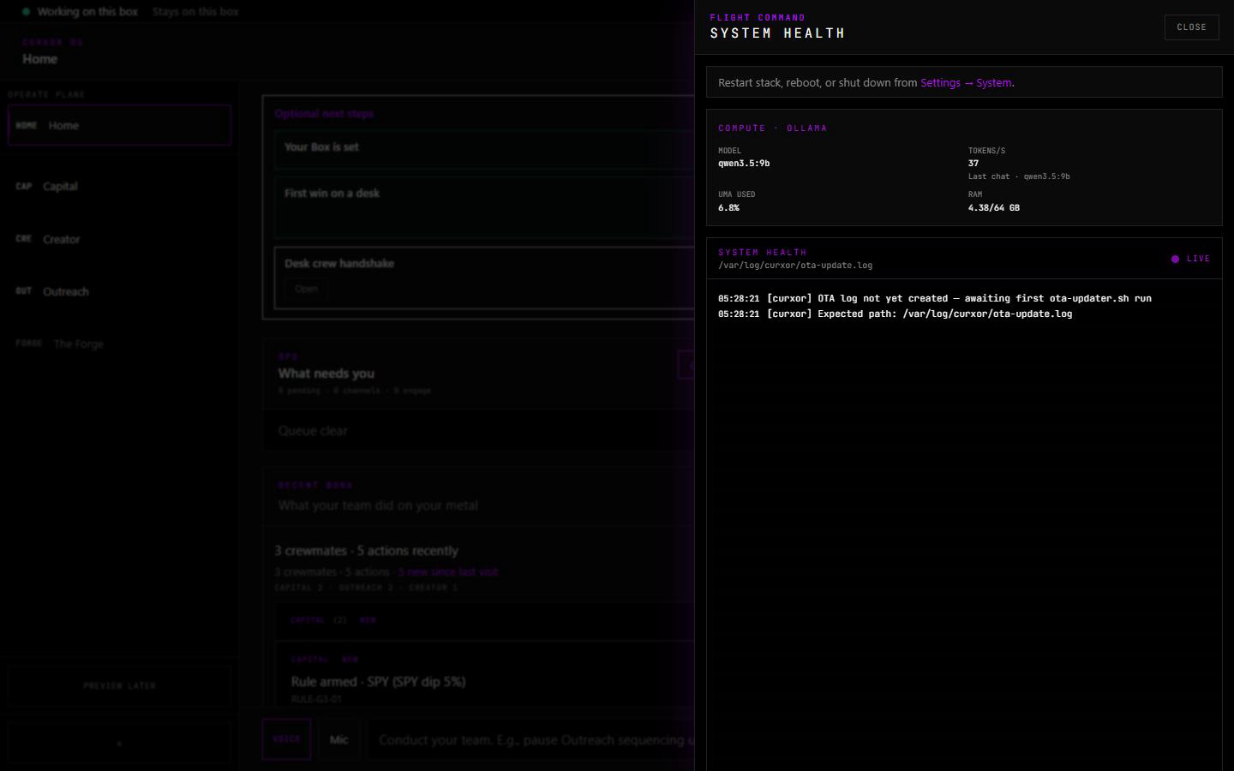
CurXor
Appendix B · Product
STILL · FUNCTIONALITY TIPS
System Health · local inference
WHAT TO NOTICE
1
Live tok/s and RAM — cognition on the appliance
2
Posted MS-S1 proof: qwen3:8b · ~38 tok/s · 4.56 / 64 GB
3
Operator can see health without leaving Flight Command
Honesty: Jul 4 still on qwen3:8b — box today runs qwen3.5:9b at ~36 tok/s.
curxor.ai · Sovereign metal · desk crew · one invoice
16 / 29
Notes:
SPEAKER NOTES — practice from SCRIPT
────────────────────────────────────────────
TIMING · 20–25 sec
SCRIPT (practice aloud)
System Health — local inference visible on the desk.
On the MS-S1 we posted about thirty-eight tokens a second on qwen three eight-B,
roughly four and a half gigs of sixty-four in use.
The brain runs on metal you own.
CUES
• Pair with paper Capital honesty on the next capital slides
IF ASKED · metric currency
• This still is Jul 4 evidence; the box now runs qwen3.5:9b at ~36 tok/s
• Offer live System Health rather than defending the older number

Slide 17
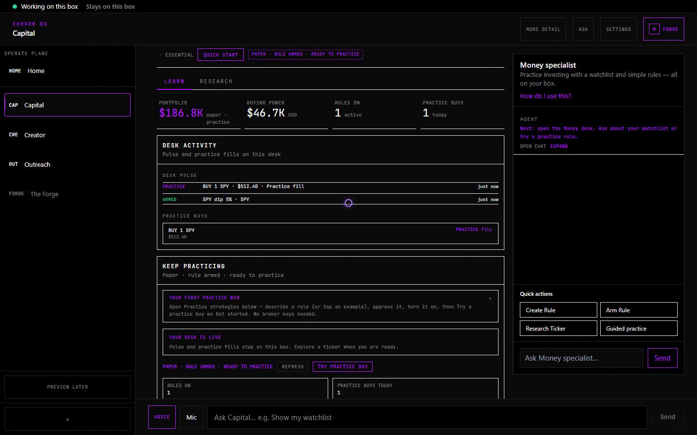
CurXor
Appendix B · Flagship
STILL · FUNCTIONALITY TIPS
Capital · paper book
WHAT TO NOTICE
1
Rules-bound trading desk on the appliance
2
Practice / paper book on camera — real UI path
3
Alpha and context stay local until you wire egress
Honesty: Paper book on camera — not live brokerage fills.
curxor.ai · Sovereign metal · desk crew · one invoice
17 / 29
Notes:
SPEAKER NOTES — practice from SCRIPT
────────────────────────────────────────────
TIMING · 20–25 sec
SCRIPT (practice aloud)
Capital desk — rules and a paper book on camera.
I say that out loud: this is practice mode, not live brokerage fills.
The product path is real; live wires are a separate gate.
HOLD
• Never imply live fills from this still

Slide 18
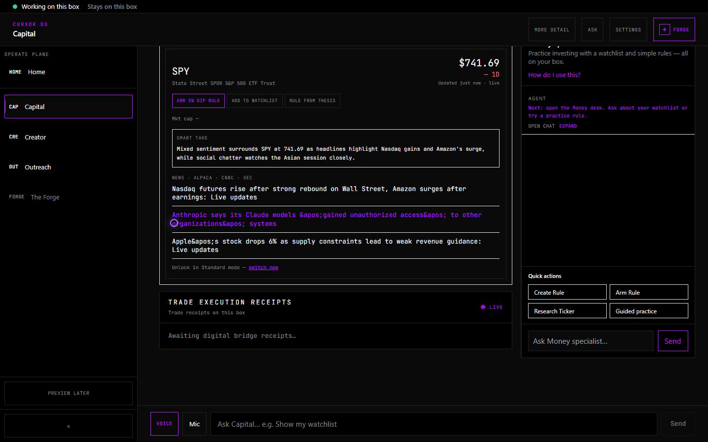
CurXor
Appendix B · Flagship
STILL · FUNCTIONALITY TIPS
Capital · rule fired · Cafe proof
WHAT TO NOTICE
1
Rule execution surfaces in the product — not a toy alert
2
Crew Cafe mirrors real desk activity
3
Inter-crew proof path for operator trust
Honesty: Staged RULE FIRED for capture — real UI path.
curxor.ai · Sovereign metal · desk crew · one invoice
18 / 29
Notes:
SPEAKER NOTES — practice from SCRIPT
────────────────────────────────────────────
TIMING · 15–20 sec
SCRIPT (practice aloud)
When a Capital rule fires, the desk and Cafe can show the proof.
That’s the inter-crew mirror — ceremony backed by real activity on the box.

Slide 19
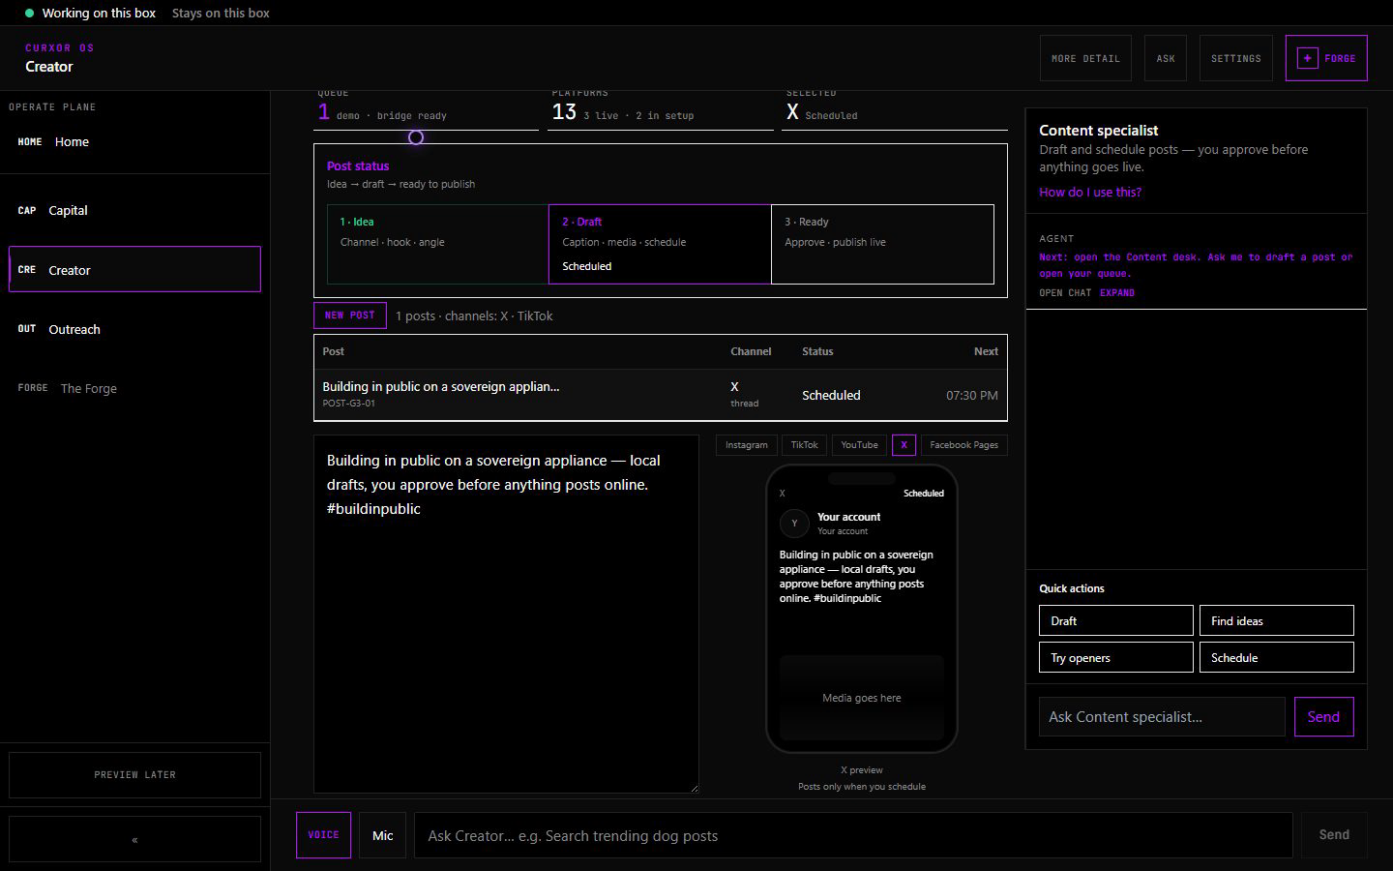
CurXor
Appendix B · Flagship
STILL · FUNCTIONALITY TIPS
Creator · content queue
WHAT TO NOTICE
1
Plan → create → queue on metal you own
2
Scheduled rows without five browser tabs
3
Sovereign copy draft path before any publish
curxor.ai · Sovereign metal · desk crew · one invoice
19 / 29
Notes:
SPEAKER NOTES — practice from SCRIPT
────────────────────────────────────────────
TIMING · 15–20 sec
SCRIPT (practice aloud)
Creator queue — content moves from plan to create to schedule on the box.
The pipeline stays with you until you approve anything outbound.

Slide 20
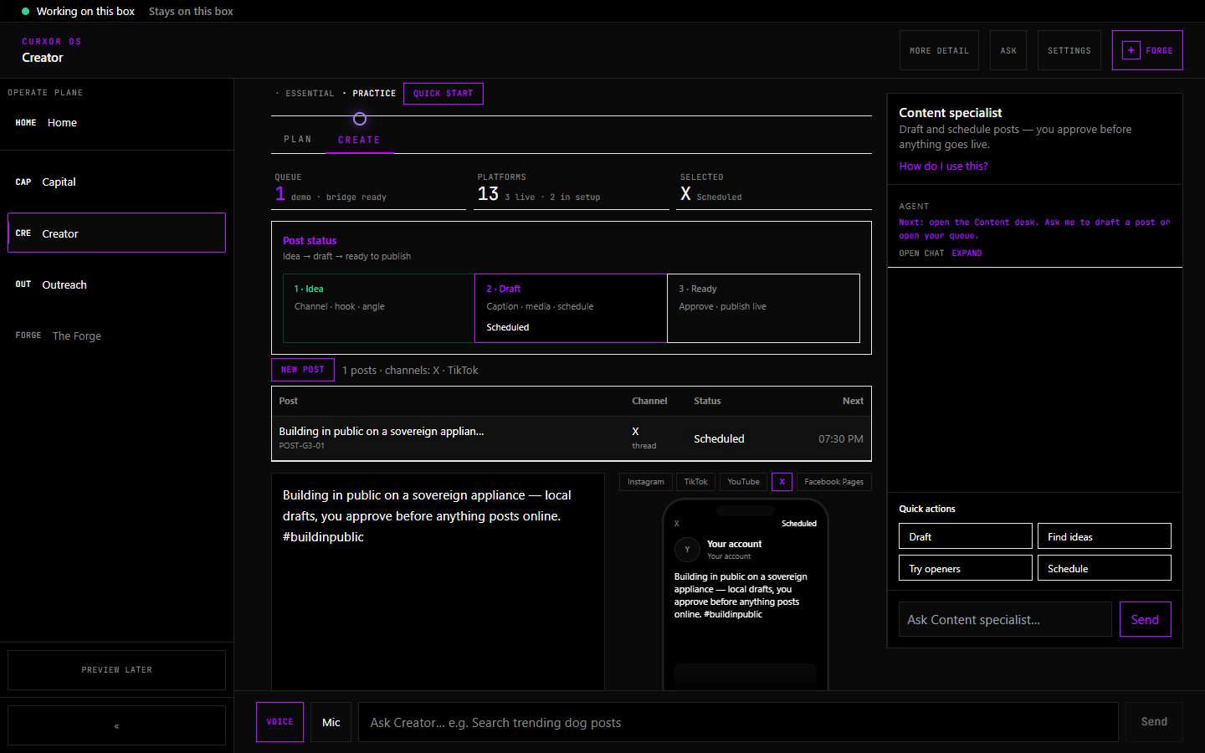
CurXor
Appendix B · Flagship
STILL · FUNCTIONALITY TIPS
Creator · publish approval
WHAT TO NOTICE
1
Operator approval gate before anything posts
2
Local drafts → explicit skill / publish confirm
3
Egress is earned — not silent publish fleets
Honesty: Approval path is real; bridge accounts may be founder-configured.
curxor.ai · Sovereign metal · desk crew · one invoice
20 / 29
Notes:
SPEAKER NOTES — practice from SCRIPT
────────────────────────────────────────────
TIMING · 20–25 sec
SCRIPT (practice aloud)
Publish approval — nothing goes out until the operator says so.
Local inference can draft; the human stays principal on egress.
HOLD
• No autonomous publish fleet claims

Slide 21
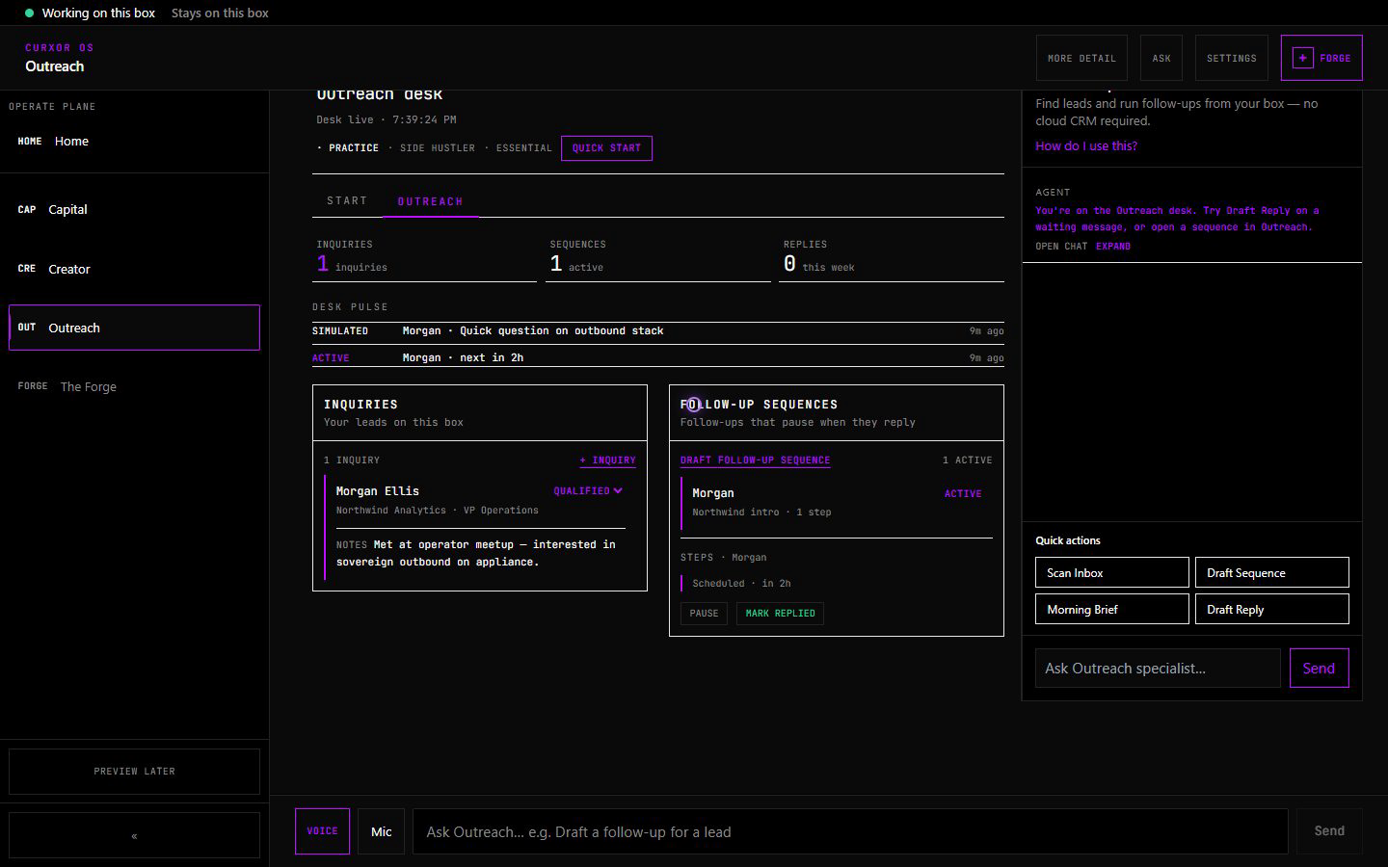
CurXor
Appendix B · Flagship
STILL · FUNCTIONALITY TIPS
Outreach · Work pipeline
WHAT TO NOTICE
1
Lead triage and active sequences on the desk
2
Pipeline visibility without a SaaS maze
3
Needs-you / approval patterns for trust
Honesty: UI and routing are real — no fabricated “sent” events on camera.
curxor.ai · Sovereign metal · desk crew · one invoice
21 / 29
Notes:
SPEAKER NOTES — practice from SCRIPT
────────────────────────────────────────────
TIMING · 15–20 sec
SCRIPT (practice aloud)
Work — the Outreach pipeline. Leads, sequences, triage on the appliance.
We don’t show fake sends; the path is real, compliance-gated outbound.

Slide 22
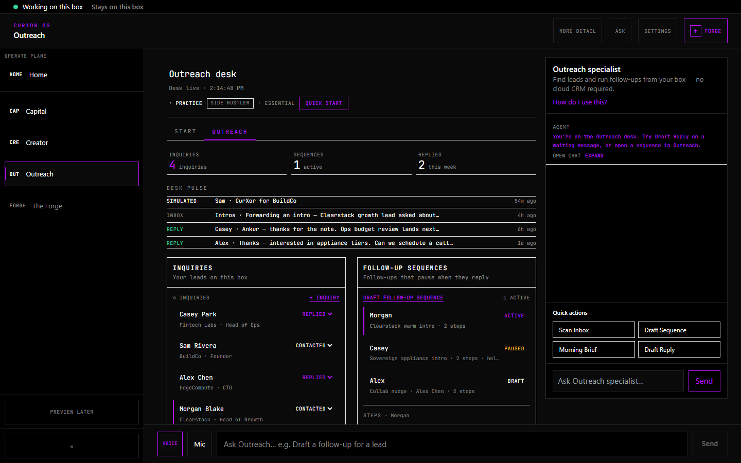
CurXor
Appendix B · Flagship
STILL · FUNCTIONALITY TIPS
Outreach · sequences
WHAT TO NOTICE
1
Sequence builder for always-on outbound
2
Steps and timing owned on the box
3
Pairs with pipeline for day-to-day run state
curxor.ai · Sovereign metal · desk crew · one invoice
22 / 29
Notes:
SPEAKER NOTES — practice from SCRIPT
────────────────────────────────────────────
TIMING · 15 sec
SCRIPT (practice aloud)
Sequences — the always-on outbound shape.
This is how outreach stays on when the chat tab closes.

Slide 23
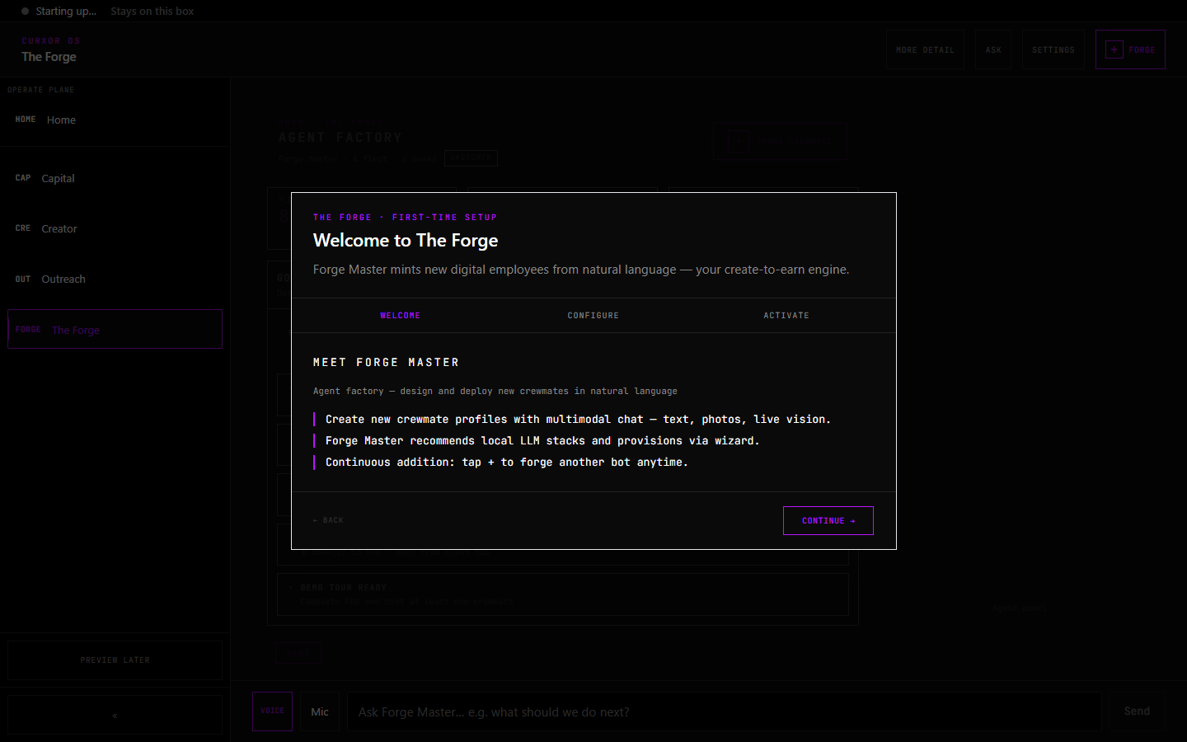
CurXor
Appendix B · Moat
STILL · FUNCTIONALITY TIPS
The Forge · mint crewmates
WHAT TO NOTICE
1
Mint custom crewmates in plain language
2
Expand the desk without a new SaaS per workflow
3
On-box creation — not a cloud agent store
curxor.ai · Sovereign metal · desk crew · one invoice
23 / 29
Notes:
SPEAKER NOTES — practice from SCRIPT
────────────────────────────────────────────
TIMING · 15–20 sec
SCRIPT (practice aloud)
The Forge — mint a custom crewmate in natural language on the box.
That’s how the desk grows without renting another tool.

Slide 24
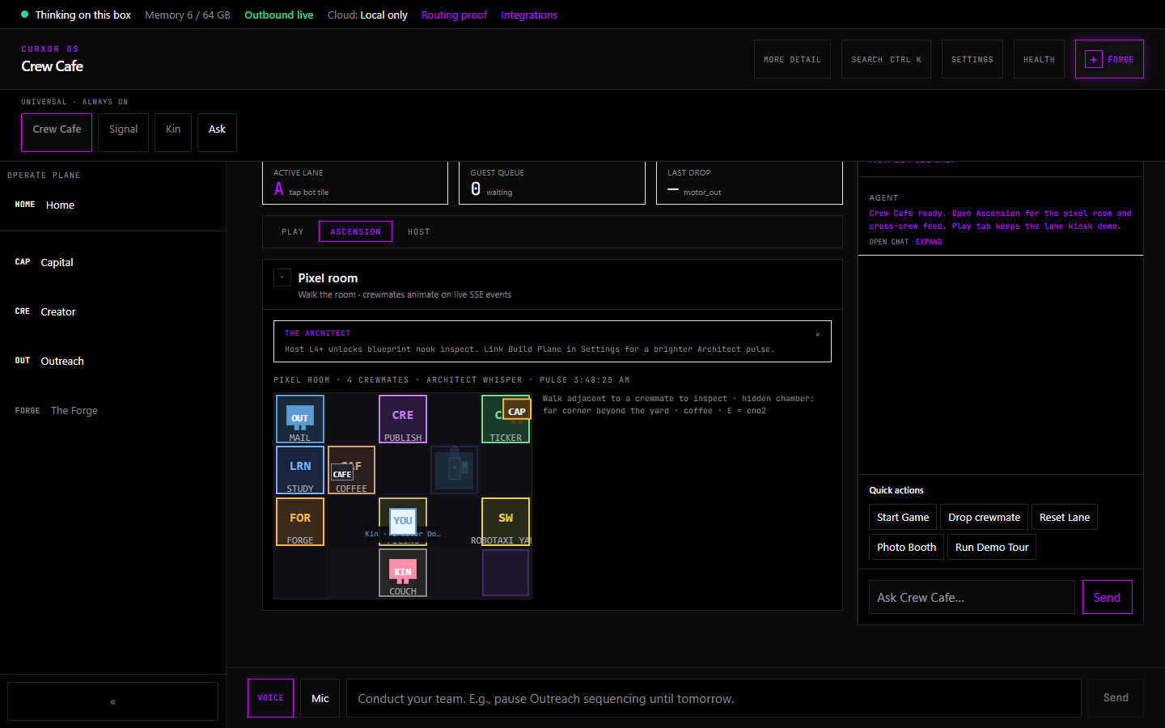
CurXor
Appendix B · Moat
STILL · FUNCTIONALITY TIPS
Crew Cafe · spatial proof
WHAT TO NOTICE
1
Living mirror of operator and crew activity
2
Inter-crew ceremony — not chrome for its own sake
3
Moat narrative after flagship desks prove depth
Honesty: Cafe mirrors real ops — don’t lead the buy with Cafe alone.
curxor.ai · Sovereign metal · desk crew · one invoice
24 / 29
Notes:
SPEAKER NOTES — practice from SCRIPT
────────────────────────────────────────────
TIMING · 15–20 sec
SCRIPT (practice aloud)
Crew Cafe — the spatial home for the desk crew.
It’s the living mirror. We sell flagship desks first; Cafe is the moat you feel after trust.

Slide 25
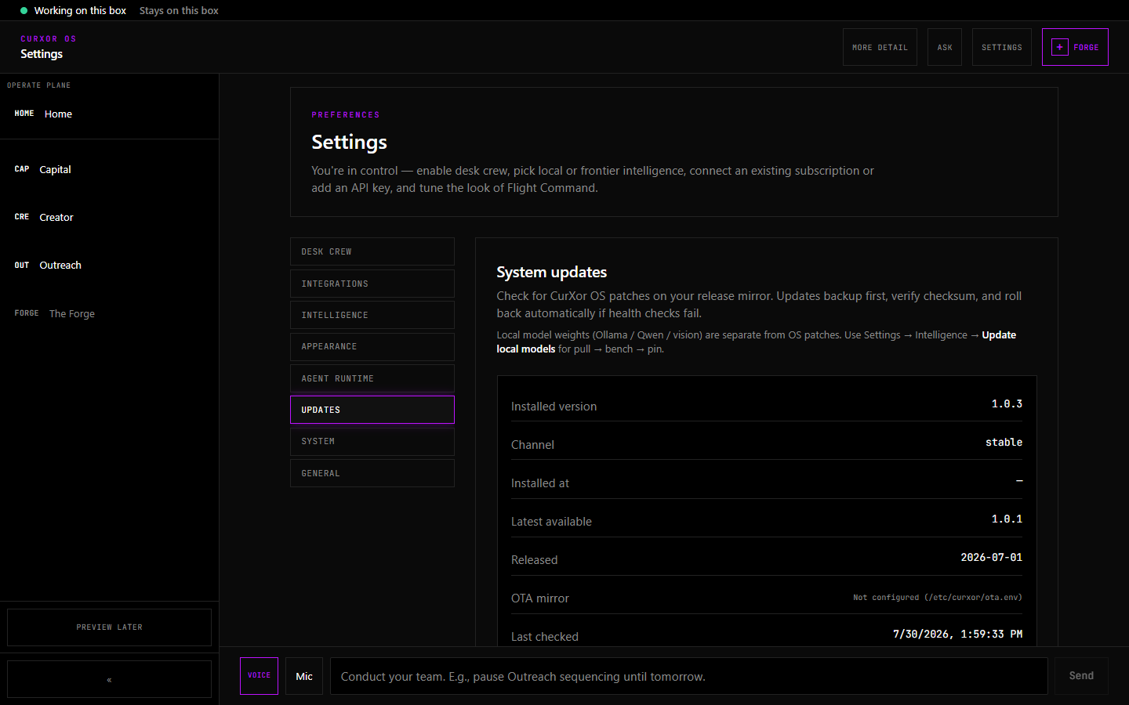
CurXor
Appendix B · Ownership
STILL · FUNCTIONALITY TIPS
Settings · OTA updates
WHAT TO NOTICE
1
Operator-owned update path on the appliance
2
Check / install without surrendering the box
3
Software evolves on metal you already own
curxor.ai · Sovereign metal · desk crew · one invoice
25 / 29
Notes:
SPEAKER NOTES — practice from SCRIPT
────────────────────────────────────────────
TIMING · 15 sec
SCRIPT (practice aloud)
Settings, Updates — OTA on metal you own.
Hardware is the anchor; the OS evolves without a new rent trap.

Slide 26

CurXor
Appendix B · Product
STILL · FUNCTIONALITY TIPS
Comms · unified inbox
WHAT TO NOTICE
1
One inbox surface across wired channels
2
Operator triage without tab sprawl
3
Pairs with Outreach and Creator engage paths
curxor.ai · Sovereign metal · desk crew · one invoice
26 / 29
Notes:
SPEAKER NOTES — practice from SCRIPT
────────────────────────────────────────────
TIMING · 15 sec
SCRIPT (practice aloud)
Unified inbox — channels come to the desk instead of the other way around.

Slide 27
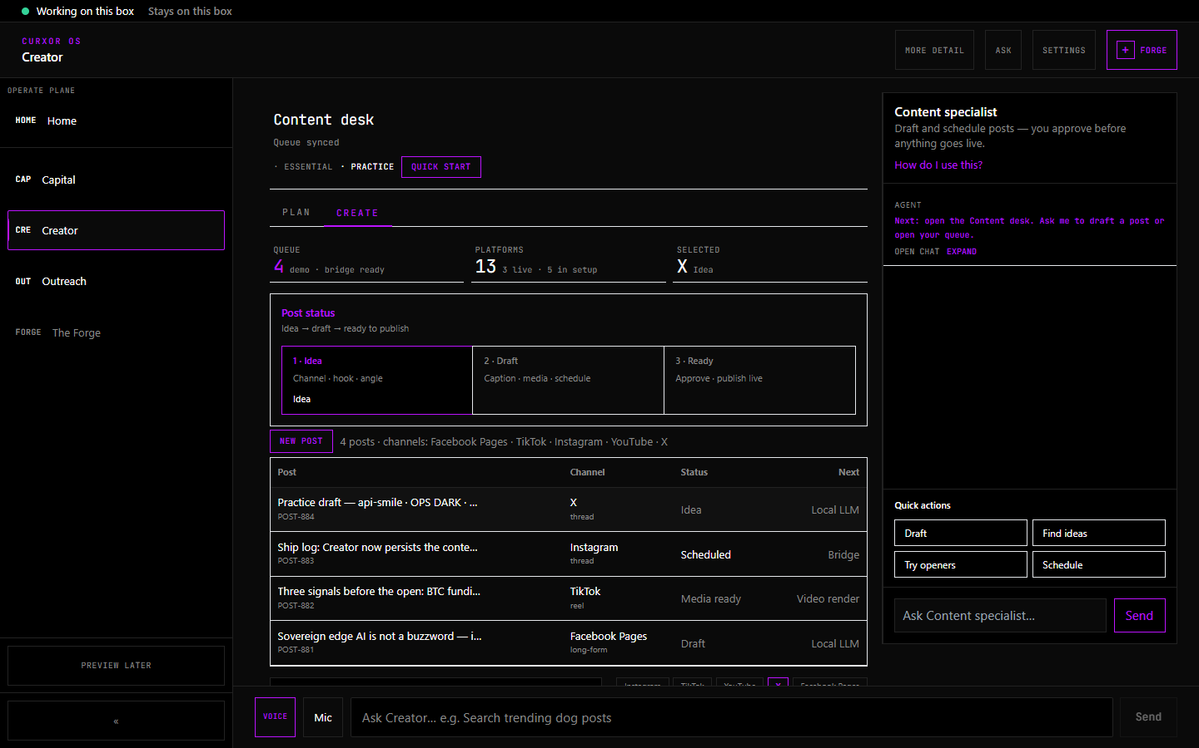
CurXor
Appendix B · Flagship
STILL · FUNCTIONALITY TIPS
Creator · content calendar
WHAT TO NOTICE
1
Calendar view for scheduled sovereign content
2
See the week without leaving Creator
3
Supports the sleep-while-it-drafts promise
curxor.ai · Sovereign metal · desk crew · one invoice
27 / 29
Notes:
SPEAKER NOTES — practice from SCRIPT
────────────────────────────────────────────
TIMING · 15 sec
SCRIPT (practice aloud)
Creator calendar — the week of content on the box, not five scheduling tabs.

Slide 28
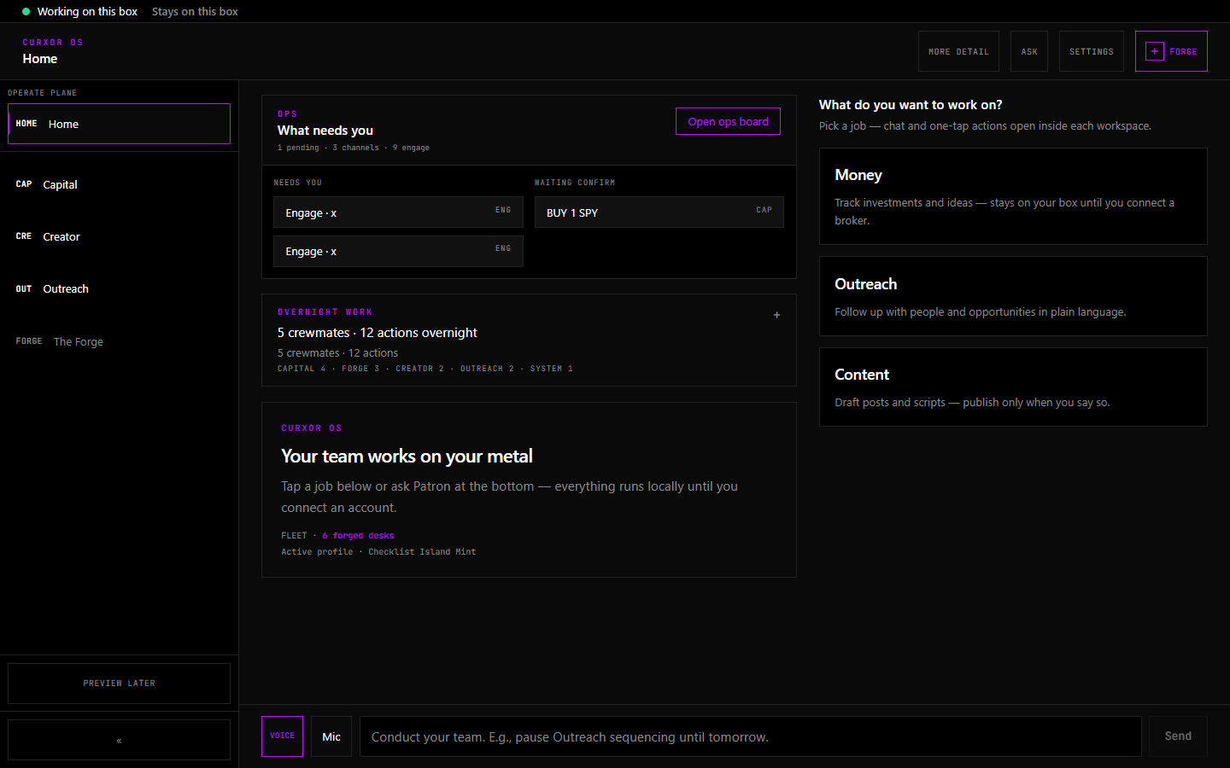
CurXor
Appendix B · Website · GTM
STILL · FUNCTIONALITY TIPS
curxor.ai · storefront
WHAT TO NOTICE
1
Cold hero: Your AI team. On a box you own.
2
Pre-order + proof links for warm intros
3
Vision film lives on /signal — not forced on homepage
Honesty: GTM ship-now hero — dream-state copy stays on /signal and deck.
curxor.ai · Sovereign metal · desk crew · one invoice
28 / 29
Notes:
SPEAKER NOTES — practice from SCRIPT
────────────────────────────────────────────
TIMING · 15–20 sec
SCRIPT (practice aloud)
The public site — curxor.ai.
Cold traffic gets plain English: your AI team on a box you own.
Category vision sits on slash signal for people who want the thesis.

Slide 29
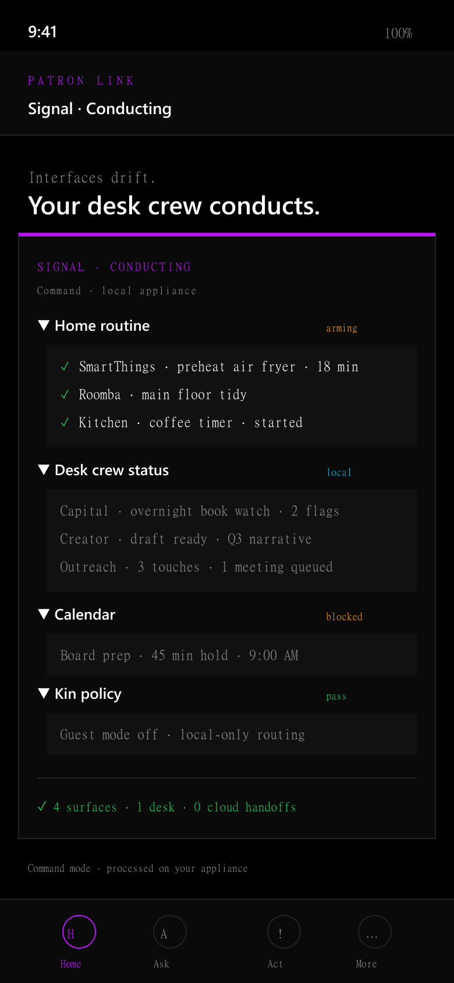
CurXor
Appendix B · Website · Film
STILL · FUNCTIONALITY TIPS
GTM · conductor plate
WHAT TO NOTICE
1
Category / film visual language
2
Desk as conductor — interfaces drift
3
Use with vision reel, not as the cold open alone
curxor.ai · Sovereign metal · desk crew · one invoice
29 / 29
Notes:
SPEAKER NOTES — practice from SCRIPT
────────────────────────────────────────────
TIMING · 10–15 sec
SCRIPT (practice aloud)
Film language — the desk conducts.
This is the category beat we pair with the vision reel.

