Slide 1
Epileptic Seizure Classification
Group 15
Ankur Parihar 16114015
Parvat Yadav 16114043
Rishikesh Chaudhary 16114054
Sagar Dhurwe 16114059

Slide 2
Data Overview
11500 single channel EEG waves in csv.
178 data column in each wave corresponding to 1 second snapshot.
Last column describing one of five categories
Recording of seizure activity
Tumor identified and recording from infected area
Tumor identified and recording from healthy area
Patient had their eyes closed while recording EEG
Patient had their eyes opened while recording EEG
All subjects falling in classes 2, 3, 4, and 5 are subjects who did not have epileptic seizure. Only subjects in class 1 have epileptic seizure.

Slide 3
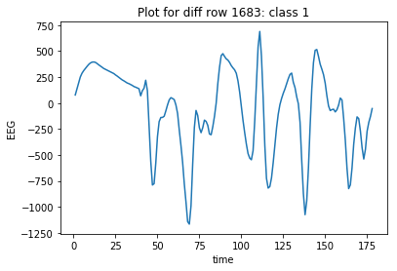
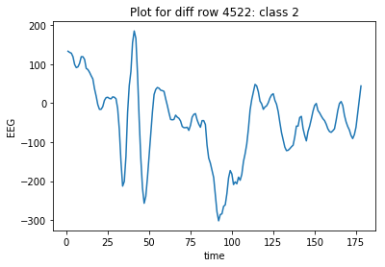
Sample Data Plots

Slide 4
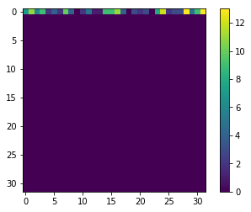
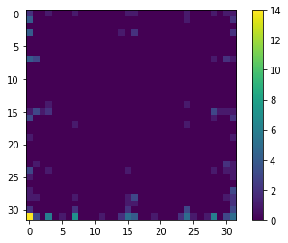
Stage 1: pulseNet
Designed for detecting pulses in wave
Its an extension and can be used to transform wave into categorical structure

Slide 5
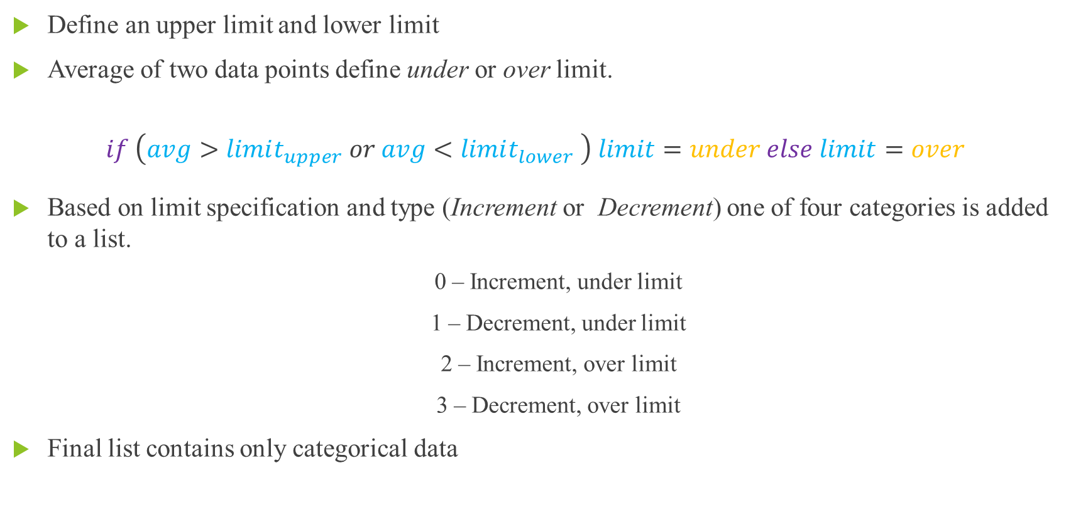
Iteration 1
Example
Upper_lim = 2, Lower_lim = -2
4, 3, 2, 1, 0, 1, 2, 3, 4
3, 3, 1, 1, 0, 0, 2, 2
Define an upper limit and lower limit
Average of two data points define under or over limit.
$$if \left(avg>limit_{upper} or avg<limit_{lower} \right) limit=under else limit=over$$
Based on limit specification and type (Increment or Decrement) one of four categories is added to a list.
0 – Increment, under limit
1 – Decrement, under limit
2 – Increment, over limit
3 – Decrement, over limit
Final list contains only categorical data

Slide 6
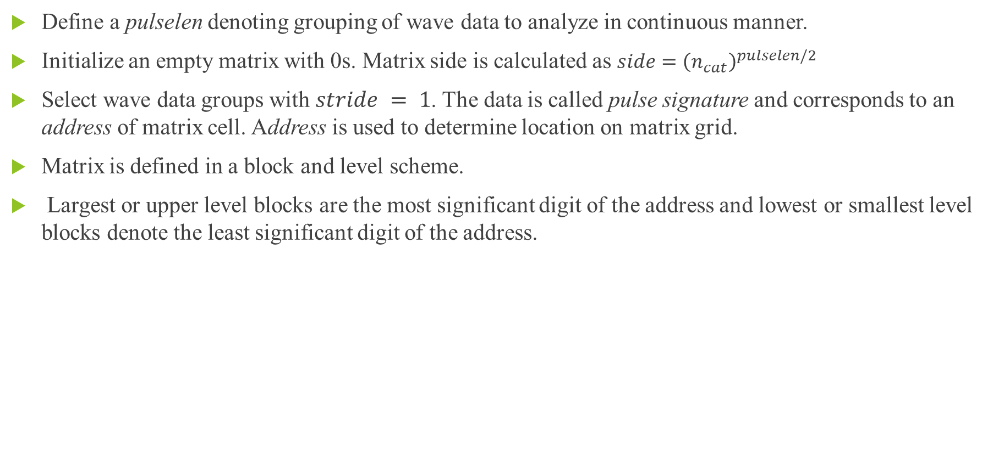
Iteration 2
Define a pulselen denoting grouping of wave data to analyze in continuous manner.
Initialize an empty matrix with 0s. Matrix side is calculated as $side={\left(n_{cat}\right)}^{pulselen/2}$
Select wave data groups with $stride = 1$. The data is called pulse signature and corresponds to an address of matrix cell. Address is used to determine location on matrix grid.
Matrix is defined in a block and level scheme.
Largest or upper level blocks are the most significant digit of the address and lowest or smallest level blocks denote the least significant digit of the address.

Slide 7
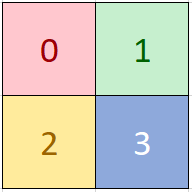
Matrix: Structure
Level = 1

Slide 8
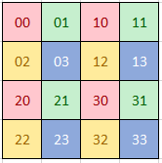
Matrix: Structure
Level = 2

Slide 9
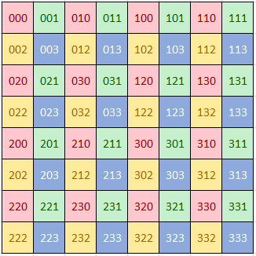
Matrix: Structure
Level = 3

Slide 10
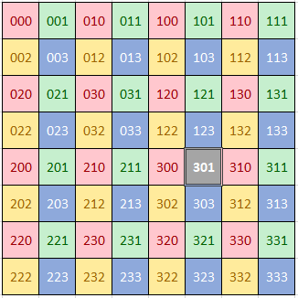
Matrix: Structure
Level = 3, Address = 301

Slide 11
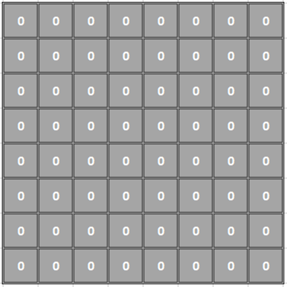
Matrix: How to insert pulse ?
Level = 3, Address = 123

Slide 12
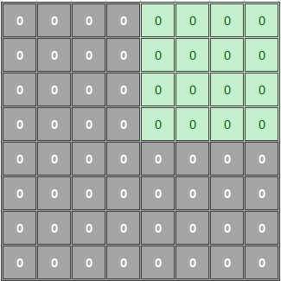
Matrix: How to insert pulse ?
Level = 3, Address = 123

Slide 13
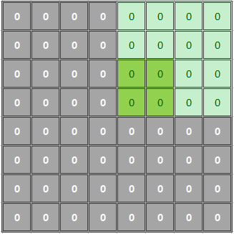
Matrix: How to insert pulse ?
Level = 3, Address = 123

Slide 14
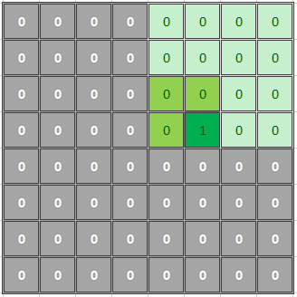
Matrix: How to insert pulse ?
Level = 3, Address = 123

Slide 15
Matrix: How to insert pulse ?
Level = 3, Address = 123

Slide 16
Matrix: features: Effective and Efficient
Convert large wave into smaller data (image or matrix) without significant reduction in important data.
No matter how long the pulse is we are only looking for slopes or similar properties in it and store in definite matrix which can be feed to deep learning networks.
Stores every sub-wave of length pulselen effectively and efficiently.
Each sub wave of pulse have some unique signature or address it they differ and similar pulses have same signature. To store each pulse of a type we need only one cell space. A specific cell of matrix contains the number of pulses with that signature.

Slide 17
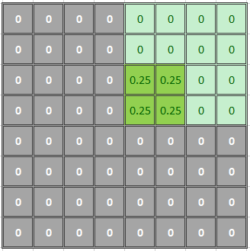

Matrix: features: Focus
We can choose to increment one pixel or a set of pixel depending on level of detail.
For example, while parsing pulses we decide to ignore the effect of last data then we can increase all 4 final blocks ($n_cat=4$) by 0.25 or more general way we can increase all $n_cat$final points by $1/n_cat$

Slide 18
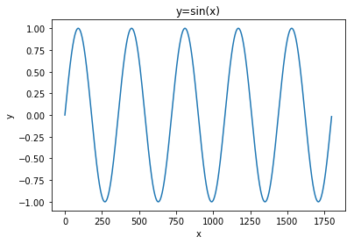
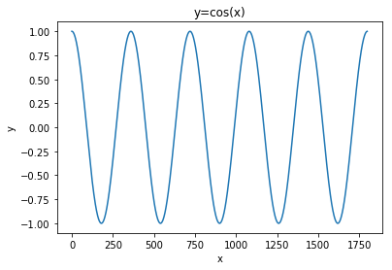
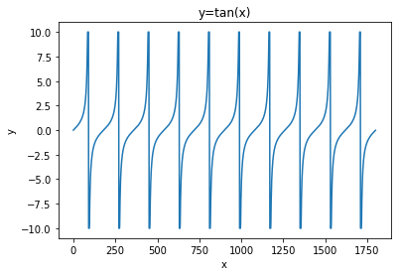
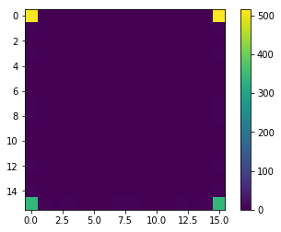

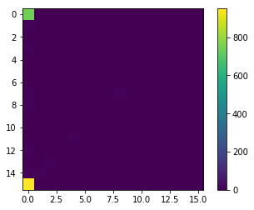
Matrix: features: Phase and Amplitude
Behaves same with shifted waves.
For example, it does not differentiate between sin wave and cos wave but effectively differentiate between sin wave and tan wave.

Slide 19
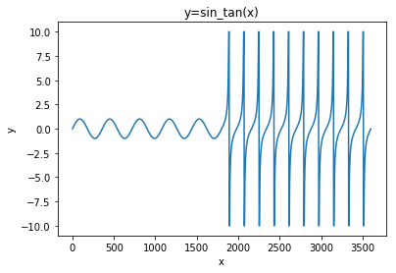
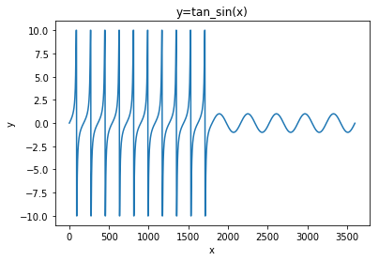
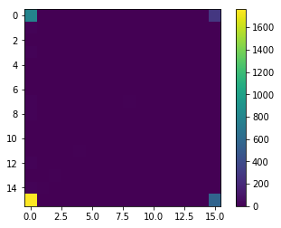
Matrix: features: Pulse Order
Pulse order in wave does not matter. But pulse count does matter. Good for independent pulses.

Slide 20
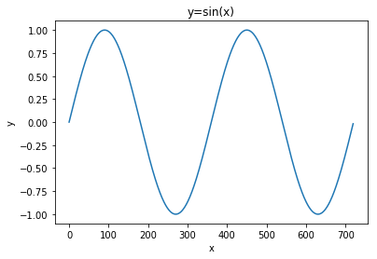
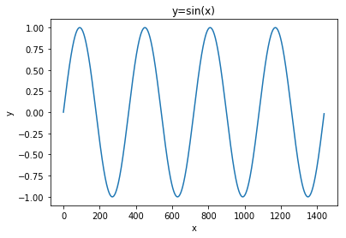
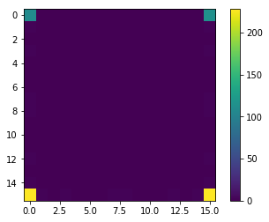

Matrix: features: Repeated wave as a Layer
A repeated shape can be seen as a layer. When the shape repeats the layer simple doubles.

Slide 21
Stage 2: CNN Classification
In this step we feed the exported images from previous step into a tensor-flow CNN image classifier and get the accuracy of model.

Slide 22
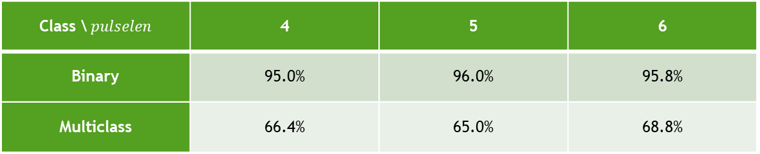
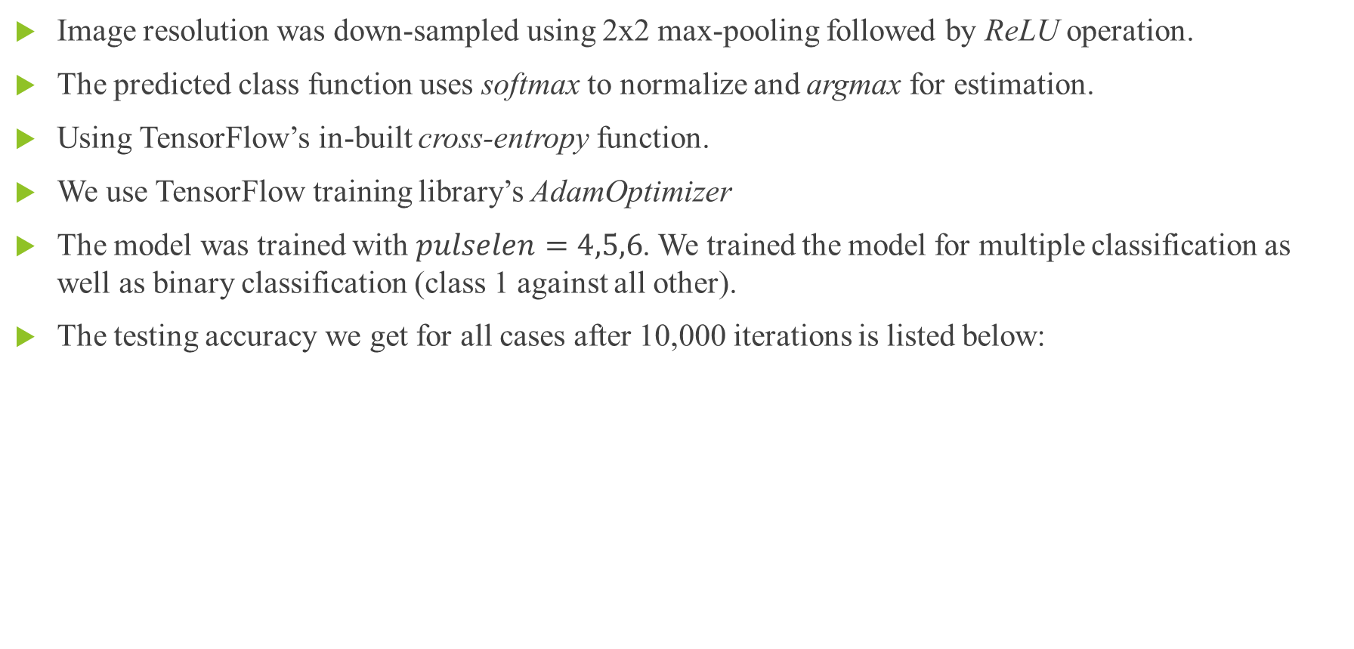
Stage 2: CNN Classification
Image resolution was down-sampled using 2x2 max-pooling followed by ReLU operation.
The predicted class function uses softmax to normalize and argmax for estimation.
Using TensorFlow’s in-built cross-entropy function.
We use TensorFlow training library’s AdamOptimizer
The model was trained with $pulselen=4,5,6$. We trained the model for multiple classification as well as binary classification (class 1 against all other).
The testing accuracy we get for all cases after 10,000 iterations is listed below:
Class \$pulselen$ | 4 | 5 | 6
Binary | 95.0% | 96.0% | 95.8%
Multiclass | 66.4% | 65.0% | 68.8%

