Slide 1

Superstore Dataset -Power BI Analysis
This PowerPoint is designed to be an interactive tutorial to Power BI.
To: Pooja Sharma
Please press F5 on your keyboard to start slideshow.
By: Ayush Mishra(21mca3135)

Slide 2
Here is an overview of the presentation
What is Power BI?
How Does Power BI Visualize Data?
What are the advantage of powerbi?
What are the limitation of powerbi?
Features of powerbi?
Reasons to use powerbi?
How do I navigate powerbi?
Overview of Our powerbi report?
FAQs

Slide 3




What does Power BI do?
Power BI is a business analytics service that delivers insights to enable fast, informed decisions.
Transform data into stunning visuals and share them with colleagues on any device.
Visually explore and analyze data—on-premises and in the cloud—all in one view.
Collaborate on and share customized dashboards and interactive reports.
Scale across your organization with built-in governance and security.

Slide 4




Visualizations of Data
How does visualizing data help users?
Visualizations allow data to be represented in different ways, leading to insights into data relationships that may not be easily seen.
Power BI allows users to create and adjust visualizations based on their own needs as they look at data.
Users will be able to look at data from different perspectives and find insights into data relationships that help them make better informed decisions.

Slide 5
Advantage of powerbi?
PRO: COST
Power BI is inexpensive. It is free to use if you want to build reports for yourself. One person could create datasets, dashboards, and reports in Power BI and give the Power BI files to co-workers to use for their analysis.
Power BI Desktop–$0.00 Power BI Cloud Service –$9.99 Monthly
Tableau–$70.00 Tableau Cloud Service –$35 Monthly
Learning Curve
Second, Power BI is easy to use. It’s basically Excel pivot tables with Excel’s data visualization tools taken to the next level. Once you get data into a Power BI dataset, making charts, graphs, and tables that make sense of the data is not that complex. Anyone with average Excel skills can figure it out. Power BI reports can have slicers to focus reports on data from a specific timeframe or data that meets certain criteria.
Constant Updates and Innovations
The third pro on the list of pros and cons is frequent updates. Microsoft releases updates to Power BI monthly. Plus, and more importantly, Microsoft listens to the user community. It is easy to submit suggestions for improvements.
Data Handling Capacity for Free Versions
Another con is the ability to work with huge amounts of data. Power BI has a limit on the amount of data it can ingest. (I think is about 2GB). After the data hit the limit, you have to upgrade to the paid version of Power BI.

Slide 6
Limitation of powerbi?
It is more useful to the Microsoft Excel users
Does not offer any data cleansing solution and assumes that the data provided is of high quality.
Unable to handle large data sources properly causing issues in connecting and importing large datasets, slow performance, and time-outs.
Performance issues arise while processing says more than 20000-30000 rows.

Slide 7
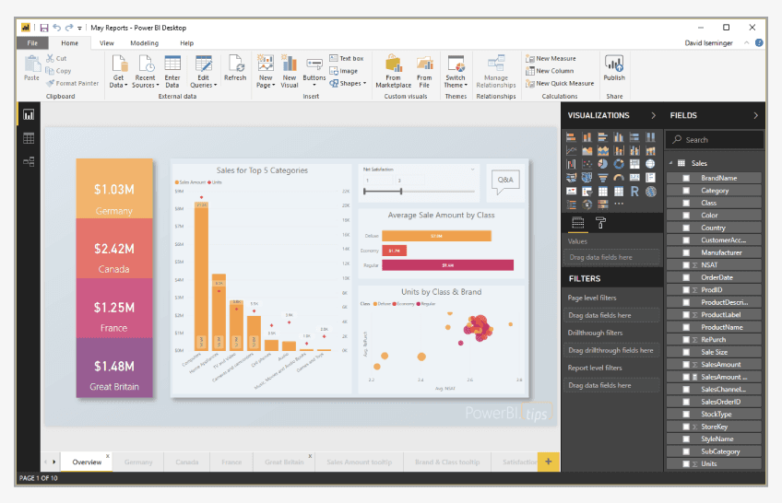
Features of powerbi?
1. Power BI Desktop
Power BI Desktop is free software that can be downloaded and installed to build reports by accessing data easily without the need for advanced report designing or query skills to build a report.
2. Stream Analytics
Stream Analytics helps to assist in real-time analytics to make timely decisions).
3. Multiple Data Sources
Multiple Data Sources support various data sources like Excel, CSV, SQL Server, Web files, etc. to create interactive visualizations).

Slide 8
4. Custom Visualization
Custom Visualization is used to access the custom visualization library to suit individual or customized needs, apart from Power BI's default standard of dealing with complex data.
5. Artificial Intelligence
AI helps to access image recognition and text analytics, create machine learning models with automated machine learning capabilities, and also integrate with Azure Machine Learning.

Slide 9
Reasons to use Powerbi?
A quick start. You'll be able to get insights quickly with an uncomplicated setup, no required training, and included dashboards for services such as Salesforce, Google Analytics, and Microsoft Dynamics.
Streamlined publication and distribution. Instead of emailing large files or putting them on a shared drive, analysts upload reports and visualizations to the Power BI service, and their data is refreshed whenever the underlying dataset is updated.
Real-time information. Dashboards update in real time, as data is pushed or streamed in, which gives viewers the ability to solve problems and identify opportunities quickly. Any report or dashboard can display and update real-time data and visuals. Sources of streaming data can be factory sensors, social media sources, or anything from which time-sensitive data can be collected or transmitted.
Ability to customize Power BI app navigation. An "app navigation experiences" feature gives report developers the power to customize navigation to help viewers find content quickly and understand the relationships between different reports and dashboards.
Ability to customize security features. Report developers can set up row-level security (RLS) access filters to ensure that viewers see only data relevant to them, mitigating the risk of people seeing data they shouldn’t.
Cortana integration. Power BI works with Microsoft's digital assistant, Cortana. Users can verbally ask questions in natural language to access charts and graphs. This can be especially helpful for users with mobile devices.
Artificial Intelligence. Power BI users can access image recognition and text analytics, create machine learning models, and integrate with Azure Machine Learning.

Slide 10
How Do I Navigate Power BI?
This module will provide an overview on logging in to Power BI, the tools available within the web app, navigating a sample report, and suggestions moving forward.

Slide 11
How Do I Navigate Power BI?
Here is an overview of the pages in this module.
Select any of the boxes below to navigate directly to that page or select Continue to begin.
Accessing the Power BI Web App
Navigating the Power BI Workspace
Opening a Power BI Report
Overview of a Power BI Report
Suggestions for Charting a Power BI Report

Slide 12




Accessing the Power BI Web App
To access the PowerBI Web App, open your internet browser
and enter the address…
app.powerbi.com

Slide 13
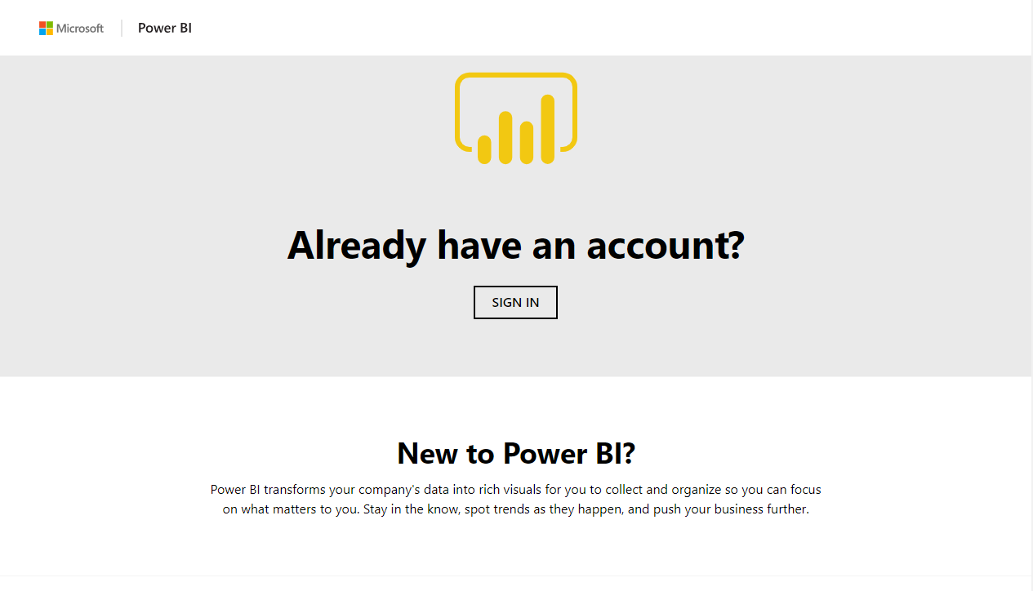
Logging In to Power BI
1) Click Sign In to bring up the login page

Slide 14
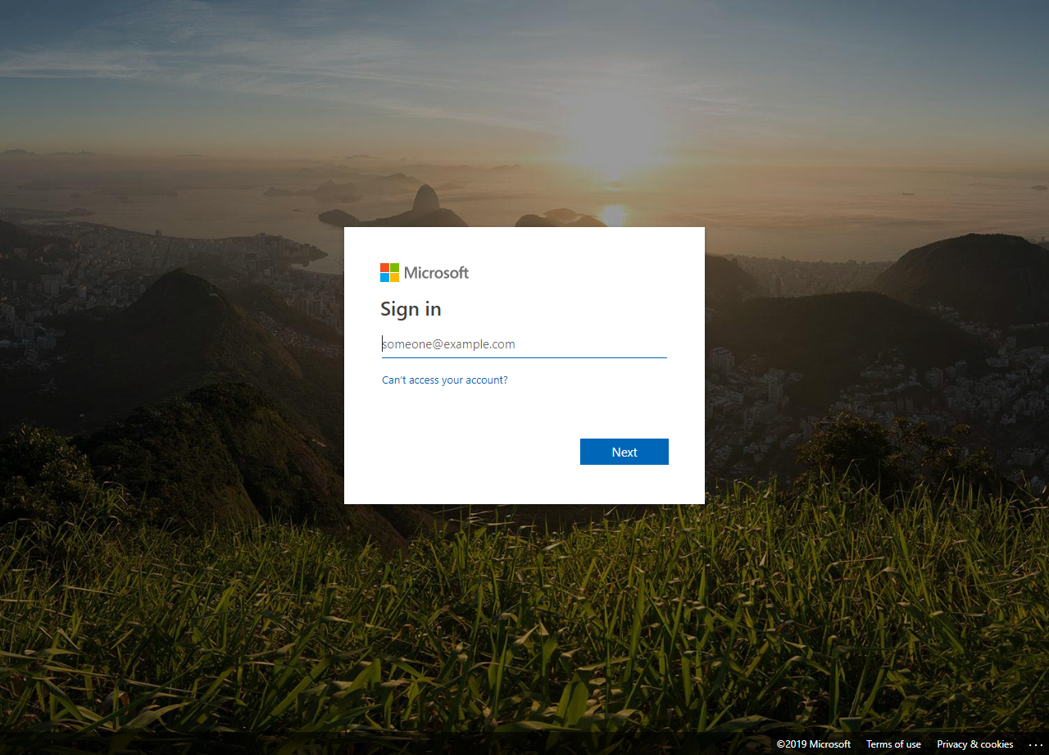
Logging In to Power BI
1) Click Sign In to bring up the login page
2) Log in with your company or collage credentials
Ayush@cuchd.in

Slide 15
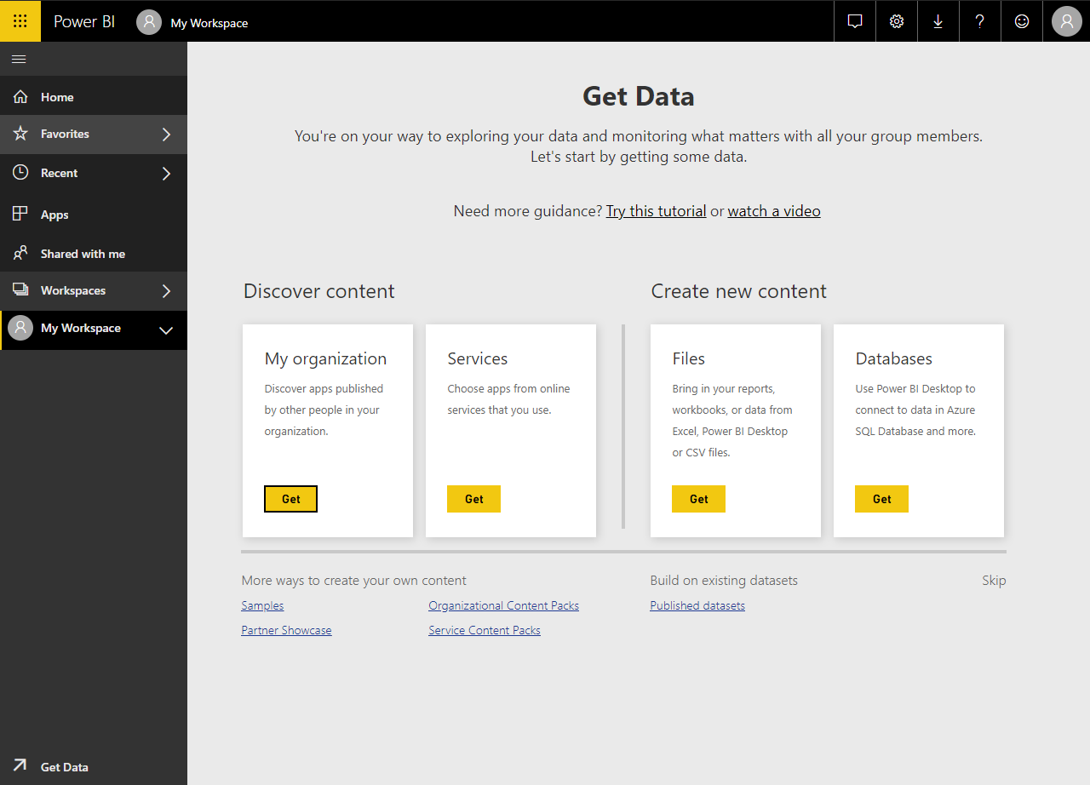
Navigating the Power BI Webapp Workspace
When you first open Power BI, you may see this default screen. This is the Power BI dashboard, but this default page is not the most helpful.
You will be using the toolbar here to navigate through the functions of the Power BI Webapp.
Click on the Home button to go to the home page.

Slide 16
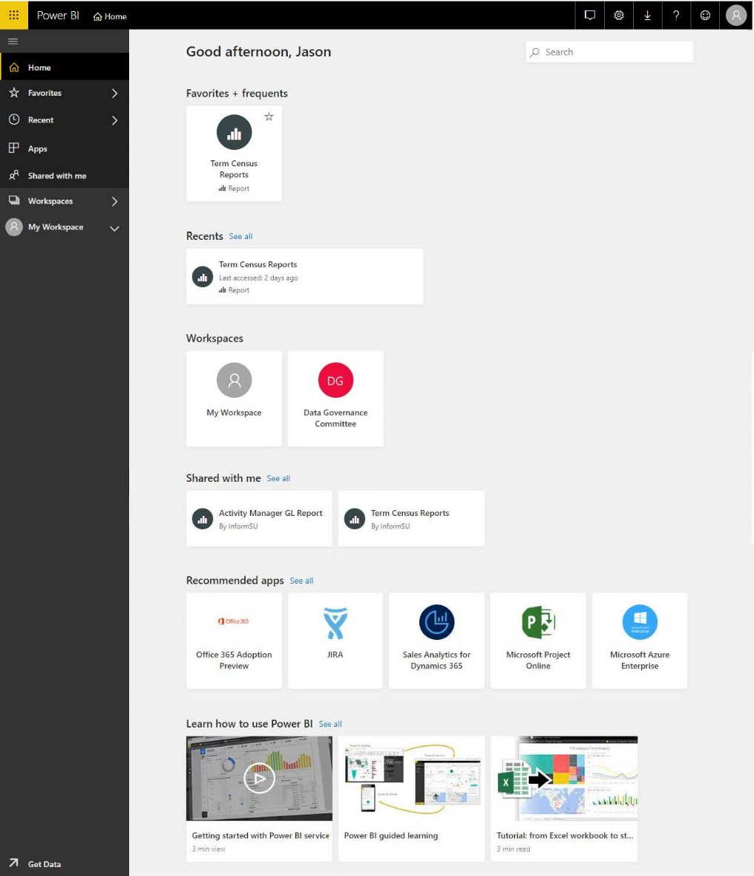
Navigating the Power BI Workspace
Settings
Notifications
Settings
Downloads
Help & Support
Feedback
Profile
This is the main workspace for Power BI.
This screen allows users to navigate the Power BI workspace, pull up reports, and share documents or dashboards with other Power BI users.
Let’s start with understanding the navigation pane.
Workspace
Displays information based on the toolbar settings. Clicking on an item on the dashboard will open it.
Navigation Pane
The main navigation directory for Power BI.

Slide 17
Navigating the Power BI Workspace
Click to explore the different tools of the dashboard.
Home
Home
Favorites
Favorites
Recent
Recent
Click on one of the tools to explore the functions of the workspace tools…
Apps
Apps
Shared with me
Shared with me
Workspace
Workspace
Get Data
Get Data

Slide 18
Navigating the Power BI Workspace
The documents and spaces that appear here will be different per account based on what is created or shared.
Home
Favorites
Recent
Apps
Shared with me
Workspace
Get Data

Slide 19
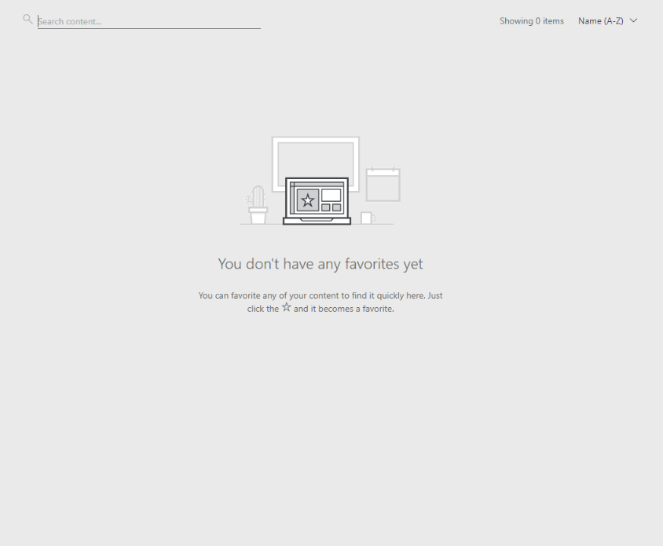

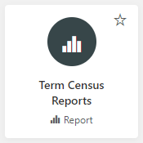
Navigating the Power BI Workspace
When you first log in, you won’t have any favorited documents.
To favorite a document, click on the star to add it to the favorite menu.
Home
Favorites
Recent
Apps
Shared with me
Workspace
Get Data

Slide 20
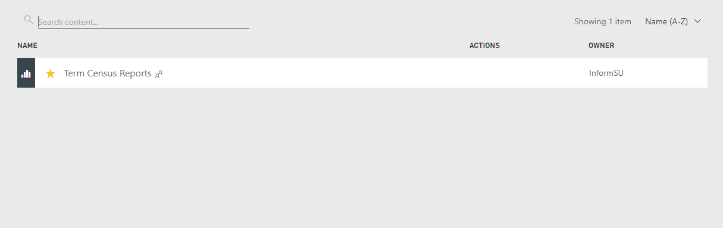

Navigating the Power BI Workspace
When you first log in, you won’t have any favorited documents.
To favorite a document, click on the star to add it to the favorite menu.
Favorites
Users have the ability to favorite reports, dashboards, and other Power BI objects. Once a user has favorited something, use this selection to access those items
Your favorited document will appear the next time you access or refresh the favorites page.

Slide 21
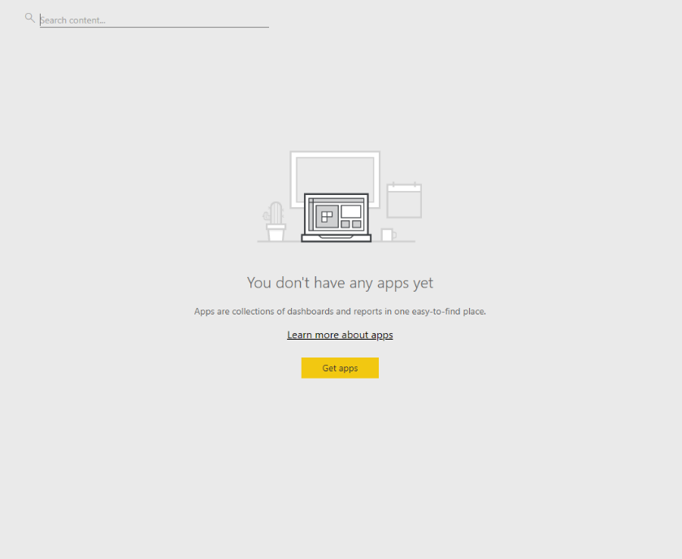

Navigating the Power BI Workspace
Home
Favorites
Recent
Apps
Shared with me
Workspace
Get Data

Slide 22
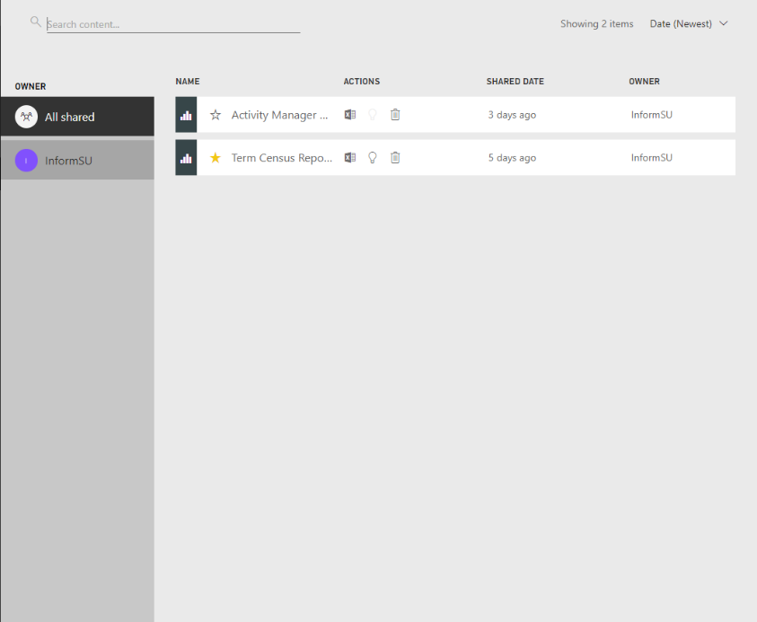

Navigating the Power BI Workspace
Official InformSU reporting will be accessed through this tool.
This is the location where users will find all the reports and / or dashboards which they have been granted access to.
You can also navigate which reports are on the dashboard by clicking on different owner groups.
Home
Favorites
*Unless you are the owner of a report, you can not share a Power BI report with another person. Instead, have the other person contact the original owner of the report for sharing access.
Recent
Apps
Shared with me
** Please remember that SU’s FERPA and Data Security Policies are in effect when considering whether to share any university-related data that has been generated within Power BI.
Click here to view Seattle University’s FERPA guidelines.
Workspace
Get Data

Slide 23
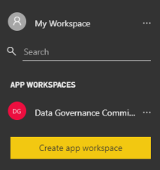
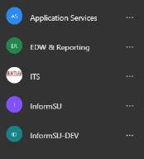
This is your own personal workspace for designing content within Power BI.
Subsequent Power BI trainings will facilitate use of this functionality. If you would like to start self-training sooner, click here.
Navigating the Power BI Workspace
These are locations where user groups can share reports and dashboards with other members of their groups.
Home
Favorites
These are workspaces you may collaborate on with other co-workers or user groups.
(The workspaces provided here are examples.)
Recent
Apps
Shared with me
Workspace
Get Data

Slide 24


Navigating the Power BI Workspace
This is a quick link to ways to pull data into the Power BI service. For general users, this functionality will not be utilized. For other users, additional trainings will be available.
Home
Favorites
Recent
Apps
Shared with me
Workspace
Get Data

Slide 25
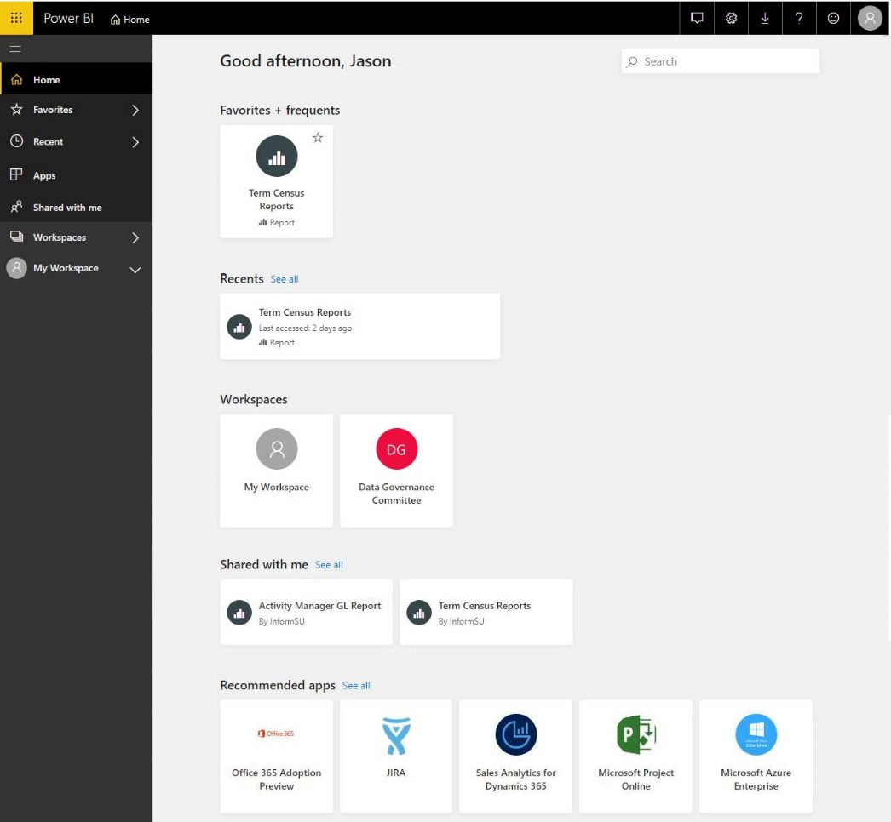
Opening a POWER BI Report
Let’s open the Power BI report, Term Census Reports.
To open the Term Census Report example, click here.
The purpose of the Term Census Reports is to answer questions concerning enrollment data and trends over time at Seattle University.

Slide 26
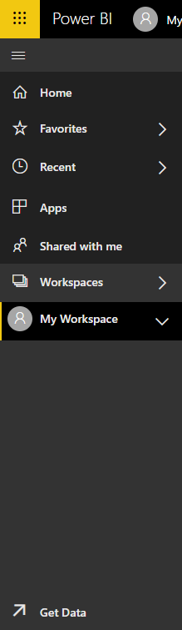
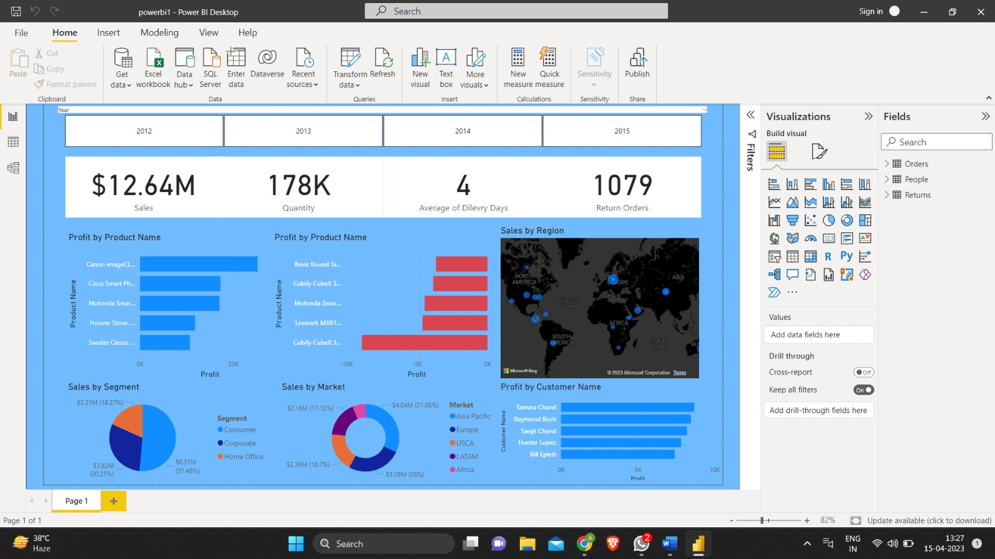
Overview of a POWER BI Report
The Power BI Report will open within your Workspace within the Web App.
The Power BI tools will remain…
…while a new set of tools will appear at the top of the report.

Slide 27
Sections of a POWER BI Report
A Power BI Report is a collection of visualizations that appear together on one or more pages.
Visualizations present data in a simple way that provides context and insight.
Slicers let users select and manipulate the way data is visualized within a report.

Slide 28
FAQs
1. How is Power BI useful?
Power BI can be used for any department of a company, any size of company for data visualization and gaining meaningful insight it in an interactive and understandable format.
2. Is Power BI difficult to learn?
As such, Power BI is not at all difficult to learn, excepting certain types of integrations and dealing with data lakes. A certificate course on Power BI training is an easier way to learn it thoroughly.
3. Is Power BI better than Tableau?
Their applications are slightly different and will depend on the specific need. Tableau is mostly used to create data visualizations while Power BI is used for reporting
5. Which is the best visualization tool?
Some to mention are Tableau, Grafana, Chartist, Google Charts, FusionCharts, Datawrapper, Infogram, and ChartBlock.

