Slide 1




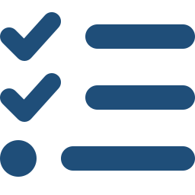






EXL Delivery Model | Governance & Quality
Robust Delivery Governance & Quality Assurance Framework
A single, integrated operating model — governing every stage of delivery to ensure speed, quality, and confidence
Predictable · Scalable · Audit-ready
Discovery & Planning
1
Adaptive Delivery Engine
3
Governance, Integration & Cadence
Delivery Assurance
Commitments
Agility & adaptability embedded in every sprint
Seamless oversight across tools, teams & stakeholders
Two-week sprint cycles with backlog prioritisation & daily standups
Built-in change accommodation — re-planning without disruption
Velocity tracking, capacity forecasting & burn-down visibility
Weekly status, fortnightly steering & executive escalation paths
Single governance layer integrating client systems, tools & teams
Risk radar, SLA dashboards & audit-ready reporting throughout
Sprint Execution
Predictable delivery with
full traceability
Quality & Testing
Continuous knowledge
capture & structured handoff
Integration & Release
2
Quality Gates & Assurance Framework
4
Scalable & Flexible Operating Model
Client-aligned governance
cadence & reporting
Quality woven in — not bolted on
Right team, right size, right time — always
Shift-left testing: requirements, design & code reviewed before build
Automated regression + UAT with signed-off acceptance criteria
Defect triage, root-cause analysis, and zero-defect SLA tracking
Onshore-offshore blended pods with T-shaped skills
Elastic ramp-up / ramp-down playbook aligned to delivery phases
Structured knowledge transfer & living documentation at every exit
Operations & Support
Built-in quality at
every stage — zero defects
Continuous Improvement
PROVEN ACROSS 50+ ENGAGEMENTS
EXL
© 2025 EXL Service Holdings, Inc. All rights reserved.

