Slide 1
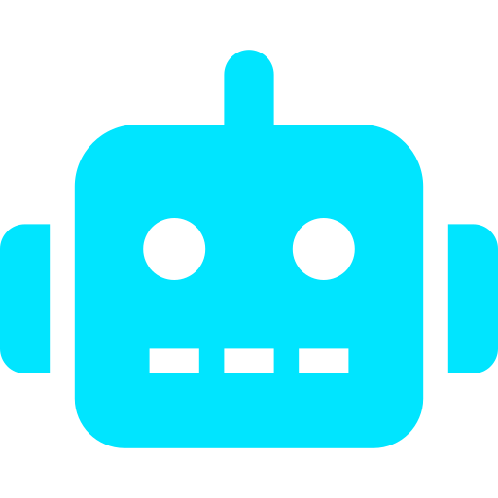


PHYSICAL AI & EDGE ML
Framework for Training
Small Models on
Microcontroller Devices
A Collaborative Framework Proposal for Yaskawa Motoman
Confidential | AI/ML Services Engagement | 2025

Slide 2
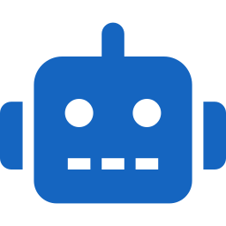


THE CHALLENGE
Edge Constraints
ML Model Size
Training–Deployment Gap
Yaskawa robots operate on microcontrollers with severe limits: < 256KB RAM, no GPU, real-time latency requirements under 10ms, and restricted power budgets.
Traditional ML/DL models (PyTorch, TensorFlow) are megabytes to gigabytes — completely incompatible with MCU-class hardware without aggressive optimization.
No unified framework exists to train, compress, and validate Physical AI models specifically for embedded robotics deployment at scale.
Yaskawa Motoman requires a purpose-built Physical AI framework — from data to deployed edge intelligence.

Slide 3
FRAMEWORK ARCHITECTURE OVERVIEW
1. DATA INGESTION
2. FEATURE ENGINEERING
3. MODEL TRAINING
4. COMPRESSION
5. EDGE DEPLOYMENT
ROS2 / URDF / Sensor Streams
Physics-Informed + Signal Processing
TinyML / Edge Impulse / NAS
Quantization / Pruning / Knowledge Distillation
MCU / RTOS / Real-Time Inference
Sensor fusion
Anomaly flags
Time-series buffer
Label pipeline
Statistical moments
FFT features
PCA reduction
Domain knowledge
TinyML training
AutoML / NAS
Transfer learning
Federated learning
INT8 quantization
Structured pruning
KD teacher→student
Model profiling
CMSIS-NN kernel
FreeRTOS deploy
OTA updates
Watchdog & safety
End-to-End: from raw robot sensor data → validated, compressed ML model running live on microcontroller hardware

Slide 4
LAYER 1 — DATA STRATEGY & INGESTION
Data Sources
Pipeline Architecture
Joint encoders & torque sensors (1kHz)
IMU / accelerometers on end-effector
Vision: depth camera + YOLO detection frames
Force-torque sensor (6-DoF, real-time)
PLC & SCADA process signals
Simulation data from MotoSim EG-VRC
Digital twin synthetic augmentation
ROS2 Topic Subscription
All sensors publish to standardized topics; bag files created for replay
Edge Preprocessing Module
Low-pass filter, normalization, missing-value imputation on-device
Labeling Pipeline
Semi-auto labeling via heuristic + human-in-the-loop for fault events
Dataset Registry
Versioned datasets in MLflow / DVC with reproducibility guarantees

Slide 5

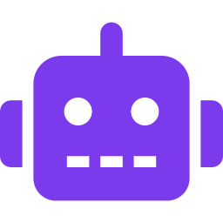


LAYER 3 — ML MODEL TRAINING STRATEGY
Anomaly Detection
Motion Classification
Autoencoder / Isolation Forest
1D-CNN / TinyML Decision Tree
Detect bearing failures, joint wear patterns from vibration signals. Target: <8KB model size.
Classify robot motion primitives (pick, place, idle) for adaptive control loops.
Predictive Maintenance
Force-Adaptive Control
LSTM (compressed) / LightGBM
Reinforcement Learning (SAC) + Distilled Policy
Time-to-failure regression for servo motors. INT8-quantized for MCU deployment.
Train in simulation (MuJoCo/Isaac Sim), distill to tiny policy network for real-time control.
All models target < 20KB footprint post-compression. Training on GPU cloud; inference on MCU edge hardware.

Slide 6
LAYER 4 — MODEL COMPRESSION FOR MICROCONTROLLERS
INT8 Quantization
Weight Pruning
4× smaller
Up to 10× faster
Post-training quantization via TensorFlow Lite / ONNX. Reduces model size 4x with <1% accuracy drop on most robotics tasks.
Remove near-zero weights with structured sparsity. Achieves 70–90% sparsity on feed-forward layers without retraining from scratch.
Knowledge Distillation
Neural Architecture Search
< 8KB student
MCU-native arch
A large 'teacher' model (trained on cloud GPU) transfers learned representations to a tiny 'student' model designed for MCU constraints.
AutoML-driven NAS (using Edge Impulse or NNI) searches for Pareto-optimal architecture: minimize latency × minimize error rate.

Slide 7
LAYER 5 — EDGE DEPLOYMENT ARCHITECTURE
Target Hardware
Software Stack
ARM Cortex-M7
TFLite Micro / CMSIS-NN
STM32H7 | 1MB Flash | 512KB RAM | 480MHz
Kernel-level INT8 inference, SIMD acceleration
Nordic nRF5340
FreeRTOS / Zephyr RTOS
Dual-core | BLE | 1MB Flash | 512KB RAM
Hard real-time task scheduling, < 1ms jitter
OTA Update Manager
Renesas RA6M5
Differential model updates over MQTT/BLE
Cortex-M33 | TrustZone | 2MB Flash
Safety Watchdog Layer
Yaskawa YCP01
Fallback to classical controller on confidence drop
Native robot controller expansion slot
Telemetry & Drift Monitor
Concept drift detection, anomaly re-trigger pipeline

Slide 8
MLOPS FOR PHYSICAL AI — CONTINUOUS LEARNING LOOP
COLLECT
RETRAIN
EVALUATE
Live robot telemetry → Edge buffer → Cloud upload
Triggered by drift detection or scheduled cadence
Benchmark vs. baseline; accuracy, latency, memory
DEPLOY
VALIDATE
COMPRESS
OTA push to robot fleet, rollback on regression
Hardware-in-loop (HIL) testing on target MCU
Auto-quantize + prune using compression pipeline
Tooling Stack: MLflow · DVC · Kubeflow Pipelines · Edge Impulse · TFLite · MQTT OTA · Evidently AI (drift)

Slide 9
ENGAGEMENT MODEL & TEAM STRUCTURE
Phase 1
Phase 2
Phase 3
Foundation (Weeks 1–6)
Build & Train (Weeks 7–16)
Production (Weeks 17–24)
Data audit & sensor integration
ROS2 pipeline setup
Baseline model benchmarks
Hardware target selection
MLOps infra deployment
Model development (4 model types)
Compression pipeline
HIL testing rig setup
Edge Impulse / TFLite integration
V1 deployment on dev board
Fleet OTA deployment
Continuous learning loop live
Drift monitoring dashboards
Documentation & knowledge transfer
Hypercare & SLA
Proposed Team: AI Lead · 2× MLEs (TinyML) · Robotics Systems Engineer · MLOps Engineer · Embedded SW Engineer

Slide 10
Why Act Now?
< 20KB
Physical AI is the
next frontier
for industrial robotics.
Model Footprint
< 5ms
Manufacturers deploying on-device ML today will achieve autonomous adaptability — reducing downtime by 30–45% and eliminating cloud dependency for latency-critical control loops.
Inference Latency
24 wks
Time-to-Deploy
Let's build intelligent machines, together.

