Slide 1
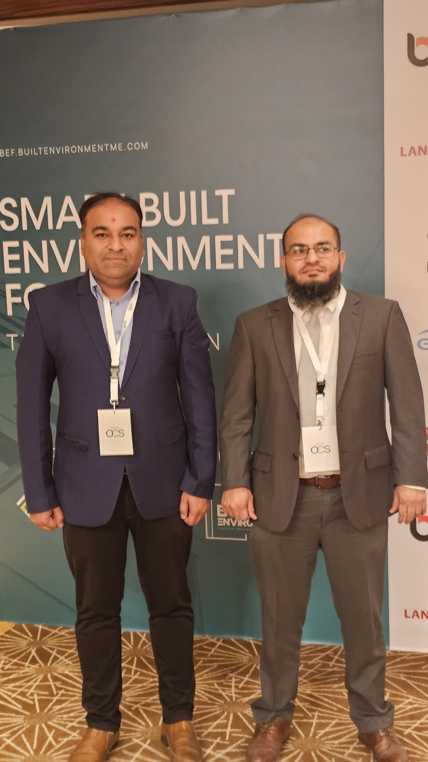
ANKUR THAKKAR
Executive Portfolio
Driving Enterprise Digital Transformation Through Product Leadership, AI & Innovation
PMP® Certified | Product Owner | IT Manager | Enterprise Applications
Dubai, UAE ankurthakkar8@gmail.com +971 50 100 2801

Slide 2
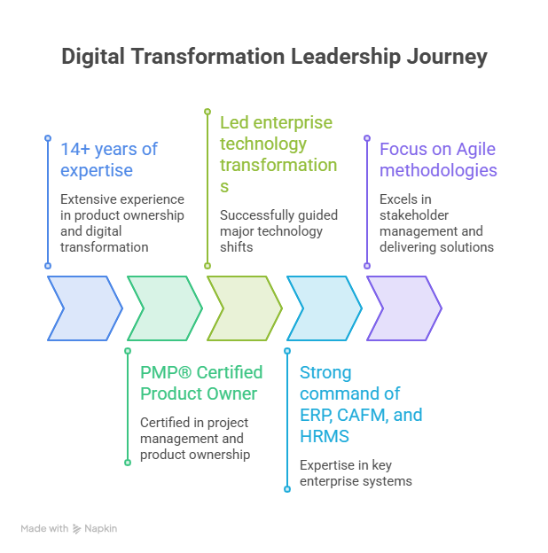
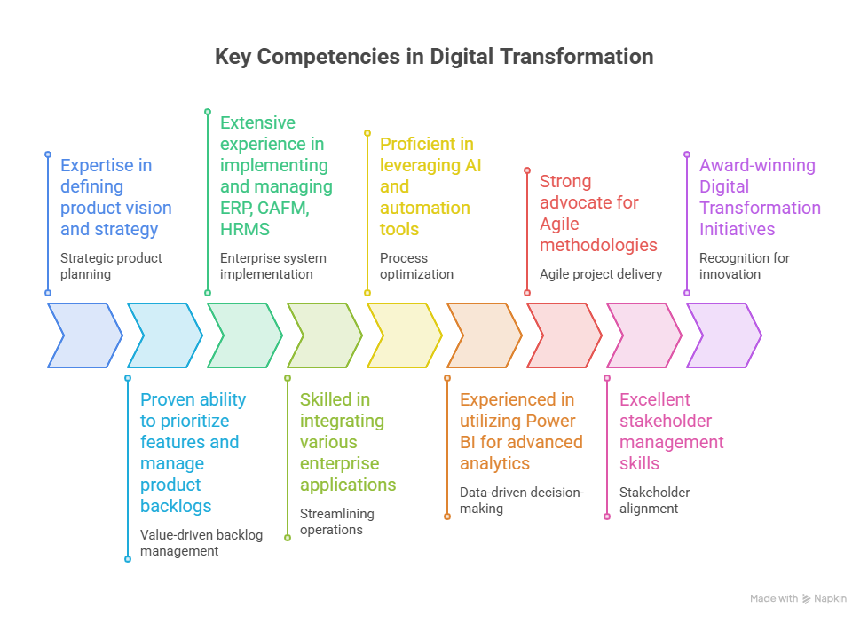

Slide 3
Executive Dashboard
14+ Years
Experience
14+ Years
UAE
18-20
Team
4
ERP
7
CAFM
2
HRMS
250+
Users
50+
Customers
500+
Vendors
7M+ AED
Budget
3
Awards
3
Certifications

Slide 4
Career Timeline
2012
2014
2017
2021
2026
Suntech
.NET Developer
Realtime
ERP Specialist
Lattice
Product Consultant
ENFM
Senior Product Owner
Digital Transformation
Leader

Slide 5
Leadership Philosophy
Technology should solve business problems and create measurable value.
Core Principles
• Customer First
• Business Value
• Innovation
• Simplicity
• Empower People
Mission:
Build intelligent enterprise products that improve efficiency,
governance, user experience and business performance.

Slide 6
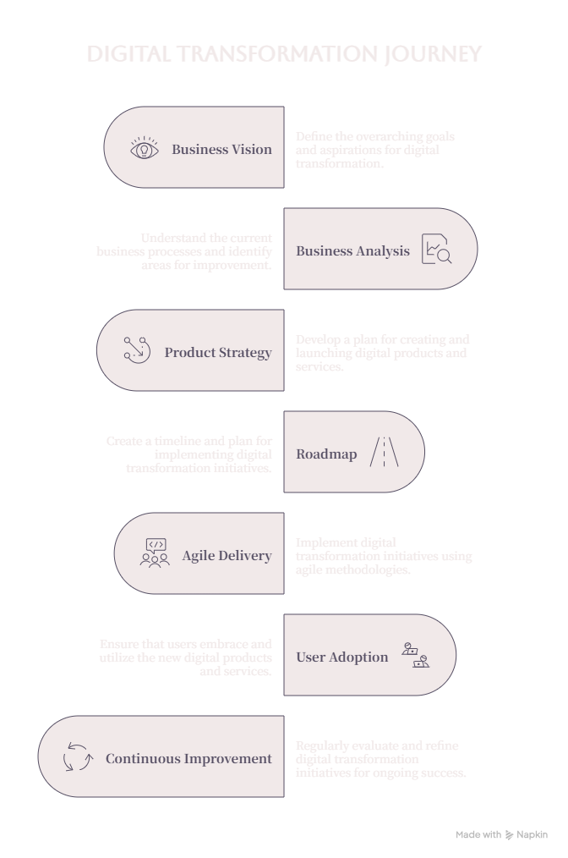
Digital Transformation Journey

Slide 7
Business Challenges
• Fragmented systems
• Manual approvals
• Spreadsheet-based reporting
• Limited visibility
• Slow decision making
• Vendor dependency
• Lack of mobility

Slide 8
EnFM360 Vision
Build one integrated enterprise platform connecting:
• Operations
• Procurement
• Finance
• HR
• Customers
• Vendors
• Executive Dashboards

Slide 9
Solution Architecture
Users
↓
Mobile Apps / Web Portal
↓
EnFM360 Platform
↓
ERP • CAFM • HRMS • Finance
↓
Power BI • APIs • Azure • SQL Server

Slide 10
Product Roadmap
Phase 1 - Work Orders & CAFM
Phase 2 - Procurement & Vendor Portal
Phase 3 - Finance & Dashboards
Phase 4 - HRMS & Mobility
Phase 5 - AI & Predictive Analytics

Slide 11
Product Lifecycle
Discovery
Requirements
User Stories
Backlog Prioritization
Sprint Planning
Development
UAT
Release
Feedback & Continuous Improvement

Slide 12
Business Impact
• 35% increase in digital adoption
• 40% reduction in process turnaround
• 30% improvement in incident resolution
• 25% reduction in IT costs
• 500+ vendors onboarded
• 50+ enterprise customers

Slide 13
Stakeholder Ecosystem
Executive Management
Operations
Finance
HR
Procurement
Customers
Vendors
Development Team
IT Infrastructure

Slide 14
Lessons Learned
• User adoption is critical
• Engage stakeholders early
• Deliver in phases
• Measure KPIs continuously
• Keep the roadmap aligned to business goals

Slide 15
Future Vision
• AI-powered enterprise assistant
• Predictive maintenance
• Microsoft Copilot integration
• UAE e-Invoicing
• Advanced analytics
• Enterprise automation

Slide 16
Iteration 3 – Product Portfolio
Enterprise Products Delivered
This section showcases major digital products, business value and your role.

Slide 17
Enterprise Product Portfolio
• EnFM360 Enterprise Platform
• ERP & CAFM
• HRMS
• Vendor Portal
• Customer Portal
• Mobile Applications
• Power BI Dashboards

Slide 18
EnFM360 Platform
Role: Product Owner
Modules: Work Orders, Assets, Procurement, Finance, HR, Inventory, Dashboards
Business Value: Unified enterprise platform.

Slide 19
Vendor Portal
Digital supplier onboarding
PO Acceptance
GRN
Invoice Upload
Vendor Performance
500+ Vendors

Slide 20
Customer Portal
Customer self-service
Asset visibility
Work Order Tracking
Service History
Reports
50+ Customers

Slide 21
Customer Mobile App
QR Code Requests
Maintenance Requests
Request History
Feedback & Ratings
PDF Reports

Slide 22
Technician Mobile App
Reactive & Preventive Maintenance
Material Booking
Asset Register
Photo Capture
Customer Sign-off

Slide 23
Hospitality Application
QR Ordering
Menu Management
Pantry Dashboard
Management Dashboard
Digital Hospitality Experience

Slide 24
Power BI & Executive Dashboards
P&L Dashboard
Procurement
Vehicle
Operations
SLA
Finance
Customer Survey
Business Development

Slide 25
AI & Automation
Power Automate
Workflow Automation
AI Readiness
Prompt Engineering
Future Copilot Integration

Slide 26
Business Value Delivered
• 35% Digital Adoption
• 40% Faster Processes
• 30% Better Incident Resolution
• 25% Cost Reduction
• Award-winning Transformation

Slide 27
Key Takeaways
Products built with customer-centric design, Agile delivery, measurable business outcomes and continuous innovation.

Slide 28
Iteration 4 – Executive Leadership & Technology
Enterprise Leadership, Delivery Excellence & Technology Strategy

Slide 29
Enterprise Architecture
Presentation Layer
Mobile Apps
Customer Portal
Vendor Portal
Business Layer: EnFM360
Data Layer: SQL Server
Cloud: Azure & Microsoft 365
Analytics: Power BI

Slide 30
Technology Stack
Azure
Microsoft 365
Power BI
Power Platform
SQL Server
.NET
REST APIs
SharePoint
Teams

Slide 31
ERP / CAFM / HRMS Journey
ERP Implementations: 4
CAFM Implementations: 7
HRMS Implementations: 2
Enterprise Integration
Business Process Automation

Slide 32
Project Delivery Methodology
Discovery
Requirements
Solution Design
Sprint Planning
Development
UAT
Go-Live
Hypercare

Slide 33
Agile Delivery Framework
Product Vision
Roadmap
Backlog
Sprint
Review
Retrospective
Continuous Improvement

Slide 34
Governance Model
Steering Committee
Executive Reporting
Risk Reviews
Change Control
Quality Gates
Benefits Tracking

Slide 35
Stakeholder Management
CEO & Leadership
Operations
Finance
HR
Procurement
Customers
Vendors
Technology Partners

Slide 36
Vendor Management
Vendor Selection
Contract Negotiation
SLA Governance
Performance Reviews
Cost Optimisation
Relationship Management

Slide 37
Risk & Compliance
ISO 27001
Business Continuity
Disaster Recovery
Cybersecurity
Access Control
Audit Readiness

Slide 38
Financial Governance
Portfolio Budget: 7M+ AED
Business Cases
ROI Tracking
Cost Optimisation
Procurement Governance

Slide 39
Team Leadership
Managed 18–20 professionals
Cross-functional Teams
Mentoring
Performance Management
Innovation Culture

Slide 40
Awards & Recognition
MEFMA Digital Transformation
Technology Implementation Awards
Technology & Innovation Award

Slide 41
Certifications
PMP®
PMI Membership
Generative AI for Project Managers
Prompt Engineering

Slide 42
Future Executive Vision
Enterprise AI
Predictive Analytics
Digital Twins
Copilot
Data-driven Decisions
Continuous Innovation

Slide 43
Iteration 5 – Executive Brand & Career Impact
Final portfolio section focused on executive positioning and personal brand.

Slide 44
Executive Achievements Dashboard
• 14+ Years UAE Experience
• 7M+ AED Transformation Portfolio
• 4 ERP | 7 CAFM | 2 HRMS Implementations
• 500+ Vendors | 50+ Customers | 250+ Users
• 3 Industry Awards | PMP® Certified

Slide 45
Career Highlights
Built award-winning EnFM360 platform
Led enterprise digital transformation
Delivered AI, ERP, CAFM, HRMS and analytics initiatives
Managed cross-functional teams of 18–20 professionals

Slide 46
Business Case Study Summary
Challenge: Fragmented operations
Solution: Unified enterprise platform
Approach: Agile delivery & stakeholder engagement
Outcome: Faster processes, improved governance, higher adoption

Slide 47
Leadership Philosophy
Customer First
Business Value
Innovation
People
Continuous Improvement

Slide 48
Thought Leadership
Digital Transformation
Enterprise Product Management
AI & Automation
Data-driven decision making
Operational Excellence

Slide 49
Training & Mentoring
Conducted user training
Executive demos
UAT workshops
Knowledge transfer
Change management

Slide 50
Professional Timeline
2012 .NET Developer
2014 ERP Specialist
2017 Product Consultant
2021 Senior Product Owner / IT Manager
2026 Digital Transformation Leader

Slide 51
Target Executive Roles
Head of Digital Transformation
Director – Enterprise Applications
Senior Product Owner
IT Director
Program Manager

Slide 52
Core Competencies
Product Strategy
ERP
CAFM
HRMS
Power BI
Azure
Agile
Stakeholder Management
Vendor Management
AI

Slide 53
Professional Brand Statement
Driving Enterprise Digital Transformation Through Product Leadership, AI & Innovation.

Slide 54
Contact
Ankur Thakkar
Dubai, UAE
ankurthakkar8@gmail.com
+971 50 100 2801
LinkedIn: linkedin.com/in/ankur-thakkar-b84a321a

