Slide 1



CONNECT
PULSE
EVOLVE
EnFM360 – Executive Board Presentation
Key insights and strategies for executive leadership review

Slide 2

CONNECT
PULSE
EVOLVE
IT Executive Summary
Digital Transformation Platform
EnFM360 integrates core business functions into a unified platform, breaking down silos and improving visibility.
Real-Time Data Insights
The platform provides real-time data insights enabling leadership to make faster and more informed decisions.
Enhanced Governance and Compliance
Structured workflows and audit trails improve governance, accountability, and compliance across departments.
Strategic IT Role
IT evolves into a strategic enabler driving operational excellence, scalability, and digital maturity.

Slide 3

CONNECT
PULSE
EVOLVE
Key Achievements
Centralized Digital Platform
EnFM360 replaced disconnected systems with a centralized digital platform boosting operational efficiency.
Automation and Workflow Streamlining
Automation has streamlined approvals, reduced errors, and increased processing speed across departments.
Enhanced Data Management
Centralized data management improved reporting and visibility for leadership across business units.
Governance and Compliance Controls
Structured approval workflows and audit trails strengthen accountability and compliance within the system.

Slide 4

CONNECT
PULSE
EVOLVE
Strategic Value Delivered
Technology-Driven Operating Model
EnFM360 enables streamlined processes and centralized data for real-time decision-making across the organization.
Improved Collaboration and Efficiency
Enhanced coordination reduces delays and minimizes manual errors, boosting service delivery and customer satisfaction.
Leadership Empowerment
Dashboards and analytics provide actionable insights, supporting proactive and strategic decision-making by leadership.
Financial and Strategic Benefits
Automation and efficiency improvements lead to cost optimization and stronger organizational agility in competitive markets.

Slide 5

CONNECT
PULSE
EVOLVE
Governance & Controls Framework
Structured Workflows and Approvals
Predefined approval hierarchies enforce consistency and reduce unauthorized actions in business processes.
Comprehensive Audit Trails
Audit trails provide detailed records of transactions, enabling effective monitoring and compliance.
Role-Based Access Control
Access restrictions protect sensitive data by authorizing only specific personnel, enhancing security.
Centralized Monitoring and Proactive Governance
Centralized platform visibility enables early detection of discrepancies, fostering trust and integrity.

Slide 6

CONNECT
PULSE
EVOLVE
Efficiency Gains
Automation of Routine Tasks
Automation eliminates manual work, speeding up task completion and reducing human errors significantly.
Digital Approval Workflow
Approval processes are digitized, enabling real-time updates and streamlined communication across teams.
Resource Optimization
Improved visibility into workload distribution helps managers allocate resources effectively and address bottlenecks.
Standardized Processes and Productivity
Standardization ensures consistent operations and frees employees for strategic tasks, boosting productivity.

Slide 7

CONNECT
PULSE
EVOLVE
Innovation & Future Outlook
AI and Automation Integration
EnFM360 integrates AI and automation to provide predictive insights and smarter decision-making capabilities.
Digital Transformation Support
The platform supports digital transformation initiatives, including e-invoicing readiness and regulatory compliance in the UAE.
Modular and Scalable Design
EnFM360’s modular and scalable design allows continuous feature enhancements as business needs evolve.
Competitive Edge and Sustainability
Innovation investments position ENFM to improve efficiency, maintain competitiveness, and drive sustainable growth.

Slide 8

CONNECT
PULSE
EVOLVE
IT Roadmap
Short-term Focus
Prioritize system stabilization, performance optimization, and user adoption for seamless daily operations integration.
Medium-term Strategy
Expand analytics, introduce advanced dashboards, and improve usability including mobile access and interfaces.
Long-term Vision
Integrate AI, predictive analytics, and IoT for smarter facility management and data-driven decision-making.
Business Alignment
Align technology advancements with business goals to maintain agility and competitiveness in dynamic markets.

Slide 9

CONNECT
PULSE
EVOLVE
Business Transformation (Before vs After)
Pre-Implementation Challenges
Fragmented systems and manual workflows caused inefficiency, errors, and siloed data limiting operational visibility.
Post-Implementation Improvements
Centralized platform enabled real-time visibility, improved coordination, and faster decision-making across departments.
Workflow Automation Benefits
Automation reduced manual interventions, accelerated approvals, and enhanced process efficiency and accountability.
Overall Business Impact
Transformation to technology-driven model strengthened service consistency and operational excellence.

Slide 10
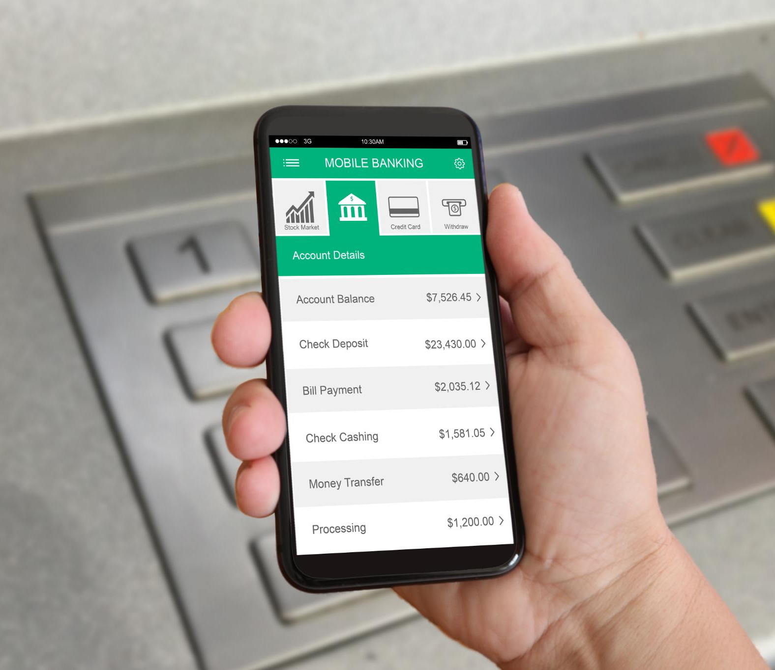
CONNECT
PULSE
EVOLVE
E-Invoicing Readiness
Digital Invoicing Workflow
EnFM360 enables a fully digital invoicing process to enhance accuracy and efficiency in financial transactions.
Regulatory Compliance
Built-in validation and audit trails ensure all invoices comply with UAE regulatory standards.
Centralized Invoice Management
All invoices are stored in a centralized database for easy tracking, reporting, and management.
Integrated End-to-End Transactions
E-invoicing integrates with procurement and finance modules for seamless transaction management.

Slide 11

CONNECT
PULSE
EVOLVE
Customer Platform Adoption
Over 50 customers use the platform to track assets, manage work orders, and handle maintenance tasks with transparency and control.
Vendor Portal Integration
More than 500 suppliers manage procurement processes digitally, improving accuracy and reducing delays via the vendor portal.
Internal Workforce Utilization
200+ operations staff and 50 corporate employees use the system for work order processing, reporting, and cross-department coordination.
Unified Digital Network
The platform connects all stakeholders into one network, enabling efficient communication, visibility, and improved service delivery.
Customer, Vendor, and Workforce Adoption

Slide 12

CONNECT
PULSE
EVOLVE
Automation Reduces Manual Work
Workflow automation and centralized access reduce manual tasks, speeding approvals and improving team coordination.
Cost Savings via In-House Development
Adopting an in-house development approach lowers infrastructure and system costs by 25-30%, reducing vendor reliance.
Centralized Data for Better Decisions
A centralized data environment improves resource tracking and decision-making for efficient allocation and governance.
Enhanced Service Delivery
Operational efficiency and faster processes improve service delivery and increase customer satisfaction significantly.
Operational Efficiency and Cost Optimization

Slide 13
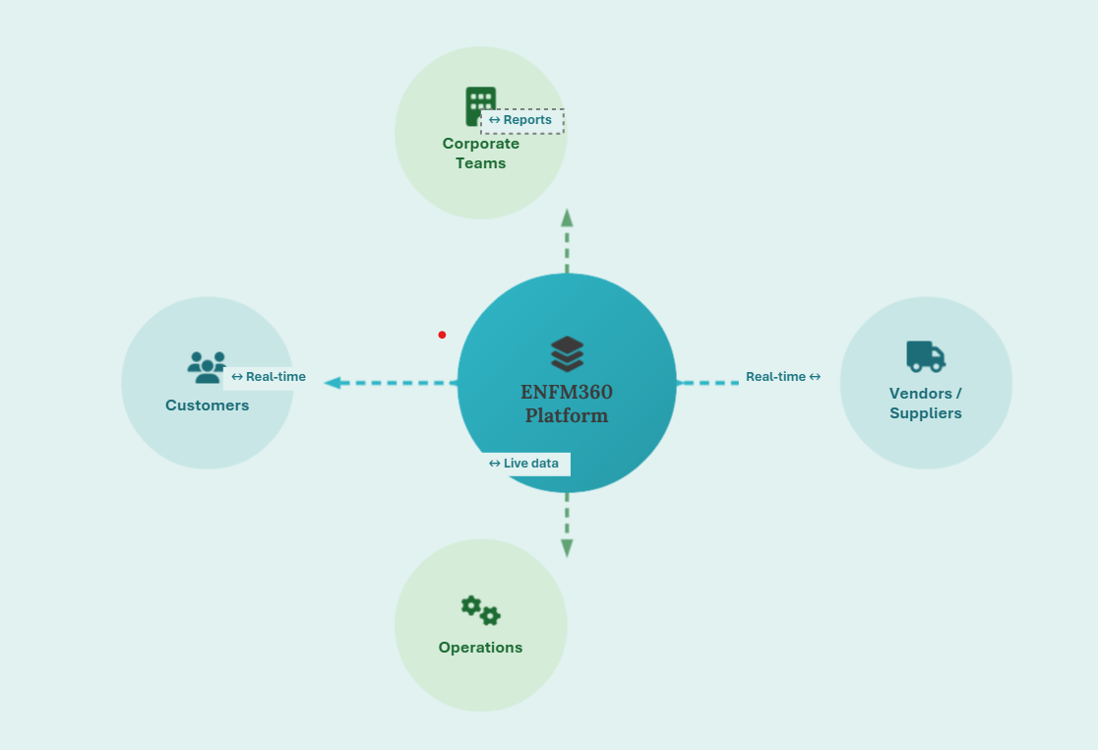
CONNECT
PULSE
EVOLVE

Slide 14

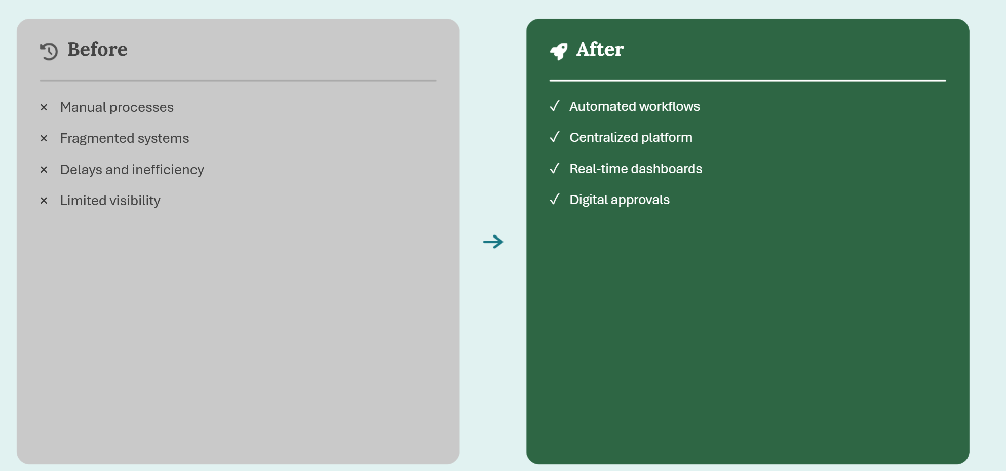
CONNECT
PULSE
EVOLVE

Slide 15
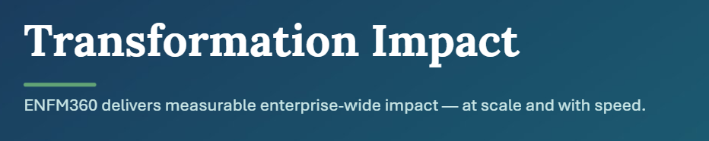
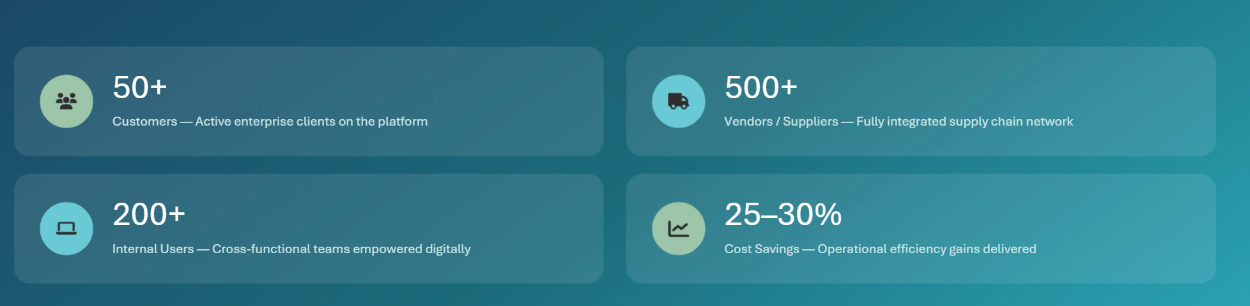
CONNECT
PULSE
EVOLVE

Slide 16


CONNECT
PULSE
EVOLVE
Business Value Creation
Process Automation Benefits
Automating processes reduces manual workload, saving time and lowering operational costs significantly.
Real-Time Operational Insights
Real-time visibility into operations enables quick identification and implementation of optimization opportunities.
Strategic Competitive Advantage
EnFM360 positions EnFM as a digitally advanced organization, adaptable to evolving market conditions.
Long-Term Digital Excellence
The platform represents a transformative initiative investing in digital excellence and sustainable growth.

Slide 17
CONNECT
PULSE
EVOLVE
Conclusion
Comprehensive Digital Platform
EnFM360 integrates core business functions and automates processes to enhance efficiency and decision-making.
Governance and Scalability
The platform ensures strong governance, compliance, and scalability to support current and future organizational needs.
Future-Ready Technology
EnFM360 is designed to incorporate emerging technologies like AI and comply with regulatory standards such as e-invoicing.
Strategic Business Impact
The platform strengthens service delivery, competitive positioning, and supports digital transformation and growth.

Slide 18
CONNECT
PULSE
EVOLVE
Thank You

