Slide 1
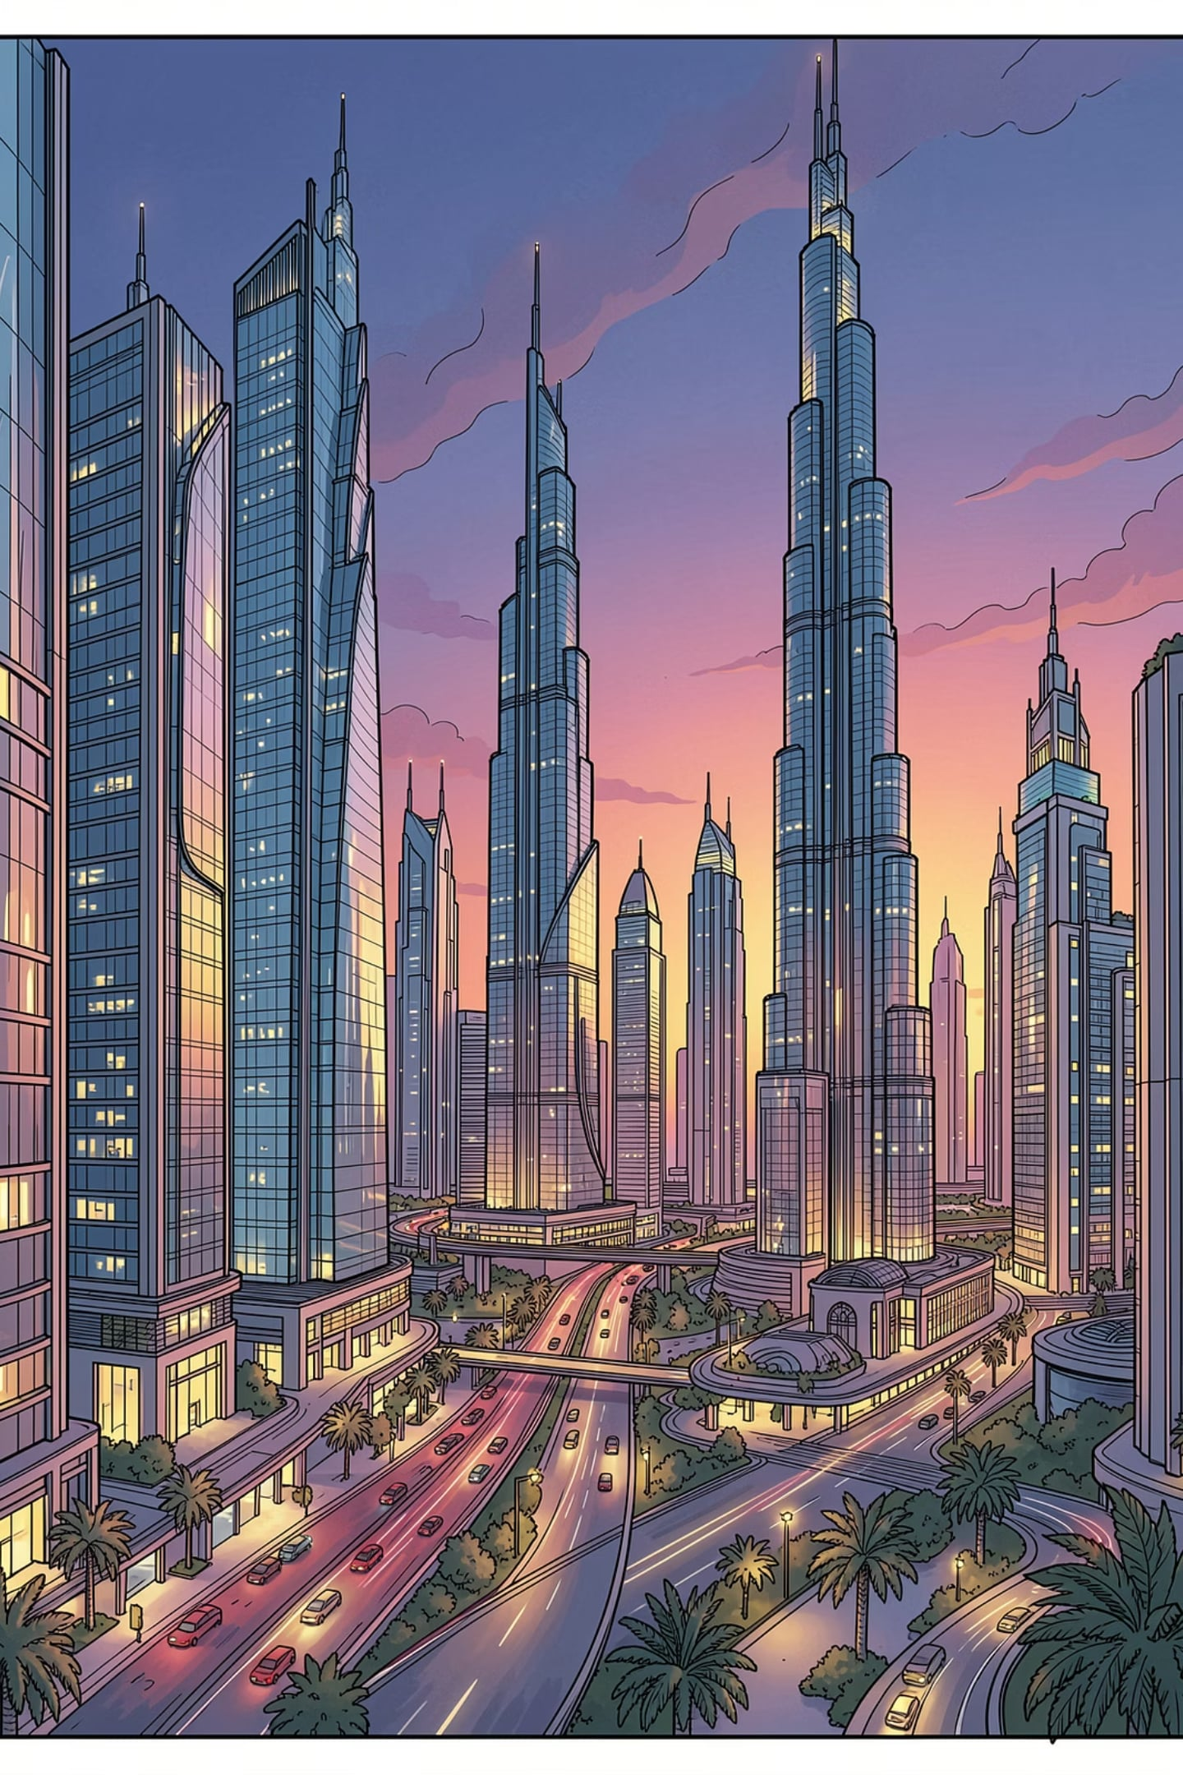
Ankur Thakkar, PMP®
Transforming Business Strategy into Scalable Digital Solutions
Senior IT & Digital Transformation Leader · Emirates National Facilities Management, Dubai, UAE
ENTERPRISE APPLICATIONS
DIGITAL TRANSFORMATION
PRODUCT STRATEGY
AI & AUTOMATION

Slide 2
Executive Impact at a Glance
PMP®-certified technology leader with 14+ years delivering enterprise digital transformation across Facilities Management, Real Estate, HR, Finance, and Operations — reporting directly to the CEO at ENFM.
14+
AED 7M+
Years of Experience
Transformation Portfolio
4,200+
200+
Employees Supported
Operational Sites
1,000+
50+
Enterprise Vendors
Enterprise Modules
20+
30+
Enterprise Integrations
REST APIs Delivered
Teams led: 25–35 cross-functional professionals · Annual IT Budget: AED 2.3M · 15+ enterprise applications

Slide 3

Career Transformation Journey
Each role expanded responsibilities from technical expertise to enterprise leadership, building the capability to lead large-scale digital transformation.
1
2012–2014 · Software Engineer
Suntech Business Solutions — Enterprise software development, .NET, SQL Server
2
2014–2017 · ERP Consultant
Realtime Technologies — ERP implementation, business process mapping, client consulting
3
2017–2021 · Product Consultant
Lattice Software Solutions — Product strategy, solution architecture, customer success
4
2021–Present · Senior IT Manager
ENFM — Enterprise technology strategy, digital transformation, AI & automation

Slide 4
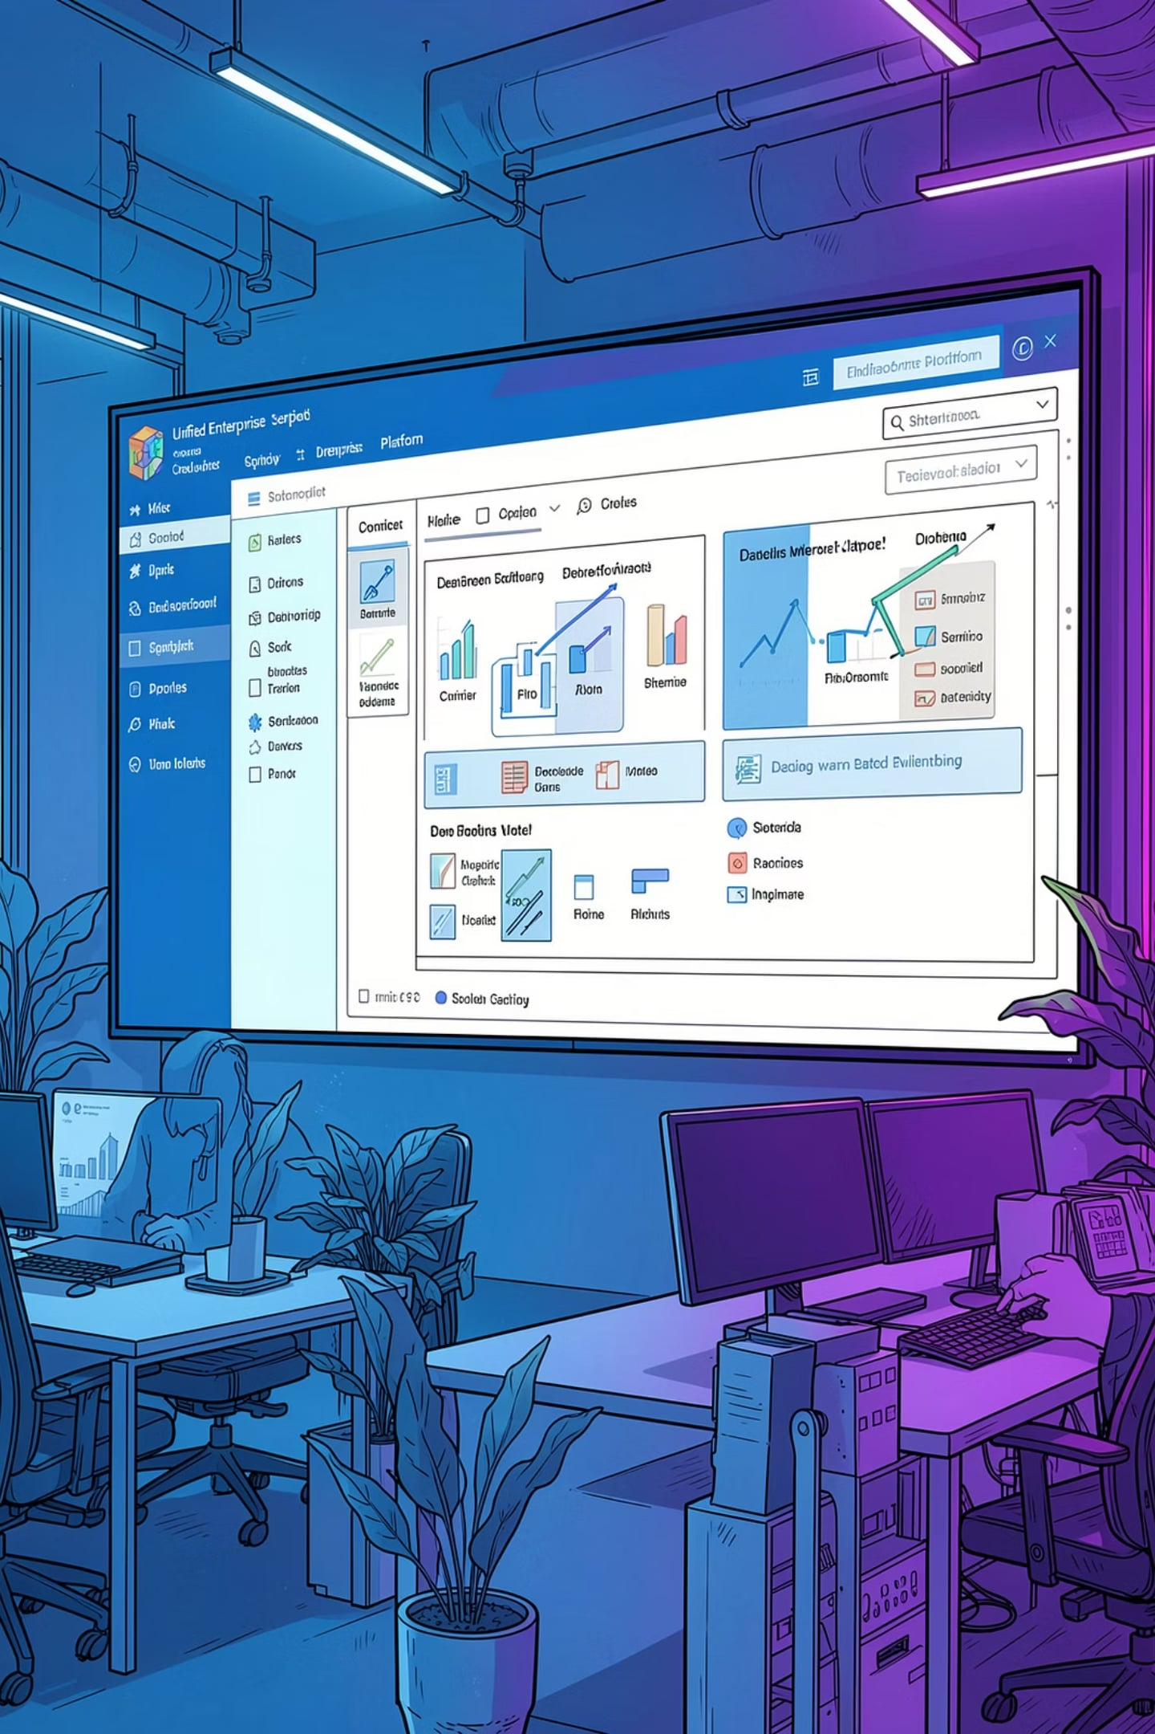
EnFM360: Enterprise Digital Transformation Platform
Proposed, sponsored, and led the development of an in-house enterprise platform replacing fragmented systems with one integrated ecosystem — covering Finance, HR, Procurement, Operations, CRM, Asset Management, Mobile Apps, and AI-ready capabilities.
Why Build vs. Buy
Portfolio Scale
Eliminated vendor lock-in, reduced licensing costs, and aligned technology to ENFM's unique business processes.
AED 7M+ · 25–35 team members · 2022–Present · CEO Executive Sponsor
Business Objectives
Unified platform, digitized processes, real-time dashboards, mobile-first operations, AI-ready architecture.

Slide 5
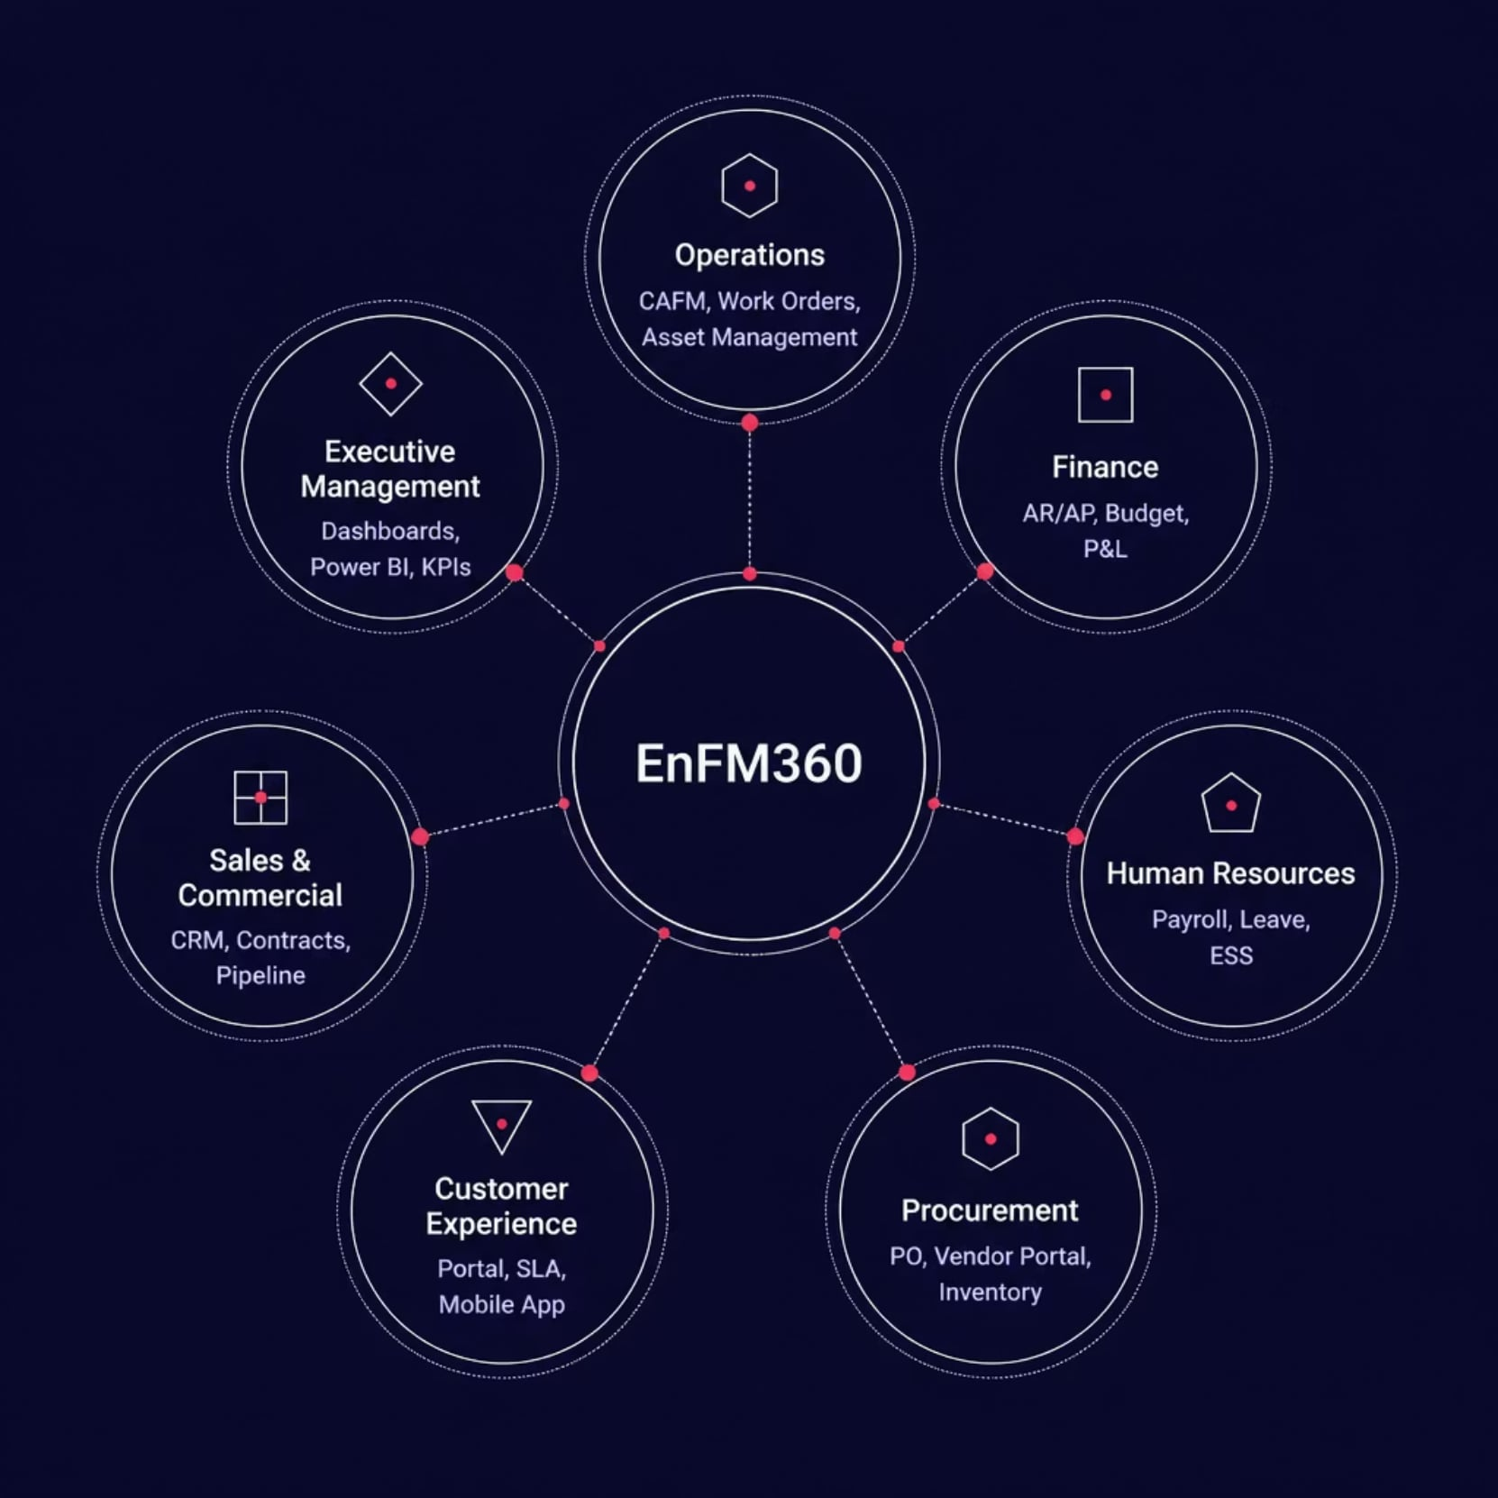
EnFM360: Enterprise Architecture
One Platform. One Data Model. One Ecosystem.
Modular, API-driven architecture on Microsoft Azure with SQL Server, Power BI, and 30+ REST APIs. Built with role-based access control, audit trails, and ISO 27001 alignment.
Business-centric, modular design
Cloud-ready & AI-ready foundation
Single source of truth across 200+ sites

Slide 6






EnFM360: Business Capabilities
EnFM360 digitized every major business function — enabling seamless data flow, automation, governance, and real-time decision-making across ENFM.
Operations
Finance
CAFM, Work Orders, PPM, Asset Management, Technician Scheduling, SLA Monitoring
AR/AP, Budget Management, P&L, Financial Dashboards
Human Resources
Procurement
Payroll, Leave, Attendance, ESS, HR Ticketing
PR/PO, Vendor Portal, Inventory, GRN, Invoice Management
Customer Experience
Executive Management
Customer Portal, Mobile App, Service Requests, SLA Monitoring
Power BI Dashboards, KPI Monitoring, 100+ Business Reports

Slide 7
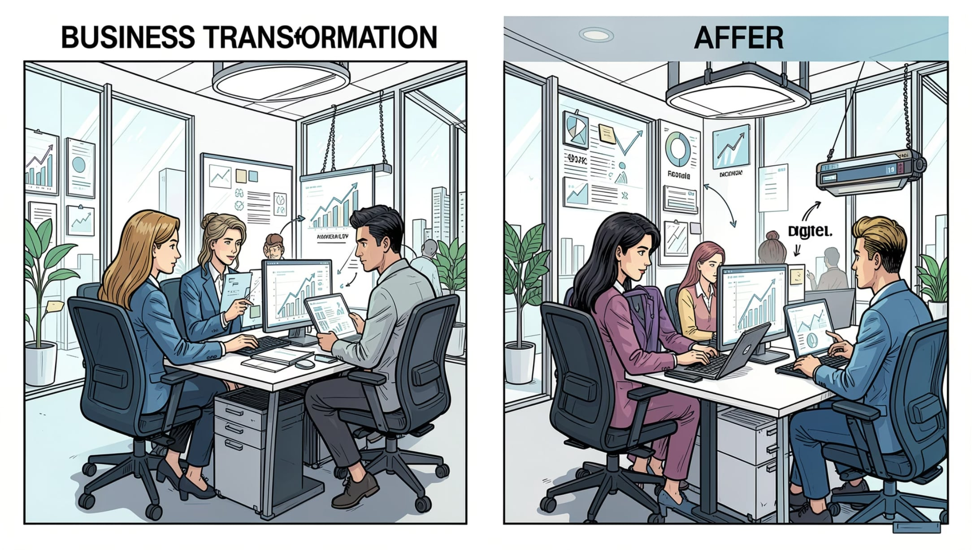

EnFM360: Business Impact & Results
Measurable Business Outcomes
~40% reduction in manual business processes
~35% improvement in customer response times
~30% improvement in IT incident resolution efficiency
Enterprise-wide digital approvals & paperless workflows
Reduced technology costs through platform consolidation
"EnFM360 was more than a technology project — it was a business transformation program that fundamentally changed how the organization operates, collaborates, and delivers value."

Slide 8
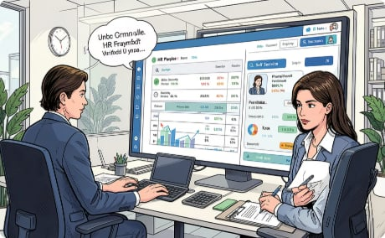
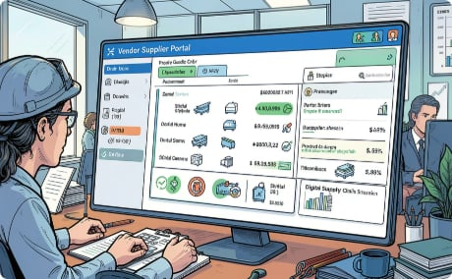
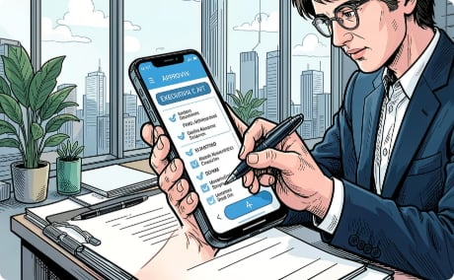

Strategic Initiatives & Technology Ecosystem
PayDay HRMS
Vendor & Customer Portals
Approval App & Power BI
AI & Automation Strategy
AED 450K · 4,200+ employees · Centralized HR, payroll automation, UAE WPS compliance
1,000+ vendors connected digitally; real-time customer self-service with SLA visibility
Mobile executive approvals; 20+ Power BI dashboards, 100+ reports enterprise-wide
AI-ready architecture, predictive analytics, digital workflows, and intelligent automation roadmap

Slide 9




Awards, Certifications & Why Organizations Choose Me
Technology & Innovation 2025
Digital Transformation 2024
Enterprise applications, mobile platforms, automation & digital transformation
Recognized for leading ENFM's most significant digital transformation via EnFM360
Technology Implementation 2024
Enterprise-wide technology delivery with measurable operational improvements
Certifications: PMP® · PMI Member · Generative AI for Project Managers · Microsoft & AI Learning
Differentiators: Business-first mindset · Bridges executives & IT · Builds enterprise platforms · Drives change across people, process & technology

Slide 10
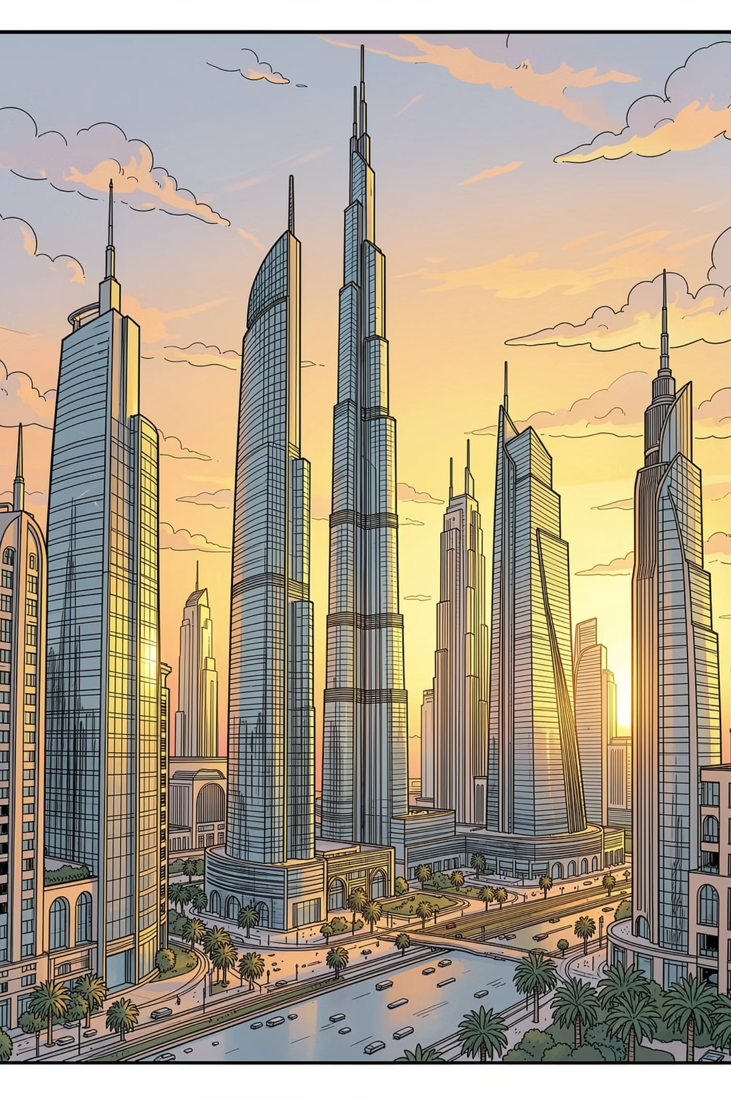
Let's Build the Future Together
Thank you for reviewing my Executive Leadership Portfolio. I look forward to discussing how my experience can contribute to your organization's technology strategy and long-term business success.
📍 Location
📧 Email
📱 Phone
Dubai, United Arab Emirates
ankurthakkar8@gmail.com
+971 50 100 2801
🔗 LinkedIn
linkedin.com/in/ankur-thakkar-b84a321a
"Technology is most powerful when it enables people, transforms businesses, and creates lasting value." — Ankur Thakkar, PMP®

