Slide 1
GitHub
What is github.
Selenium Integration With GitHub Using Eclipse.
Ankur Prasad

Slide 2
What is GitHub?
Let us consider a situation for Example. Suppose you are working in a team to test a software application and two members of a team are working on a specific module. Let us consider them as A and B.For that module, the tester A will have a copy in his PC and tester B will have a copy on his PC. Now at this point, if tester B changes the code in the module, then tester A wouldn’t know the changes made by the tester B and vice versa.
To overcome this problem, we have a platform which is called GitHub. Github is a Web hosting service where the source code of a software application can be uploaded/saved through the git software (installed on your local PC) or you can directly copy the code from your PC and save on the server.

Slide 3
How to generate Github Token?
Go to ‘https://github.com/’ and login with username and password.
Go to ‘Settings’
Go to ‘Developer settings’
Click on ‘Personal access tokens’
Click on ‘Generate token’

Slide 4
How to create Repository on GitHub?
A Repository in context with GitHub means a central location where all data, files, etc., can be stored. It is particularly used to efficiently co-ordinate the activities of a project. You can add java files, screenshots, videos, Excel sheets, documents, etc., in short, all that which your project needs can be added to a repository.
This is the use of Repository.
STEPS :
Load URL https://github.com/
Log in with valid credentials.
Click on “New Repository” as shown in the below image.

Slide 5
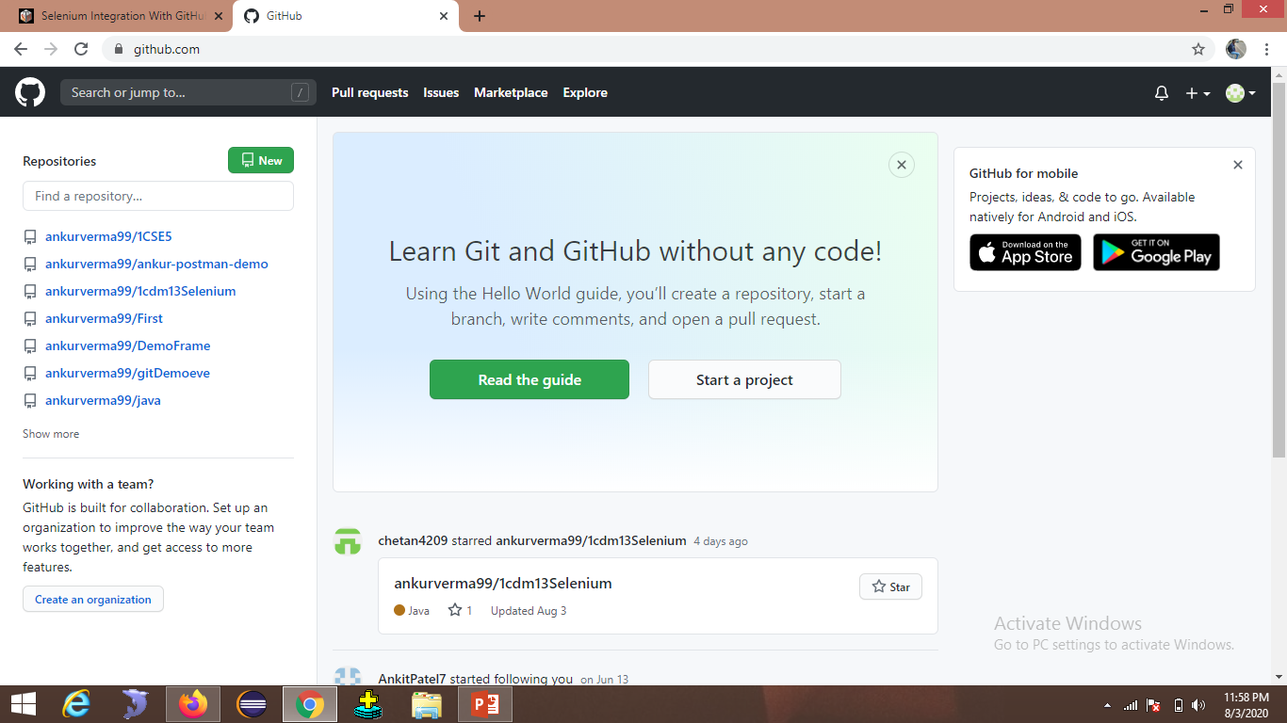

Slide 6
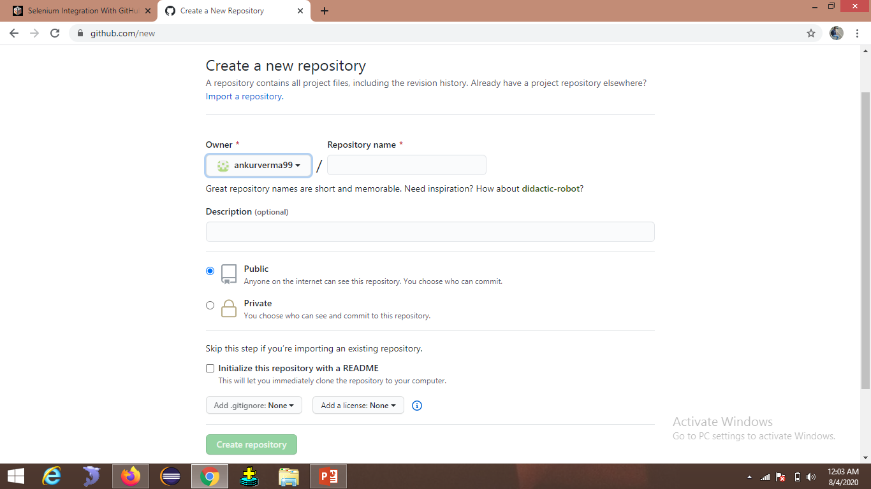
4. Enter the name of the repository in the “Repository name” text box. 5. Provide a description (optional) of the repository. 6. Click on the “Create Repository” button.
Selenium1

Slide 7
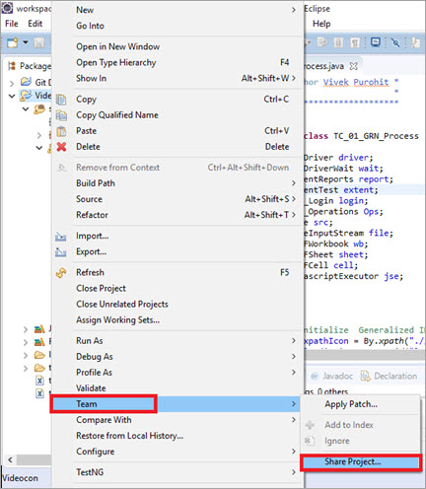
Integration With GitHub Using Eclipse
To integrate Selenium with GitHub, launch Eclipse and navigate to the project which is to be synced with GitHub.
Right-click on the project and navigate to Team => Share Project

Slide 8
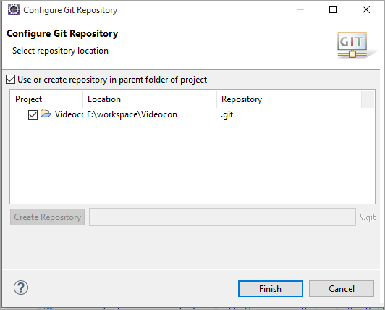
3. Select the Repository from the drop-down. If no data is displayed in the dropdown, then click on Create.
4. Click on the project which you want to integrate with GitHub. Click on the Finish button.

Slide 9
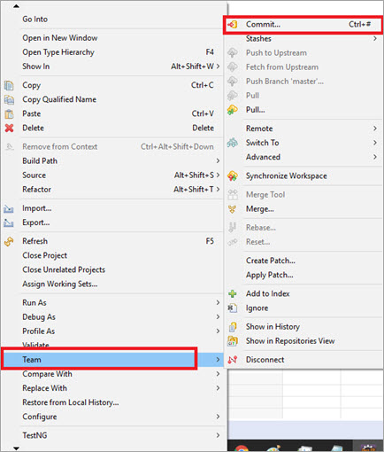
5. Notice the following change in the structure of your Selenium project.
6. Right-click on the project which was configured with the Git Repository. Navigate to Team => Commit.

Slide 10
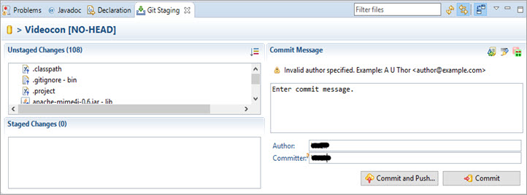
7.Drag the file from Unstaged Changes to Staged Changes.
8.Enter some Commit message and click on Commit and push.

Slide 11
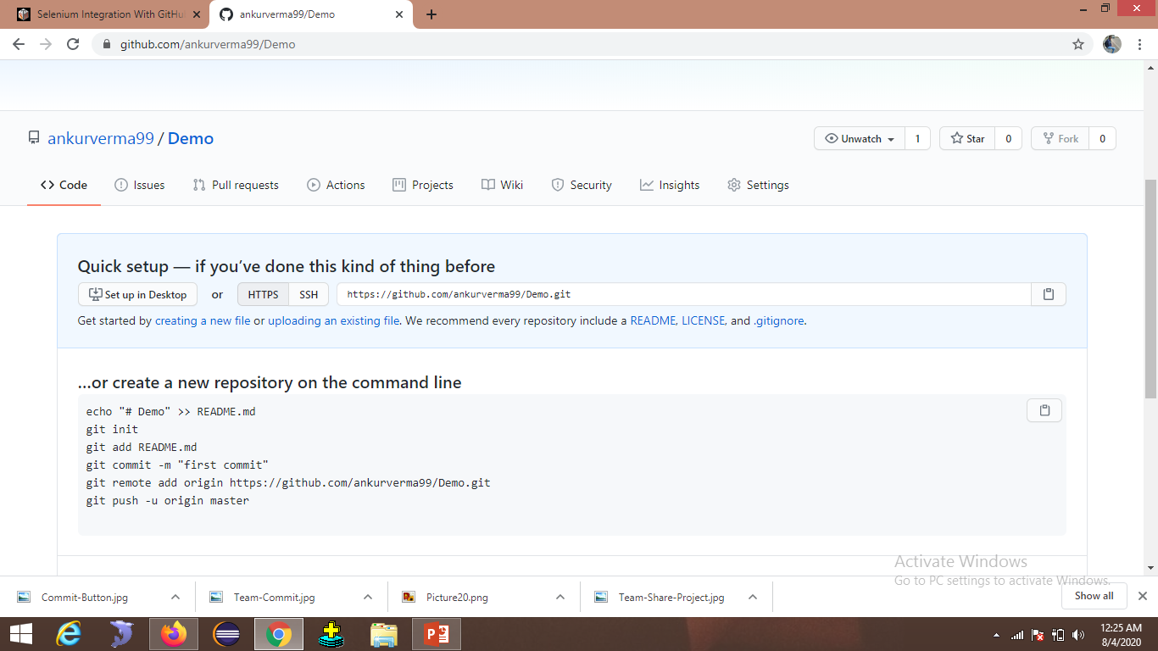
Navigate to the created repository on GitHub.
Copy the Url of the repository.
Reopsitory url

Slide 12
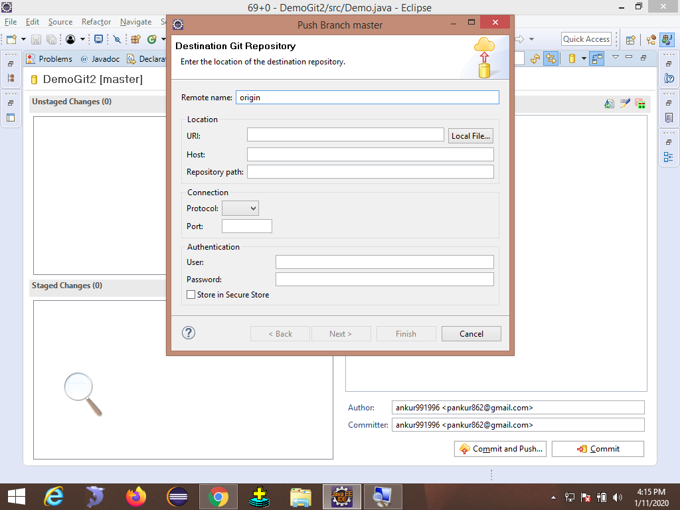
9. Go back to Eclipes.
10. Enter the copied Url to eclipse.

Slide 13
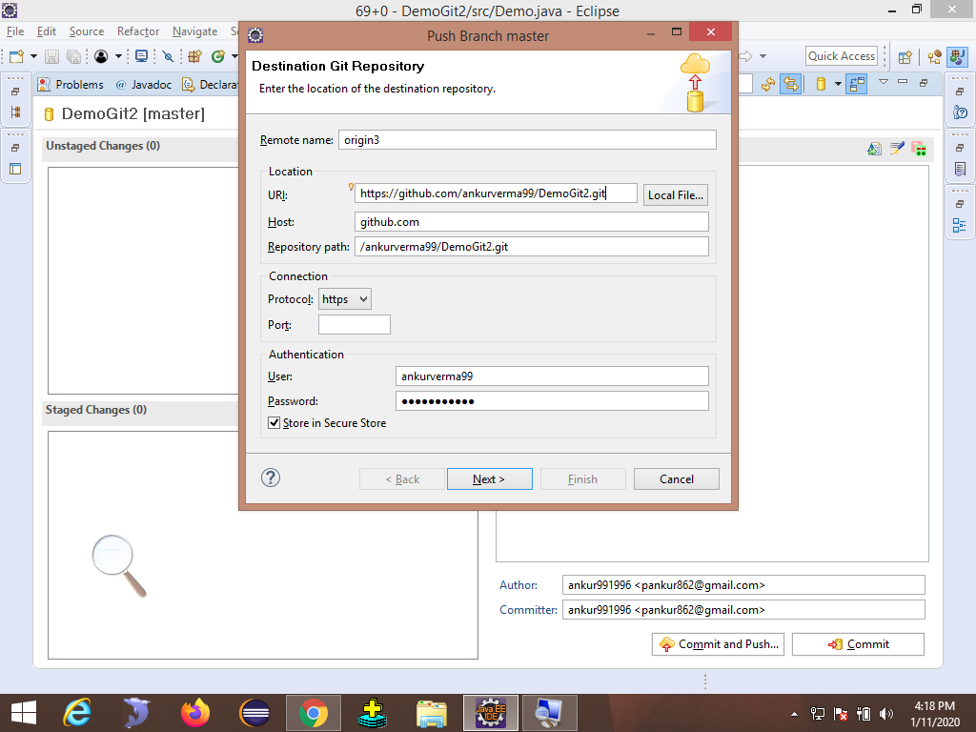
10.After given url and UserName and Personal access tokens we have to click on next.

Slide 14
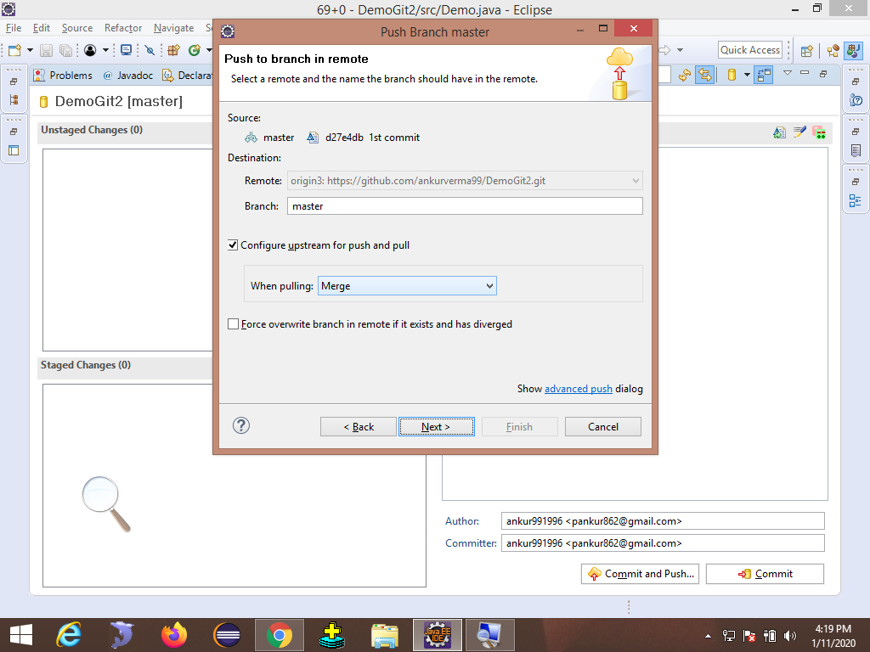
11.After clicking on next we have to click on next again.

Slide 15
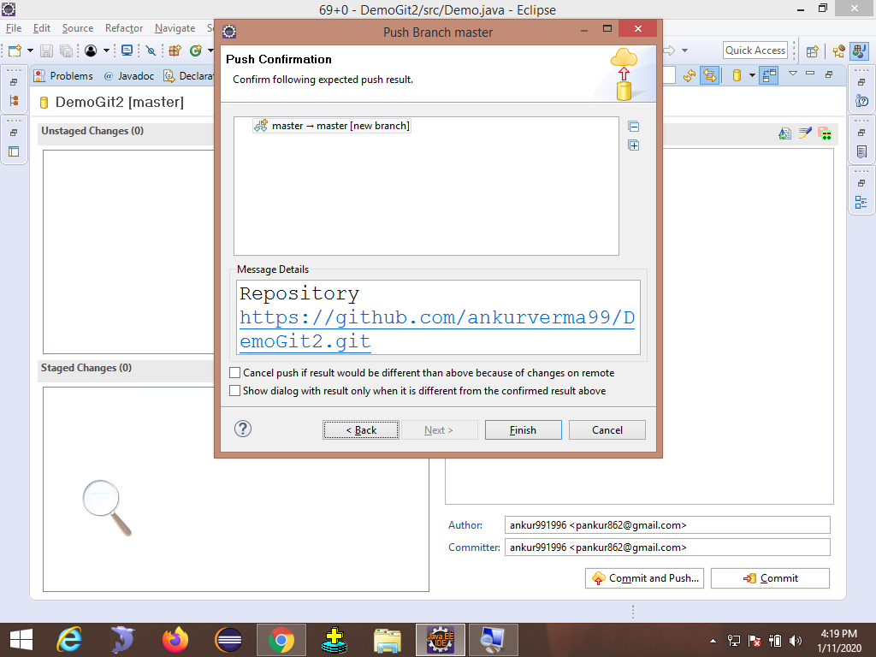
12.In push confirmation page we have to click on finish.
It will take some time to push the file to repository and after that it will give confirmation that it has pushed or not.

Slide 16
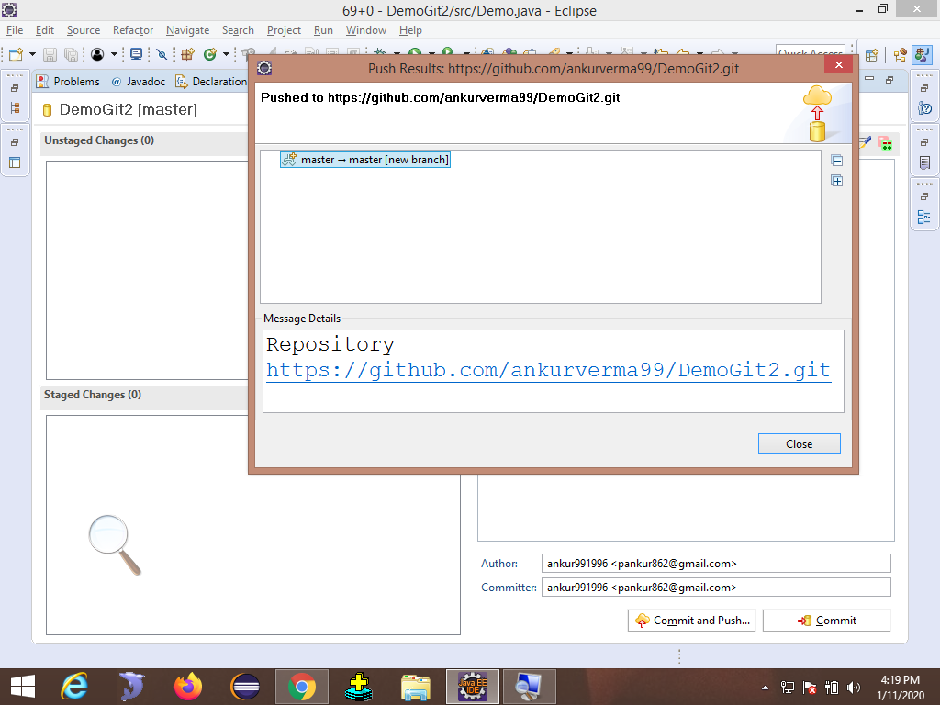
To check the file in github refresh the github Repository

Slide 17
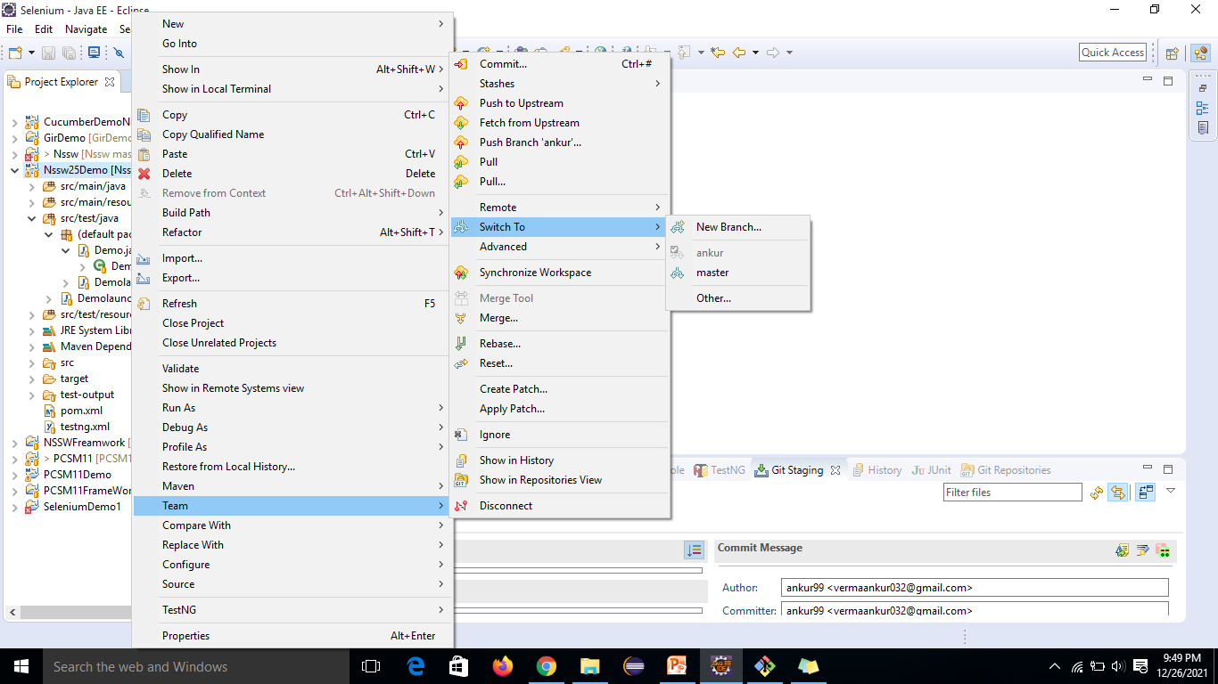
How to push the data to Branch to github.
1.Right click on project
2.Go to ‘Team’
3.Click on ‘Switch To’

Slide 18
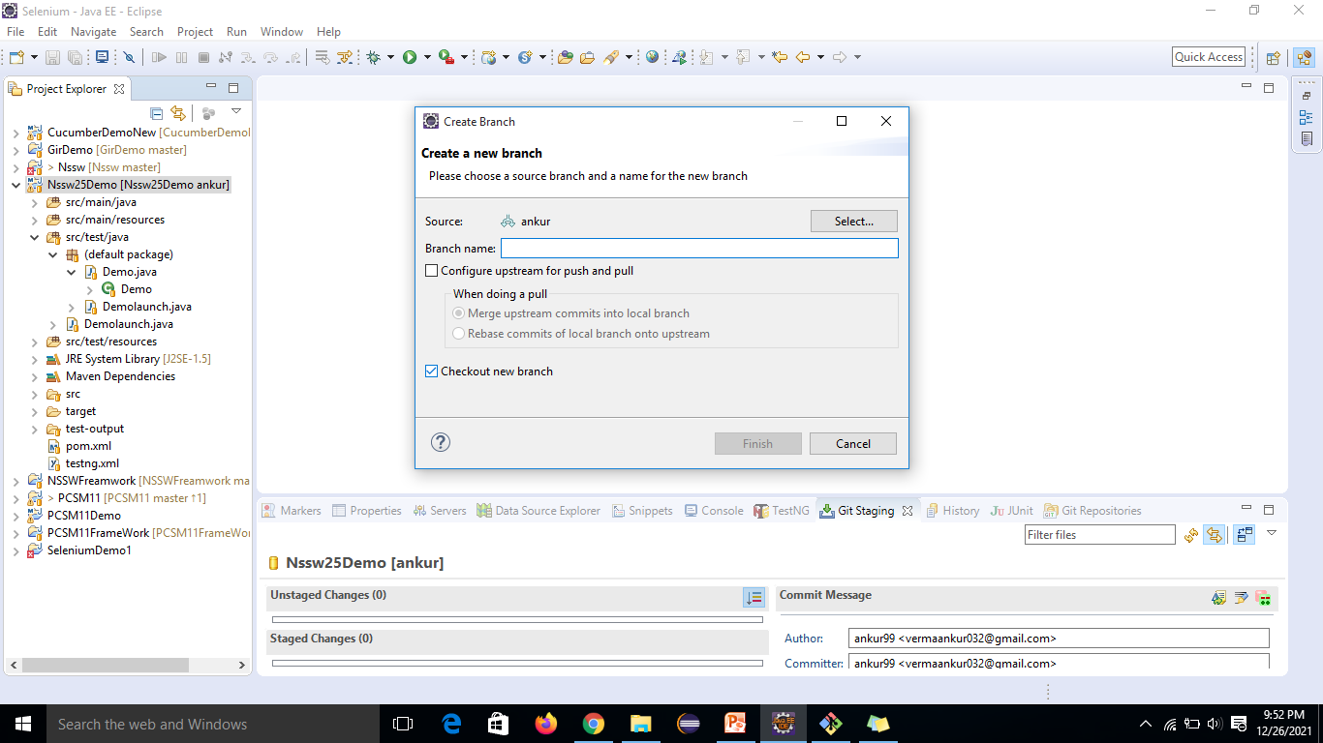
4.Click on ‘New Branch’
5.Give the Branch Name
‘Branch Name existing or new ’
6. Click on ‘Finish’
7. Repeat the same steps to push the file it will go to Branch.

