Slide 1

ANKUR PRASAD

Slide 2

1.Introduction.
2. Automation
What is Automation
Why we go for Automation
Disadvantage of Automation
How to achieve Automation
3.Selenium
What is selenium
Why we will go for selenium
ANKUR

Slide 3
4.Open Source
5. Selenium Architecture
6. How to Download & configure with project
7. How to Launch Browser.
Chrome
Firefox
8. Java-Selenium Architecture
9. WebDriver Methods
10. Locators
11. By Class
12. Methods of WebElements
13. Select Class
14. Robot Class

Slide 4
15. Actions Class
16. Synchronization
Implicit wait
Explicit wait
Custom wait
17. Handling PopUps
WINDOWS POPUP
ALERT POPUP
NOTIFICATION POPUP
UPLOAD POPUP
AUTHENTICATION POPUP
HIDDEN DIVISON POPUP
18. Working in Iframes
19. TakeScreenShot
20. JavaScriptExecutor

Slide 5
21.Read Data from excel
22.POM Class
25.TestNG
26.GIT
27.MAVEN
28.Jenkins
29.FrameWork

Slide 6
What is Automation?
Doing any task using a tool or system without manual intervention is called Automation . You can also call it as replication of human effort.
Advantages of Automation
1.It is faster.
2.Saves Time
3.Reduces effort.
4.Increases the Quality.

Slide 7


Disadvantages of Automation.
1.Initial investment is high.
2.Required Skilled Man power.
How we can achieve Automation?
We can achieve automation with the help of some tool
and software like QTP,SELENIUM.

Slide 8
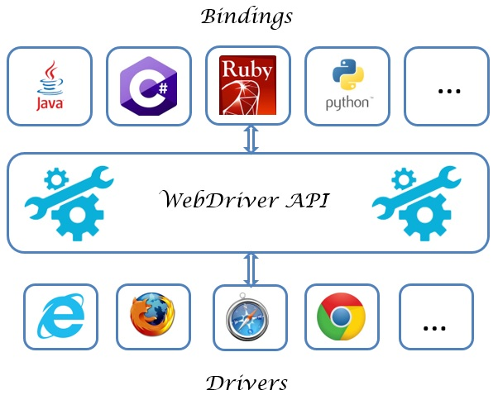


WHY SELENIUM.?
Language and Framework Support
Open Source
Availability
Multi-Browser Support
Support Across Various Operating Systems

Slide 9
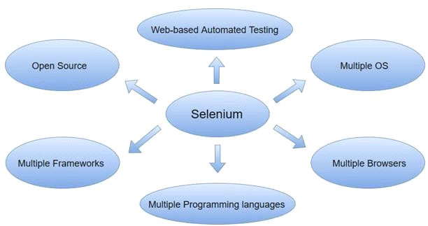
What is Selenium?
Selenium is free(open Source) testing suite containing tools
each with different approach
for test automation of web application.
Advantages

Slide 10
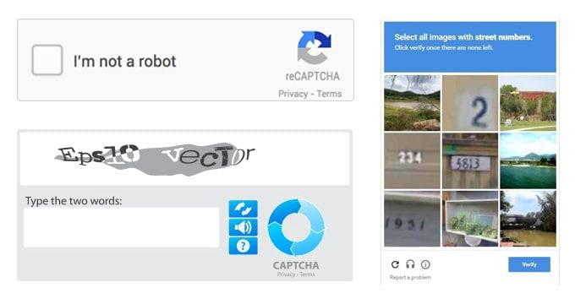
Disadvantages
It does not support window application.
We cannot automate captcha and OTP and animation.

Slide 11
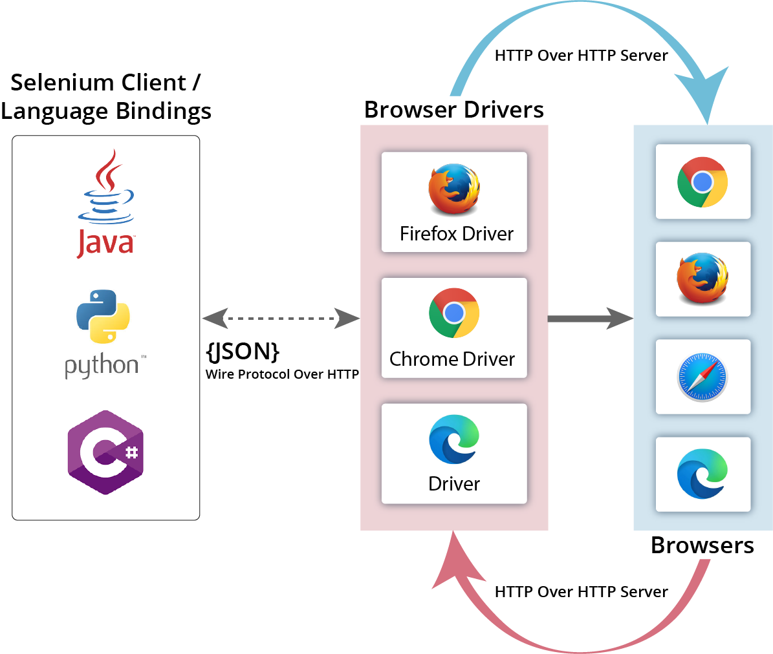
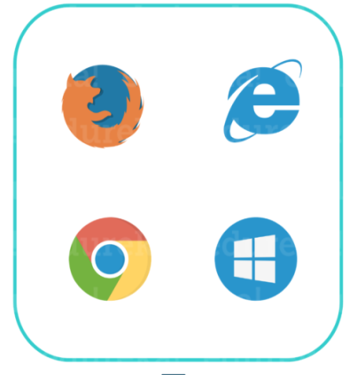

What is OpenSource?
Open source mean that we can download it for free and we can see source code and modification in that source code.
Selenium Architecture
Browser
14 Language
Language binding
Or
Client binding
JSON VIA protocol (HTTP)

Slide 12


How to launch a browser?
In order to launch a browser we have to write some set of line in main method.
System.setProperty(“Which Browser we want to launch ” ,” Path OF DRIVER Exc.”);
System
setProperty
It is a Final class in java. Lang
It is a static of System class which will take 2 String as arug.
webdriver.chrome.driver
webdriver.gecko.driver

Slide 13

We have to create the object or Driver class.
TO LAUNCH CHROME
Public class DemoChromeLaunch{
Public static void main(String[] args){
System.setProperty(“webdriver.chrome.driver”,”path of chromeDriver Exc.”);
ChromeDriver driver = new ChromeDriver();
}
}
TO LAUNCH CHROME
Public class DemoFireFoxLaunch{
Public static void main(String[] args){
System.setProperty(“webdriver.gecko.driver”,”path of geckoDriver Exc.”);
FirefoxDriver driver = new FirefoxDriver();
}
}

Slide 14

INTERVIEW
Questions
Why we are writing WebDriver instead of FirefoxDriver and ChromeDriver?
we are performing up-casting over here in order to avoid unnecessary method ,because if we are creating an object of any driver class so it will give me the method which we will not use. And in future if we want to change from one browser to any browser we can change it easily because WEBDRIVER is the parent of all the driver class.

Slide 15
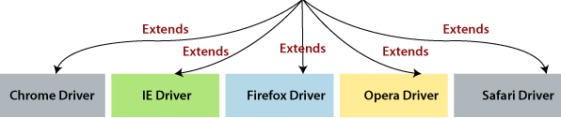
Java-Selenium Architecture
Inf
SearchContext
EXTENDS
EXTENDS
TakeScreenShot
Inf
WebDriver
Inf
JavaScriptExecutor
inf
implements
implements
C
RemoteWebDriver

Slide 16
In java selenium architecture super most interface is search context
After than we have three more interface 1.takescreenShot 2.Webdriver 3.javaScriptexec. All are interface so they will have only Abstract method
With no body no implementation ,So we will provide implementation in RemoteWebDriver class and we will use these method in DriverClass.
WebDriver Method
Methods | Description
get() | It will load the website URL it will accept String URL argument.
close() | It will close the current browser which driver has focused.
getTitle() | To get the current page title in the form of string.

Slide 17
Methods | Description
getpagesource() | It will fetch the html code of web page.
getcurrenturl() | For current page url in the form of string.
getwindowhandle() | to get parent windowhandle in the form of string.
getwindowhandles() | to get parent and child windowhandle in the form of Set<String>
manage() | An interface for managing stuff you would do in a browser menu
navigate () | An abstraction allowing the driver to access the browser's history and to navigate to a given
quit() | To kill the WebDriver instance.
switchTo() | for switching to frame or window and Alert

Slide 18
How to load URL..?
In Two ways we can load the url.
1.driver.get(“url”);
2.driver.navigate.to(“url”);
INTERVIEW
Questions
What is difference between get() and to()..?
Difference Between quit and close..?

Slide 19

How to the Browser Window.?
maximize
To maximize a browser we have to go for method chaining
driver.manage().window().maximize();
WebDriver
Options
Window
void

Slide 20

How to find WebElement in WebPage.
To find WebElement we need to take the help of findElement & findElements .

Slide 21
FindElement and FindElements are non-Static method which are present in Search-context .since the Search-Context is the parent of WebDriver so we can call these method with the help of webdriver object .Both method will accept By class as an argument.
For Multiple WebElement
List<WebElement> elementName=driver.findElements(By.LocatorStrategy("LocatorValue"))
WebElement elementName= driver.findElement(By.LocatorStrategy("LocatorValue"));
For Single WebElement

Slide 22
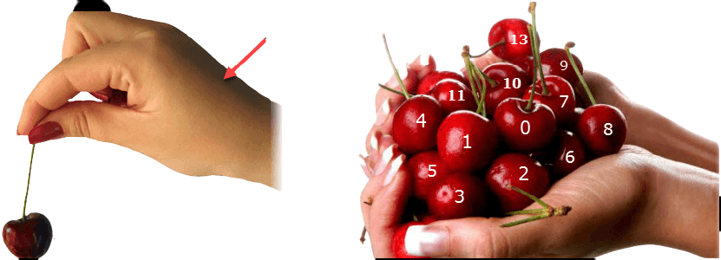
findElement
findElements
Differences between FindElement and FindElements.
Find Element | Find Elements
Returns the first most web element if there are multiple web elements found with the same locator | Returns a list of web elements
Throws exception NoSuchElementException if there are no elements matching the locator strategy | Returns an empty list if there are no web elements matching the locator strategy
It will only find one web element | It will find a collection of elements whose match the locator strategy.

Slide 23
Locators
We can locate the web or application element like
Text Field and Button.
Types of Locators
ID----1st
Name—2nd
ClassName
TagName —3rd
LinkText
PartialLinkText
Css Selector
X-path----4th
All locators are present in BY Class and they are Static method which will take String as an Argument.

Slide 24
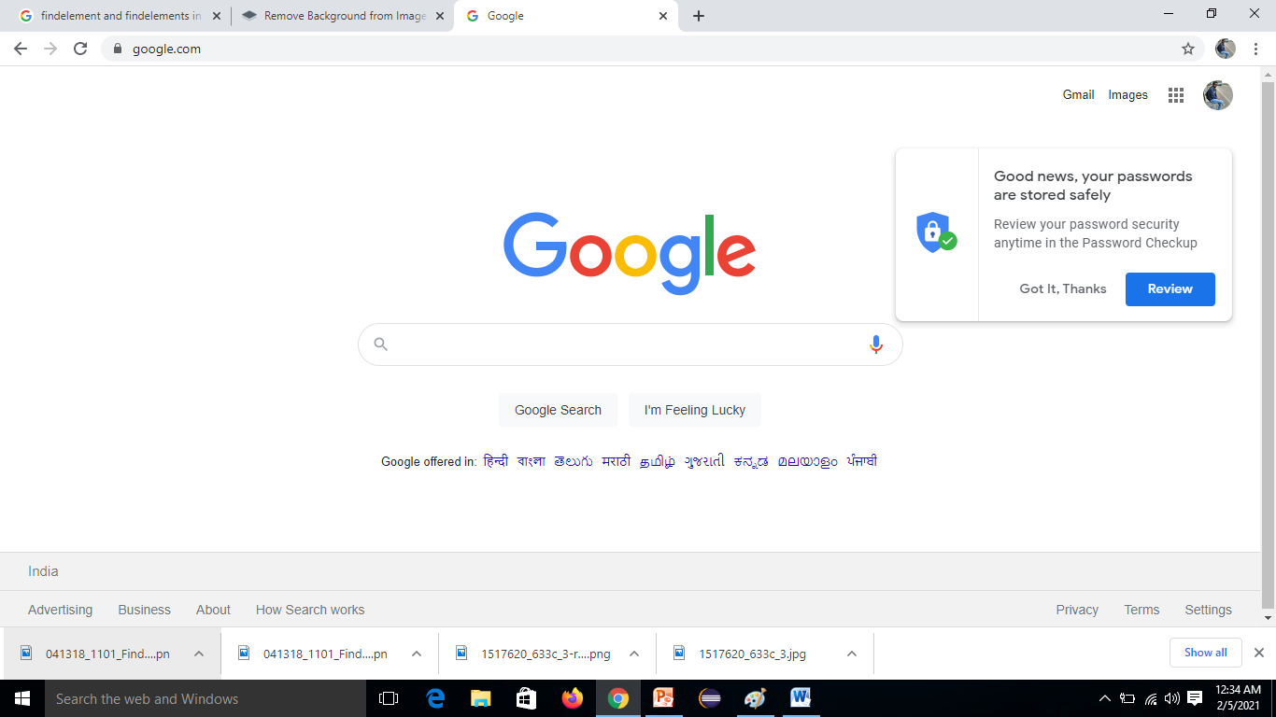
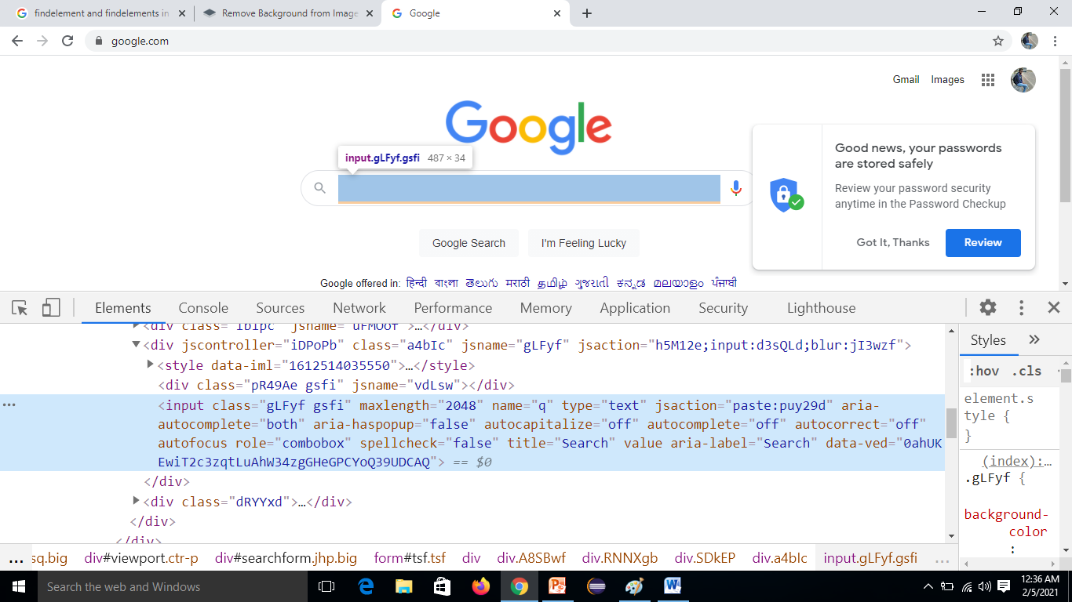
To find the Google SearchBar we need to inspect the element than we need to take locator value.

Slide 25
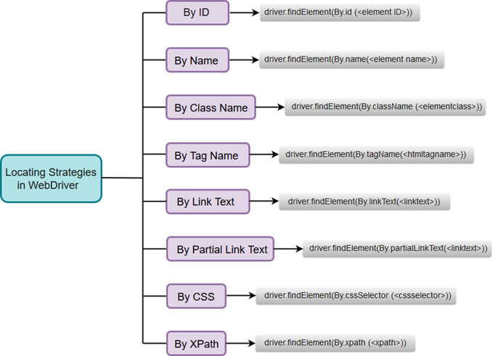
Webelement ele = driver.findElement(By.name(“q”));

Slide 26
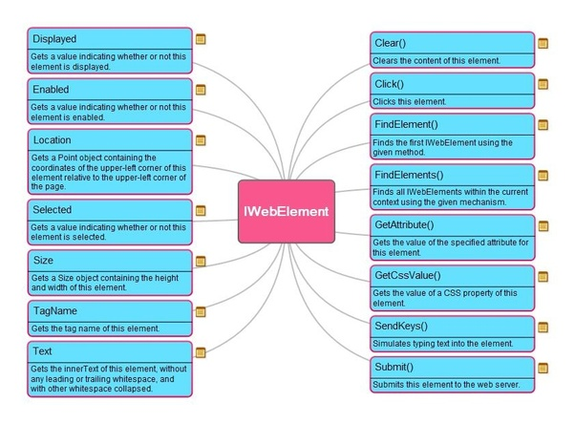
WebElement Methods

Slide 27

CLASS in Selenium
In order to do action events, you need to use org.openqa.selenium.interactions Actions class. The user-facing API for emulating complex user gestures. Use the selenium actions class rather than using the Keyboard or Mouse directly. This API includes actions such as drag and drop, clicking multiple elements.
Actions a = new Actions(WebDriver driver)
moveToElement()
contextClick()
dragAndDrop()
dragAndDropBy()
doubleClick()

Slide 28
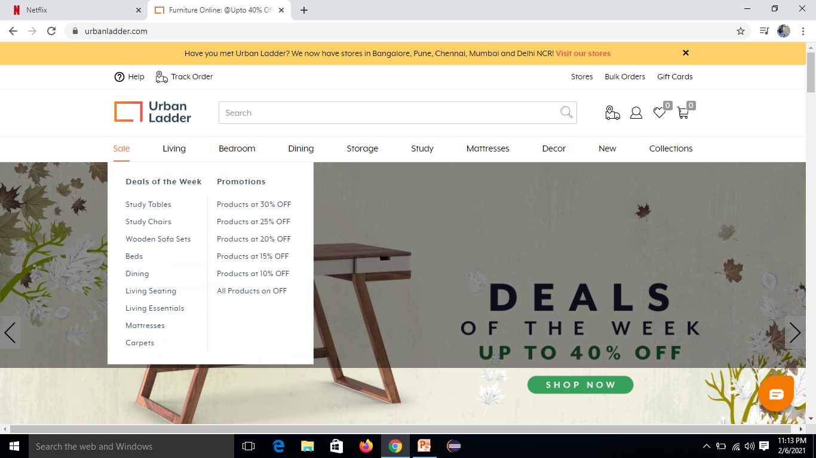
For Mouse over Action we have moveToElement(), it will take webelements as an argument.
a.moveToElement(ele).build().perform();
build = The build() method is used to compile all the listed actions into a single step.
Perform = A convenience method for performing the actions without calling build() first

