Slide 1





CSS
</body>
JS
HTML5
Web Technology
HTML
ANKUR

Slide 2
Agenda
HTML
CSS
JS

Slide 3
Web Application
The applications which will provide services over the web are called web applications.
Eg gmail.com, facebook.com, youtube.com etc…
Every web application contains 2 main components
Front-End
Back-End

Slide 4
Front - End
It represents what user is seeing on the website We can develop Front-End content by using the following technologies: HTML, CSS and JS
HTML: Hyper Text Markup Language Every web application should contain HTML. i .e HTML is the mandatory technology for web development . It represents structure of web page

Slide 5
CSS : Cascading Style Sheets It is optional technology; still every web application contains CSS. The main objective of CSS is to add styles to the HTML Pages like colors,fonts,borders etc.
Java Script: It allows to add interactivity to the web application including programming logic. The main objective of Java Script is to add functionality to the HTML Pages. ie to add dynamic nature to the HTML Pages.
HTML===>Meant for Static Responses
HTML+JS==>Meant for Dynamic Responses

Slide 6
Back - End
It is the technology used to decide what to show to the end user on the Front-End. i ,e. Backend is responsible to generate required response to the end user , which is displayed by the Front-End. Back-End has 3 important components:
The Language like Java, Python etc
The Framework like DJango, Pyramid, Flask etc
The Database like SQLite, Oralce, MySQL etc

Slide 7


HTML

Slide 8


HTML + CSS

Slide 9
<html>
HTML stands for hyper text markup language. It is a language to describe or creating the web page it is a markup language.
Markup language is set of markup tags . Tags is to describe the page content.
HTML document is also called as webpage.
BROWSER can read the html document and display them as a web page.
the browser will not display the html tags but uses to interrupt the content of the webpage.

Slide 10
Strcutre of HTML Page:
Every HTML page contains 2 parts
1. Head
2. Body
Head contains meta data like title of the page, keywords etc. CSS files and Java Script files information we have to specify in the Head Part only.
Body contains actual content.

Slide 11
<!doctype html>
<html>
<head>
Meta Data like keywords,author,title... css files information
js files information
</head>
<body>
Actual Data
</body>
</html>
HTML Comment:
<!-- Anything here is considered as Comment -->

Slide 12
Title:
<head>
<title> >Basic HTML </title>
</head>
Heading Tags:
HTML supports 6 heading tags
<h1>,<h2> ,....
<h1>This is Heading1</h1>

Slide 13
Paragraph tag: <p>:
We can use this tag to represent paragraph of text.
<p>This is first paragraph <p>
Type 1
<p>This is First Line
This is Second Line
This is Third Line
This is Four Line
</p>
Total Data will come in a single line, because we are using only one paragraph tag.

Slide 14
Type 2
<p>This is First Line</p>
<p>This is Second Line</p>
<p>This is Third Line</p>
<p>This is Fourth Line</p>
Output will come in 4 lines
Type 3
<p>This is First Line</p><p>This is Second Line</p>
output will come in multiple lines

Slide 15
Bold and Italic:
legacy tags:
<b>for bold
<i>for italic
These are old (lEgacy)html tags and not recommended to use
<p><b><i>hiii…</i></b></p>

Slide 16
advanced tags:
We can use the following HTML 5 advanced tags for bold and italic
<strong> for strong text(bold)
<em>for emphasis (italic)
<p><strong><em> Eg This is Binod</em></strong></p>
HTML Lists:
There are 2 types of lists
1. ordered list
2. unordered list

Slide 17
ordered list:
All list items will be displayed with numbers
<ol>
<li>Chicken</li>
<li>Mutton</li>
<li>Fish</li>
<li>paneer</li>
</ol>
Output:
Chicken
Mutton
Fish
paneer

Slide 18
2. unordered list:
Instead of numbers bullet symbol will come. Here order is not important.
<ul>
<li>Chicken</li>
<li>Mutton</li>
<li>Fish</li>
<li>paneer</li>
</ul>
OUTPUT
Chicken
Mutton
Fish
paneer

Slide 19
Div and Span Tags:
We can use div and span tags to group related tags into a single unit.
In general we can use these tags with CSS
<div class =“bolly”>
<h1>SRK is the King of Bollywood<.h1>
<p>This division tag helpful to style a group of html tags with css</p>
</div>

Slide 20
div means division tag
<span> is exactly same as division tag except that it is inline. i.e to define group within the line of text we can use <span>tag.
<p>This<span> division tag helpful</span> to style a group of html tags with css</p>
<div>will work for group of lines where as<span> will work within the line.
Note: tags are helpful only for styling html. Hence they will always work with css only.

Slide 21
Attributes: HTML Attributes will provide extra information to HTML tags. To insert image in the html page, src attribute specify location of the image to the <img> tag.
Image tag:
<img src=“path of image” alt=“text”>
src means source where we have to specify the image source(complete location). We can take image address from the google also.
alt means alternate. If image is missing then broken link image will display . In this case if we want to display some meaningful text information then we should go for alt attribute.
Note: We have to open the tag and we are not responsible to close the tag , such type of tags are called self closing tags.
<a href=“link”>click here</a>
<a href=“https://www.google.com”>facebook</a>
Link tag:

Slide 22
href stand for Hypertext Reference it will contain the link for another page.
It’s mandatory attribute of link tag ,if we’ll not mentation this link tag will not work .
Table Creation:
<table> to create table
<thead> to specify head row
<th> to specify column data in head row(column name)
<tr> to insert row in the table
<td> to specify column data in the row/record
We can use border attribute inside <table> tag

Slide 23
Creation of HTML Forms:
As the part of web application development, we have to develop several forms like login form, registration form etc
We can create Html form by using tag
<form class="" action="" method="">
…
</form>
Within the form to collect end user input, we have to use tag. This tag will play very important role in form creation

Slide 24
Input tag :
<input type=“” name =“” value =“”/>
type attribute can be used to specify the type of input end user has to provide.
important types are :
Text
Password
Submit
Checkbox
Radio
Email
etc

Slide 25
name attribute represents the name of input tag. By using this name , in the next target page we can access end user provided input value.
value attribute represents default value will be displayed in the form.
<input type="text" name="username" value="Enter User Name“/>
<input type="email" name="mailid" value=""/>
<input type="password" name="pwd" value="“/>
<input type="checkbox" name="course" value=""/>
<input type="radio" name="married" value=""/>
To provide default value it is highly recommended to use placeholder attribute because end user is not required to delete defualt value while entering data

Slide 26
<input type="text" name="username" placeholder="Enter User Name"/>
Creation of Labels for HTML Elements:
We can define Label Text for our HTML Elements like Radio Buttons, Text Box etc by using tag.
Syntax: <label for="name">Enter Name:</label>
<p>Enter Name:</p>
<input type="text" name="username" placeholder="Enter Name">
required attribute:
If end user compulsory should required to provide input value then we should go for required attribute.
<input id="name" type='text' name='username' placeholder='Name to Contact' required>

Slide 27
action attribute:
once we fill the form and click submit, then to which page it will go is decided by action attribute . The value of action attribute can be either local resource or web url .
<form action="target.html" >
<form action="https://facebook.com" >

Slide 28
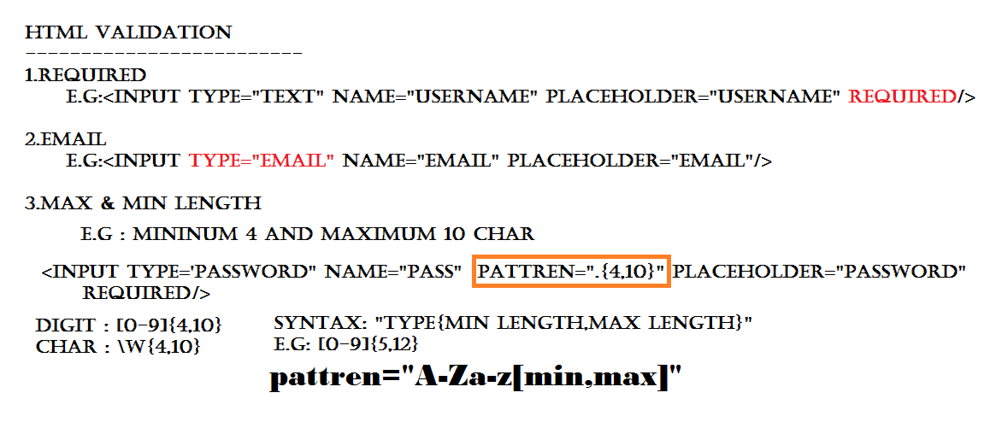

Slide 29
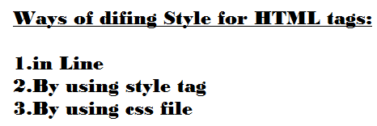
Css(Cascading Style Sheets)

Slide 30
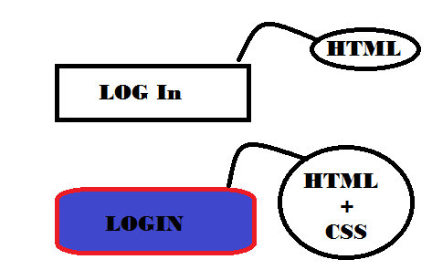
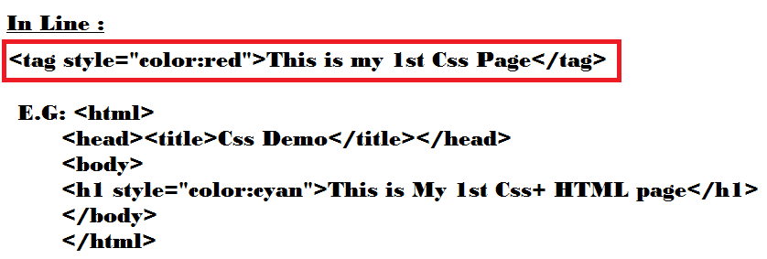

Slide 31
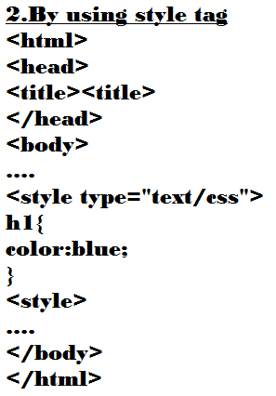
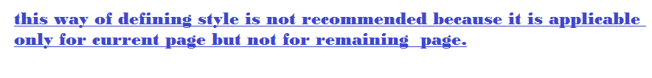

Slide 32
3. By using css file:
Style.css
h1{
Color:red;
}
We use link tag to connect css file to html file
<head>
<link rel="stylesheet" href="style.css">
</head>
We can reuse same css file for every html page so that we can promote code reusability. Hence this approach is highly recommended to use.

Slide 33
Basic Structure of CSS File:
tagname{
property:value;
}
E.g:
h1{
color:red;
}
Once we defined css file, we can link it to html by using tag inside part of html.
<head>
<link rel="stylesheet" href=“form.css">
</head>

Slide 34
How to define comments in css file:
/*
This is CSS comment
*/
Demo -1:
<!DOCTYPE html>
<html lang="en" dir="ltr">
<head>
<meta charset="utf-8">
<link rel="stylesheet" href="style.css">
<title>CSS Demo</title>
</head>
<body>
<h1>This is 1st css demo</h1>
<p>Here we'll see how define css file and how to link it..</p>
<h2>List of topic</h2>
<ul>
<li>Chapter-1</li>
<li>Chapter-2</li>
<li>Chapter-3</li>
<li>Chapter-4</li>
</ul>
<h3>Baki bad mai dekhenge....</h3>
</body>
</html>

Slide 35
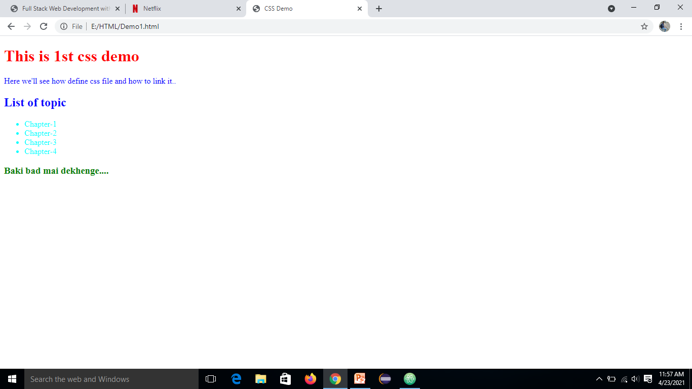
Style.css
h1{
color:red;
}
h2{
color: blue;
}
h3{
color: green;
}
p{
color: blue;
}
ul{
color: cyan;
}
OutPut

Slide 36
Various possible ways to specify color:
color:red;
Color : rgb(244,66,220);
we have to collect values from google color picker
The allowed values are: 0 to 255
(0,0,0)--->black
(255,255,255)-->white
3. color:#f44e42 This 6-digit number represents hexa code of color
4. . Color : rgba(244,66,220,0.9)
a means alpha
The allowed values for a attribute are : 0.0 to 1.0
1.0 means full dark and 0.0 means full light(transparent)
http://www.december.com/html/spec/colorrgbadec.html
Note: The most commonly used approach is: hexa code

Slide 37
Setting Background and Borders:
In CSS, we can set Background as follows:
body{
background-color:red;
}
We can set Border as follows:
div{
border-color:blue;
border-width:thick;
border-style:double;
}
The allowed values for border-width are : medium , thin , thick.
We can also set our own width with pixels.
Eg: border-width:10px;
The allowed values for border-style are: dashed ,dotted , groove, double etc.

Slide 38
color vs background:
color attribute meant for text color background attribute meant for background color
h1{
color:white;
background:blue;
}
How to Set Background Image:
body {
background:url(“img url from google or path from local”); }

Slide 39
Various properties while setting image:
body{
color:white;
background:url(img url);
background-repeat: no-repeat;
background-size: cover;
}
By default background image will be repeated. If we don't want to repeat then we should specify: no-repeat
How to set border:
h1{
border-color:orange;
border-width: 5px;
border-style: solid;
}

Slide 40
short-cut way:
h1{
border: solid red 5px; order is not important
}
To set border for the image:
Img{
border: groove 10px blue;
}
Basic CSS Selectors:
1. Element Selectors:
select all instances of given element. i.e style is applicable for every tag of the specified type.
h1{
color : red;
}
This style applicable for every h1 tag of the html page.

Slide 41
2. ID Selectors:
Selects an element with the given Id. But with in the HTML Page ID is always unique.
html:
<h1 id="specialh1">Hello This is First Line</h1>
CSS:
#specialh1{
color:white;
background: blue;
}
3. Class Selector:
Select all elements with the given class.
<body>
<h1 class="specialh1">Hello This is First Line</h1>
<h1>Hello This is Second Line</h1>
<h1 class="specialh1">Hello This is Third Line </h1>
</body>

Slide 42
css:
.specialh1{
color:white;
background: blue;
}
Note: element , id and class selectors are considered as basic css
selectors.
Advanced CSS Selectors:
The following are main important advanced selectors
* selector
Descendant Selector
Adjacent Selector
Attribute Selector
nth of type selector

Slide 43
1. * selector:
* means everything. This style is applicable for every thing in the web page.
*{
color:blue;
}
2. Descendant Selector:
E.g:
Syntax:
Parent-tag child-tag{
Css property
}
li a{
color:white;
background: blue;
}
li is considered as parent tag and a is considered as child tag. For every anchor tag present in li tag this style is applicable
3. Adjacent Selector:
a+ul{
color: red;
}
For every ul tag which is adjacent to a tag , this style is applicable.

Slide 44
div+p{
color:blue;
}
For every paragraph tag, which is adjacent to div tag this style is applicable
4. Attribute Selector:
We can define style based on attributes.
Eg 1:
a[ href ]{
color:red;
background: yellow;
}
For all href attributes of anchor tag this style is applicable.

Slide 45
Eg 2:
a[href="https://www.google.com/"]{
color:red;
background: yellow;
}
If the value of href attribute is https://www.google.com/ then only this style is applicable.
input[type="password"]
{
background:red;
}
This style is applicable for all password fields of input tag.

Slide 46
5. nth of type selectors:
li:nth-of-type(2){
color:red;
}
For every 2nd li tag this style is applicable.
ul:nth-of-type(2){
color:red;
background: yellow;
}
For every 2nd ul tag this style is applicable.
li:nth-of-type(even){
color:red;
}
For every even numbered li this style is applicable.

Slide 47
CSS Inheritance:
All properties of the parent are by default available to the child and we are not required to redefine. This property is called inheritance. Inheritance concept applicable for css styles also. i.e what every styles are defined for the parent automatically avilable to the child tags also.
Eg: body{
color:red;
}
This style is applicable for all elements present in side body tag.
Eg: ul{
color:red;
}
This style is also applicable for all <li></li> tags inside <ul></ul> tag.

Slide 48
CSS Specificity:
If multiple styles are available for element then most specific style will be considered . This property is called Specificity of CSS.
E.g:
body{
color:red;
}
ul{
color:blue;
}
li{
color:green;
}
For tag 3 styles are avilable but css will consider most specific style from tag which is nothing but green color.

Slide 49
Fonts and Text in CSS:
The following are very important properties related to fonts and text in css.
font-family
font-size
font-weight
line-height
text-align
text-decoration
font-family:
We can select desired font from default css system fonts in the following link
https://www.cssfontstack.com/
h1{
font-family: Arial Black;
}

Slide 50
Note: If we are not satisfied with default css system fonts, then we can use external fonts also.
2. font-size:
p{
font-size: 20px;
}
We can also specify font-size in em units, which is also known as dynamic font-size (relative fontsize)
Eg:
span{
font-size: 2.0em;
}
2.0 em means double of parent tag font-size

Slide 51
3. font-weight:
p{
font-weight: 600;
}
something like bold font , light font etc.
The different allowed values are: bold , bolder , lighter , normal
100 to 900 where 100 means light and 900 means too much bold.
4. line-height:
The space between 2 lines is called line height.
p{
line-height: 1.5;
}

Slide 52
5. text-align:
p{
text-align : center;
}
The allowed values are: left , right , center , justify
6. text-decoration:
like underlined , strike through
p{
text-decoration: line-through;
}
The allowed values are: underline, overline , line-through

Slide 53
The Box Model:
In a document, each element is represented as a rectangular box. In CSS, each of these rectangular boxes is decribed by using the stanadard box model.
Each box has 4 edges:
Content Edge
Border Edge
Padding Edge
Margin Edge

Slide 54
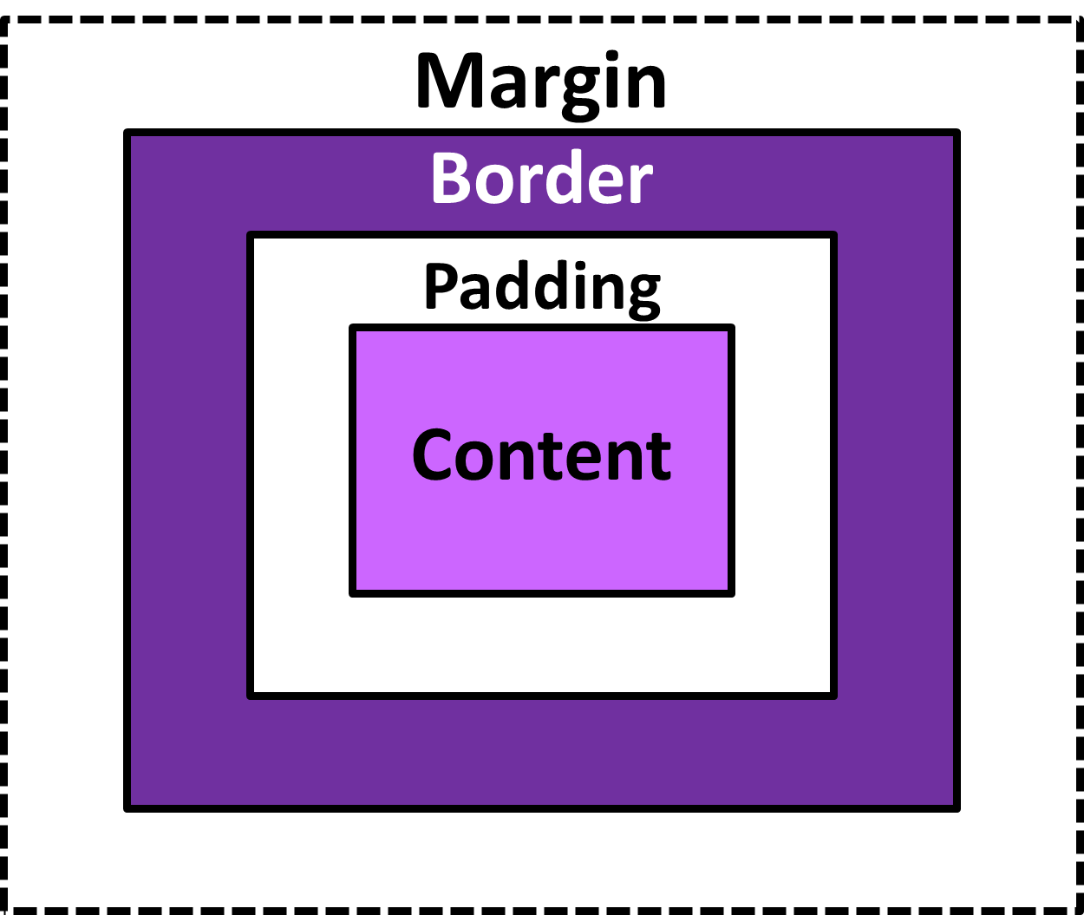
CSS Box Model Diagram -1

Slide 55
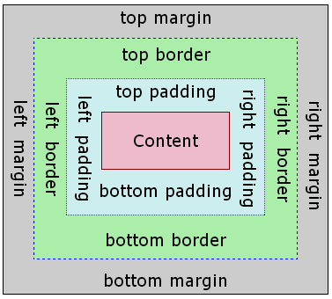
CSS Box Model Diagram -2

