Slide 1
CCNA
Networking
Ankur Batta 2001200

Slide 2
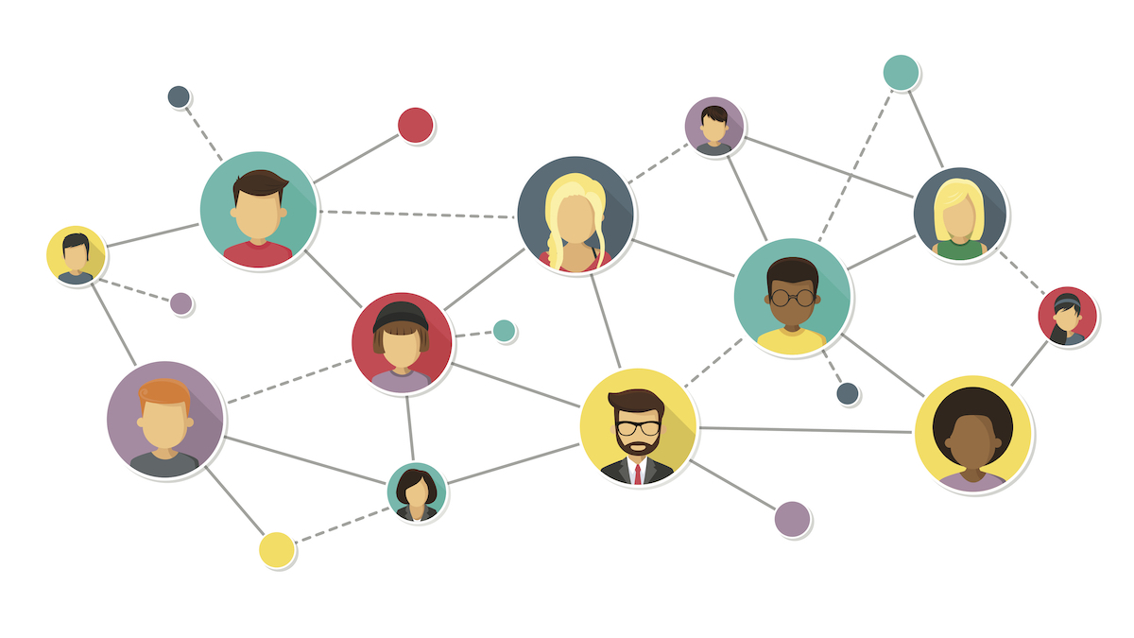
What is a Network?

Slide 3
What is a Network?
A computer network is a digital telecommunications network for sharing resources between nodes, which are computing devices that use a common telecommunications technology.
Data transmission between nodes is supported over data links consisting of physical cable media, such as twisted pair or fibre-optic cables, or by wireless methods, such as Wi-Fi, microwave transmission, or free-space optical communication.

Slide 4
Types Of Network
LAN: A local area network is a computer network that interconnects computers within a limited area such as a residence, school, laboratory, university campus or office building.
MAN: A metropolitan area network is a computer network that interconnects users with computer resources in a geographic region of the size of a metropolitan area.
WAN: A wide area network is a telecommunications network that extends over a large geographic area for the primary purpose of computer networking. Wide area networks are often established with leased telecommunication circuits.
PAN: A personal area network is a computer network for interconnecting electronic devices within an individual person's workspace.

Slide 5
What is a Server?
A server is a computer program or a device that provides functionality for other programs or devices, called “clients”.
What is a Client?
A client is a piece of computer hardware or software that accesses a service made available by a server.

Slide 6
How to Setup a Network?
Using Cables like CAT5 and CAT6 we are able to establish a network between 2 or more computers
We have to do some configuration so that switches and router should work.
For a secure network it demands the proper placement of firewall in the topologies so we have to see which place is better for placing the firewall.
Use of multilayer switch helps to remove router completely from the network.
Using Switch instead of HUB is a smart option.

Slide 7
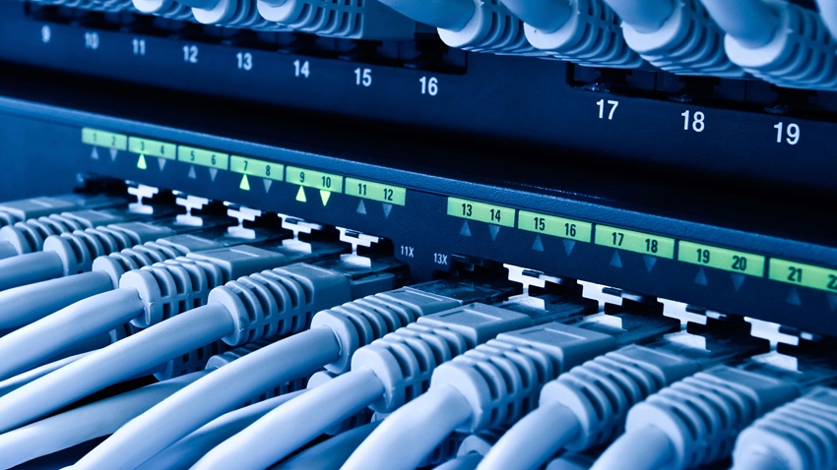
What is a Switch?

Slide 8
What is a Switch?
A switch is a device in a computer network that connects other devices together. Multiple data cables are plugged into a switch to enable communication between different networked devices. Switches manage the flow of data across a network by transmitting a received network packet only to the one or more devices for which the packet is intended. Each networked device connected to a switch can be identified by its network address, allowing the switch to direct the flow of traffic maximizing the security and efficiency of the network.

Slide 9
Switch Or HUB?
A switch is more intelligent than an Ethernet hub- which simply retransmits packets out of every port of the hub except the port on which the packet was received, unable to distinguish different recipients, and achieving an overall lower network efficiency.

Slide 10
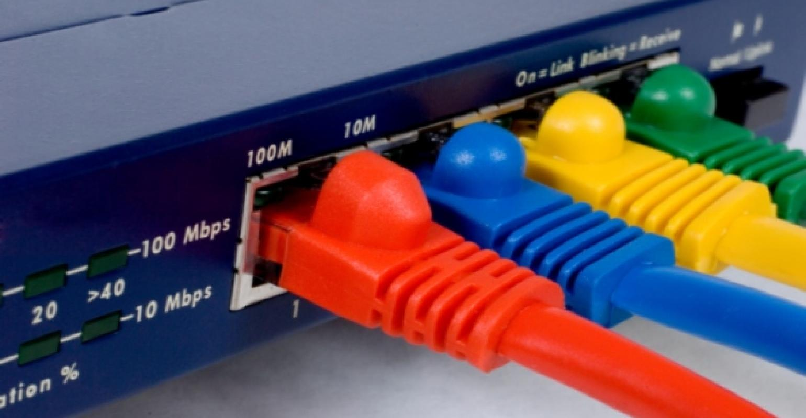
What is a Router?

Slide 11
What is a Router?
A router is a networking device that forwards data packets between computer networks. Routers perform the traffic directing functions on the Internet. Data sent through the internet, such as a web page or an email, is in the form of data packets. A packet is typically forwarded from one router to another router through the networks that constitute an internetwork (e.g. the Internet) until it reaches its destination node.

Slide 12
Working of Router
A router is connected to two or more data lines from different IP networks.When a data packet comes in on one of the lines, the router reads the network address information in the packet header to determine the ultimate destination. Then, using information in its routing table or routing policy, it directs the packet to the next network on its journey.

Slide 13
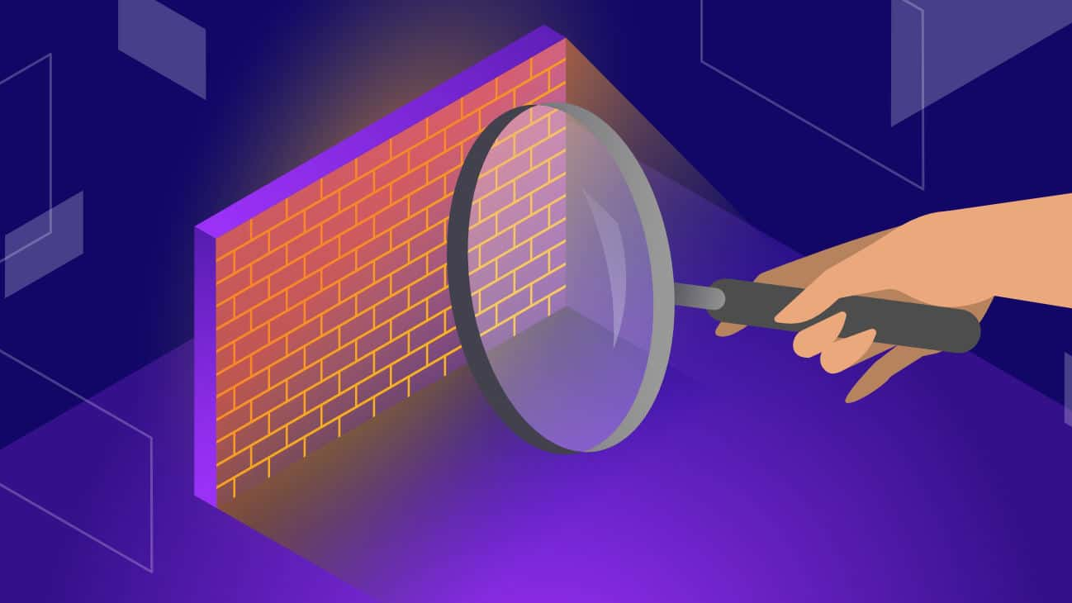
What is a Firewall?

Slide 14
What is a Firewall?
A firewall is a network security system that monitors and controls incoming and outgoing network traffic based on predetermined security rules. A firewall typically establishes a barrier between a trusted network and an untrusted network, such as the Internet.

Slide 15
Why we need a Firewall?
Apart from the numerous benefits of network, it can be used by intruders to track the daily activities of people, steal their confidential and invades their privacy. In order to protect network, firewall is made to keep the intruders away.

Slide 16
What is a OSI Model
The Open Systems Interconnection model (OSI model) is a conceptual model that characterises and standardises the communication functions of a telecommunication or computing system without regard to its underlying internal structure and technology. Its goal is the interoperability of diverse communication systems with standard communication protocols.
It has 7 layers: Physical Layer, Data link Layer, Network Layer, Transport Layer, Session Layer, Presentation Layer, Application Layer.

Slide 17
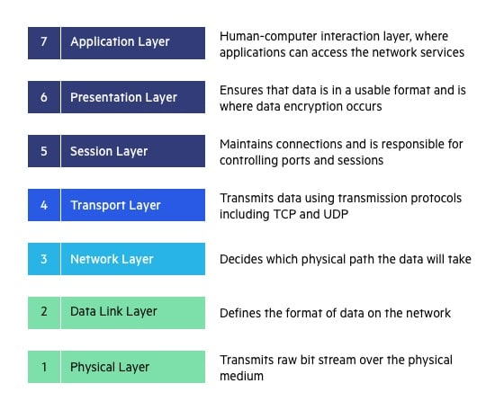
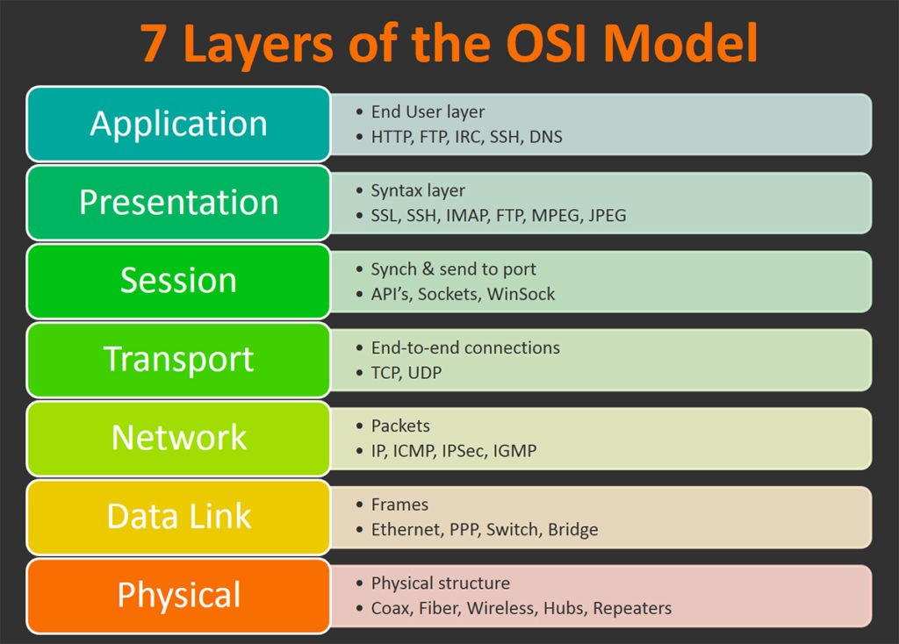

Slide 18
What is a TCP/IP Model
TCP/IP stands for Transmission Control Protocol/Internet Protocol. TCP/IP is a set of standardised rules that allow computers to communicate on a network such as the internet.
It has 5 layers: Physical Layer, Data link Layer, Network Layer, Transport Layer, Application Layer.

Slide 19
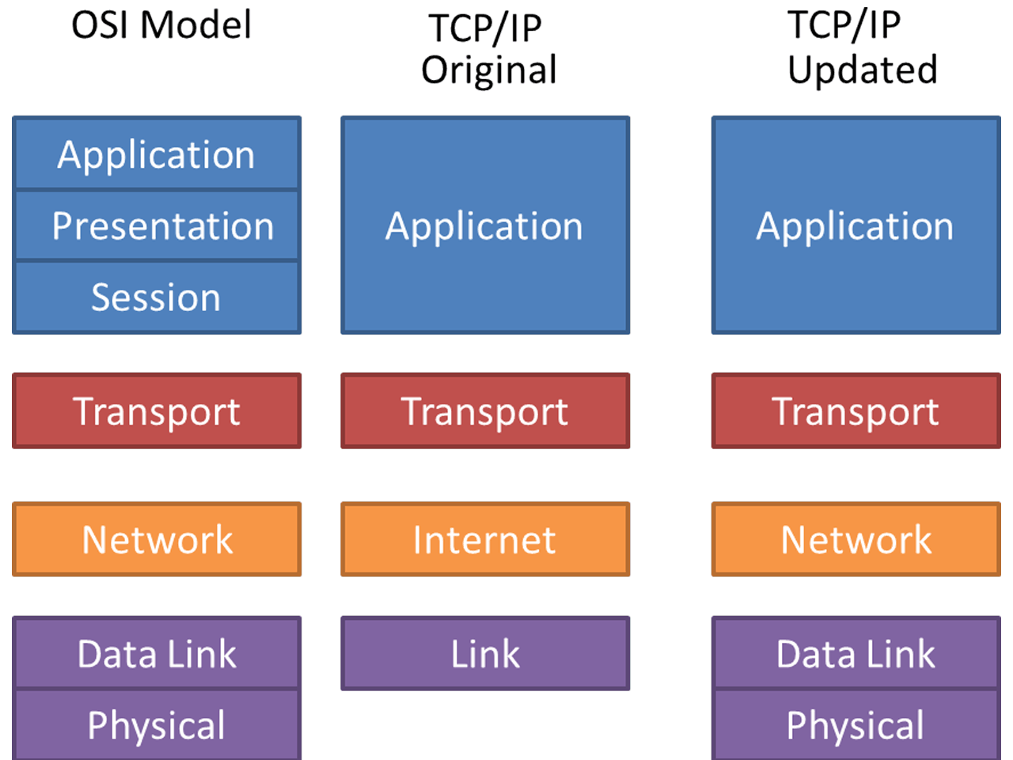

Slide 20
Some Important Ports
Port 80: Port 80 is one of the most commonly used port numbers in the Transmission Control Protocol (TCP) suite. Any Web/HTTP client, such as a Web browser, uses port 80 to send and receive requested Web pages from a HTTP server.
Port 443: Port 443 is the standard HTTPS Port for all the secured transactions and almost 95% of the secured sites use Port 443 for data transfers. If you are a web user or a web owner, you must be aware of the encryption securities provided by SSL (Secure Socket Layer) certificates.
Port 21: Port 21 is commonly associated with FTP (File Transfer Protocol). FTP has been assigned to Port 21 by the Internet Assigned Numbers Authority (IANA). The IANA also oversees global IP address allocation.

Slide 21


