Slide 1

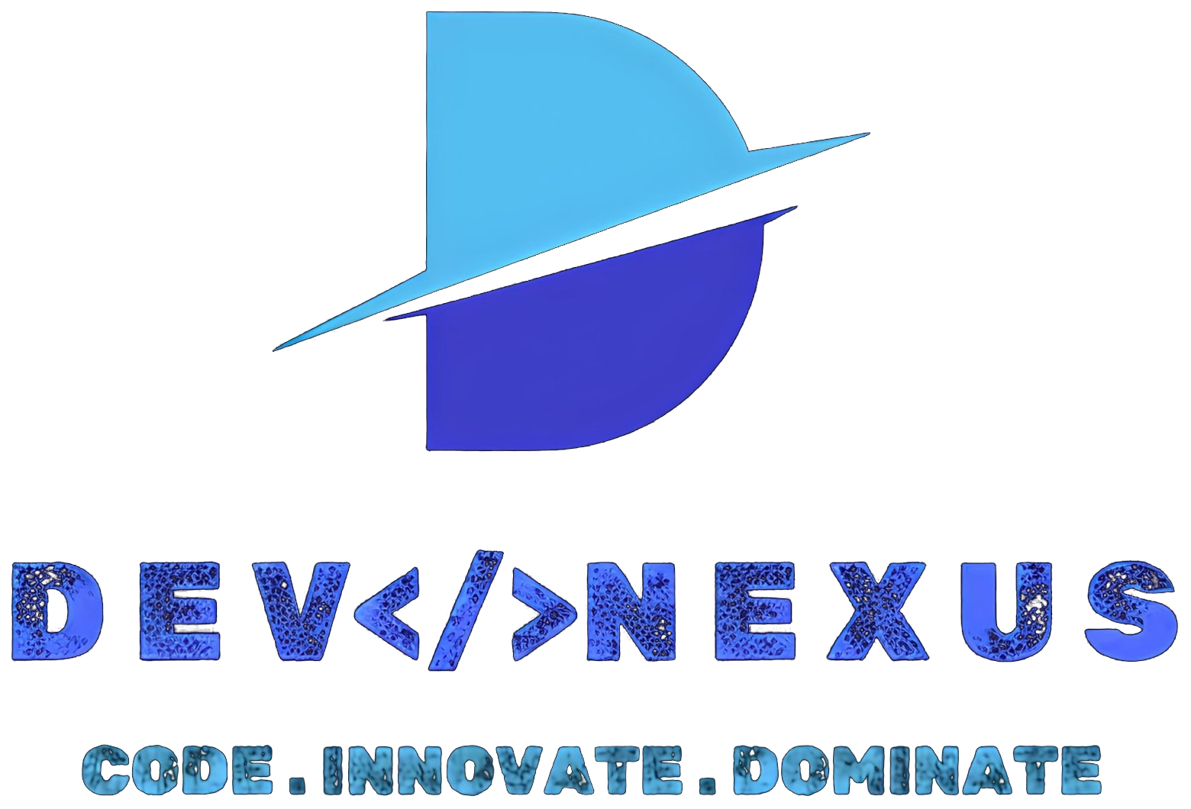
GOVERNMENT COLLEGE OF ENGINEERING
AND LEATHER TECHNOLOGY
TEAM NAME
Kaccha Papad
TRACK
AI / ML & Enterprise Automation
PROBLEM STATEMENT TITLE
BrandGuard AI – AI-Powered Brand Governance & Real-Time Marketing Claim Verification Engine
TEAM MEMBERS | TEAM KACCHA PAPAD
Ankush Shaw (Team Leader) | Ananya Bhadra | Aksita Das | Sounak Ghosh

Slide 2



BrandGuard AI
Proposed Solution: Real-Time Multimodal Compliance & Claim Verification Copilot
1
2
3
Detailed Explanation
How It Addresses the Problem
Innovation & Uniqueness
In fast-paced digital marketing, teams produce hundreds of ad variants across channels, often unintentionally including unverified claims ("10x guaranteed", "#1 fastest"), trademark drift, or poor visual contrast that risk legal penalties. BrandGuard AI is a proposed AI-powered governance tool that analyzes marketing copy and visual creatives before publication. It combines deterministic brand rules, image contrast/OCR inspection, and LLM reasoning to flag compliance issues, verify empirical claims, and suggest safe rewrites.
1. Problem Solved: Detects deceptive claims, trademark violations, and brand guideline discrepancies before ad launch.
2. Beneficiaries: Marketing teams, copywriters, and compliance officers get instant warnings and suggested fixes.
3. Expected Outcome: Safer campaign launches, fewer compliance rejections, and reduced risk of regulatory fines.
1. Difference: Inspects both text copy and image creatives simultaneously within a unified workflow.
2. Novel Approach: Uses AI reasoning to cross-check empirical claims against verified company evidence and SLAs.
3. Competitive Edge: Does not just flag violations—dynamically suggests compliant ad copy alternatives with an objective Brand Health Score.

Slide 3


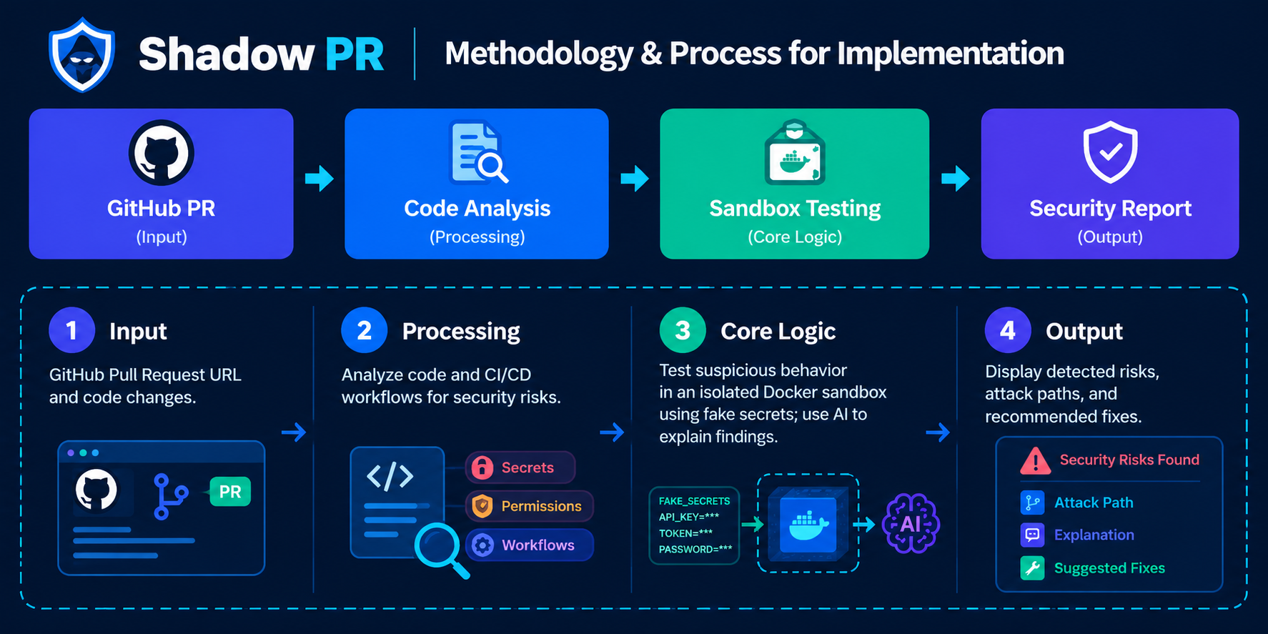
Technical Approach
Technologies Used
Methodology & Process for Implementation
Programming Languages
TypeScript, JavaScript
1. Ingestion
2. Processing
3. Core Logic
4. Output
Frameworks & Libraries
React 19, Node.js / Express 5, Sharp, Tesseract.js, Tailwind CSS
Tools, APIs & Cloud
Google Gemini API, Supabase / PostgreSQL, Docker, GitHub, Vite

Slide 4



Feasibility and Viability
Feasibility Analysis
Potential Challenges & Risks
Strategies to Overcome
Technical: Built using lightweight web frameworks (React, Express), proven OCR tools, and modern Gemini AI APIs.
Economic: Highly cost-effective; utilizes open-source libraries and efficient lightweight LLM calls.
Time & Resources: A working functional prototype is achievable within the hackathon timeframe by a 4-member team.
Technical Hurdles: Handling diverse font stylings, low-contrast graphics, and noisy image backgrounds in OCR.
Data, Cost & Hardware: Managing API rate limits and structuring guidelines effectively for consistent AI checks.
Adoption & Scalability: Ensuring review suggestions feel natural and do not slow down creative drafting speed.
Risk Mitigation: Apply image pre-processing (grayscale, contrast boost) to maximize OCR text accuracy.
Fallback Options: Rely on deterministic regex rule checking if API latency occurs.
Phased Development: Start with text copy compliance, add image OCR & contrast analysis, then integrate dynamic AI claim verification.

Slide 5




Impacts and Benefits
Impact on Target Audience
Social Benefits
Encourages truthful advertising, prevents misleading claims, and promotes transparency for everyday digital consumers.
Target Audience: Content creators, marketing teams, brand agencies, and compliance reviewers.
Improvement: Replaces days of manual compliance checking with instant pre-publish feedback.
Expected Reach: Highly scalable from student projects and startups to large marketing teams.
Economic Benefits
Minimizes risk of heavy regulatory penalties (FTC/advertising boards) and cuts time spent on ad re-work and legal revisions.
Environmental Benefits
Lightweight, targeted inference reduces redundant cloud compute cycles and server energy consumption.

Slide 6


Research and References
References
Research Works
[1] FTC Advertising Guides. Federal Trade Commission Truth-in-Advertising and Endorsement Guides. https://www.ftc.gov/legal-library/browse/rules/endorsement-guides
[2] W3C Web Accessibility Initiative. WCAG 2.1 Guidelines on Visual Contrast and Readability. https://www.w3.org/WAI/WCAG21/quickref/
[3] Google AI Documentation. Gemini Multimodal Prompting and Structured JSON Outputs. https://ai.google.dev/docs
[1] NIST AI Risk Management Framework. Standards for Trustworthy and Responsible AI Systems. https://www.nist.gov/itl/ai-risk-management-framework
[2] IEEE Research Papers. Automated Claim Verification and Fact-Checking in Digital Media. https://ieeexplore.ieee.org/
[3] Tesseract OCR Documentation. Open Source Optical Character Recognition Architecture. https://github.com/tesseract-ocr/tesseract

