Slide 1

Project: Inventory Management System
Synopsis
Name: Ankush
ID: AF0417098

Slide 2

Project Overview
This project focuses on analyzing key performance indicators (KPIs) related to inventory management for a business. The goal is to provide insights into stock levels, reorder needs, sales trends, and overall inventory performance by calculating essential KPIs using Python, Power BI, and SQL.

Slide 3

Dataset
A sample inventory dataset is used, which includes columns such as:
- Item ID
- Item Name
- Category
- Quantity Available
- Quantity Sold
- Reorder Level
- Lead Time (Days)
- Supplier Name
- Unit Price
- Last Restocked Date

Slide 4

Problem Statement
The project aims to address the following key performance indicators (KPIs):
1. Total Inventory Value
2. Reorder Status: Identify items that need to be reordered.
3. Monthly Sales Trends: Track sales volume over time.
4. Stock Levels by Category: Analyze stock distribution across categories.
5. Supplier Performance: Track supplier-wise stock and orders.
6. Average Reorder Lead Time: Calculate average time taken to restock.
7. Stockout Rate: Measure frequency of stockouts.
8. Inventory Turnover Ratio: Assess inventory turnover frequency.

Slide 5

Charts
The following types of visualizations will be used to analyze and present data:
1. Sales Trends by Month (Line Chart): Show monthly sales volume.
2. Stock Levels by Category (Bar Chart): Display stock levels by item category.
3. Reorder Status (Gauge): Highlight items needing reorder.
4. Supplier Analysis (Pie Chart): Display item distribution by supplier.
5. Inventory Value Over Time (Line Chart): Track inventory value trends.

Slide 6

Methodology
1. Data Collection & Processing: Data is collected from the inventory system using SQL, cleaned and transformed for analysis in Python and Excel.
2. Excel Analysis: Basic data exploration, KPIs calculations, and preliminary analysis.
3. Power BI Dashboard: Interactive visualizations created in Power BI to present key insights.

Slide 7

Technologies Used
- Python: For Data Analysis and Calculations.
- MS Excel: For Data Cleaning and Preprocessing.
- Power BI: For Interactive Dashboards and Reports.

Slide 8
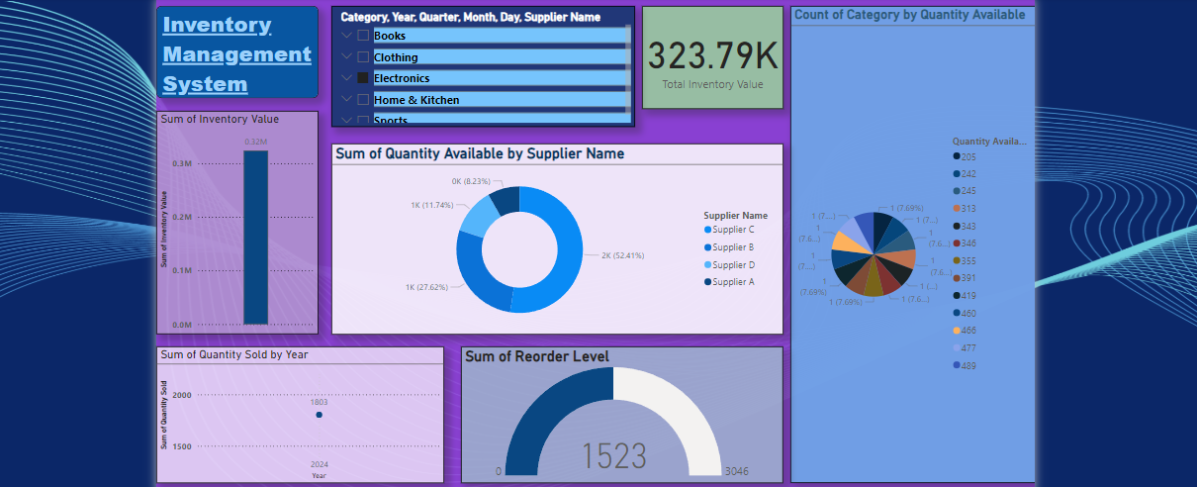

Slide 9


