Slide 1


Masters of Science
in
Machine Learning & AI
Lending Club Case Study
Contributors:-
Ankush Sharma
Rakesh Kumar Reddy Mudda

Slide 2
Problem Statement :-
Lending Club is the largest online loan marketplace, facilitating personal loans, business loans, and financing of medical procedures. Borrowers can easily access lower interest rate loans through a fast online interface.
Like most other lending companies, lending loans to ‘risky’ applicants is the largest source of financial loss (called credit loss). Credit loss is the amount of money lost by the lender when the borrower refuses to pay or runs away with the money owed. In other words, borrowers who default cause the largest amount of loss to the lenders. In this case, the customers labelled as 'charged-off' are the 'defaulters’.
When a person applies for a loan, there are two types of decisions that could be taken by the company:
Loan accepted: If the company approves the loan, there are 3 possible scenarios described below:
Fully paid: Applicant has fully paid the loan (the principal and the interest rate)
Current: Applicant is in the process of paying the instalments, i.e. the tenure of the loan is not yet completed. These candidates are not labelled as 'defaulted’.
Charged-off: Applicant has not paid the instalments in due time for a long period of time, i.e. he/she has defaulted on the loan
In other words, borrowers who default cause the largest amount of loss to the lenders. In this case, the customers labelled as 'charged-off' are the 'defaulters'.
The core objective of the excercise is to help the company minimise the credit loss. There are two potential sources of credit loss are:
Applicant likely to repay the loan, such an applicant will bring in profit to the company with interest rates.** Rejecting such applicants will result in loss of business**.
Applicant not likely to repay the loan, i.e. and will potentially default, then approving the loan may lead to a financial loss* for the company

Slide 3
Problem Solving Methodology :-
Data Understanding
Data Cleaning
Recommendations
Multivariate Analysis
Univariate Analysis
Bivariate Analysis

Slide 4
Data Cleaning and Manipulation :-
Data Quality Issues can be treated by
For Missing Values in the Columns:
Dropping the columns containing maximum null values
Dropping the columns which are not required for the analysis
Drop columns with just a single value
Drop columns which does not add any value to analysis.
For Missing Values in the Rows
Filter rows to perform targeted analysis
Dropping the rows containing the missing values
Check for data inconsistencies
Missing Value Imputation
Removing Duplicate Entries
Incorrect Data Types:
Clean certain values/Manipulation of strings
Clean and convert an entire column to correct data type e.g date, int64 etc.
Converting the columns to numeric variables in order to perform more analysis.
Treating outliers

Slide 5
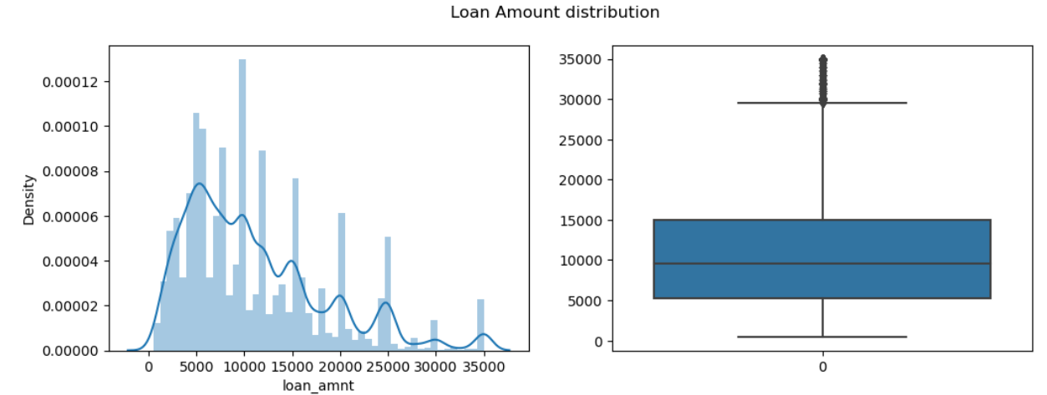
Univariate Analysis:-
Observations:
From the above plots, more number of people took loan amount of 10000, and also median of distribution is 10000. And very few people took more than 30000 loan amount.

Slide 6
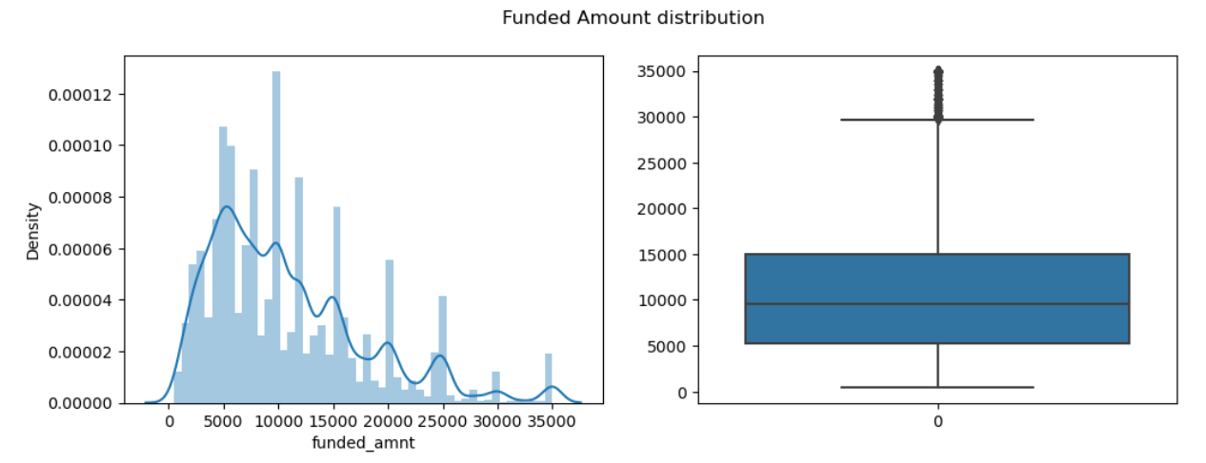
Observations:
Funded amount data behaves similar to loan Amount. It tells us that Lending club approved most of Applied loan amount.

Slide 7
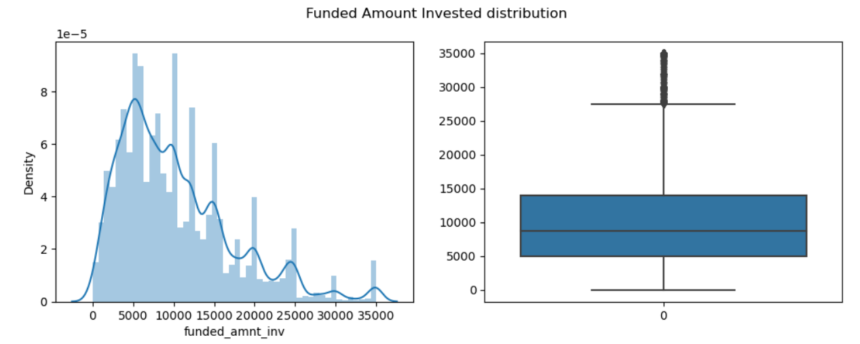
Observations:
Funded amount investment data behaves similar to loan Amount, which tells us that investors in Lending club approved almost of Applied loan amount

Slide 8
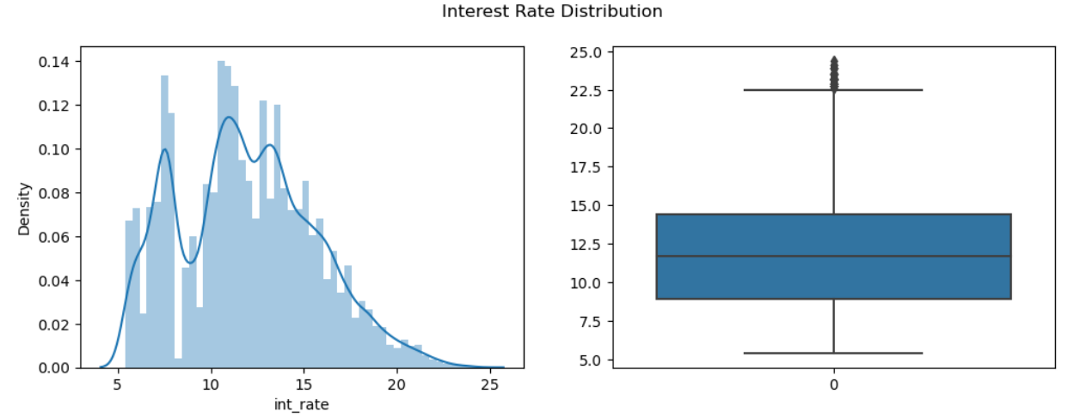
Observations:
From the above 2 plots and statistics of interest rates we can conclude that most of the interest rates lies between 9% to 14.5%. Some people took loan at higher rates of interest i.e., 22.5%

Slide 9
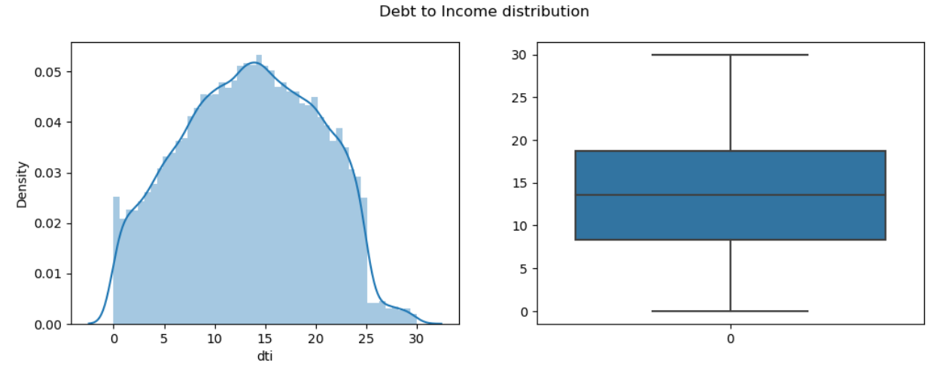
Observations:
There are no outliers, which means that all the loans are given to borrowers who have Debt to Income ration less than 30.

Slide 10
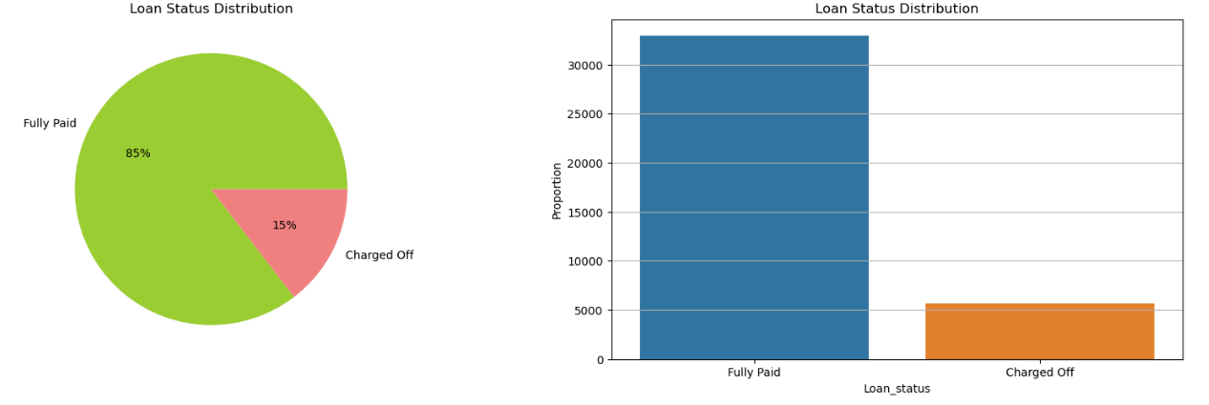
Observations:
85% of borrowers has paid the loan fully. whereas 15% are defaulted the loan.

Slide 11
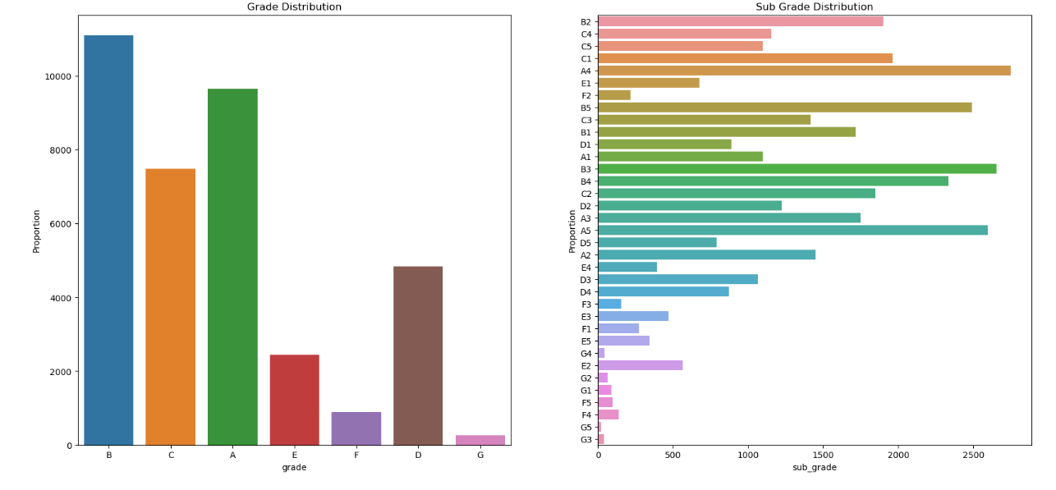
Observations:
Most of the Borrowers lie in A & B grades.
As grades are decreasing, charged off proportion is increasing.
So, we can say that lower the grade more is the chance of getting defaulted due to high loan amount and high interest.

Slide 12
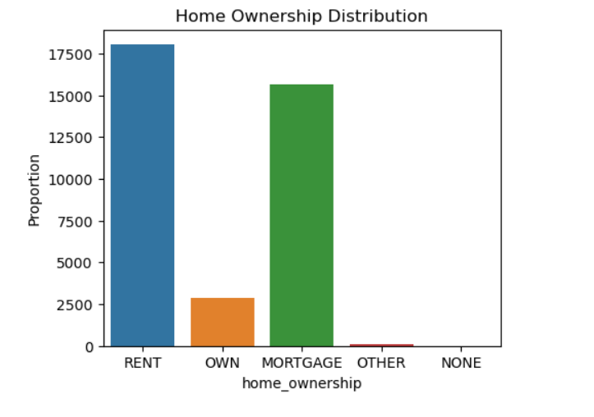
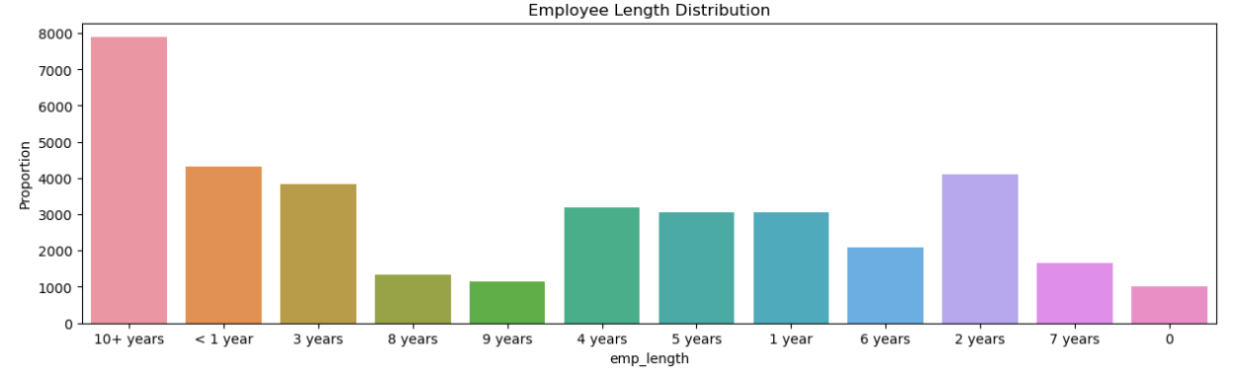
Observations:
The loan borrowers are more having rented and mortgage houses than owning their own house.
Observations:
Borrowers are mostly 10+ year employment length.

Slide 13
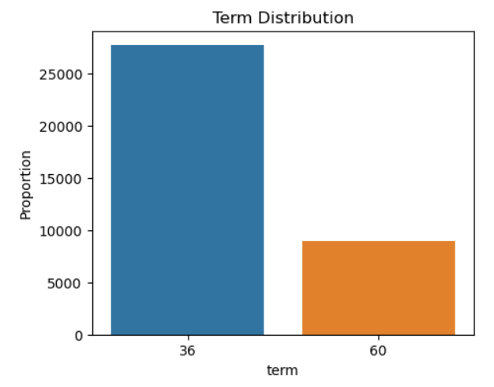
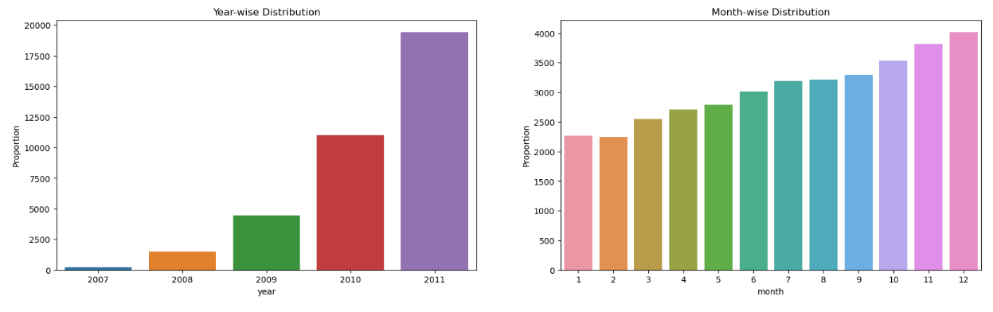
Observations:
There are only two loan terms 36 and 60 months. Around 75% borrowers took loans with 36 months term.
Observations:
The Lending Club has doubling up loan issue every year.
Loan issue gradually increases month-wise. There are more issues of loan in last 3 months every end of the year.

Slide 14
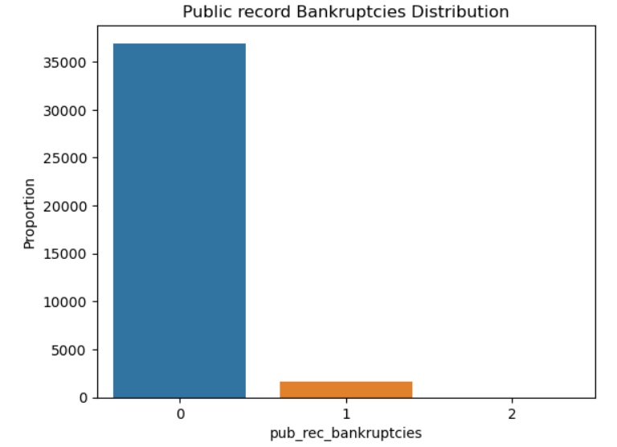
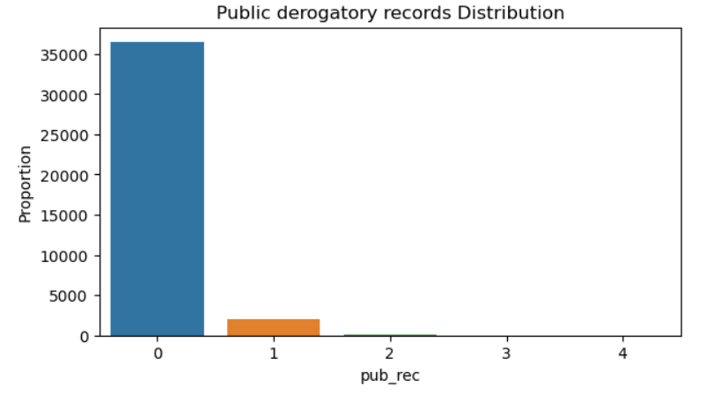
Observations:
Around 99% doesn't have Public Record Bankruptcies.
Observations:
Around 95% borrower's are having no public derogatory records.

Slide 15
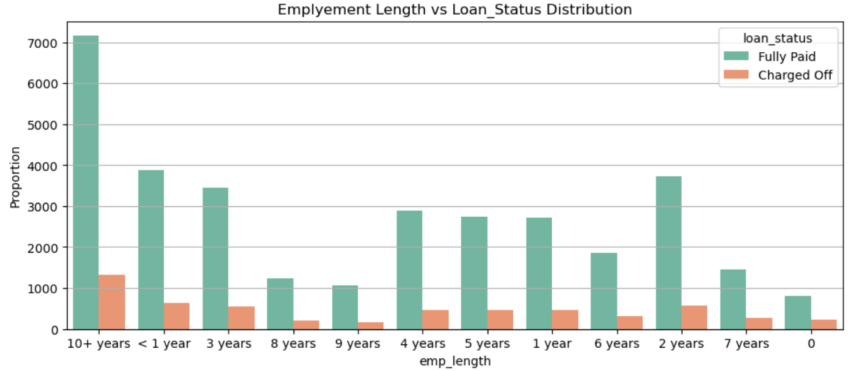
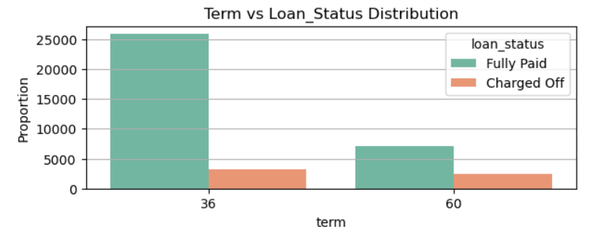
Bivariate Analysis :-
Observations:
36 month loan default is more compared to 60 month.
Observations:
Maximum loans are issued for category 10+ years and there are the maximum defaulters.

Slide 16
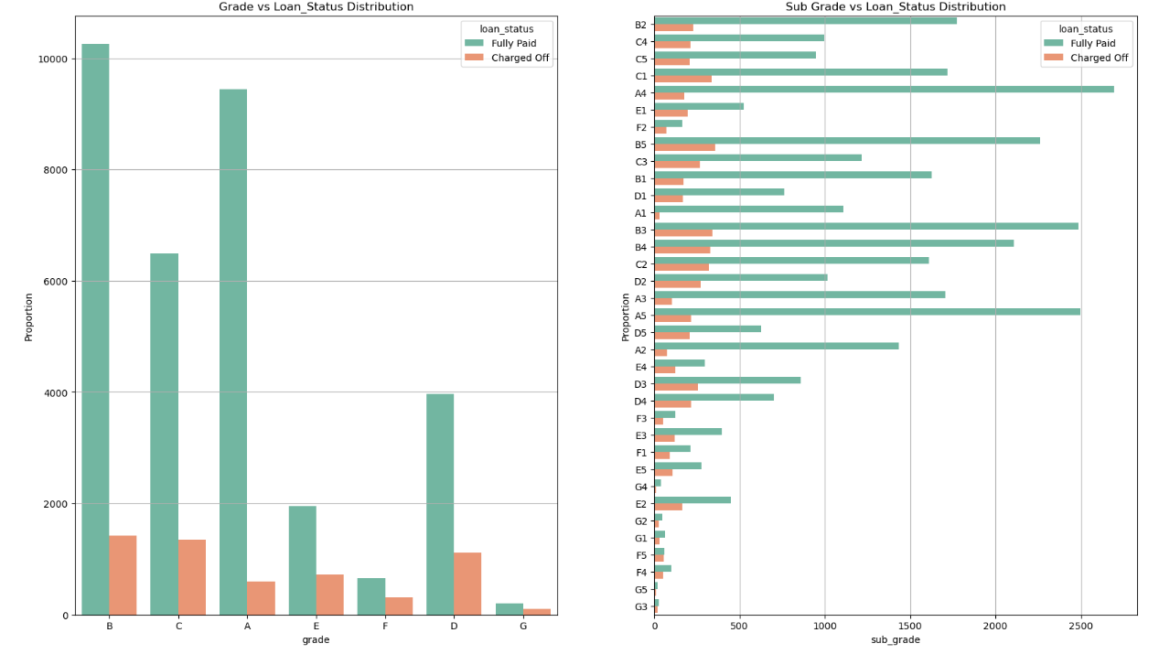
Observation:
Based on the counts, Grade B, C and D are top three in Charged Off
Based on the counts, Grade B3,B4,B5, C1,C2, D3, D4 top sub grades in Charged Off

Slide 17
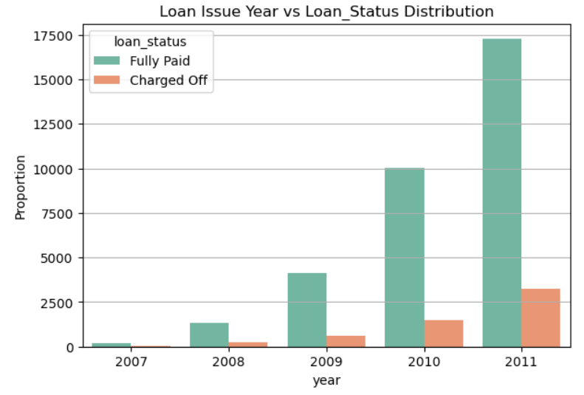
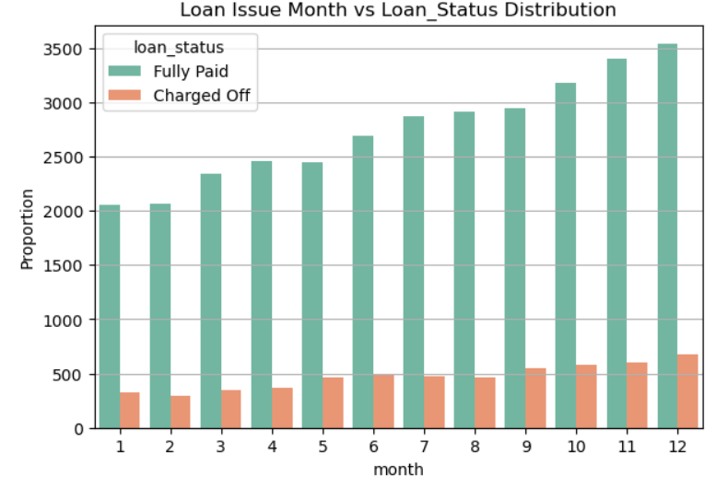
Observations:
Plot of loan issue year shows maximum loans were taken in the year 2011
Also high loans are being Charged Off in 2011
Observations:
Plot of the loan issue month shows maximum loans were given in the month of Oct, Nov, Dec.
Also high loans are being Charged Off for the loans issued in Sep - Dec months

Slide 18
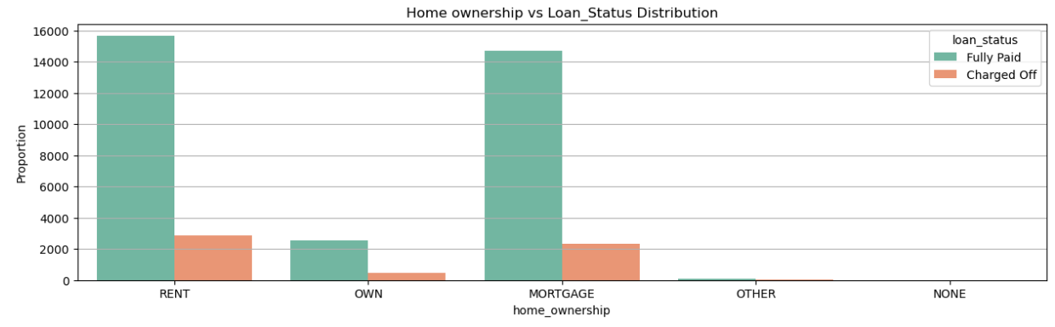
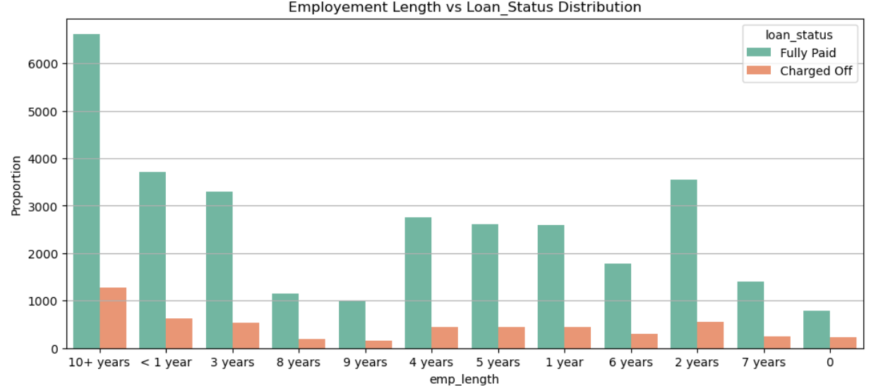
Observations:
People who are in Rent or Mortgage have failed to pay the loan compared with people in Own house
Observations:
Employment length of 10 years got more loans and they are the maximum defaulters

Slide 19
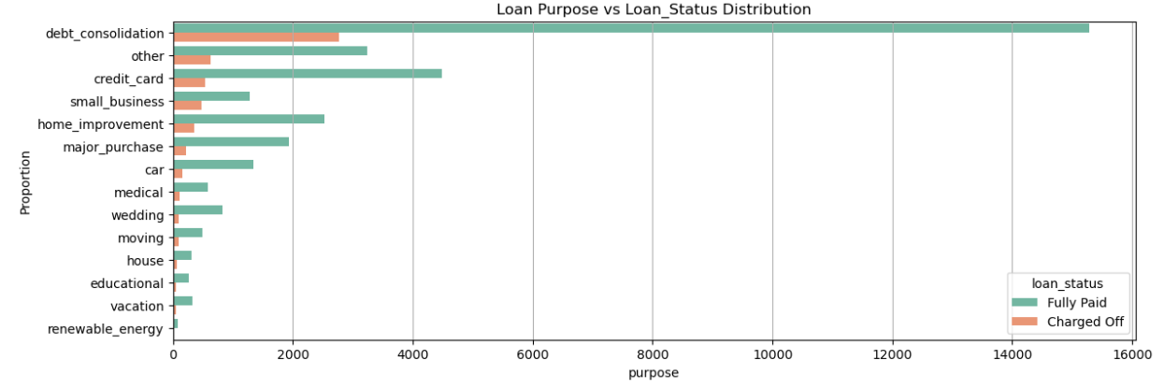
Observations:
Loans with purpose debt consolidation, other, credit card and home improvement categories have failed to pay the loan compared with education / renewable energy
Also debt consolidation is the category where maximum loans are issued.

Slide 20
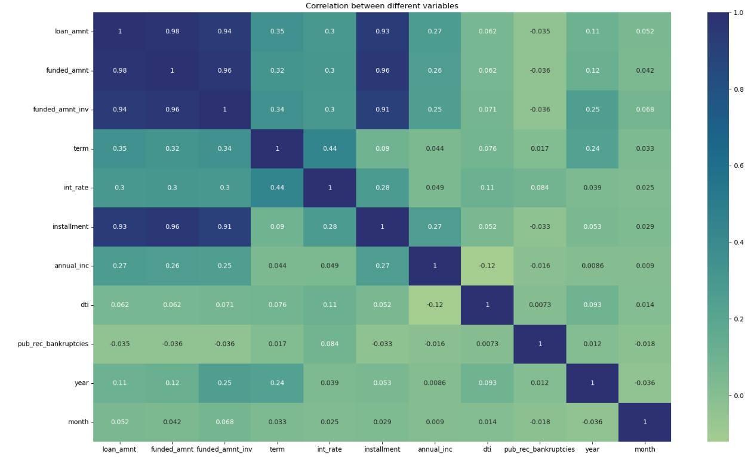
Data Cleaning and Manipulation :-
Observations:
Correlation graph shows variables annual_inc, installment, month, loan_amt, funded_amt, year have negative impact on the loan_status variable
Negative Correlation
loan_amnt has negative correlation with pub_rec_bankrupticies
annual income has a negative correlation with dti
Strong Correlation
term has a strong correlation with loan amount
term has a strong correlation with interest rate
annual income has a strong correlation with loan_amount
Weak Correlation
pub_rec_bankruptcies has weak correlation with most of the fields

Slide 21
Recommendations
Lending club should reduce the high interest loans for 60 months tenure, they are prone to loan defaulted.
Grades are good metric for detecting defaulters. Lending club should examine more information from borrowers before issuing loans to Low grade (G to A).
Borrowers with mortgage home ownership are taking higher loans and defaulting the approved loans. Lending club should stop giving loans to this category when loan amount requested is more than 12000.
People with more number of public derogatory records are having more chance of filing a bankruptcy.
When the purpose is debt consolidation check applicant thoroughly as it has high tendency todefault.
Lending Club before approving loan should take a look at the DTI(Debt to Income ratio) of the applicants. As DTI of borrowers increases their tendency of defaults also increases.
Applicants with more revolving utilization rate tends to default more.
Lending club should be more alert when approving loans for applicants in the lower annual income segment.
High loan amounts has more chances of Charge-offs. Lending club should properly analyze the applicants demanding higher loan.

