Slide 1
Distributed version control System
Some popular one available in the market:
Gitlab
Github
Bitbucket
Why it is used ?
provides version control (track history, undo mistakes, branch/merge).
Multiple developers can work on the same project.
Code accessibility

Slide 2
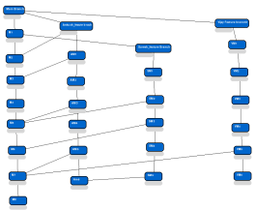

Visual Perception of DVCS
Ankush PC
Network
Remote Repositry
Suresh PC
Vijay PC

Slide 3
GITHUB INITIAL COMMANDS
Git init
Git clone
  git clone -b feature-branch <repo_url>
  git clone --depth 1 <repo_url>
Git config
  git config --global user.name
  git config --global user.email
  git config --global credential.helper cache # store in memory temporarily
  git config --global credential.helper store # plain text (not safe)
  git config --global credential.helper manager # Windows Credential Manager

Slide 4
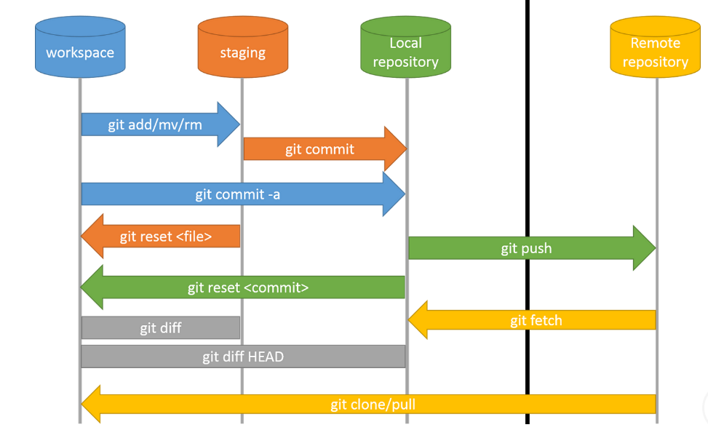
Git Commands in local and remote

Slide 5
Most used commands
git add .
git commit –m “comment”
git branch, git branch branchname, git branch -d branchname, git branch –r # remote branches
git switch branchname or git checkout branchname # do similar operation
git log
git status
git push origin branchname
git pull = git fetch + git merge

Slide 6
Github commands (github cli)
gh --version
winget install GitHub.cli
gh repo fork <owner>/<repo> --clone
Pr raising commands
gh pr create --base main --head my-feature --title "Add feature" --body "Details"

Slide 7
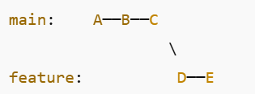
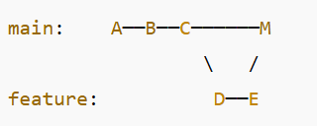
Git merge:
Before:
After :

Slide 8
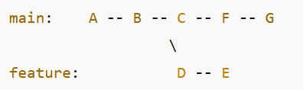
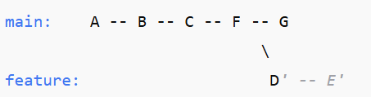

Git rebase
Before :
After :
Linear History visualised as :

Slide 9
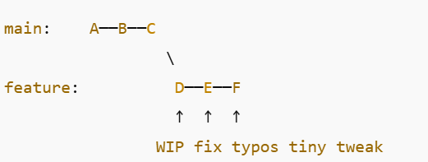
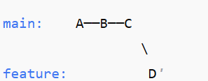

Git squash
Before :
git swtch feature && git rebase -i HEAD~N (here N = 3)
After
Squash & merge :

Slide 10
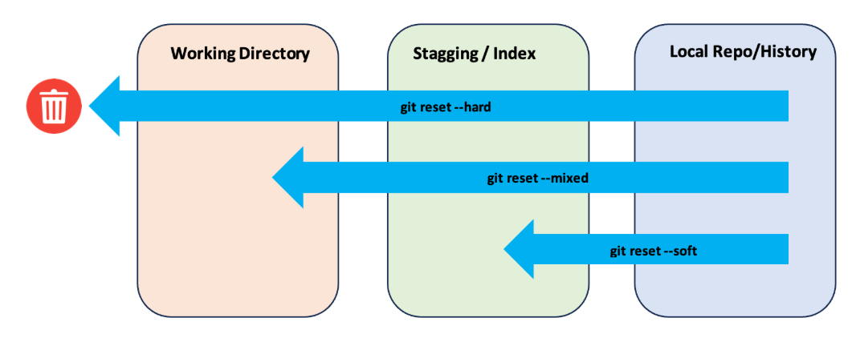
Git reset , revert,restore,cherry-pick
Git reset
Git Revert /Git Restore/ cherry-pick == > Mindmap tool

Slide 11
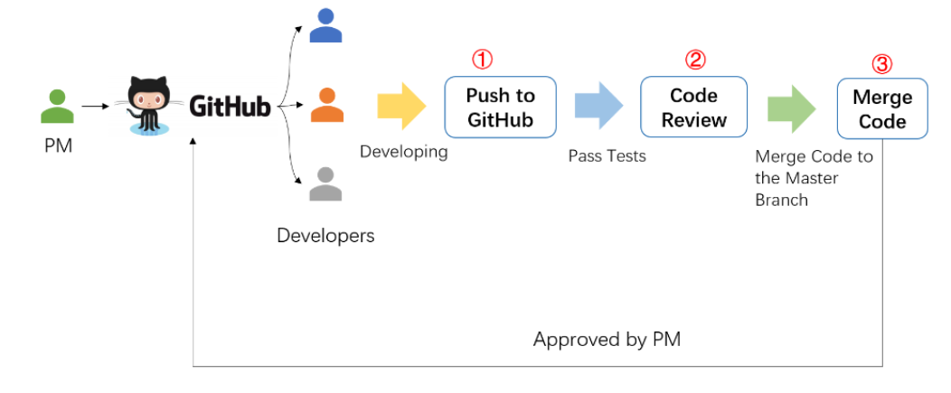
PR - Pull request
Use mindmap tool if needed

Slide 12
THANKYOU

