Slide 1
Causal Explanation Under Indeterminism: A Sampling Approach
Christopher A Merck and Samantha Kleinberg
Stevens Institute of Technology
Hoboken NJ
Copyright 2015, Association for the Advancement of Artificial Intelligence (www.aaai.org)
All rights reserved

Slide 2
Purpose of Work
Causal Explanation – Assign Responsibility (To Study Why things happen)
This helps inform future decisions
Most Methods provide theoretical contributions with
limited computational capability
Contributions:
“An algorithm for explanation that calculates the strength of token causes.
An evaluation based on simulated data that enables objective comparison against prior methods and ground truth.”

Slide 3
Importance
“Given a database of medical records, we can find causal relationships between variables like medications, lifestyle, and disease.
Yet while causal inference can tell us what causes heart failure in general, it cannot tell us that a specific patient’s heart failure is caused by their thyroid disfunction rather than their uncontrolled diabetes — that is the role of causal explanation.”
Hence, the task of assigning responsibility
“One of the core approaches to explanation is based on counterfactuals, which capture that without the cause the effect would not have happened”

Slide 4
Shortcomings of Some Existing Methods
“The primary shortcoming of existing explanation methods is their handling of time”
Bayesian Networks – Ignore Time entirely
Dynamic Bayesian Networks - add time ad-hoc but
Computationally expensive
Large amounts of input required

Slide 5
What types of questions do we need to answer?
From Whether an event happens to identify causes which could potentially change whether, when and how an event happens
This requires continuous time and state modelling
Examples:
Timing effect (The When kind): “Perhaps an individual had a genetic disposition toward lung cancer, but smoking led to diagnosis at a much earlier age than otherwise would have happened”.
Intensity effect (The How kind): “Two arsonists individually didn’t change whether a fire happened (since either would have brought it about), but they increased the intensity of the fire and prevented it from being extinguished”

Slide 6
How to Answer these in terms of Counterfactual Queries?
Compute Probabilistic Trajectories
Show how to test whether one event changes the probability, time or intensity of another event.
Compute quantitative strengths for these relationships (How Statistically Significant are they really?)

Slide 7
Application Areas
Law
Medicine
Computer Science
Philosophy

Slide 8
Philosophy
Probability of the Effect Over Time
Requires Background Contexts to Hold Fixed (and requires a whole lot of them)
Counterfactual methods:
“A cause is something without whose presence the effect would not have occurred”
Intuitive Appeal but not reducible to Algorithm cannot Handle Over determinism
The theory has been extended to capture overdeterminism though without a way of quantifying the similarity

Slide 9
Computer Science: “Inspiration” from 2 Philosophy Methods
“This lets us find that while an event may have been inevitable, and a cause made no change to whether it occurred, it can still change when and how it happens.
For example, if we have a continuous variable that assesses severity of cancer, we can test how much this is changed by each exposure in the prior example”
Causal explanation has received significantly less attention than Causal Inference
- “Halpern and Pearl (2005a; 2005b) introduced a method (henceforth “HP”) for explanation that links structural equation models (SEMs) and counterfactuals”
- Variables to Model Time

Slide 10
Continued..
Encodes the processes underlying relationships with logical formulas (Dash, Voortman, and De Jongh 2013), links these with a Bayesian network (BN), and then finds the most likely path through the structure to the effect.
- Timing of Events?
- Multiple Causes are responsible for an Event?
Only finds only the most likely causal sequence
Does not distinguish between the significance of each component of the sequence
Other Approaches do not support general counter factual queries!

Slide 11
Motivating Example..
Aim is to provide not only explanations but better explanations considering impact of overall event on the end-effect.

Slide 12
Model Definition
State
World
Actual World
Event
probability
trajectory Pw;t(A)
Timing of an Event tA(w)
Intensity of an Event mA(w)

Slide 13
Billiards Example
6->7->8->P
What if 7 did not strike 8?
Assign a distribution to a set of outcomes where 7 does not strike 8
Simulate alternate worlds other than w0 till some threshold where 7 does not strike 8 (antecedent)
Use of Stochasticity present in the system

Slide 14
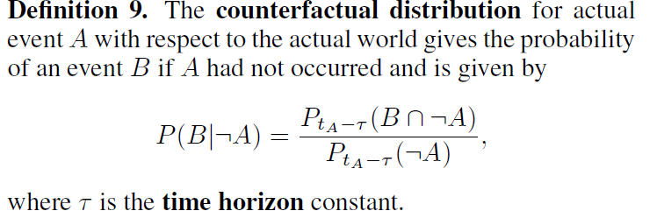
Counter Factual Distribution

Slide 15
The Threshold
If Thres is large, say 1 minute, then the alternatives considered differ unduly from the actual world, and dependence of past events on future antecedents may be found, an undesirable feature called backtracking.
In general, should be as small as possible to limit backtracking, but large enough to allow plausible alternatives to arise from stochasticity in the system.
Horizon can be arbitrarily small if decision is spontaneous??

Slide 16
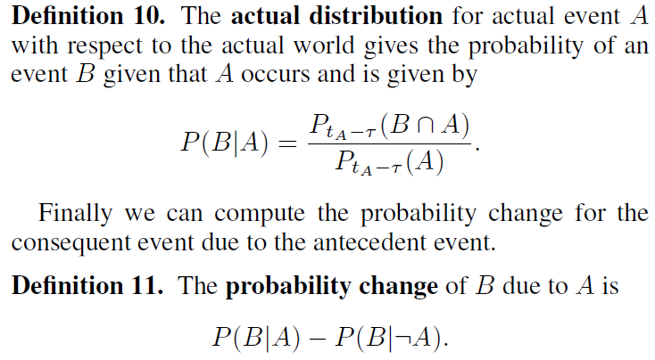
Actual Distribution and Probability Change
When the probability change is positive we say B occurred
because of A, and if it is negative B occurred despite A.

Slide 17
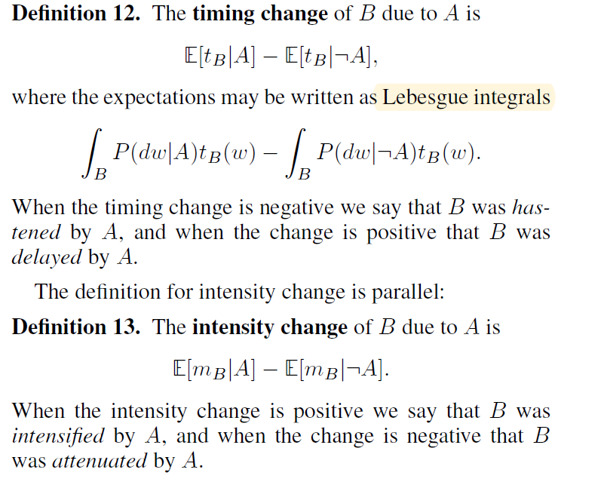
Timing and Intensity Changes
Not all causes raise the probability of their effects.
When explaining an event B, we should look not only for events A that raised the probability of B,
But also for events that caused B to occur sooner
OR
Increased its expected intensity.

Slide 18
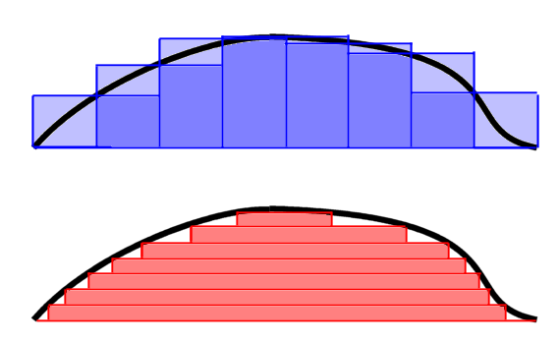
The Riemann–Darboux approach vs The Lebesgue approach

Slide 19
Computing Explanations
Computing an explanation for event B in terms of event A given the actual world w0
Subroutine for sampling worlds from the probability trajectory Pt
Example: In the glucose-insulin example, the actual world w0 is represented as a list of vectors, each containing the concentrations of glucose, insulin, and other state variables at a point in time
-Reading from Paper!

Slide 20
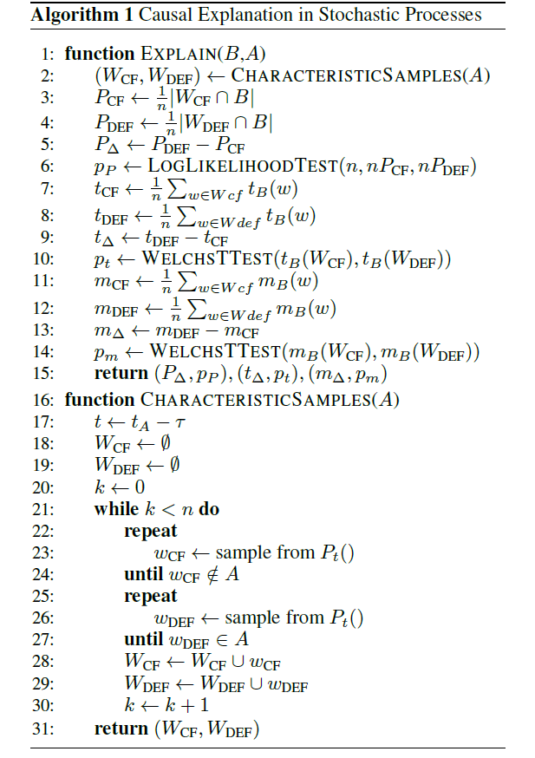

Slide 21
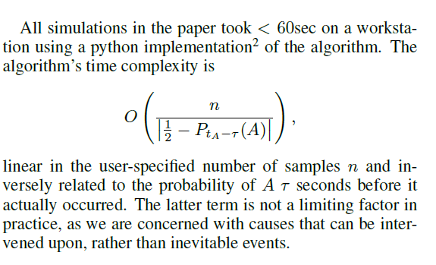
Computational Complexity

Slide 22
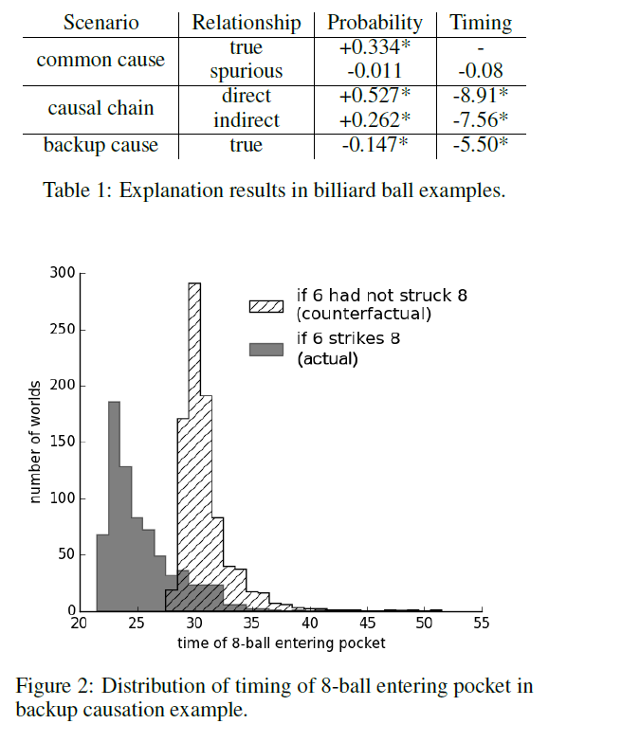
Experiments
Common Cause
6->7
6->9 && 7->8

Slide 23
Experiments Contd..
Causal Chain
6->7 (indirect)
7->8 (direct)
8->P

Slide 24
Experiments Contd..
Back Up Causation
6->8 | 7->8 (also off course)
8->P
This interpretation helps devise better strategies for
better strategies for
bringing about outcomes

Slide 25
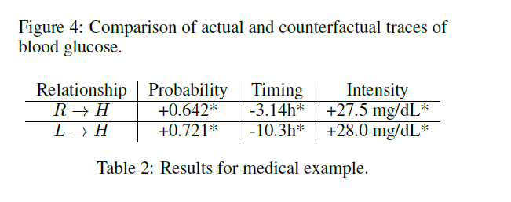
Experiment 2
Shaded Regions are error bars

Slide 26
Limitations
Requires a Model
Cannot Handle Deterministic Systems
Not Scalable
Naïve Algorithm implementation/Approximation in spite of good model

Slide 27
Conclusion
“Explanations are needed to assign blame, learn from our actions, and make better future decisions.
Yet while many fields such as computer science, epidemiology, and political science regularly use methods for causal inference to learn how systems work, explanation has remained in the domain of theory.
One of the primary impediments to this is the difficulty of formalizing methods for explanation, and capturing the nuanced ways we explain events.”

Slide 28
Questions and Discussion.

