Slide 1
A Semi-Supervised Learning Approach to Why-Question Answering
Jong-Hoon Oh, Kentaro Torisawa, Chikara Hashimoto, Ryu Iida,
Masahiro Tanaka, Julien Kloetzer
National Institute of Information and Communications Technology (NICT), Kyoto, 619-0289, Japan
Copyright c 2016, Association for the Advancement of Artificial
Intelligence (www.aaai.org). All rights reserved

Slide 2
Purpose 1 of Paper
Automatically Generate Training Data from Causal Relations in Text
Naïve Methods using Cue Words bias the Answering Problem of Why Question towards the pattern of these words
For Example,
“[Tsunamis are generated]effect because [the ocean’s water mass is displaced by an earthquake]cause.”
Question - “Why are tsunamis generated?”
Expected Answer - The ocean’s water mass is displaced by an earthquake
Problem of Overfitting – towards their automatic causality recognizer

Slide 3
Purpose 2 of Paper
Alleviate the Problem to generate Incomprehensible Questions
How did [He] win the Nobel Prize?
These questions are generated due to Pronoun and zero Anaphora's.
For Example,
Allan Turing discovered …. therefore (Pronoun anaphora) he won the Nobel Prize.
Grapevine wears glasses and (Zero anaphor)[] has a beard (zero or null reference)

Slide 4
Related Work in Why QA
Machine Learning Approach with Supervised Classifier
Either Classify as correct or incorrect pairs for Question and Answer
give a Score based on likelihood that question+answer-passage is correct (used to rank answers for question)
The authors say/claim they use semi-supervised learning using new unlabeled raw text from web.

Slide 5
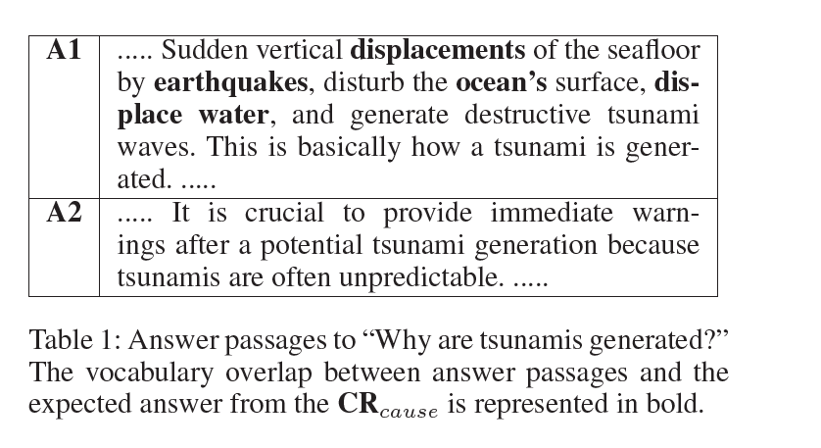
Overview of How they Achieve Their Purpose
Hypothesis: “Given such a causal relation as CR and a question generated from its effect part, the correct answer passage to the question (in the results of our baseline why-QA system) has and indeed must have a large vocabulary overlap with the cause part of the causal relation”

Slide 6
Contd..
An important point is that there is no explicit clue such as “because” for recognizing the causal relation in A1 and our automatic causality recognition method actually fails to detect it
It is important to enable why-QA systems to recognize a wide range of such indirectly expressed causal relations as candidates for answers to why-questions.
Problem with Hypothesis:
Many False Negatives (correct answers) which have a small vocabulary overlap

Slide 7
Contd..
Judge Comprehensibility of questions using a supervised classifier with subset-tree kernels - ??
Moschitti, A. 2006. Making tree kernels practical for natural language learning. In Proceedings of EACL ’06, 113–120.

Slide 8
System Architecture

Slide 9
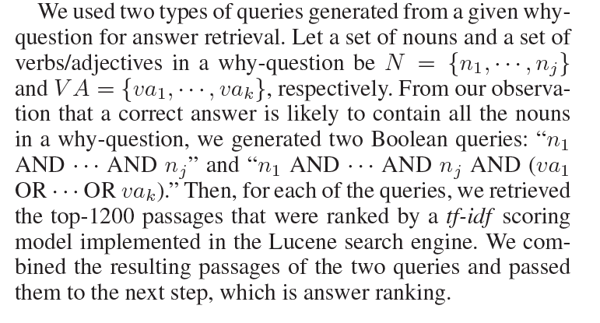
Answer Retrieval of Baseline Why-QA
Conditions : 7 Consecutive Sentences should have 1 cue word minimum to extract Passages for Causality Recognition
“We extracted about 4.2 billion passages that satisfy these conditions from the two billion web texts and indexed them for keyword search using a Lucene search engine”

Slide 10
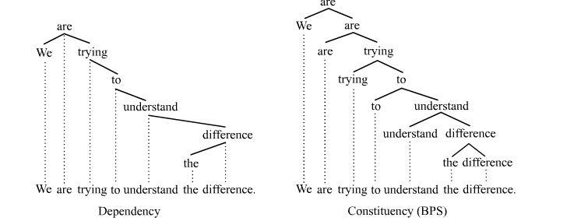
Answer Ranking of Baseline Why-QA
Supervised SVM Classifier
Features :
Morpho-syntactic features (n-grams of morphemes and syntactic dependency chains)

Slide 11
Contd..
Semantic Word Class Features (semantic word classes obtained by automatic word clustering)
Kazama, J., and Torisawa, K. 2008. Inducing gazetteers for named entity recognition by large-scale clustering of dependency relations. In Proceedings of ACL-08: HLT, 407–415.
For example, Tsunami is a Disaster (class)
Sentiment Polarity Features (word and phrase polarities)
Causal Relation Features (n-grams, semantic word classes, and excitation polarities in causal relations whose effect part is matched with a question).
He underwent cancer treatment, AND/THUS he could cure the cancer. (undergo X is excitatory, cure X is inhibitory.)
He underwent cancer treatment, BUT still had cancer. (Both undergo X and have X are excitatory.)
Hashimoto, C.; Torisawa, K.; Saeger, S. D.; Oh, J.-H.; and Kazama, J. 2012. Excitatory or inhibitory: A new semantic orientation extracts contradiction and causality from the web. In Proceedings of EMNLP-CoNLL ’12, 619–630.

Slide 12
Identifying Incomprehensible Questions
1) filtering out questions containing any pronoun
2) filtering out questions, in which any essential argument of the predicates, such as subject and object, is missing.

Slide 13
How They dealt with Second Problem
Subset-tree kernels implemented in SVMLight
Joachims, T. 1999. Making large-scale SVM learning practical. In Sch¨olkopf, B.; Burges, C.; and Smola, A., eds., Advances in Kernel Methods - Support Vector Learning. Cambridge, MA: MIT Press. chapter 11, 169–184.
Moschitti, A. 2006. Making tree kernels practical for natural language learning. In Proceedings of EACL ’06, 113–120
http://disi.unitn.it/moschitti/Tree-Kernel.htm
All the subset-trees of a phrase structure tree (e.g., [NP [N tsunamis] P])
All the subset-trees of a phrase structure tree where their nouns are replaced with their corresponding word class (e.g., [NP [N Wdisaster] P])
Vectors expressing morpheme and POS tag n-grams
Reading

Slide 14
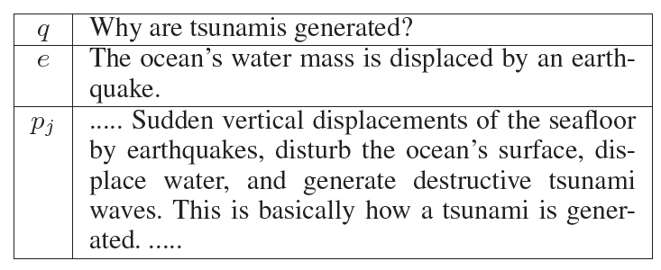
Obtaining Unlabelled Examples
U = {(q, e, pj)}
q – Question
e – Expected answer
pj – Answer Passage from top 20 Answers

Slide 15
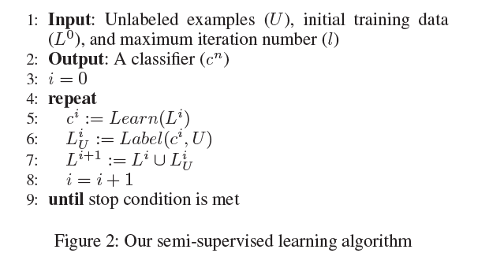
Semi-Supervised Learning

Slide 16
Candidate Selection From UnLabelled data
Classifier ci provides score s for question-passage pair (q, p)
s = ci(q, pj).
First Choose Highest Score Pair
|ci(q, p)| < α (α > 0), where α is a threshold value to determine the uncertainty of the classifier’s prediction.
Answer passage p does not include the causal relations from which q and e were extracted.
(q, p) does not appear in current labeled example Li.
Uncertainty Sampling Approach (Lewis and Gale 1994) that has been used in active learning (Tong and Koller 2001; Zhu et al. 2008; Lughofer 2012; Settles 2012; Zhu and Ma 2012) and Semi-Supervised Learning with Multi-View classifiers (Cao, Li, and Lian 2003; Gu, Zhu, and Zhang 2009; Oh, Uchimoto, and Torisawa 2009; Oh et al. 2010).

Slide 17
Automatic Labelling of Candidates
VO(e, p) = maxs∈S(p) |T(e) ∩ T(s)| /|T(e)|
Observation that the terms in an Expected Answer are likely to coherently appear in subsequent two sentences in a correct answer passage
If VO(e, p) > β and VO(q, p) > β, then the label is “correct,” where 0.5 < β < 1.
If VO(e, p) < 1 − β or VO(q, p) < 1 − β, then the label is “incorrect.”
They don’t deal with intermediate cases

Slide 18
Adding to Training Set
“All the automatically labeled examples are ranked by |ci(q, p)| in ascending order.
The top K examples are selected from the ranked result and added to Li(U).
Intuitively, the automatically labeled examples, which current classifier ci classified with lower confidence (i.e., of which current classifier ci is more uncertain about its prediction) has higher priority to be selected as new training instances”

Slide 19
Why QA - Data
Reading!
Development Data
α (the threshold value to determine whether a classifier is uncertain about its classification result)
β (the threshold value to determine the label of an unlabeled example in the automatic labeling)
K (the maximum number of automatically labeled examples added to the existing training data at each iteration).

Slide 20
Unlabelled Examples
Reading!
Comprehensible Questions – Usc
All Questions – Uall
Finally, we had unlabeled examples such that |USC| = 514,674, |UAll| = 1,548,998 and |USC ∩ UAll| = 17,844

Slide 21
Evaluation with Why-QA DataSet
MURATA
INIT
ATONCE (without K restriction)
OURS(Uall)
OURS(CR) (without same causal relation restriction)
OURS(Usc)
UPPERBOUND – (top-n if n present in test data)??

Slide 22
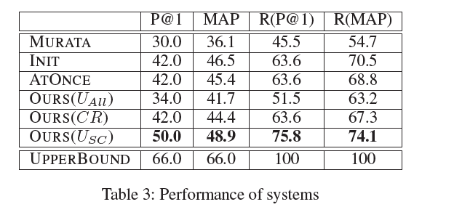
Results

Slide 23
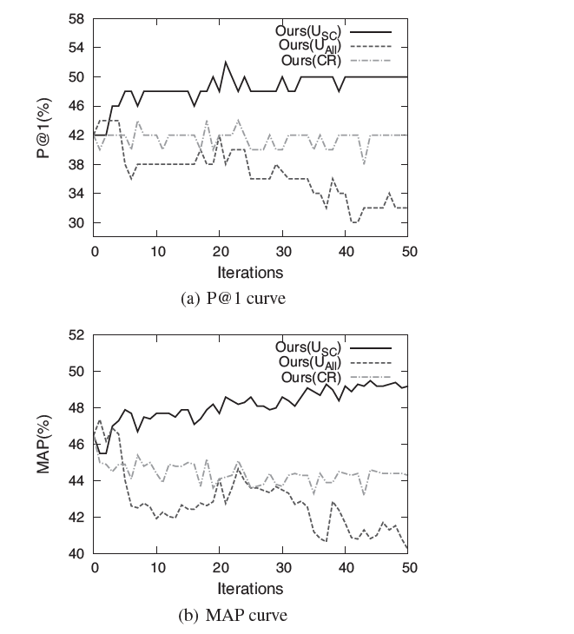
Contd..

Slide 24
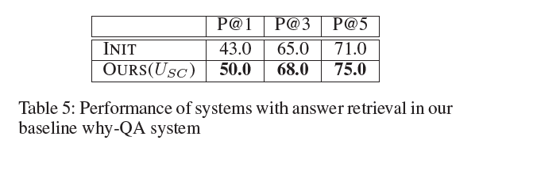
Different Experiments

Slide 25
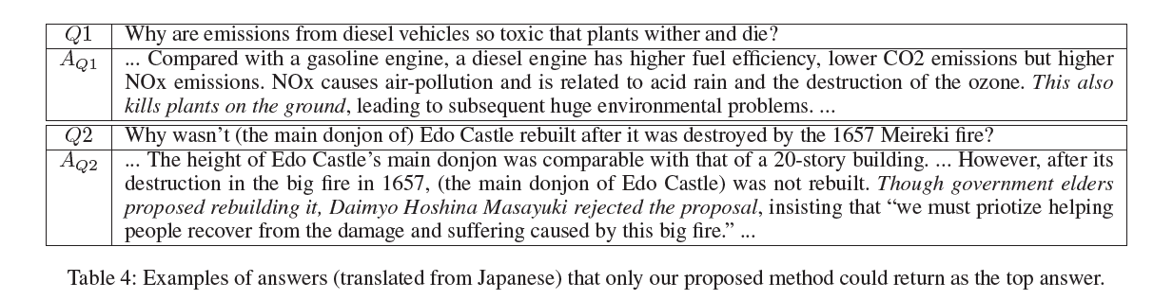
Examples

Slide 26
Conclusions and Future Work
Answer Ranker Could return Different Patterns of Causality using balanced |instances| of Automatically Labelled Training Data
Removal of Incomprehensible Questions
Extend Work with Event Causality
Entailment/Contradiction Patterns
Zero anaphora resolution
(Reference Papers for All of these)

Slide 27
Limitations
Naïve Removal of Pronoun Anaphora Questions preceded by context (not addressed in future work)
Hypothesis incorporates False Negatives. (Addressed in future work)
Don’t Test with Other Datasets / only ones which they have used previously
No Specific Details on Upper Bound in Experiments.
Most Importantly, they do a Japanese-to-English Translation everywhere for the purposes of this paper.
We actually don’t even know how the system performs on Text Documents in Enligsh (Could be Better or Worse)

Slide 28
Questions and Discussion..

