Slide 1
Cyberbullying Classifier
using Machine Learning
Disruptive Technology 22ECH-102
22BCB-124 (A)

Slide 2
Group Members
Ankush Singh 22BCT10002
Prayrit Dhingra 22BCT10015
Harsh Saini 22BCT10007
Moksh Verma 22BCT10059
Md Karimul Hasan 22BCT10001

Slide 3
Problem Statement
Often people are targeted and cyberbullied on social media platforms like Discord, Twitter, Reddit and Instagram.
We aim to make a text classifier that classifies tweets from twitter as ‘not_cyberbullying’ or ‘cyberbullying’ along with it’s type – racial, age based, gender based, etc.

Slide 4
How will it work?
We have a labeled dataset that contains more than 40 thousand tweets from twitter that are labelled with types of cyberbullying.
We plan to train a model on that dataset (also on other datasets to get better accuracy if possible).
The model would be able to:
Process a sentence
Figure out its sentiments
Classify its cyberbullying type.

Slide 5
How is this different from other methods?
The most simple method of detecting vulgar speech in cyberbullying would be checking for keywords.
But this is not accurate since the poster can modify the spellings of the words however he wants, so our program has a high chance of failure.
We are using an approach that uses Machine Learning to analyze sentiments of a sentence and decide if it should be categorized as cyberbullying.

Slide 6
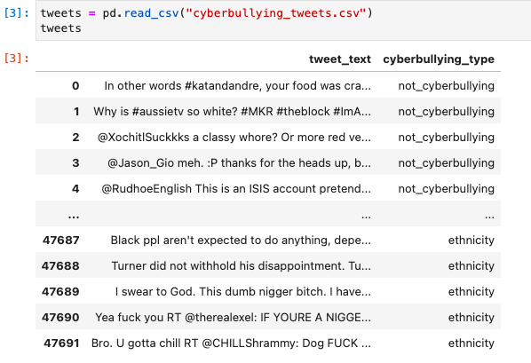
Progress of building our Model
Vulgar Speech Dataset
Credits : Kaggle

Slide 7
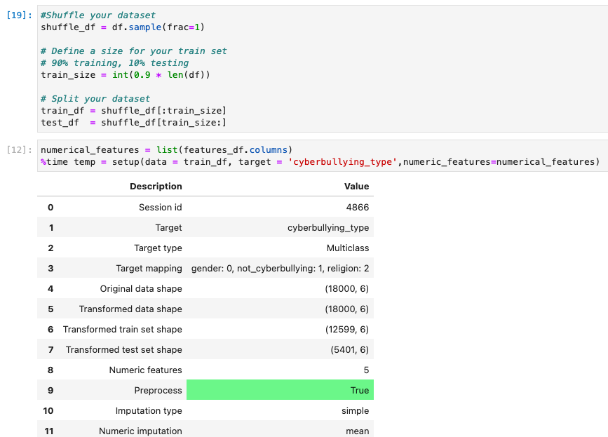
Splitting our dataset into training and testing parts

Slide 8
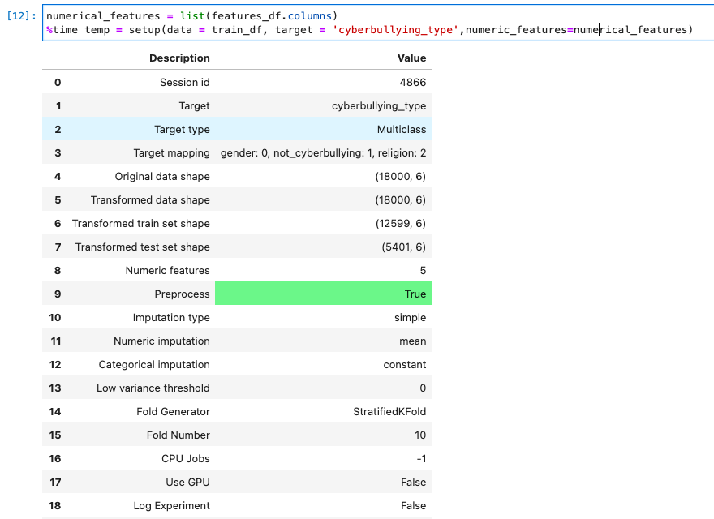
Setting up training dataset

Slide 9
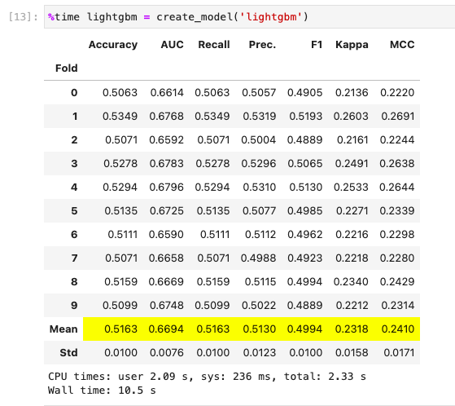
Creating a Light Gradient Boosting Machine Model

Slide 10
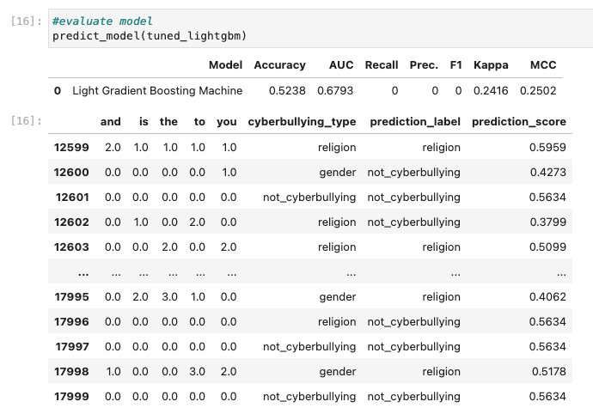
Testing the Model

Slide 11
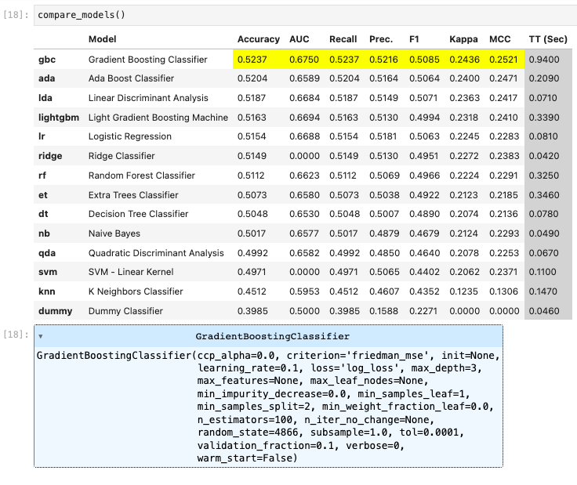
Comparing different
model accuracies

Slide 12
Thank You

