Slide 1

IILM UNIVERSITY, GREATER NOIDA
TRAINING REPORT PRESENTATION
CISCO NETWORKING ACADEMY
Networking Basics • Introduction to Cybersecurity Introduction to IoT & Digital Transformation
B.Tech CSE • 5th Semester • 3CSE9
ANKUSH RAJ
Roll No. 2410031647 Batch 2024–2028 IILM University, Greater Noida, U.P.
COURSE COMPLETION DATES • JUNE 2026
Cisco Networking Academy Training • Ankush Raj
01

Slide 2
ABOUT THE STUDENT
Candidate Profile
Academic and training details
1
Institute
ANKUSH RAJ
IILM University, Greater Noida, U.P.
2
Programme
B.Tech CSE • Batch 2024–2028
B.Tech – Computer Science & Engineering
3
Training Platform
Cisco Networking Academy
5th Semester • 3CSE9
4
Training Focus
2410031647
Networking • Cybersecurity • IoT
Cisco Networking Academy Training • Ankush Raj
02

Slide 3
ABOUT THE TRAINING
Cisco Networking Academy
Three introductory courses that build one connected technology foundation
The three courses were completed as a single learning journey: first understanding how devices communicate, then how digital systems are protected, and finally how connected technologies transform the world.
1
Networking Basics
2
Introduction to Cybersecurity
3
Introduction to IoT & Digital Transformation
Foundation of networking, network devices, media, protocols, IP addressing and simple LAN concepts.
Cyber trends, threats, safe behavior in cyberspace, privacy and protection of personal and company data.
IoT, connected devices, data analytics, artificial intelligence and digital transformation.
FOUNDATION
PROTECTION
CONNECTED FUTURE
Cisco Networking Academy Training • Ankush Raj
03

Slide 4
PROBLEM STATEMENT
Building a Connected Technology Foundation
Why these three areas were studied together
Modern digital systems depend on networks, connected devices and information that must be protected. Learning these topics separately can make it harder to understand how the complete technology environment works.
The training addressed this gap through a simple progression:
1 CONNECT
2 PROTECT
3 TRANSFORM
How devices and networks communicate.
How users and organizations reduce digital risk.
How IoT and emerging technologies use connectivity and data.
NETWORKING → CYBERSECURITY → IoT / DIGITAL TRANSFORMATION
Cisco Networking Academy Training • Ankush Raj
04

Slide 5
TRAINING OBJECTIVES
What the Training Set Out to Achieve
Six practical learning goals
1
Understand Networking
2
Build Security Awareness
3
Explore IoT
Build a foundation in networks, devices, media, protocols and IP communication.
Recognize cyber threats, safe online behavior and the importance of protecting data.
Understand connected devices and the basic role of IoT in digital systems.
4
Understand Digital Transformation
5
Connect the Domains
6
Prepare for Further Learning
See how data and emerging technologies change organizations and industries.
Relate networking, cybersecurity and IoT instead of treating them as isolated topics.
Use the foundation for deeper study in networking, cloud, cybersecurity and software.
Cisco Networking Academy Training • Ankush Raj
05

Slide 6
TECHNOLOGIES & CONCEPTS
The Toolkit Behind the Training
Core concepts covered across the three courses
1
Network Devices
2
Protocols & IP
3
LAN Concepts
4
Cyber Threats
Routers, switches, hosts and the role of network media.
How protocols and IP addresses enable communication.
Basic network setup and communication within a local network.
Awareness of threats and risks in connected environments.
5
Privacy & Data
6
Internet of Things
7
Data Analytics
8
Artificial Intelligence
Protecting personal information and organizational data.
Connected devices, data exchange and smart environments.
The role of data in digital transformation.
An emerging technology highlighted in the IoT course.
Cisco Networking Academy Training • Ankush Raj
06

Slide 7
LEARNING ARCHITECTURE
From Course Content to Demonstrable Learning
A simple view of how the training translated into outcomes
1
COURSE MODULES
Structured lessons covering networking, cybersecurity and IoT.
2
PRACTICE & ACTIVITIES
Practice labs, interactive activities, quizzes and course exercises.
3
ASSESSMENT
Final tests / exams used to check understanding.
4
COMPLETION
Successful completion of each course and its corresponding credential.
5
LEARNING OUTCOME
A connected foundation for further technical study.
Cisco Networking Academy Training • Ankush Raj
07

Slide 8
METHODOLOGY
The Learning Process
A repeatable approach used across all three courses
01
02
03
04
05
Learn
Practice
Assess
Review
Document
Study the course modules and understand the concepts before moving forward.
Use labs, interactive activities, quizzes and course exercises where provided.
Complete knowledge checks and the final assessment for each course.
Revisit difficult concepts and connect ideas across networking, security and IoT.
Record learning outcomes and preserve certificates as evidence of completion.
COURSE-BY-COURSE • LEARN → PRACTICE → ASSESS → REVIEW → DOCUMENT
Cisco Networking Academy Training • Ankush Raj
08

Slide 9
EXPECTED OUTCOMES
Skills & Capabilities Gained
What I can take forward from the training
1
Outcome 1
5
Outcome 5
THE BIG TAKEAWAY
Explain foundational networking concepts and terminology.
Describe the basic purpose of IoT and connected devices.
2
Outcome 2
6
Outcome 6
Recognize the role of devices, media, protocols and IP addressing.
Relate IoT to data analytics, AI and digital transformation.
Connect the network. Understand the risk. See the connected future.
3
Outcome 3
7
Outcome 7
Identify common cybersecurity concerns and safer digital practices.
Connect networking and cybersecurity ideas to connected environments.
4
Outcome 4
8
Outcome 8
FOUNDATION BUILT
Explain why personal and organizational data must be protected.
Identify useful next steps for deeper technical learning.
Cisco Networking Academy Training • Ankush Raj
09

Slide 10
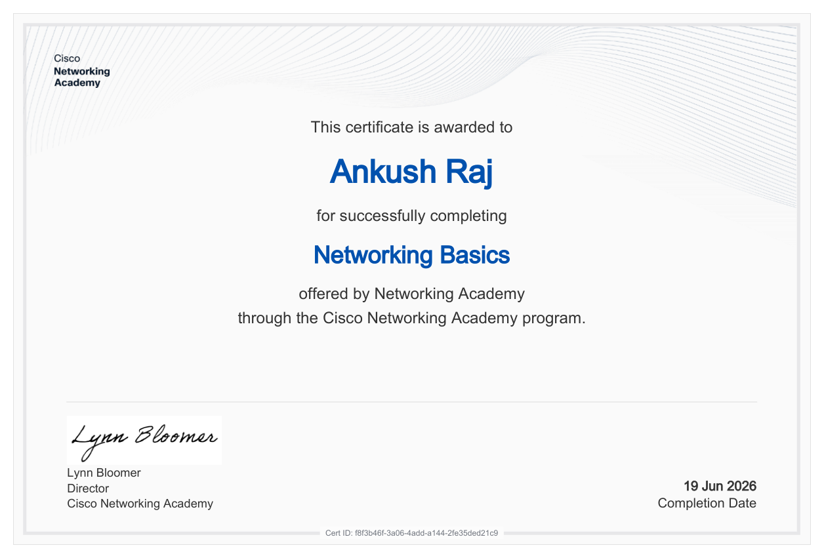
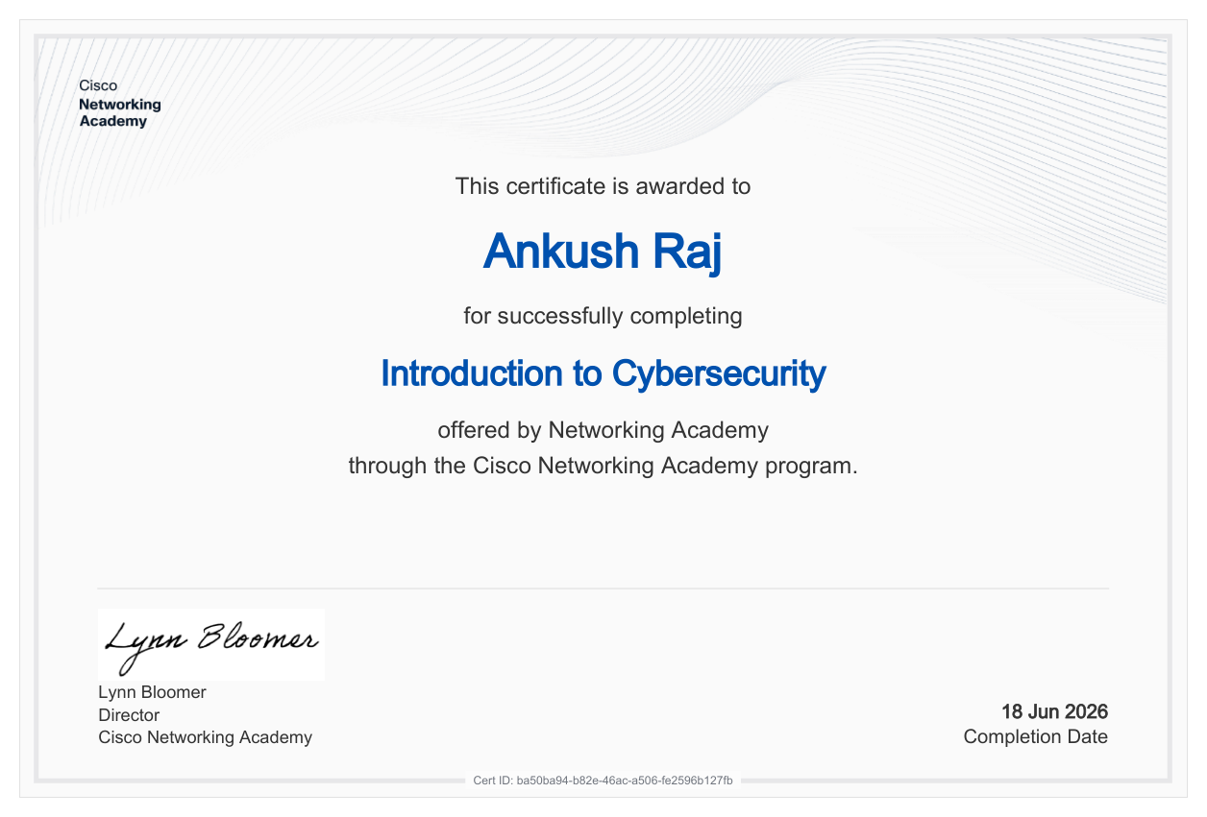
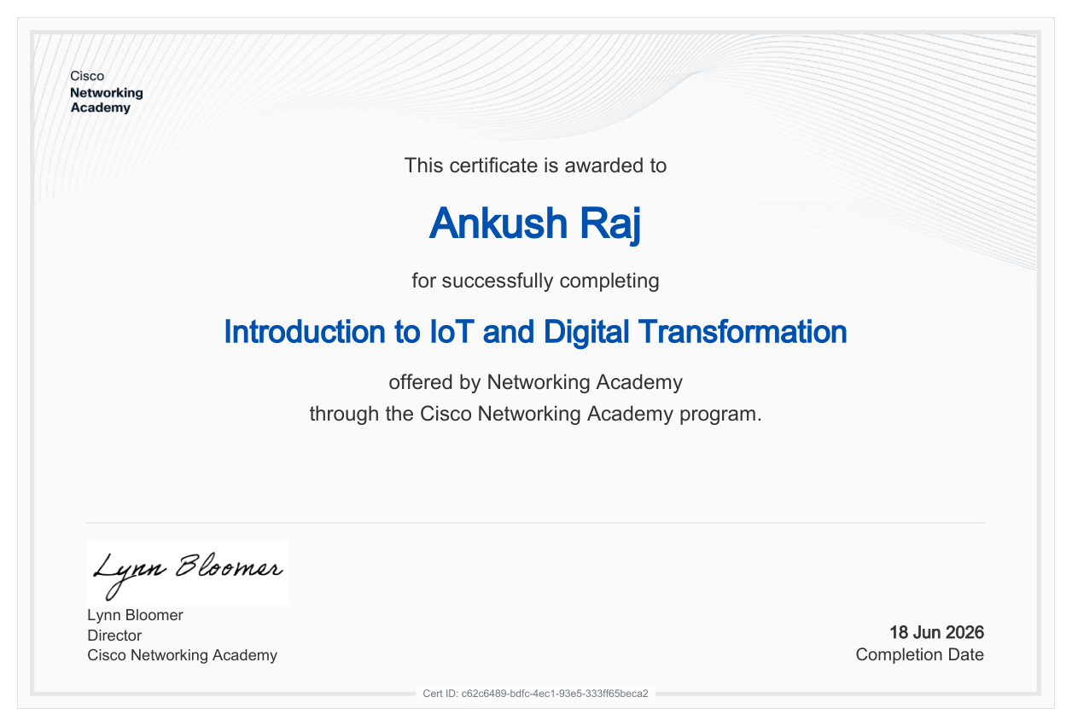
CERTIFICATION
Successfully Completed
Three Cisco Networking Academy course-completion certificates
Networking Basics
Introduction to Cybersecurity
Introduction to IoT & Digital Transformation
Completed: 19 June 2026
Completed: 18 June 2026
Completed: 18 June 2026
Certificate ID f8f3b46f-3a06-4add-a144-2fe35ded21c9
Certificate ID ba50ba94-b82e-46ac-a506-fe2596b127fb
Certificate ID c62c6489-bdfc-4ec1-93e5-333ff65beca2
3 COURSES • 3 CERTIFICATES • CISCO NETWORKING ACADEMY
Cisco Networking Academy Training • Ankush Raj
10

Slide 11
REFERENCES
Official Course Sources
Cisco Networking Academy references used for the course descriptions
1
Networking Basics
netacad.com • Networking Basics
Cisco Networking Academy course information
2
Introduction to Cybersecurity
netacad.com • Introduction to Cybersecurity
Cisco Networking Academy course information
3
Introduction to IoT & Digital Transformation
netacad.com • Introduction to IoT
Cisco Networking Academy course information
4
Cisco Course Catalog
netacad.com • Course Catalog
Cisco Public Course Catalog, January 2024
Course descriptions are based on Cisco's published course information; certificate dates and IDs are taken from the certificates included in this presentation.
Cisco Networking Academy Training • Ankush Raj
11

Slide 12
THANK YOU
Cisco Networking Academy Training
Networking Basics • Cybersecurity • IoT & Digital Transformation
ANKUSH RAJ | Roll No. 2410031647 B.Tech CSE • IILM University, Greater Noida
Cisco Networking Academy Training • Ankush Raj
12

