Slide 1
Social Media Algorithm & Political Polarization

Slide 2




Are we choosing what we see or is it choosing us?
Active Selection
Passive Reception
Choose perspectives to embrace
Be influenced by algorithmically selected content
How we approach social media content?

Slide 3
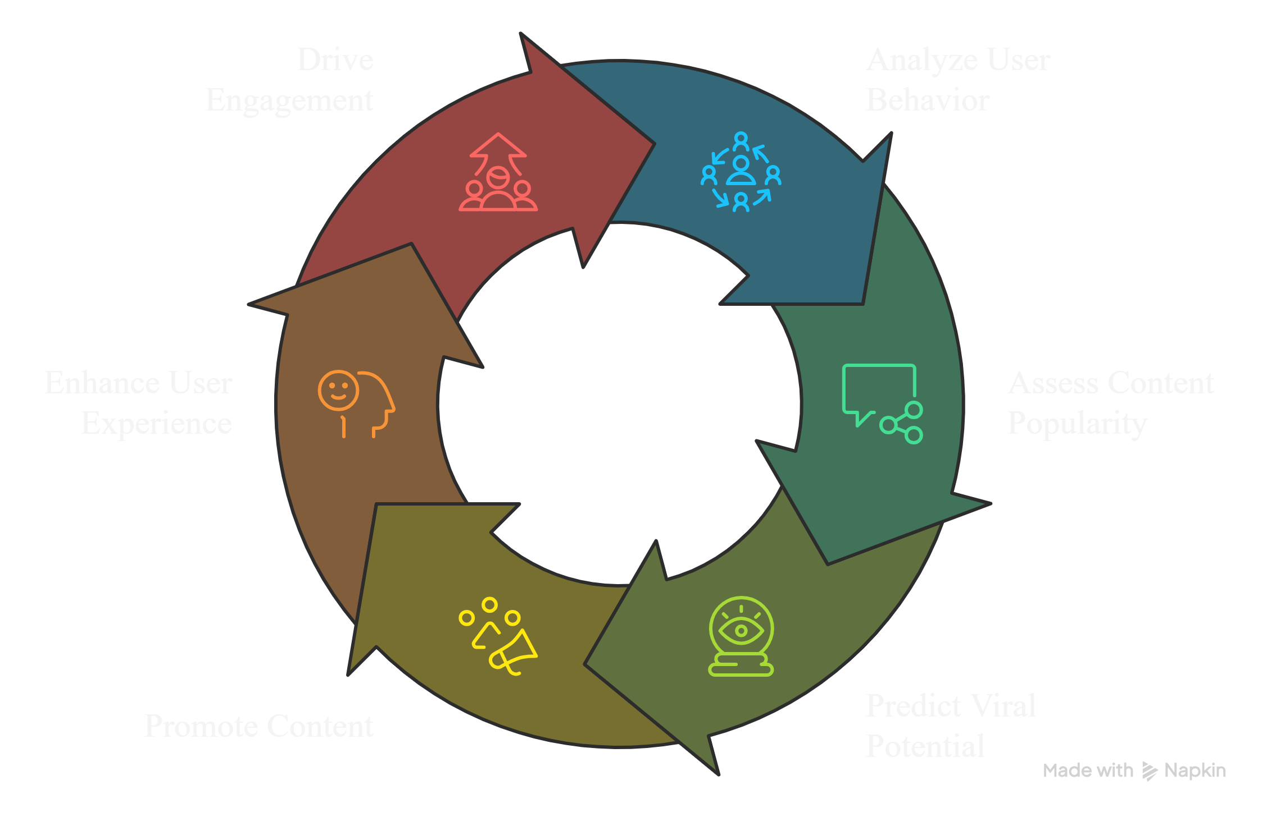
Viral Content Algorithm Cycle

Slide 4
Problem Statement
Analyze how social media algorithms influence political opinions and their resulting impact on society.

Slide 5
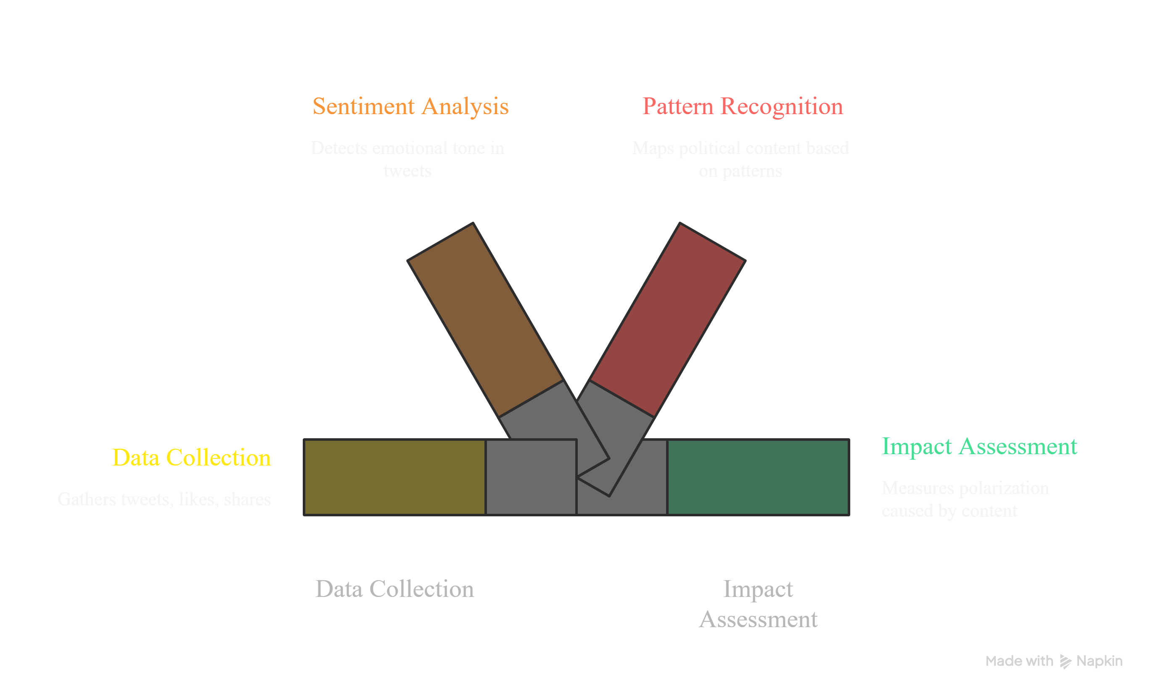
Analysis

Slide 6
Key Findings & Conclusion
Machine learning detected strong patterns of manipulation in political content
Highly engaging posts are often emotional.
Viral content tends to prioritize reaction over accuracy
Users are repeatedly exposed to similar opinion-based content
Engagement-driven systems amplify extreme viewpoints

