Slide 1
Social Media Algorithm and Political Polarization
Ankush(2210991283)
Bhupesh(2210991447)
Chirag(2210991466)
Anuj(2210991315)
Subject: IOHE(Industry Oriented Hands-on Experience)
Supervised by : Dr Ashish Kumar
Chitkara University Institute of Engineering and Technology,
Chitkara University, Punjab

Slide 2
Introduction
Social media platforms have changed the way people communicate and share political opinions. These platforms provide quick access to news, discussions, and public debates. However, users are often exposed only to content that matches their beliefs. This creates echo chambers and limits exposure to different viewpoints. As a result, divisions among social groups continue to increase. This process contributes significantly to social polarization in society.
Political polarization refers to the growing gap between opposing political ideologies. Social media algorithms frequently promote emotionally engaging political content. Misinformation and biased information further influence public opinion online. People become more supportive of their own political groups and less tolerant of others. This increases conflicts in political discussions and weakens democratic dialogue. Therefore, social media plays an important role in shaping political polarization.
.

Slide 3
Problem Statement
The increasing use of social media has changed the way people receive political information and express opinions online. Many users are exposed only to content that supports their existing beliefs and viewpoints. Social media algorithms often recommend similar posts, creating echo chambers among users. This limits interaction with different perspectives and increases misunderstandings between social groups. As a result, social divisions and ideological conflicts continue to grow in society. Therefore, social media has become a major factor contributing to social polarization.

Slide 4
Objective
To examine the role of social media in influencing social and political opinions among users. To understand how online platforms affect communication and information sharing in society. To analyze the impact of social media algorithms on user behavior and content exposure. To study the formation of echo chambers and selective exposure on digital platforms. To identify factors that contribute to social divisions through online interactions. To evaluate the relationship between social media usage and social polarization.
To analyze how social media contributes to political polarization in modern society. To study the spread of misinformation and biased political content on online platforms. To examine the effect of political discussions on public opinion and democratic values. To understand how users develop extreme political attitudes through social media engagement. To evaluate the impact of online political conflicts on social harmony and stability. To suggest possible measures for reducing social and political polarization online..

Slide 5
Methodology
This research is based on both qualitative and quantitative methods to study social and political polarisation.Data is collected from research papers, journals, articles, and online sources related to social media.Surveys and questionnaires are used to understand public opinions and social media usage patterns.The study focuses on how users interact with political and social content on digital platforms.Different social media platforms are analyzed to identify trends in online discussions and behavior.The collected data is examined to understand the relationship between social media and polarisation.
The research also includes the analysis of misinformation, echo chambers, and algorithm-based content recommendations.Comparative analysis is used to study different political viewpoints shared on social media platforms.Statistical methods are applied to interpret survey responses and user engagement data.Secondary data from books, reports, and previous studies supports the research findings.

Slide 6
Key features & Learnings
Social Media Analysis: Studies the impact of social media on social and political opinions.
Echo Chamber Identification: Examines how users are exposed to similar viewpoints online.
Misinformation Detection: Analyzes the spread of fake news and biased political content.
Public Opinion Study: Evaluates how online discussions influence public thinking and behavior.
Polarisation Assessment: Identifies factors responsible for increasing social and political divisions.
Data Collection Methods: Uses surveys, journals, research papers, and online sources for analysis.

Slide 7
Technology Stack
Backend:
The backend processing is developed using Python, which handles dataset loading, preprocessing, sentiment analysis, machine learning model training, and prediction tasks. The system processes large-scale social media datasets efficiently and performs automated classification of political content.
Data Processing:
Data preprocessing is performed using Pandas, NumPy, and regular expression techniques. The datasets collected from Kaggle are cleaned by removing URLs, symbols, stop words, and unnecessary text. The processed textual data is then normalized and transformed into machine-readable format using TF-IDF vectorization for machine learning analysis.
AI Model Integration:
The system uses Logistic Regression and Random Forest models implemented with Scikit-learn for fake news detection, virality prediction, and manipulative language classification. Sentiment analysis is performed using VADER Sentiment to analyze emotional intensity and political sentiment in social media posts. These models help classify content as fake, viral, manipulative, positive, negative, or neutral.

Slide 8
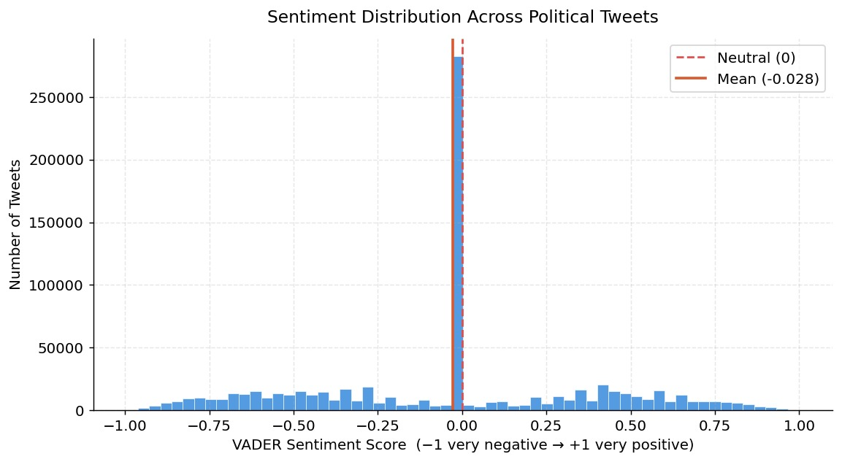
Results and Outputs

Slide 9
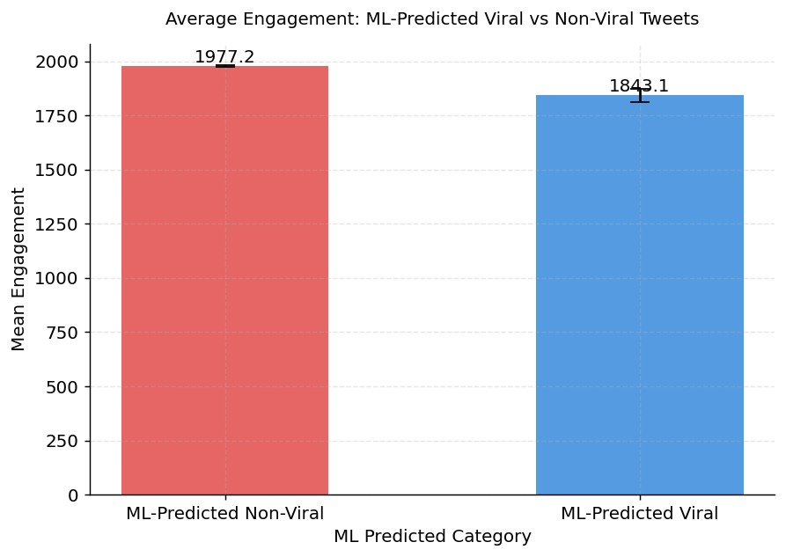
Results and Output

Slide 10
Conclusion
Social media algorithms have a strong influence on the way people receive political
information and interact online. Engagement-based systems often promote emotional and controversial content to increase user activity.This creates echo chambers where users mostly see opinions similar to their own beliefs.The spread of misinformation and biased political content further increases social and political divisions.Machine learning analysis also shows a connection between engagement and the visibility of manipulative content.Therefore, social media platforms contribute significantly to political polarisation in modern society.

Slide 11
Future Scope
Improved Model Accuracy: Enhance detection using larger datasets and advanced hybrid AI models.
Mobile Application Development: Extend the system to Android/iOS for on-the-go deepfake detection.
Cloud Deployment & Scalability: Deploy on cloud platforms for large-scale, real-time processing.
Integration with Social Media Platforms: Enable automatic detection of deepfake content on online platforms.

Slide 12


