Slide 1
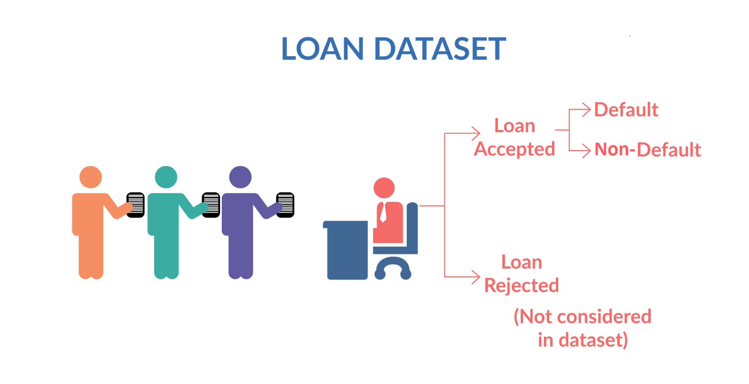
Lending club case study
Program: EPGPML- C49
Group: Ankush Garg
Pulkit gangwar

Slide 2
Objective
If the applicant is likely to repay the loan, then not approving the loan results in a loss of business to the company
If the applicant is not likely to repay the loan, i.e. he/she is likely to default, then approving the loan may lead to a financial loss for the company
Our objective is to analyse which applicant is able to repay the loan and which applicant is most likely to default on the loan

Slide 3
Data cleaning
Few columns are having 100% NAN Values, which can not be part of our analysis
Apart from this there are few columns which have more than 30% NAN values, imputations in such variables can make our data biased and will not give us clear picture.

