Slide 1
HOTELS REVIEW REVIEWED
Sentiment Analysis for Hotel Reviews
Group 9
Notes:
Hi, we are group 9.
We have been working on some very interesting problem for past 15 days. And here we are to discuss and answer about it.

Slide 2
WHAT WE OFFER ?
Notes:
With increase in number of information about hotels available online, there is a huge lot of reviews for hotels, but I doubt if common mass reads them all before booking. Thus is the need for sentiment analysis and conversion of reviews to ratings.
We present a system that collects hotel reviews and hotel description and apply on it some feature-aspect based sentiment analysis and then ship our data in presentable format.

Slide 3
WHO WE OFFER TO?
Common Mass, trying to book tickets for best-fit hotels according to filters and preferences.
Currently Existing Booking Platforms, trying to increase their conversion rate by showing reviews and ratings to users.
Hotel Managers, trying to get to know users’ views about their hotel.
Notes:
Firstly, for facilitating booking for users. The users can know about stay ranking in a city, read about pros and cons about a hotel and thus choose a best-fit hotel. One can filter hotel according to various parameters like region, price, star rating and amenities provided. At the same time one can see the rating score given to the hotel.

Slide 4
WHO WE OFFER TO?
Common Mass, trying to book tickets for best-fit hotels according to filters and preferences.
Currently Existing Booking Platforms, trying to increase their conversion rate by showing reviews and ratings to users.
Hotel Managers, trying to get to know users’ views about their hotel.
Notes:
It is a well known fact that when hotel booking platforms show ratings with hotel information, conversion rate increases. We provide booking platforms with vital and handier information about hotels which they can then display on their website.
It is evident that showing user’s review increases the conversion rate by 14- 76%. Now showing them handier information would be quite useful and necessary for booking platforms.

Slide 5
WHO WE OFFER TO: BOOKING PLATFORMS
Total rating – 7.6
Rank in “Andheri East” – 16
102 reviews
30 mentions about food, food rating – 9.1
Very positive food reviews – [ “Loved the buffet”, The food and service was awesome”…
Notes:
This is a sample data display that a booking platforms can deliver. One can see the rating, number of reviews, ranking, and also categorised ratings. Of-course there are more categories than food.

Slide 6
WHO WE OFFER TO?
Common Mass, trying to book tickets for best-fit hotels according to filters and preferences.
Currently Existing Booking Platforms, trying to increase their conversion rate by showing reviews and ratings to users.
Hotel Managers, trying to get to know users’ views about their hotel.
Notes:
Hotel managers are keen to know about their hotel’s performance and the views customers carry about their services. They like to know, what about their hotel is liked and what is hated by the customers.
Currently hotel booking services often only publish scalar ratings, e.g. scores between 1 and 5. Such scores are not very helpful for hotel managers as the numeric value does not provide information of what guests actually considered positive or objectionable. For hotel managers the textual user comments would be much more significant than the numeric scores since they would be interested to know what the users exactly commented on and how they thought of it. Another problem for hotel managers is that of following updates and new reviews. Hotel booking services and travel agencies collect and publish user reviews systematically, e.g. by asking their customers for comments or ratings. So, new reviews appear quite frequently on their pages but it would be difficult to follow these by just using general search.
So, we aim at providing such a service for hotel managers that collects user reviews for hotels from various sites on the web, analyse the textual content of the review and give classified ratings along with classified reviews.

Slide 7
HOW DID WE?
Notes:
Now we will discuss about our methodology.

Slide 8
STEPS
Data Acquisition System
Sentiment Analysis
Score Methodology
Feature-Aspect Based Analysis
Score Normalisation
Notes:
The first step was to scrape information from various websites.

Slide 9
DATA ACQUISITION SYSTEM
Software used: SCRAPY
Websites crawled: expedia.co.in, tripadvisor.in, holidayiq.com
Notes:
Scrapy is a Python package that aims at easy, fast, and automated web crawling. Scrapy uses a class called Item as a container for the crawled data. The class that actually does the crawling is called Spider (for obvious reasons). We feed the spider with a list of starting URLs. The spider goes to each of the URL, extracts data that is desired, and stores them as a list of instances of the class that we previously defined.

Slide 10
STEPS
Data Acquisition System
Sentiment Analysis
Score Methodology
Feature-Aspect Based Analysis
Score Normalisation
Notes:
After getting handful of data, we did analysis on the textual reviews.

Slide 11
SENTIMENT ANALYSIS
Software used: Stanford’s coreNLP
Algorithm used: Recursive Neural Tensor Network
Notes:
For this, we used Stanford’s coreNLP package in JAVA. This coreNLP defines a set of dictionary and grammar. The sentences are parsed as trees according to POS(part of speech) tagger. The algorithm used is recursive neural tensor network and the output is extracted in probabilistic manner. More discussion about it in further slides.

Slide 12
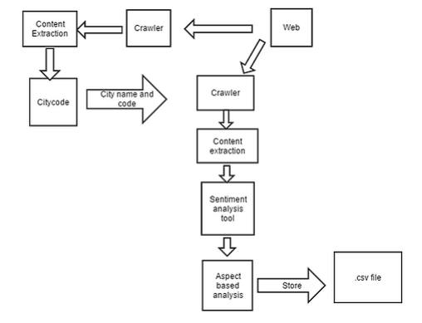
Notes:
So now, suppose you want to know about reviews of Kolkata. The crawling starts from getting hotel list, which we retrieved from expedia.co.in. Now the hotel page is achieved from other travel booking websites, we used tripadvisor.in and holidayiq.com for the start. Other info about the hotel like price, star rating, location was also retrived. Then using sentiment analysis tool of stanford’s we did converted rviews to ratings. Using feature based analysis we arrived at a .csv file.

Slide 13
STEPS
Data Acquisition System
Sentiment Analysis
Score Methodology
Feature-Aspect Based Analysis
Score Normalisation
Notes:
Now after doing sentiment analysis, we did some overhead manipulations for scoring.

Slide 14
SENTENCES, NOT REVIEWS
Notes:
First big point was that we used sentence as atomic unit instead of complete reviews. The selection of sentences instead of sentences was done after a good amount of evaluation.
It was noted that evaluating a text at the document level has some disadvantages. For example, a negative review does not necessarily mean that complete object (hotel in this case) is negative! There can be some specific aspect about that particular object that is positive. Likewise, a positive evaluation does not mean that the author dislikes everything about the object. For instance, in hotel reviews an author usually writes both positive and negative aspects about that hotel, even though the overall sentiment of the review can be either positive or negative. To obtain such detailed aspects, we will have to go to the sentence level and extract the interesting features.

Slide 15
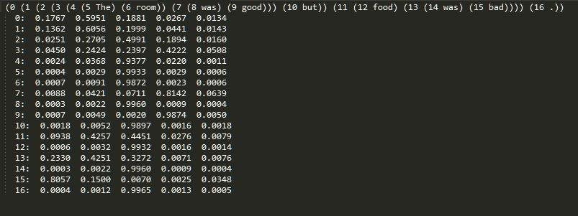
SCORE METHODOLOGY
Notes:
Now consider an example sentence “The room was very good but food was bad.” It is fairly usual review. This was the output we received when we evaluated this.
The first line of the output is the parsed string in the form of binary tree. If we visualise the tree it would be somewhat like this.

Slide 16
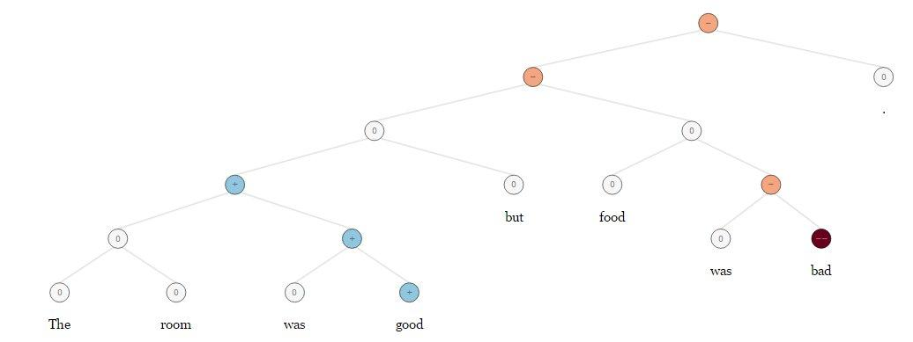
SCORE METHODOLOGY
Notes:
Here. The sentence is divided in a binary tree.

Slide 17
SCORE METHODOLOGY
Notes:
The lines that follow the first line give the probabilistic score for the corresponding number of node. The coreNLP package categories sentiment into 5 categories – very negative, negative, neutral, positive, very positive. The number over here are probability of the node to be in a particular category. This means the root node (0th node, i.e. for whole sentence) has a probability of 19% that it is neutral. The parsed tree string was read by pyparsing module of python and converted to nested string array.
The score then is calculated for the root node by multiplying the probability of very negative, negative, neutral, positive, very positive sentiments with 1, 3.25, 5.5, 7.75 and 10 respectively and adding thus to get a total score for a line. The numbers (1, 3.25, 5.5, 7.75, and 10) are the equal distribution of the range 1…10 (the desired range of output).

Slide 18
FEATURE-ASPECT BASED ANALYSIS
Notes:
One of the cool thing we are proud about our platform is feature based sentiment analysis. Giving only one number, the total rating, was sad- since it involved a loss of huge amount of information.

Slide 19
FEATURE-ASPECT BASED ANALYSIS
General rating
Food rating
Room rating
Service rating
Location rating
Cleanliness rating
Notes:
These are the list of categories we picked, general rating being total rating.
This is a helpful way for users to find hotels which have the facilities that each individual user finds important. If one does not need a breakfast, but require good location, it should be possible to filter out what previous users think about specific services and filter results accordingly. These features are defined ahead of time and are generally meant to be domain specific. However these categoires were to our understanding. One can easily modify the source code to add, alter or remove a category.

Slide 20
FEATURE-ASPECT BASED ANALYSIS
Seed array for location: ["location","position","place","property","situation","site","locality","local","spot","whereabouts","whereabout","scene","setting","area","environment","venue","address","view","sight","beach"]
Notes:
For this, specific words marking the particular feature were seeded in arrays. The occurrence of these words was then figured from the string. If the main string contained more than one feature, then the sentence was broken into smaller phrases recursively.

Slide 21
FEATURE-ASPECT BASED ANALYSIS
“I had a wonderful meal at Hotel Oberoi, I loved the puddings.”
Notes:
Initially, we marked features from the sentence, like this has feature – food. The score for this sentence affects food rating as well apart from general total rating.

Slide 22
FEATURE-ASPECT BASED ANALYSIS
“The room was good but the food was very bad.”
Notes:
But the idea quickly failed, consider this. Two separate feautre, two separate views.
It is evident that the reviewer is unsatisfied by food, but is happy with room. If we did normal sentiment analysis, we will get almost neutral review. But this sentence tells more than that.

Slide 23
FEATURE-ASPECT BASED ANALYSIS
Notes:
#Explain algo down on the node one
So, the parser detects the two fragments – “the room was good” and “the food was very bad”. Then it gives the score to individual feature thus specifying this particular hotel to be good in room while bad in food.

Slide 24
FEATURE-ASPECT BASED ANALYSIS
Notes:
This was the output coreNLP gives. The noteworthy point is that the total score given remains the same, i.e. the score of the root node (node numbered 0)
.
However, if the sentence is too complex for this method, like having more than one feature in one phrase we used our initial idea.

Slide 25
STEPS
Data Acquisition System
Sentiment Analysis
Score Methodology
Feature-Aspect Based Analysis
Score Normalisation
Notes:
After we did all this, we faced one problem, problem of normalising the score.

Slide 26

SCORE NORMALISATION: THE NEED
Notes:
The score achieved from this had a mean of 5.73 and median of 5.75. However, the standard deviation was just 0.49.
So all the hotel ratings were between 3.86-6.74
The problem figured was due to objective sentences. There were a fairly large amount of sentences saying “I went to Bangalore” or “Reached there in winters”. And when such sentences were given to stanford, they got neutral ratings, thus forcing the overall rating of hotel to be in a nearer range of 5.5.

Slide 27
SCORE NORMALISATION: THE SOLUTION
Simply don’t consider objective reviews.
We defined the range of 5.0 to 6.0
If a review lies in this range, don’t consider the review for overall rating.
Applied only for general rating
Notes:
The solution figured was simple. Simply don’t consider neutral reviews.
#todo read slide.

Slide 28

SCORE NORMALISATION: THE OUTPUT
Notes:
So, that was something, the standard deviation increased.
#Todo add chart and range.

Slide 29
OKAY, HOW TO USE IT ?
Notes:
Now we will discuss about our user interface
# focus on scalability and automation
# show csv

Slide 30
OKAY, HOW DO WE USE IT ?
Command Line Interface
Web-based simple interface
Web-based advanced interface

Slide 31
COMMAND LINE INTERFACE
Code written in PYTHON
Works in windows
Single command to roll
Notes:
# ?

Slide 32

COMMAND LINE INTERFACE
Notes:
So this is the how the back end looks.
This command in python executes main.py file which in itself does all the work – Mumbai is the argument, for which data fetching, analysis and scoring.
#Automation, scalability
# insert code of python main.py $city_name
# insert 2-3 slides of demo
# we can give you demo after presentation (maybe)

Slide 33
COMMAND LINE INTERFACE
Files generated in $city_name directory
review.json
rate.csv
text.txt
Notes:
After giving command for Mumbai, the code after evaluation creates a directory after city name and this directory includes JSON file for hotel reviews and a CSV file

Slide 34
OKAY, HOW DO WE USE IT ?
Command Line Interface
Web-based minimal interface
Web-based advanced interface
Notes:
Now for web-based minimal interface made for non-technical individuals to retrieve all the information.
Let me show you a demo.
# show website, then csv

Slide 35
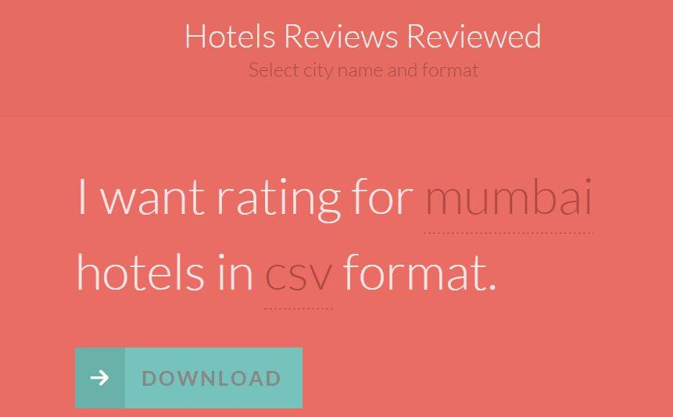
Notes:
Now for web-based minimal interface made for non-technical individuals to retrieve all the information.
Let me show you a demo.
# show website, then csv

Slide 36
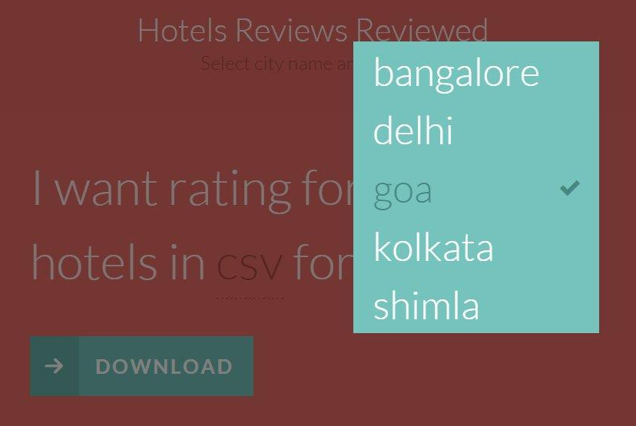
WEB-BASED MINIMAL INTERFACE
Notes:
Now for web-based minimal interface made for non-technical individuals to retrieve all the information.
Let me show you a demo.
# show website, then csv

Slide 37
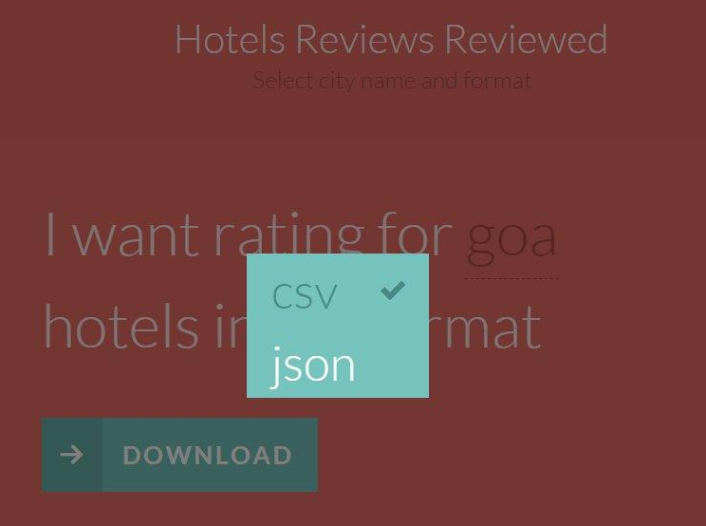
WEB-BASED MINIMAL INTERFACE
Notes:
Now for web-based minimal interface made for non-technical individuals to retrieve all the information.
Let me show you a demo.
# show website, then csv

Slide 38
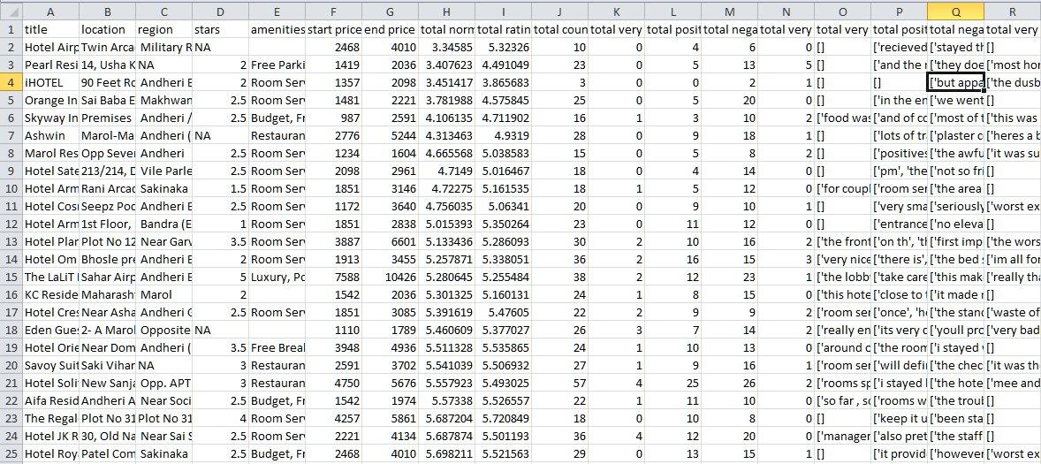
WEB-BASED MINIMAL INTERFACE
Notes:
Now for web-based minimal interface made for non-technical individuals to retrieve all the information.
Let me show you a demo.
# show website, then csv

Slide 39
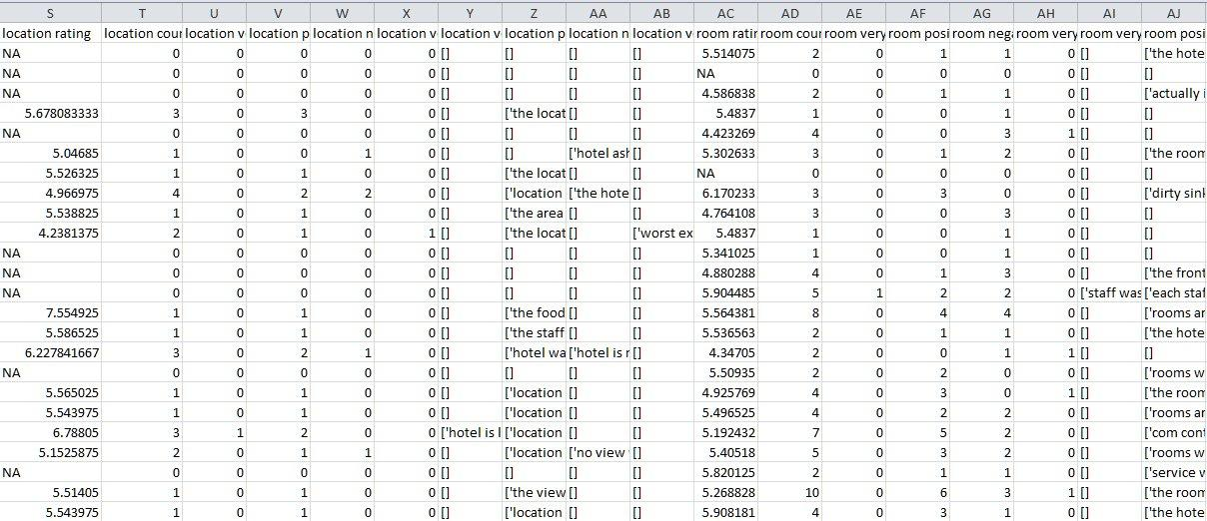
WEB-BASED MINIMAL INTERFACE
Notes:
Now for web-based minimal interface made for non-technical individuals to retrieve all the information.
Let me show you a demo.
# show website, then csv

Slide 40
OKAY, HOW DO WE USE IT ?
Command Line Interface
Web-based minimal interface
Web-based advanced interface
Notes:
The advance interface offer filter, sort, pagination and other features of table. #Show demo,
Although this is not production ready, but will do the job for now and can then be used eventually for booking

Slide 41
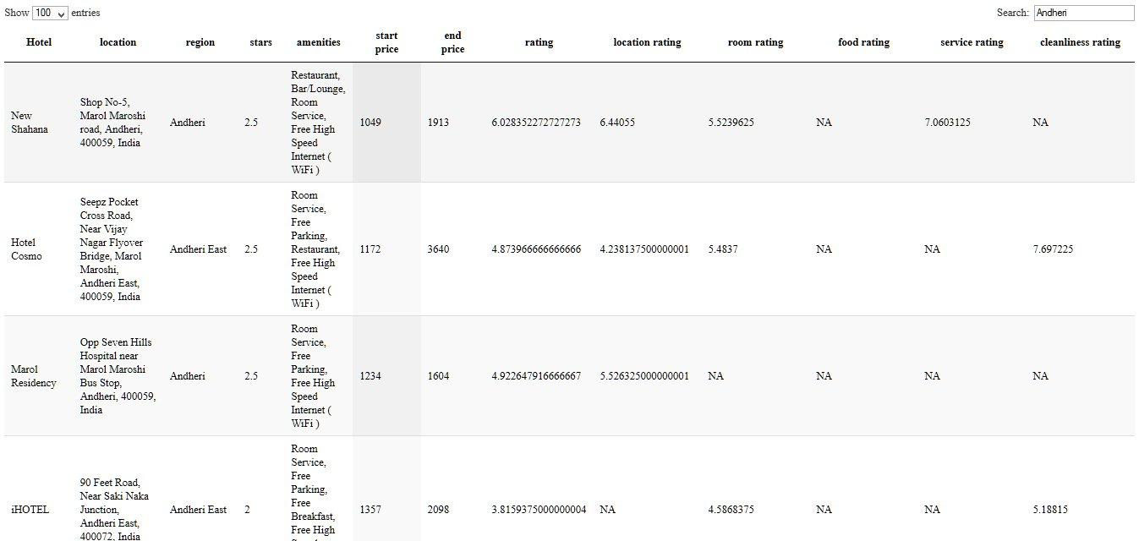
WEB-BASED ADVANCED INTERFACE
Notes:
Now for web-based minimal interface made for non-technical individuals to retrieve all the information.
Let me show you a demo.
# show website, then csv

Slide 42
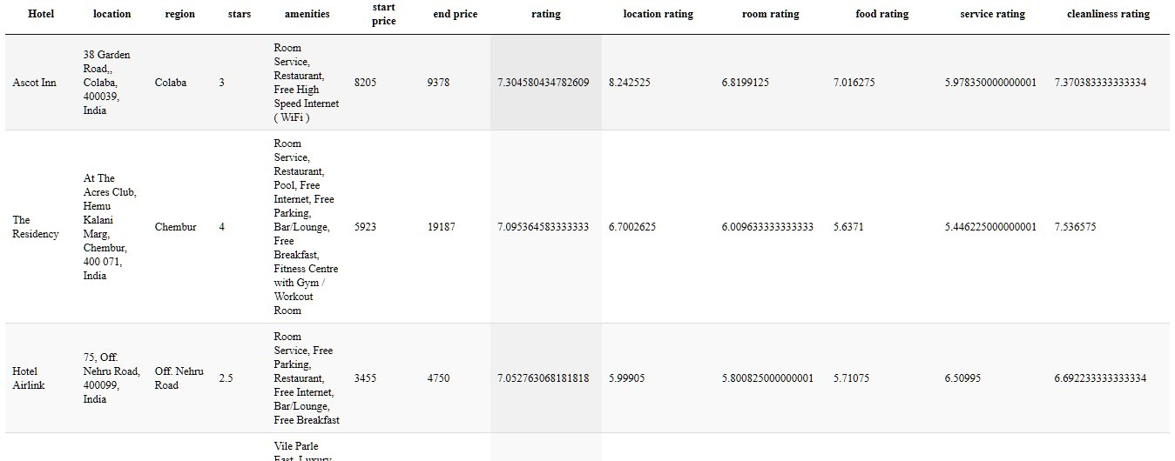
WEB-BASED ADVANCED INTERFACE
Notes:
Now for web-based minimal interface made for non-technical individuals to retrieve all the information.
Let me show you a demo.
# show website, then csv

Slide 43
VISUALISATION

Slide 44
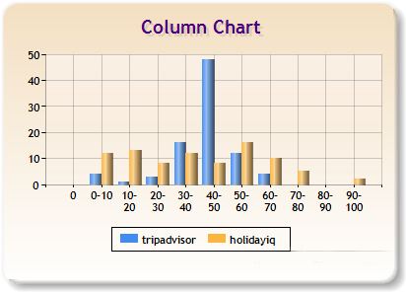
Percentage of hotels for each amount of reviews interval.

Slide 45
Website | Total reviews | Positive reviews | Negative reviews | Neutral reviews
holidayiq | 3334 | 1583 | 698 | 1053
Tripadvisor | 3788 | 1171 | 1195 | 1422
The segments were classified with respect to their polarity, including the neutral polarity.

Slide 46
WHAT’S IN THE FUTURE ?
Notes:
Before we conclude, we want to discuss about some of our shortcomings and out future plans.

Slide 47
WHAT’S IN THE FUTURE ?
Social information gathering- from twitter/facebook
Sarcasm
Notes:
# for first point -> Although we made script to get tweets from twitter using twiter API. But we didn’t used them for analysis as of now. That was due firstly, the short tweets were mostly objective and rarely express the opinion of reviewer. Also, the tweets were two short to convey meaningful info.
# for second point -> Now this is a hard one, people usually talk in sarcastic way. Our algorithm is unable to detect it and do appropiate steps.

Slide 48
WHAT’S IN THE FUTURE ?
Our immediate plan would be to scale for more data.
For hotel managers, we would be adding visualised results with charts and trend-lines displaying how the hotel is doing with time.
Notes:
#read slide
#For first point -> “We used only few web-sources for information gathering, because we know it would now be a easy job to scale after we build the software”
#for second point -> “we think it would be very cool and useful for hotel manager to get graphs and charts telling growth stories, using user review data”

Slide 49
WHAT’S IN THE FUTURE ?
To get more accurate results, we will train the sentiment tree bank with specific hotel reviews.
We would add our solution to read smiles/emoticons, images and different form of texts present in reviews.
Notes:
# for first point -> The Stanford’s core NLP is trained in general data. There is specific terminiolgies used in hotels. Once we trained them using sentiment tree bank, we might very well increase our accuracy”
# for second point -> Nowadays, people are using smilies, emoticons, leet and slang language in internet communications. So, we would focus on handling them as well.

Slide 50
THIS IS IT.
Thank You
Notes:
# Maybe a demo
# Maybe add contact, website address, references
FAQ’s
1) Your crawler dont crawl javascript- We already hit the number for demo purposes, we planned to hit. Moreover, adding the fesature of javascript is not at all a big deal - you just have to use Selenium RC in python shell and it will render you a DOMed page.
2) You didn't scrape stayzilla's page- That’s not at all different from current method. Although we aimed at hitting more external websites like expedia, tripadvisor, holidayiq
3) You didn’t crawl twitter - Although we made script to get tweets from twitter using twiter API. But we didn’t used them for analysis as of now. That was due firstly, the short tweets were mostly objective and rarely express the opinion of reviewer. Also, the tweets were two short to convey meaningful info.
4) Could you show us demo – show them CLI command (hit it, but don’t show it), show them both websites.
5) Why did you removed the export csv option? (from webTable) – we had that in earlier version, but we then realised that the target audience for this inteface is common mass, and export csv option an having complete table would be giving out more than required.

