Slide 1
Task Tracker
Ankush Kashyap
Romaine Herrera
Jasmeet Kaur
Pardeep Kaur
Parveen Kaur

Slide 2
Background
Project An individual or collaborative enterprise planned and designed to achieve an aim.
Project management is the discipline of planning, organizing, securing and managing resources to achieve specific goals.
Project managers responsible for the planning, execution and closing of any project in software development industry.

Slide 3
Problem Statement
The main problem in any project arises due to reporting time in the various steps, which results in delay to complete the targets.
TaskTracker will provide a centralized solution, where in every user will report according to the roles & rights. If the reporting person is geographically dispersed even then the proposed system will give proper support to report his/her work.

Slide 4
Features
Project Portfolio User will be able to track the project on the basis of project team, priorities, tasks, project type etc. Along with the percentage of whole work done.
Document Sharing among team so that information regarding project is centralized & every team member would be able to use it any time.
Report Generation user would be able to generate various reports on the basis of monthly, weekly etc.

Slide 5
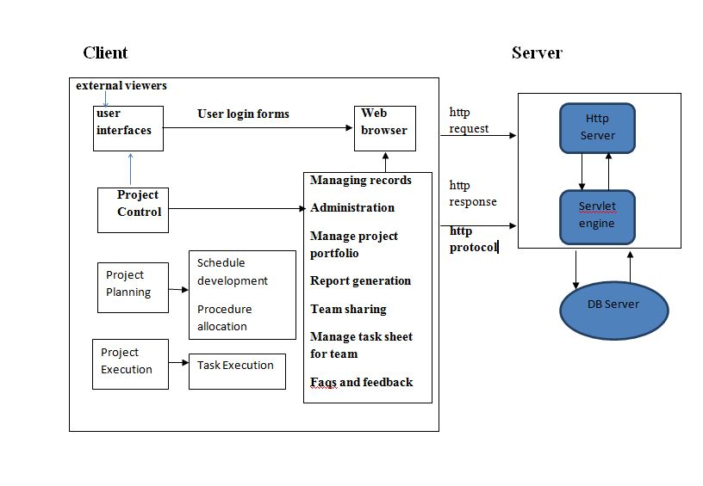
High Level Architecture

Slide 6
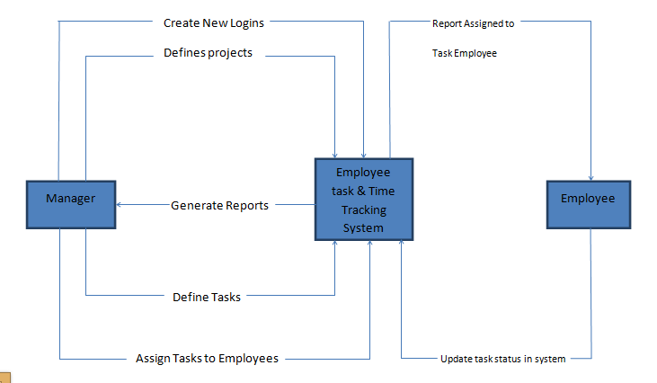
Project Scope

Slide 7
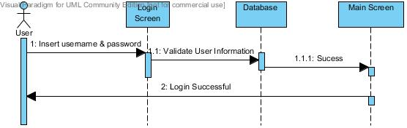
Sequence Diagram User Login

Slide 8
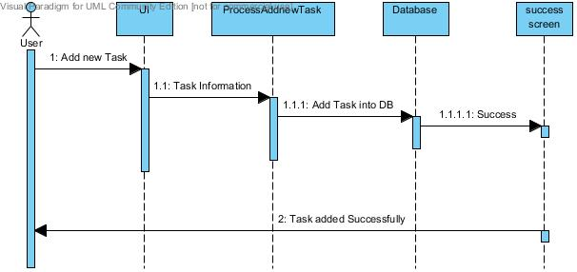
Sequence Diagram Add Task

Slide 9
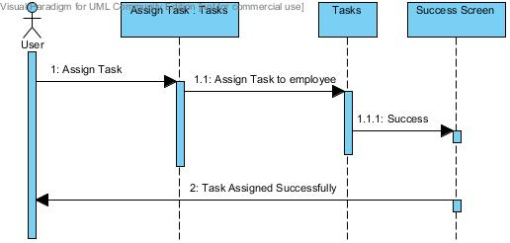
Sequence Diagram Assign Task

Slide 10
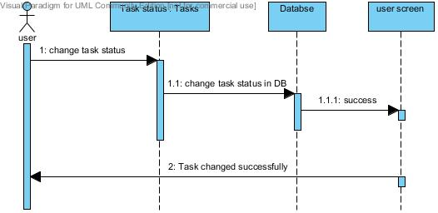
Sequence Diagram Update Task

Slide 11
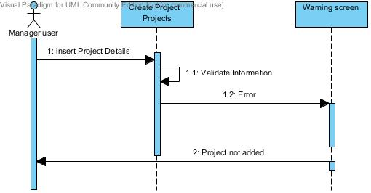
Sequence Diagram Manage Project

Slide 12
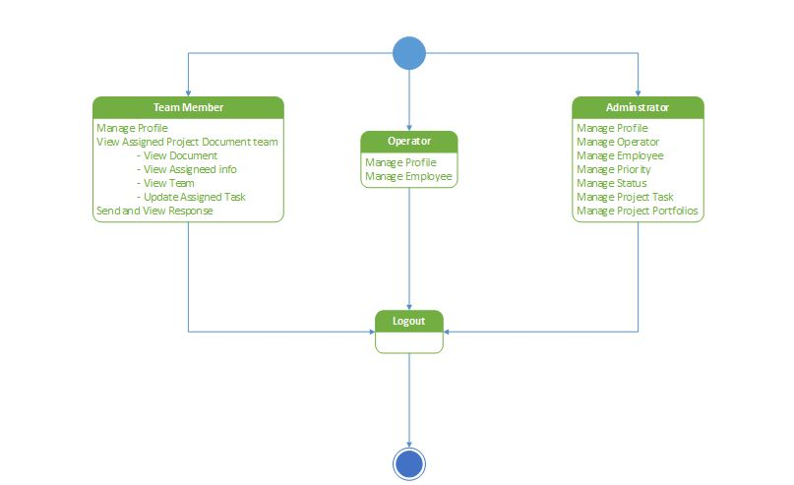
State Chart

Slide 13
Use Case Diagram

Slide 14
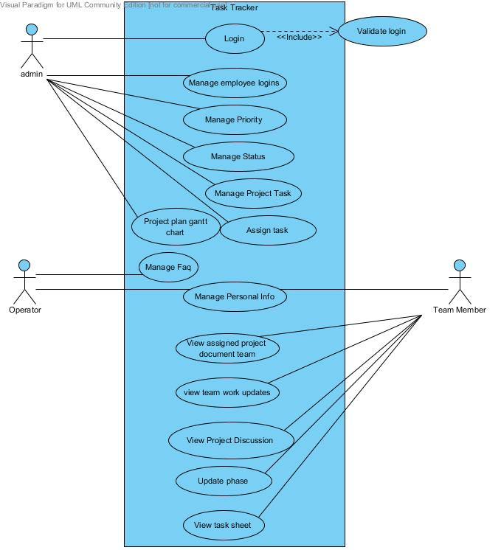

Slide 15
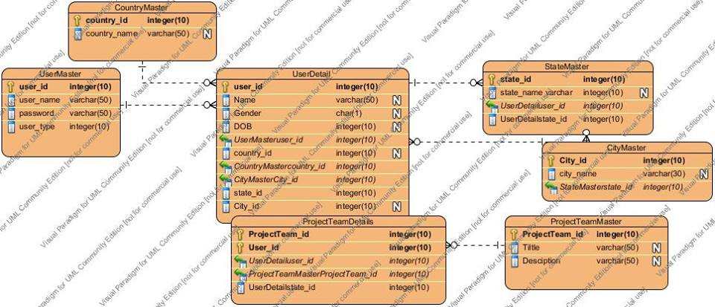
ERD

Slide 16
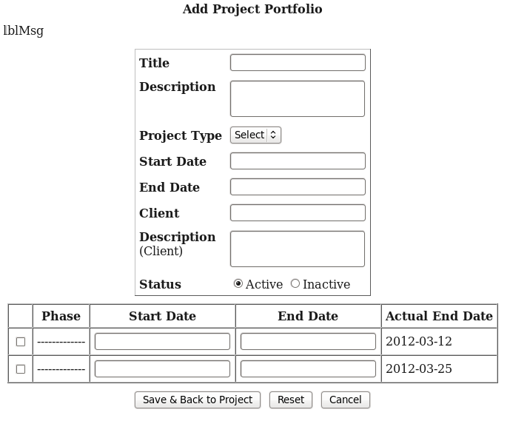
Mock Up

Slide 17
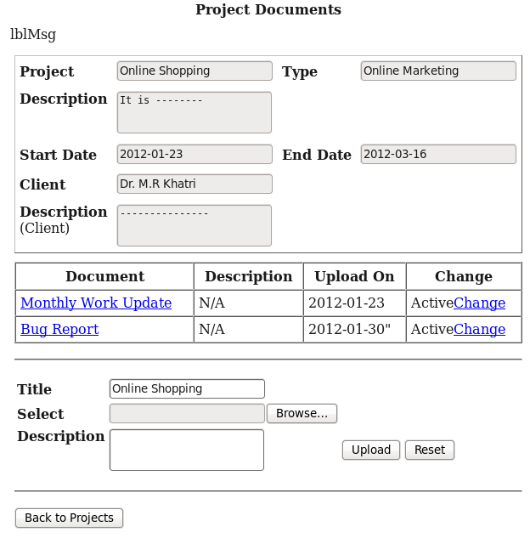
Mock Up

Slide 18
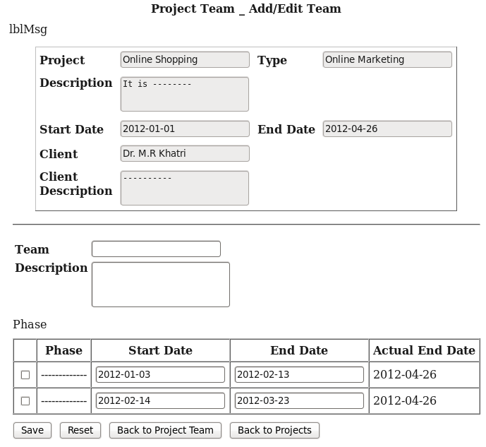
Mock Up

