Slide 1
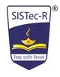
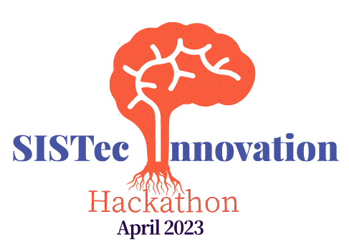
Sagar Institute of Science Technology and Research
PS Title: Automatic recognition of Human Disease using radiological Data
PS number:HT301, Category:- Software
Team Members:
Ankush Mishra
Abhishek Bisen
Gaurav Kumar Gupta
Anjali Tiwari
Harsh Sahu
Guided by-:
Guide Name
College Name
Post

Slide 2
Introduction
Automatic recognition of human disease using radiological data and machine learning is a field of medical imaging that aims to use machine learning algorithms to assist in diagnosis and treatment.
Radiological data such as X-rays, CT scans, and MRIs can provide detailed visualizations of the body's internal structures.
Machine learning algorithms can analyze images, identify patterns and anomalies, and make predictions about the presence, severity, and progression of diseases .
Recent research has shown that deep learning models can outperform radiologists in the detection of lung cancer on CT scans, which could lead to better patient outcomes.

Slide 3
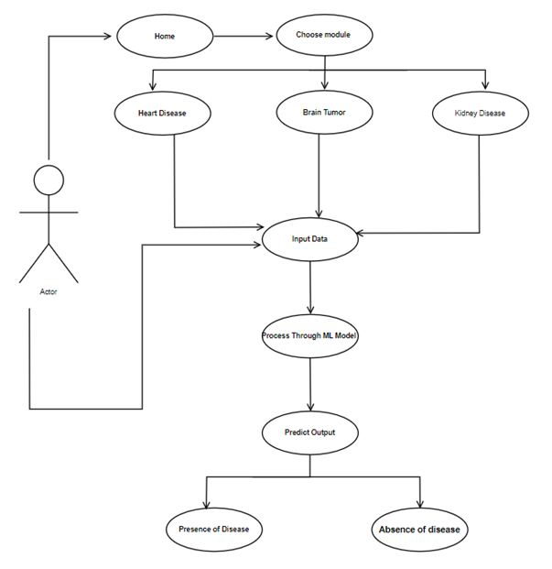
Proposed Solution
Description of Proposed Solution:-
Firstly we acquire radiological images (e.g. X-rays, CT scans, MRIs).
Preprocess images to enhance contrast, remove noise, and normalize image size.
Extract relevant features from the images, such as texture, shape, and intensity.
Train a machine learning algorithm (e.g. deep neural network) on a dataset of labeled images.
Use the trained model to predict the presence or absence of disease in new, unlabeled images.
Deploy the model in a clinical setting to assist radiologists in diagnosing disease and improving patient outcomes.

Slide 4
Working Steps
Identify the problem: Determine the specific disease or condition that needs to be detected or diagnosed using radiological data.
Collect data: Gather a large and diverse dataset of radiological images and associated metadata.
Preprocess the data: Clean and normalize the data to ensure that it is consistent and compatible with the machine learning algorithms being used.
Select a machine learning algorithm: Choose a machine learning algorithm used in medical imaging include deep learning models such as convolutional neural networks (CNNs).
Train the algorithm: Train the algorithm using the preprocessed dataset.
Evaluate the algorithm: Evaluate the performance of the algorithm on a validation dataset to ensure that it is accurate and reliable.
Test the algorithm: Test the algorithm on a separate test dataset to verify its performance and generalizability.
Integrate the algorithm: Integrate

Slide 5
Conclusion and Future Scope
Automatic recognition of human disease using radiological data has the potential to improve diagnostic accuracy, increase efficiency, and enhance patient outcomes in healthcare.
Machine learning algorithms have shown promising results in detecting and diagnosing a wide range of diseases, including lung cancer, breast cancer, and Alzheimer's disease.
As the technology becomes more reliable, we can expect that it can be deployed in clinical practice to assist healthcare professionals in diagnosing and treating diseases.
The global market for medical imaging AI software is projected to reach $4.3 billion by 2024, according to a report by MarketsandMarkets.
There will be ongoing efforts to address challenges related to the interpretability of machine learning models, data privacy, and bias to ensure that these technologies are used in an ethical and responsible manner.

