Slide 1
KPMG Data Science Prodegree Capstone Project
Employee Attrition Analysis
Prepared by : DSP 32 (Group 4)
Members : Pallavi Pawara.
Ankush Pardeshi.
Anand Choudhari.
Tirth shah.

Slide 2









Introduction
Problem Overview
Data Standardization
Steps Performed
Data Visualizations
Transforming Data
Result
Conclusion
Recommendations

Slide 3
Introduction
In the corporate world employee satisfaction have played a major for the organization growth.
Employee attrition and candidates absconding are significant business concerns in today’s knowledge- driven marketplace, where employees are the most important human capital assets.
Employee Attrition is one of the critical problem which are faced by an HR.
Attrition in the company not only pushes up cost incurred on the training of the employee but also affects utilization along with the ideal level of "Knowledge maturity" of the organization and the employee.

Slide 4
Retaining employees has always proved to be fruitful across many industries rather than to search for new & efficient talent. so to gain the fruit of the this tree we need to apply the different strategies.
So this project is to find the factors influencing the employee attrition also to retain the high performers in the XYZ corp.
Project is also discussing about the various retention strategies that can help to check the high attrition rate in the organization.

Slide 5
Problem Overview
Identify the factors influencing attrition.
Predict the possible attritions
Identify possible ways to retain high performers.

Slide 6
Data Standardization
We got 2 datasets i.e. “Staff utlz latest 16-17_masked”, “staff utlz latest 17-18_masked”.
We also got “Terminations 15-18” dataset.
The staff utlz datasets contains details of employees as well as the details of the projects that they have worked on in the last two years.
The other file contains all the attrition in the organization for the years 2015-18 with details such as reason of attrition along with other employee details.
Staff utlz datasets contains monthly utlz data and utlz of the employee for the whole year. Since we need to Predict Possible attrition, we have removed all the monthly data. Now datasets will only have details of employees along with yearly utlz data.
We have build a model on this columns (variables) only.

Slide 7
Initially we had 2 data files:
1 . 2016-2017 dataset
2. 2017-2018 dataset
Then we merged 2016-2017 dataset and 2017-2018 dataset using SQL Full Join with the help of Union concept.

Slide 8
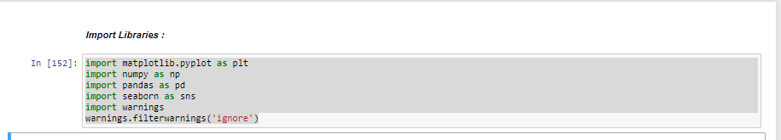
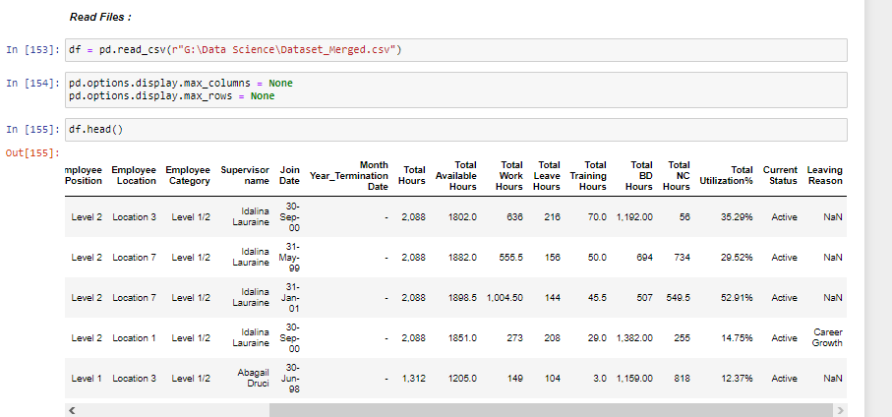
Transforming Data
In this step, we will pre-process/prepare the data so that we can use it in our code efficiently.
#Importing libraries :
matplotlib.pyplot as plt
numpy as np
pandas as pd
seaborn as sns
warnings.filterwarnings('ignore')
We have read the file in python
#Reading file

Slide 9
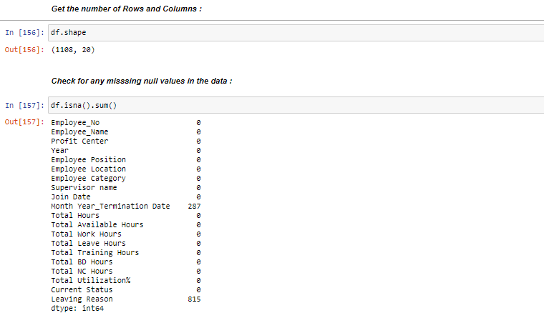
Steps Performed
Viewed the number of Rows & Columns
Check for any missing null values in the data

Slide 10
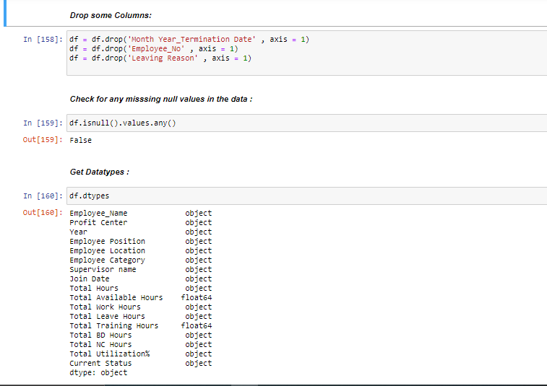
Drop the columns & Checked the missing value in the data
Checked the Data Types

Slide 11
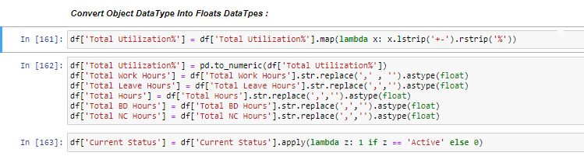
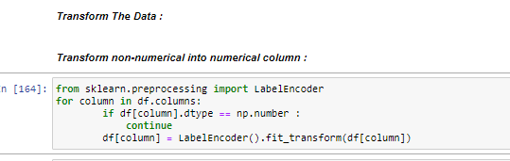
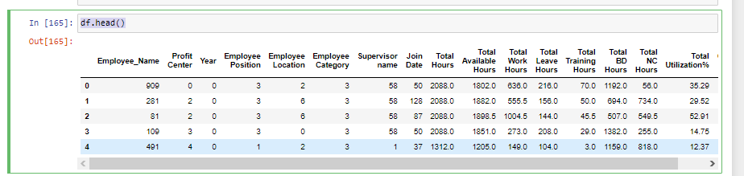
Converted the object data types into float data types
Transform the non numeric data into numeric data
Viewed the data set

Slide 12
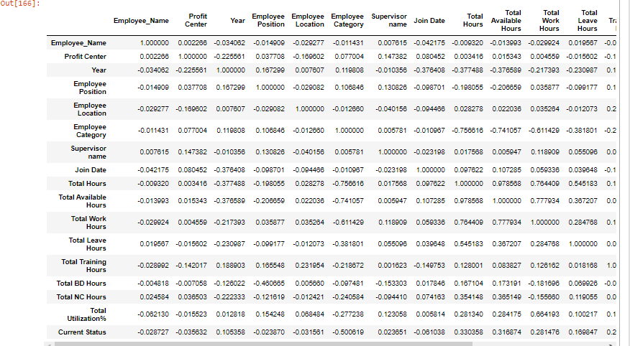
Data Visualization
Checked the correlation

Slide 13
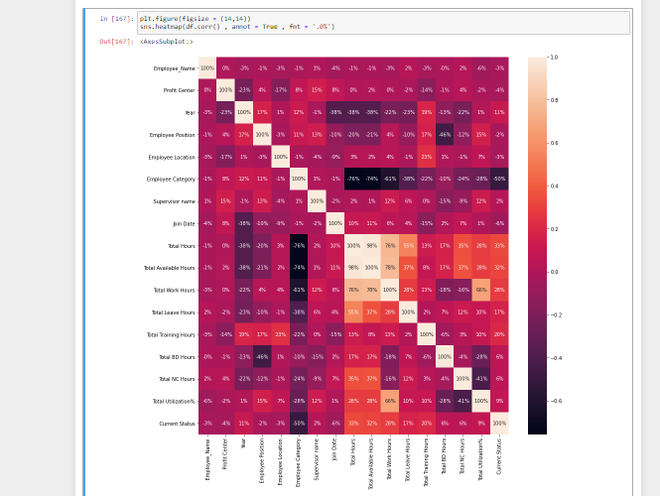
Visualize the correlation
Using Heatmap

Slide 14
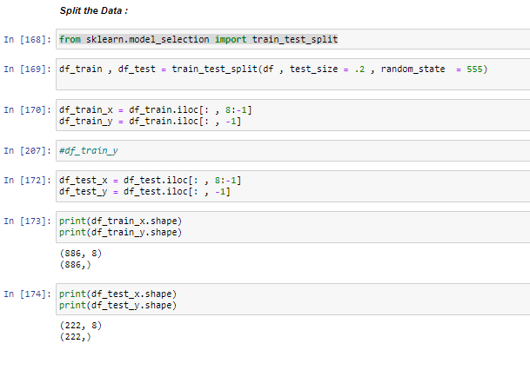
Extract Independent and dependent Variables And Split the Dataset into Train & Test :

Slide 15
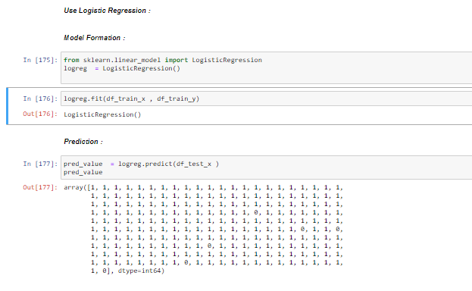
Implementation of Logistic Regression

Slide 16
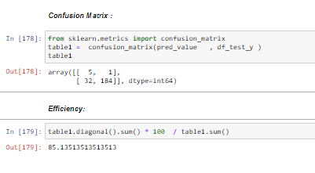
We can find the accuracy of the predicted result by interpreting the confusion matrix. By the output, we can interpret that 5+184= 189 (Correct Output) and 1+32= 33(Incorrect Output).

Slide 17
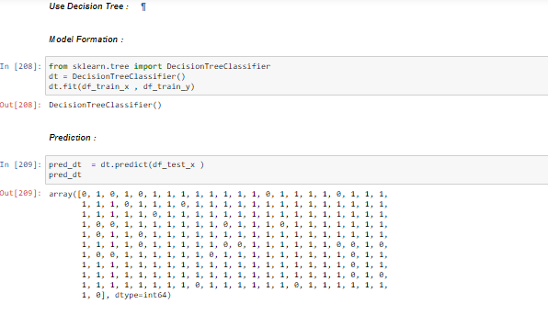
Implementation of
Decision Tree.
As Y Variable is categorical in nature.

Slide 18
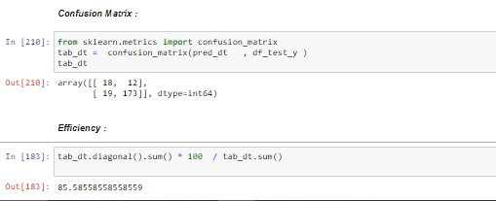
We can find the accuracy of the predicted result by interpreting the confusion matrix. By above output, we can interpret that 18+173= 191 (Correct Output) and 12+19= 31(Incorrect Output).

Slide 19
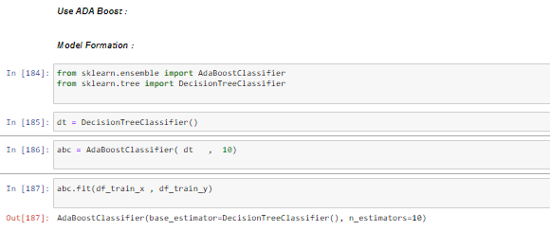
Implementation of ADA Boost Classifier

Slide 20
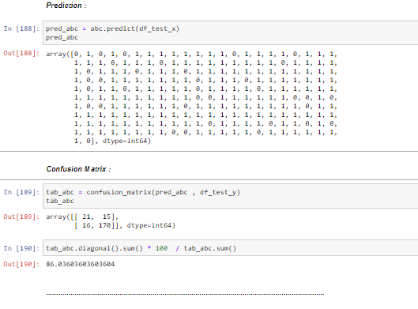
We can find the accuracy of the predicted result by interpreting the confusion matrix. By above output, we can interpret that 21+170= 191 (Correct Output) and 15+16= 31(Incorrect Output).

Slide 21
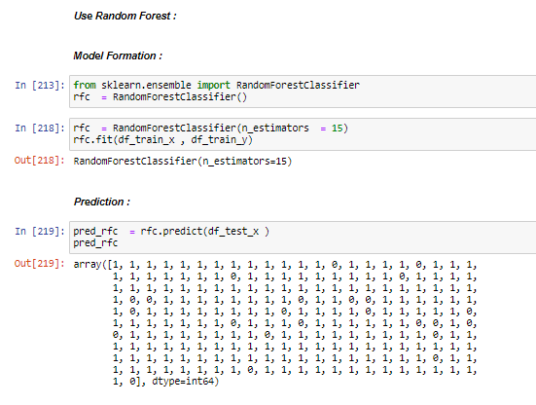
Implementation of
Random Forest .

Slide 22
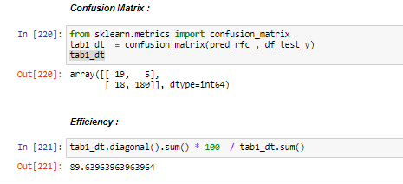
We can find the accuracy of the predicted result by interpreting the confusion matrix. By the output, we can interpret that 19+180= 199 (Correct Output) and 5+18= 23(Incorrect Output).

Slide 23
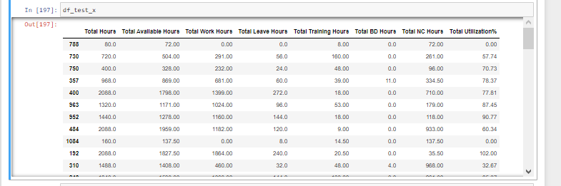
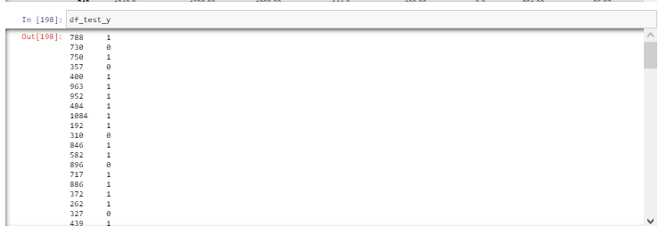
Viewed the Test data set

Slide 24
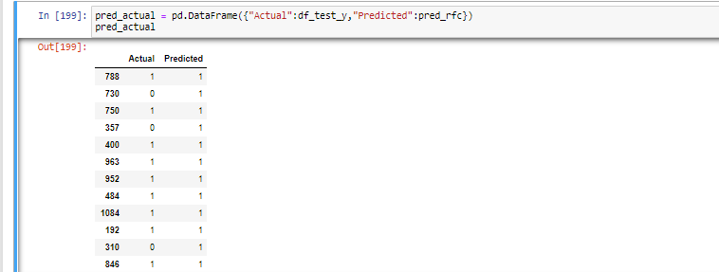
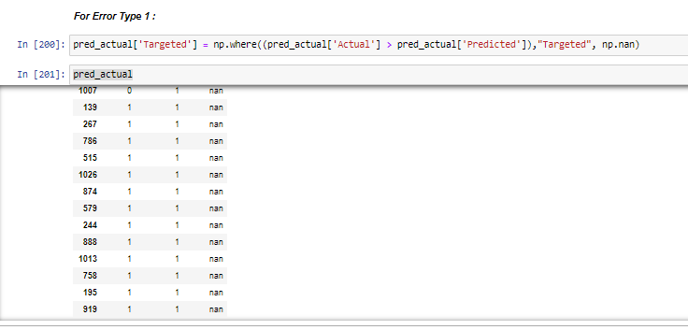
Compared the Actual & Predicted output

Slide 25
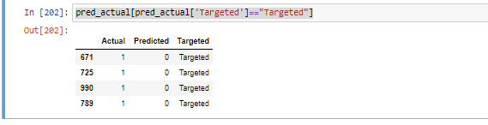
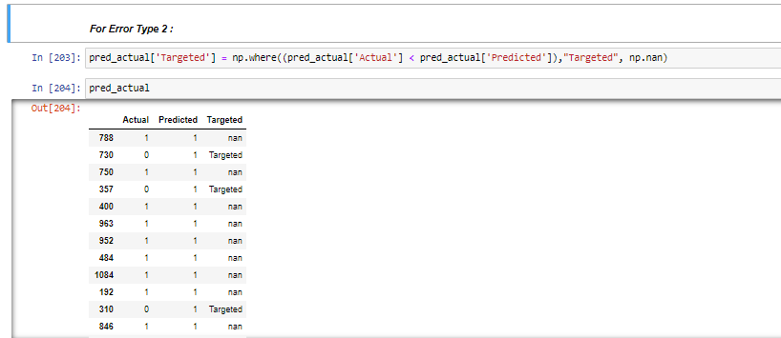

Slide 26
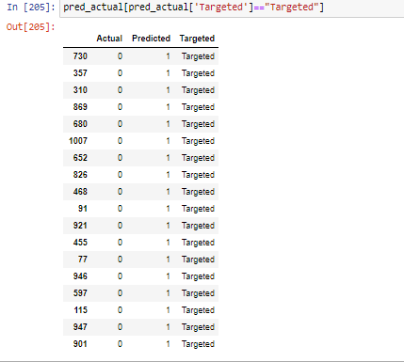

Slide 27
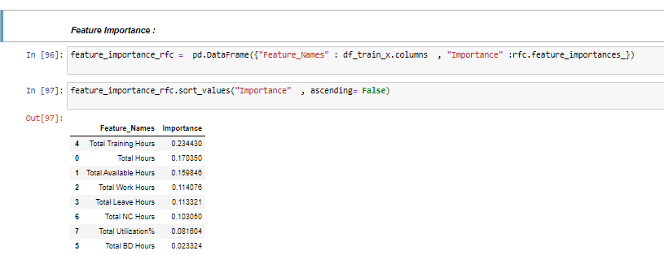
Feature Importance

Slide 28
Result
Why we have selected the Random Forest Classifier ?
Serial No | Model Name | Accuracy
1 | Random Forest Classifier | 89.63963964
2 | Decision Tree | 85.58558559
3 | ADA Boost | 86.03603604
4 | Logistic Regression | 85.13513514

Slide 29
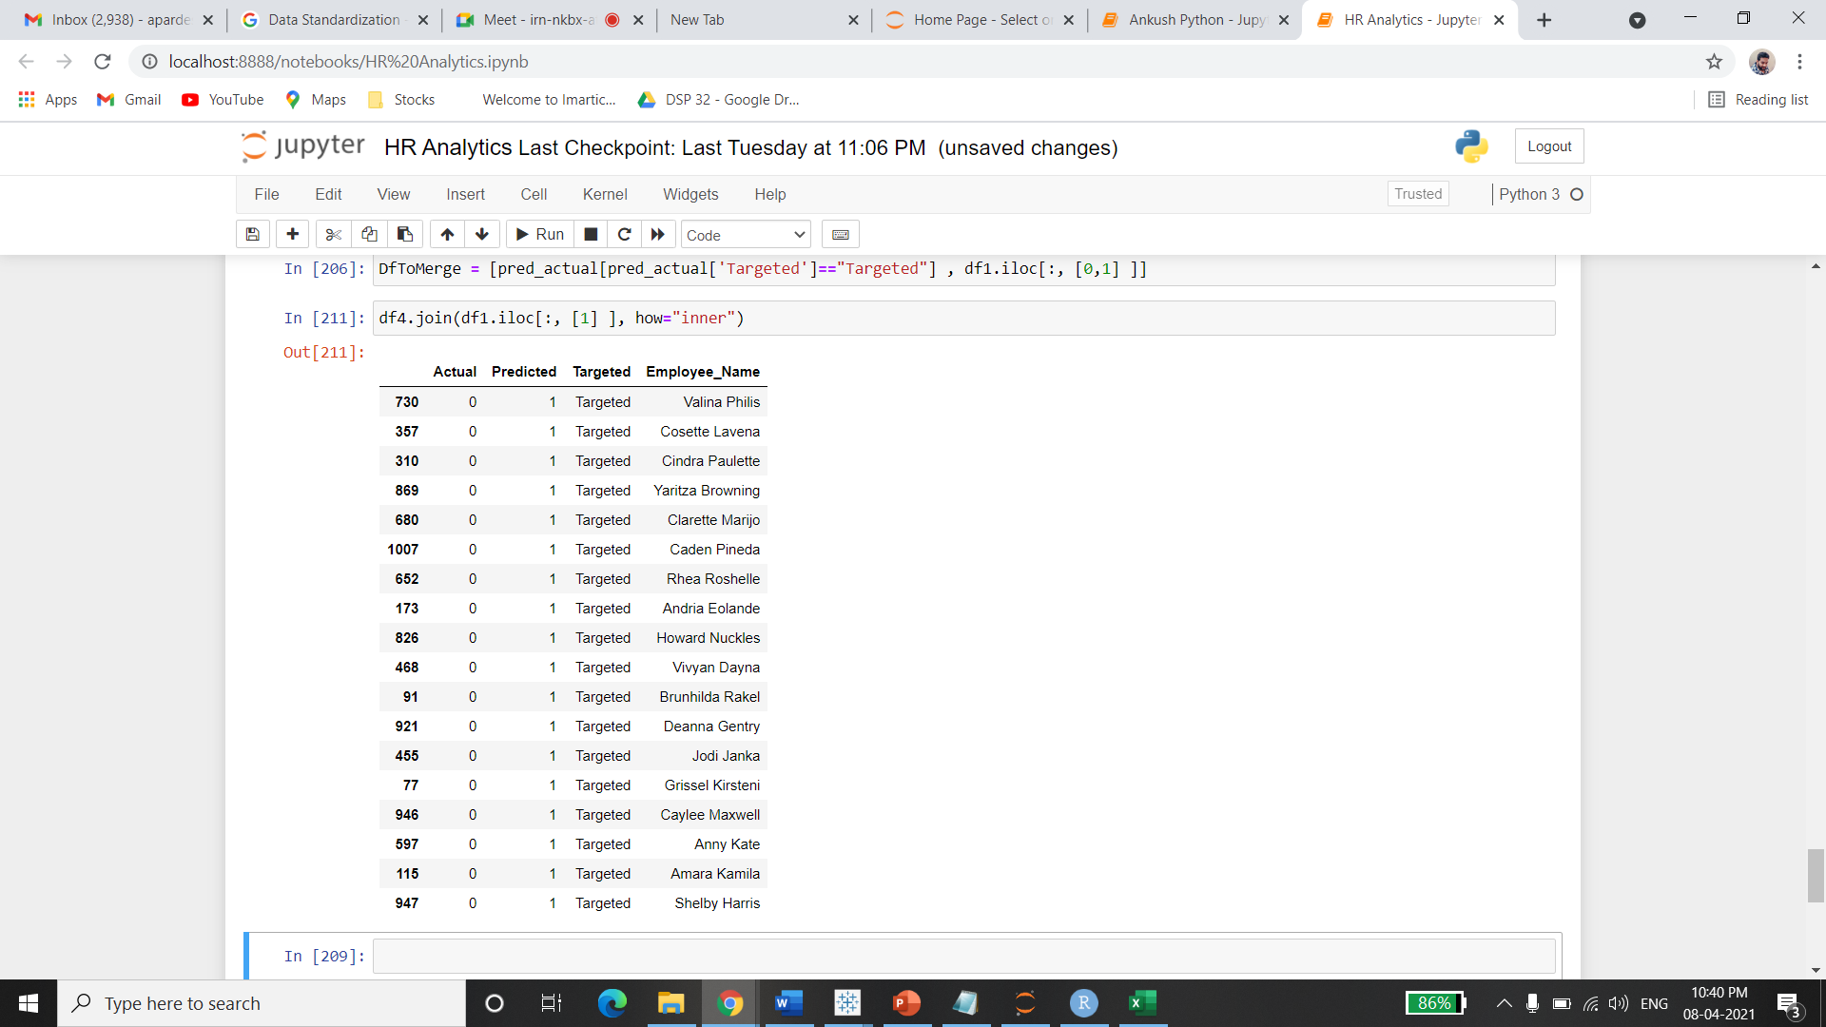
Possible attritions as per model

Slide 30
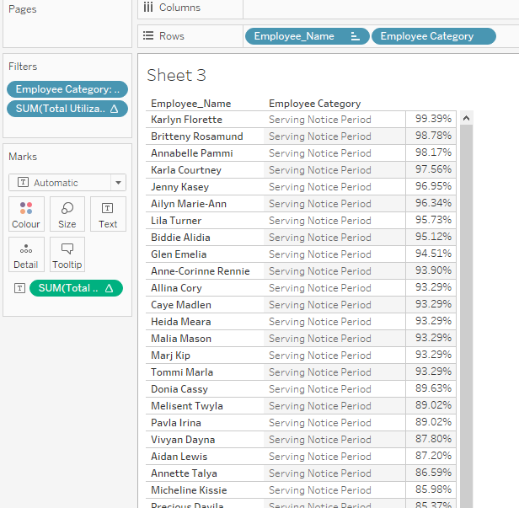
This are the Employees we need to Retain as they have the highest utilization & they are serving the notice period.

Slide 31
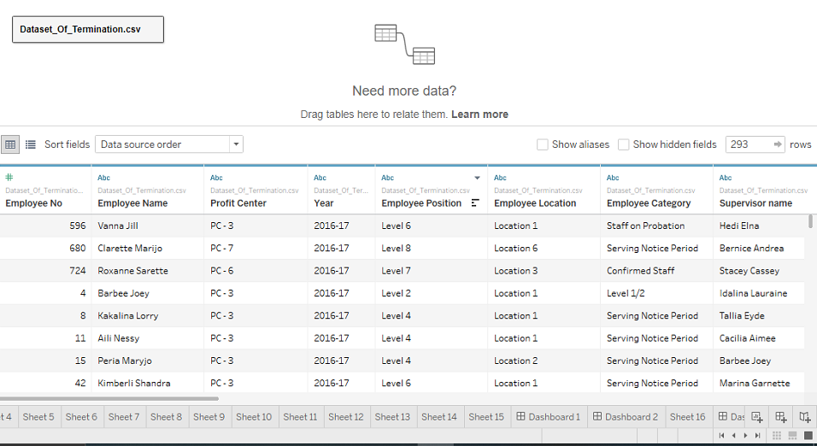
Visualization Using Tableau
Here we have used the Termination File from the given data set from KPMG.

Slide 32
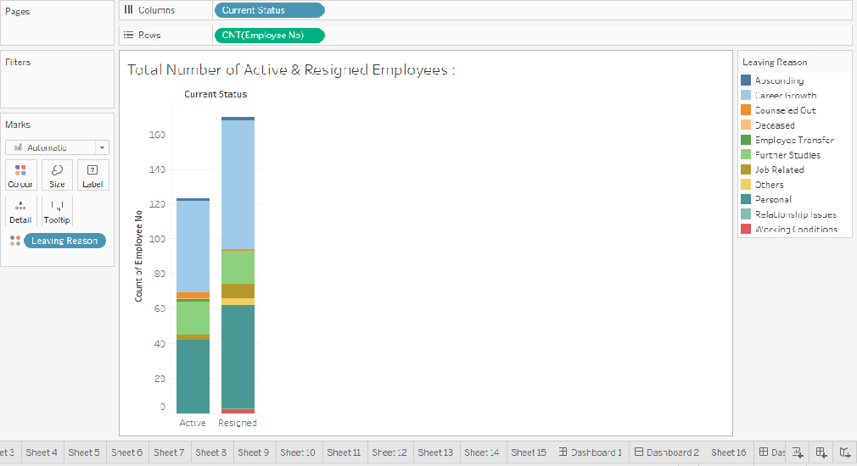
Total Number of Active & Resigned Employees :

Slide 33
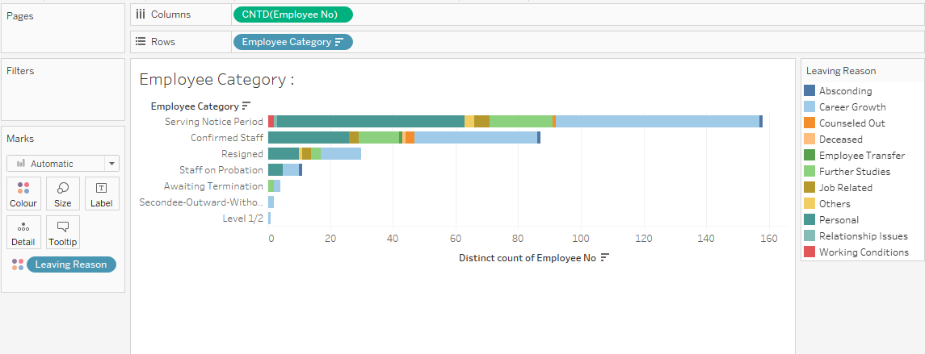
Employee Category

Slide 34
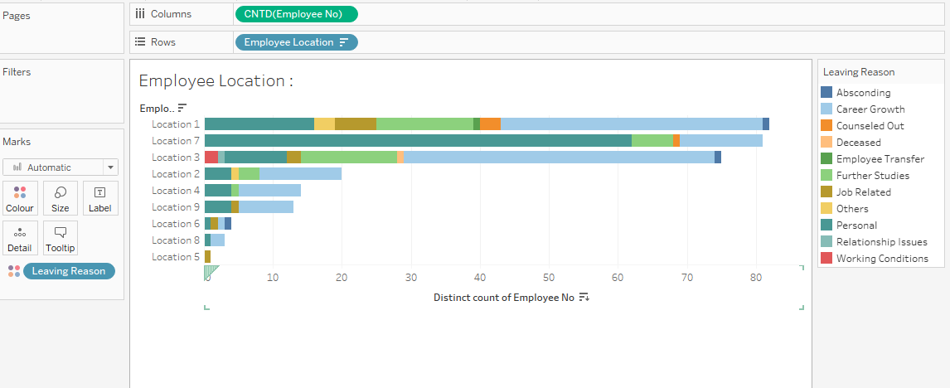
Employee Location

Slide 35
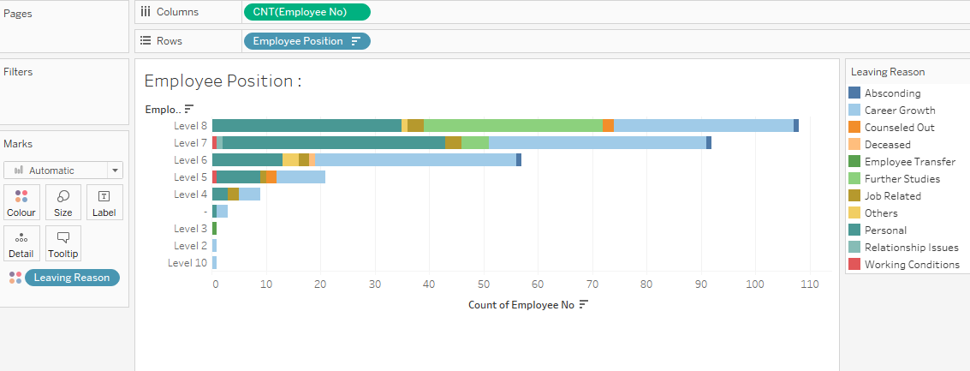
Employee Position

Slide 36
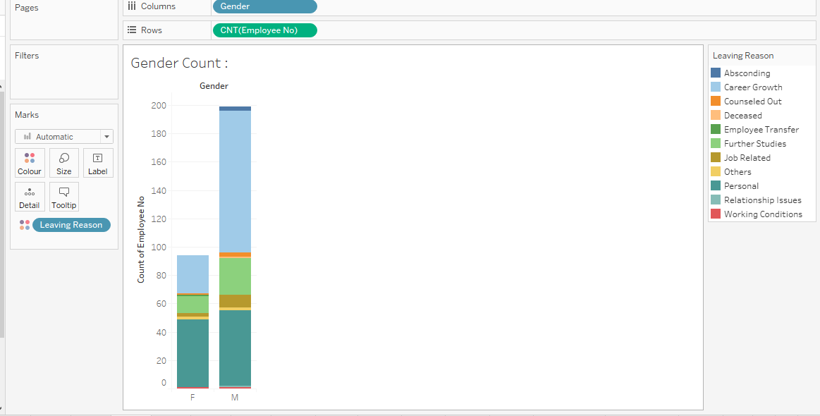
Gender Count

Slide 37
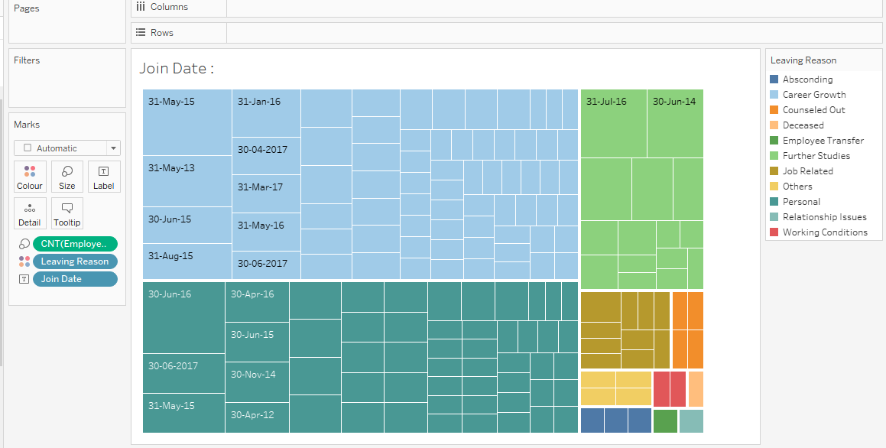
Joining Date

Slide 38
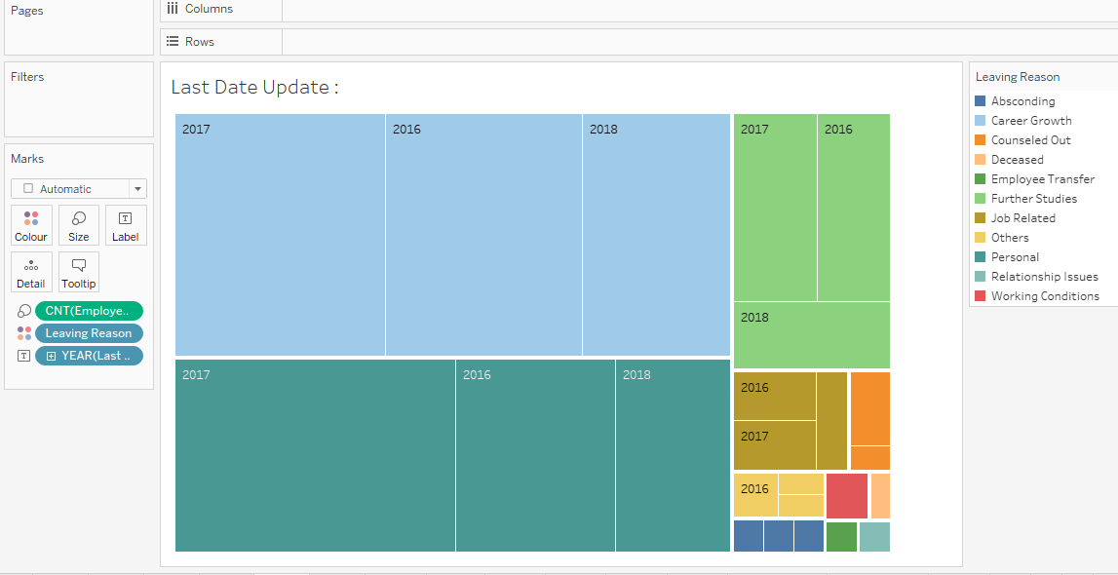
Last Date Update

Slide 39
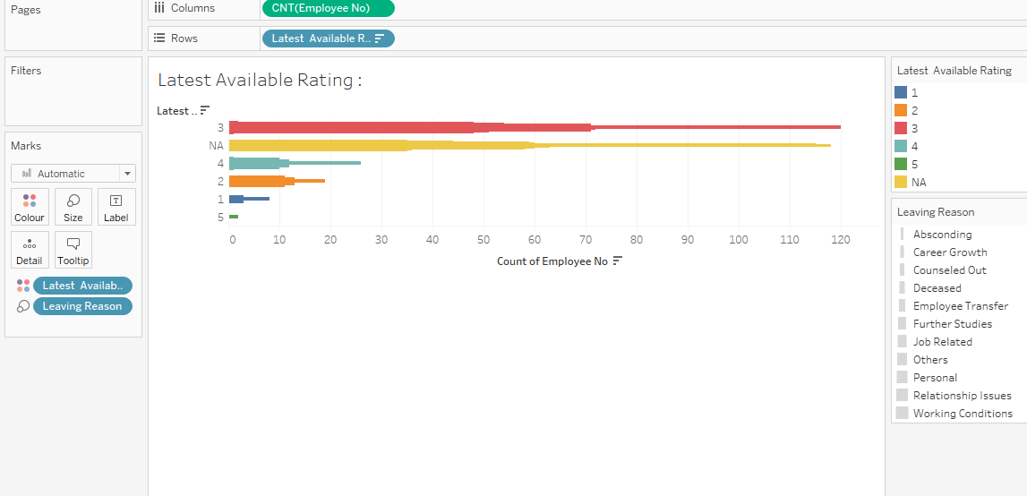
Latest Available Rating

Slide 40
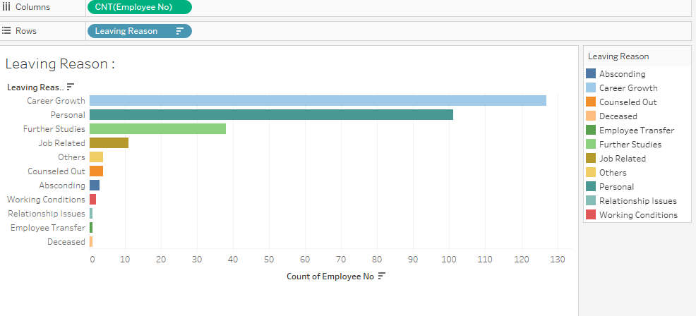
Leaving Reasons

Slide 41
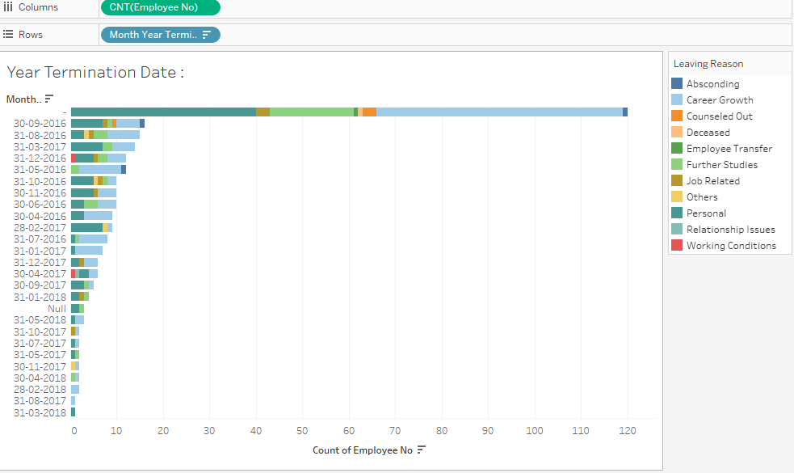
Year Termination Date

Slide 42
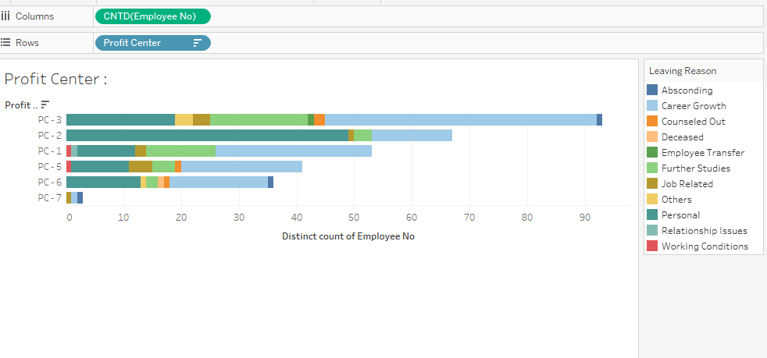
Profit Center

Slide 43
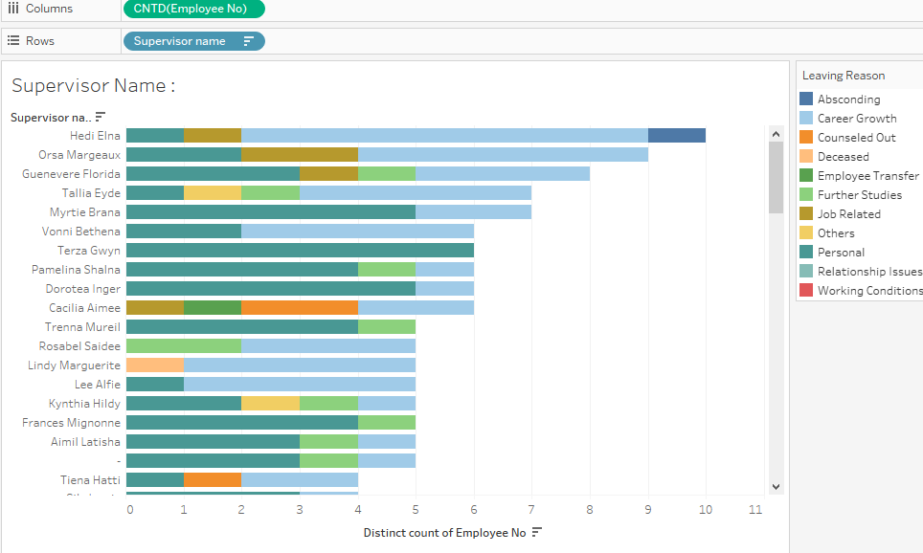
Supervisor Name

Slide 44
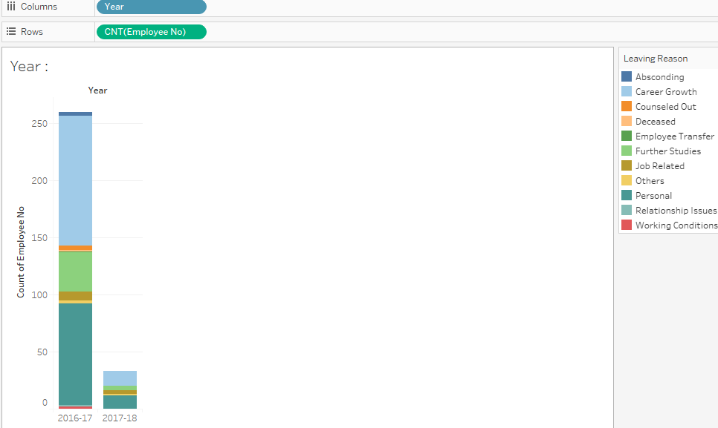
Year

Slide 45
Conclusion
We have successfully completed our employee attrition analytics data science project trying various models in Python.
In this we have found that Career Growth , Personal reasons & Further Studies are main factors which are influencing more for employee attrition.
As per the models Random Forest is the best fit Model.
Accuracy of this model is .. 89.63963964%
After performing Random Forest Classifier model we also found possible attrition of employee
And to retain them we have given some points in recommendation part

Slide 46
Recommendations
Career Growth , Personal reasons & Further Studies are the main reason for employee attrition.
What Could have been done :
One on one session with employees every month which means to its easy to understand the mindset of employee.
Skip meetings with the higher management on quarterly basis so that if the employee is able to discuss the any dissatisfactions with direct manager also higher management will also get to understand the employee in person.
Employee salary hike as per industrial standard.
Focused on Internal Job Posting as per employee strength .
Learning & development should be option for employee also rewarding.
Employee is going to resign in coming months can only be judge by direct manager, So manager should flag that person.

