Slide 1
Bank Marketing Campaign
brightflag

Slide 2
Objective - Optimize Bank telemarketing campaign
Whom to target
When to target
Identify our target

Slide 3
Introduction to FEATURES
Demographic features:
age
job
marital
education
balance
Loan
housing
default
Campaign Features:
Contact
Day
Month
Duration
Campaign
Pdays
Previous
poutcomne

Slide 4
Business Problem 1:
which customers should we target?

Slide 5
Insights from Customer Demographics – Feature Age
Target the youngest and the oldest instead of the middle-aged.
less than 30 and greater than 60 age customers have better Subscription rate then other age groups.
Older people tend to save for retirement.
Term deposits, as the least risky investment tool, are more preferable to the eldest.
The middle-aged group tend to be more aggressive with a main objective of generating high investment income.

Slide 6
Insights from Customer Demographics – Balance
No Balance: Negative balance
Low Balance: clients with a balance between 0 and 1000 euros
Average Balance: clients with a balance between 1000 and 5000 euros.
High Balance: clients with a balance greater than 5000 euros.

Slide 7
Insights from Feature Balance
Higher Subscription rate for customers with high balance
Positive correlation between clients’ balance levels and subscription rate.
More than 50% of clients contacted had a low balance level.
In the future, the bank should shift its marketing focus to high-balance customers to secure more term deposits.

Slide 8
Insights from Customer Demographics Age vs Balance
Our First Priority should be to:
Target older clients with age greater than 60 with positive bank balance.
Followed by customers with age less than 30

Slide 9
Creating a Customer Profile …
Willingness to subscribe is exceptionally high for people aged above 60 and younger people aged below 30 also have a distinguishable higher subscription rate than those of other age groups.
The effect of balance levels on subscription decision is applicable to each individual age group: i.e. percentage of subscription rate increases with balance for all age groups.
In sum, the bank should prioritize its telemarketing to clients who are above 60 years old and have positive balances, because they have the highest acceptance rate of about 43%. The next group the bank should focus on is young clients with positive balances, who showed high subscription rates between 5% to 10%.

Slide 10
Insights from Customer Demographics – Feature Job
Subscription rate for Students and Retired customers is > 50%.
Consistent with our earlier findings.

Slide 11
Business Problem 2:
When to run our program?

Slide 12
When to run the campaign to maximize the customer acquisition…
In Principal, apart from customer demographics, the timing of our campaign should also have an impact on customer subscription rate.
Previous campaigns shows us that, bank contacted most customers between May and August. The subscription rate for this period is around 30%.
The highest subscription rate occurred in March, which is over 51%, and all subscription rates in September, October, and December are over 40%.

Slide 13
When to run our campaign
Previous Campaigns were not initiated at inappropriate times.
Consider initiating the telemarketing campaign in fall and spring when the subscription rate tends to be higher.
Nevertheless, the bank should be cautious when analysed external factors.
More data from previous marketing campaign should be collected and analysed to make sure that this seasonal effect is constant over time and applicable to the future.

Slide 14
Ideal Customer Profile would be
According to previous analysis, a target customer profile can be established. The most responsive customers possess these features:
Feature 1: age < 30 or age > 60
Feature 2: students or retired people
Feature 3: a balance of more than 5000 euros
Ideal time to Initiate our Program
Telemarketing campaign should be initiated during the fall and spring when subscription rate tends to be higher.

Slide 15
Business Problem 3:
Identify our targets based on Our Model
EDA, Preprocessing and building our model.

Slide 16
Preprocessing
There are 45211 rows and 17 features.
There is no missing value in this dataset. but, there are values like “unknown”, “others”, which are helpless just like missing values. Thus, these ambiguous values are removed from the dataset, for features job, education and contact.
poutcome and pdays have 81% unknown values, since this is huge removing them.
Checking the Correlation between all features especially for poutcome and pdays.

Slide 17
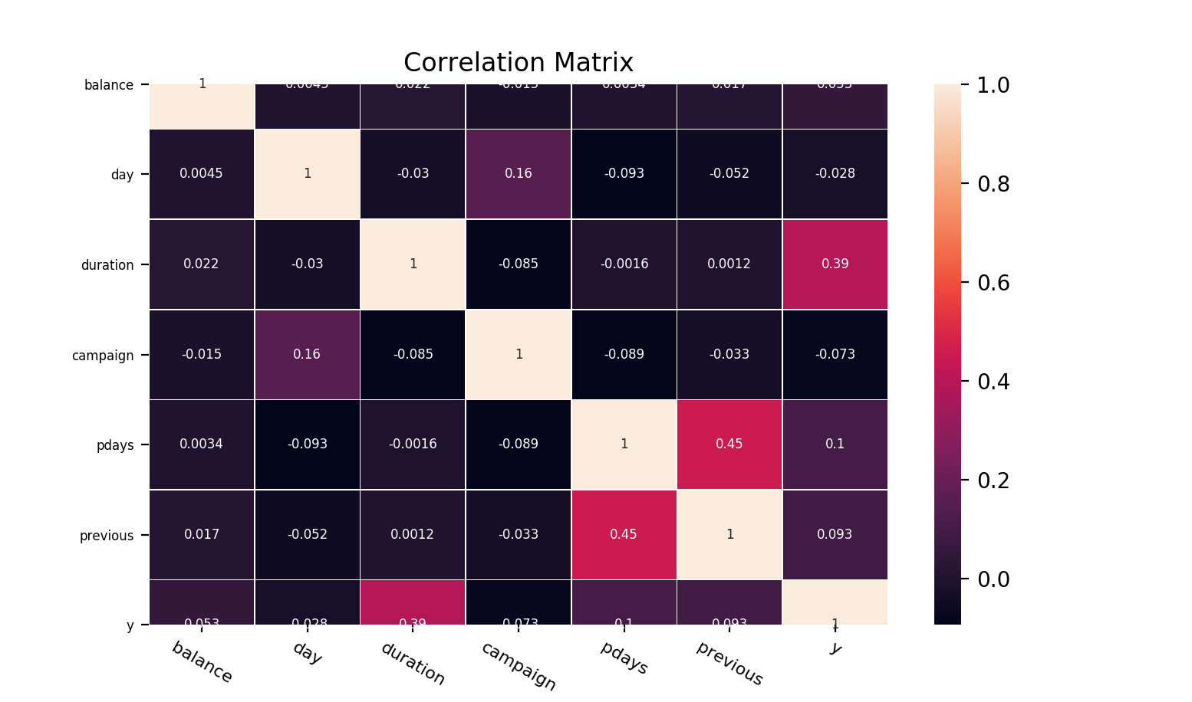
High correlation between pdays and previous.
High correlation between the feature duration and the outcome feature y.
previous - number of contacts performed before this campaign and for this client
pdays - number of days that passed by after the client was last contacted from a previous campaign
poutcome: outcome of the previous marketing campaign
Pdays, poutcome and previous has high correlation. Hence dropping two of these features and using only one, for model building.

Slide 18
Investigating the relationship between duration and outcome variable y
It is evident from the graph that, with increasing call duration there is a increase in subscription rate
However, this data should not be used while building up the model. As, it has a high correlation with the output variable.
Hence, Dropping this feature during the model build up for realistic predictions.

Slide 19
Preprocessing
Removing the outliers from Balance feature.
Removing values which are far from three standard deviation from the mean of this distribution.
Treating all categorical features using the One-hot encoding.

Slide 20
Model Building
After Preprocessing data we perform following steps.
Split data to train and test data
Select K-Select Feature method using Information Gain scores to select best feature for model training.
Using model building techniques that includes model selection, model testing using Hold-out and cross validation techniques.
Using Decision Tree, kNN, Naïve Bayes and Gradient Boosting classifiers and selecting the one that performs best to make predictions.
Finally, creating ten deciles to segment customers who have a high descending probability to subscribe.

Slide 21
Hold – Out testing on all our Models
Our data is heavily skewed towards the majority class “No”. Unbalanced data.
We get the following results:
Decision Tree and Naive Bayes have decent performance.
Gradient Booster and knn are heavily biased towards the majority class.
Investigating further.. To calculate accuracy,
Sensitivity, false negative rate etc

Slide 22
Hold – Out testing on all our Models
G-boosting classifier has high accuracy but very biased towards majority class.
Decision Tree has low accuracy but meets our objective of having:
High True Positive rate(Sensitivity), low false positive rate.
Need to Implement strategies to remove algorithm bias.
Performing Cross Validation to confirm our findings
Cannot use Decision Tree , very high false positive rate.
Hold - Out Testing | FN Rate | TN Rate | FP Rate | TP Rate | Accuracy
Knn | 0.91 | 0.97 | 0.03 | 0.09 | 84%
Decision Tree | 0.68 | 0.87 | 0.13 | 0.32 | 79%
Naïve Bayes | 0.72 | 0.89 | 0.11 | 0.28 | 80%
Gradient Boosting Classifier | 0.81 | 0.98 | 0.02 | 0.19 | 86%
Cross Validation | FN | TN | FP | TP
KNeighborsClassifier | 0.91 | 0.96 | 0.04 | 0.09
DecisionTreeClassifier | 0.77 | 0.3 | 0.7 | 0.23
GaussianNB | 0.71 | 0.81 | 0.19 | 0.29
GradientBoostingClassifier | 0.88 | 0.8 | 0.2 | 0.12

Slide 23
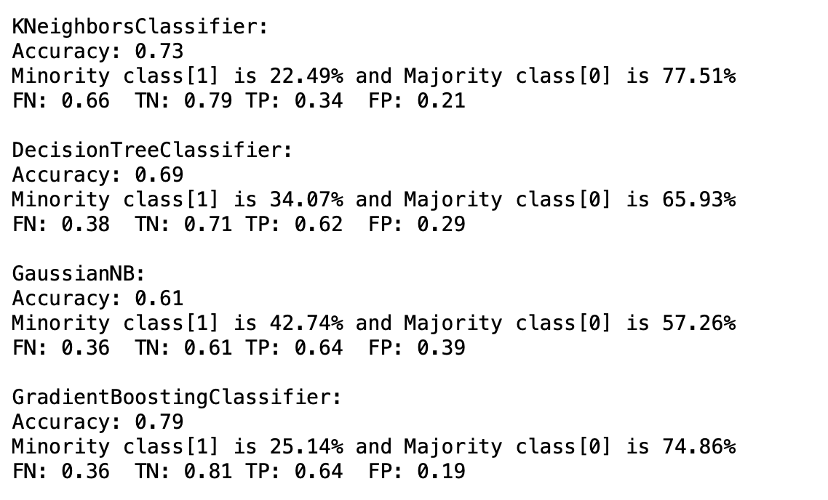
Algorithm Bias treatment – Under Sampling
Perform under sampling on the training data.
Under Sampling, scaling down the majority class label count.
Training our models and performing the hold-out testing on all models.
Gradient Boosting classifier gives better results.
Accuracy dropped but not our objective.
High FP and low FP is our objective.
Good Enough model

Slide 24
Deciles
We do not have the real validation data.
Using our model to create 10 deciles of customers.
Deciles are the probabilities → more likelier to subscribe.
Decile1 customers are more likely to subscribe then decile 2.
Helps to better strategize and minor tweaks in the campaign can do wonders.
Can be easily implemented if we have budget constraints and need to target only few ideal customers.

Slide 25
Recommendations
Smarter Market Design - based on each decile.
More appropriate timing- External factors very important
Better services provision – based on customer profile

