Slide 1


Fault Tolerant Distributed Window Aggregations for IoT
Ankush Sharma
Master Thesis Defense
03/11/2020
Advisor : Philipp Grulich

Slide 2
Motivation : In-Network Count Aggregation
Cloud
6
4
10
4
2
4
6
4
4
2
4
Sensor1
Sensor2
Sensor3
Sensor4
Sensor5

Slide 3
Motivation : Faults in In-Network Count
Aggregation
Cloud
6
4
10
4
2
4
6
4
4
2
4
Sensor1
Sensor2
Sensor3
Sensor4
Sensor5

Slide 4

Contributions
Fargo:
A Stream Processing Engine for Fault Tolerant
In-Network Window Aggregations

Slide 5
Foundations : Tumbling Window
Instance
Instance
Instance
0
10
20
30
Tumbling Windows of size 10 seconds

Slide 6
Foundations : Sliding Window
Instance
Instance
Instance
Instance
0
5
10
15
20
30
Sliding Windows of size 10 seconds and slide 5 seconds

Slide 7
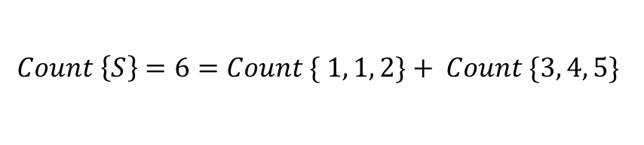
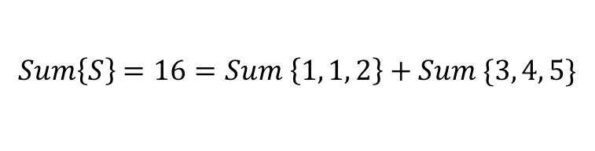

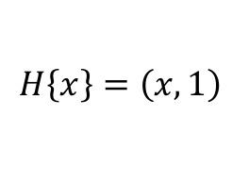

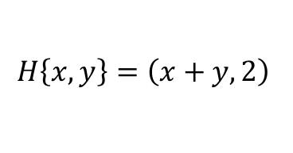
Foundations : Algebraic Aggregates
MultiSet S = { 1, 1, 2, 3, 4, 5 }
$$Count \left\{S\right\}=6=Count \{ 1, 1, 2\}+ Count \{3, 4, 5\}$$
$$Sum\left\{S\right\}=16=Sum \left\{1, 1, 2\right\}+Sum \{3, 4, 5\}$$
3
3
4
12
\
$$H\left\{x\right\}=\left(x, 1\right)$$
$$H\left\{x, y\right\}=\left(x+y, 2\right)$$
$$G\left(sum, count\right)=\frac{sum}{count}$$
$$Avg\left\{S\right\}=G(H\left\{S\right\})$$
$$Avg\left\{S\right\}=G\left(H\left\{S\right\}\right)=\frac{16}{6}= G( H\left\{1, 1, 2 \right\}+H\left\{3, 4, 5\right\})=G\left(\left(4, 3\right)+\left(12,3\right)\right)$$

Slide 8
Foundations : Types of Faults/Failures in a Distributed Systems
Faults/Failures
Byzantine Failure
Crash Failure
Timing Failure
Network Failure
Arbitrary responses
Ex : Malicious attacker
takes over a process
Process shuts down
Ex : Loss of power
Process does not respond
within expected time interval
Communication error between two processes
Messages dropped

Slide 9
Foundations : Conflict-Free Replicated Data Types (CRDT)
CRDT
Replica1
Replica2
Replica3
Replica4
Replica4
ReplicaN
. . . . . . . . . .
Replicated Data Structure
Grow Only Set
Comprises of Replicas
Map
Graph
Eventual Delivery of Updates
Distributed Counting
Query can be against any one replica
Distributed Summing
Distributed Average

Slide 10
Foundations : Conflict-Free Replicated Data Types (CRDT) - Spectrum
State-Based CRDTs ✔
Propagation of whole states
Delta-Based CRDTs ✔
Propagation of delta states
Operation-Based CRDTs ⨯
Propagation of each operation

Slide 11



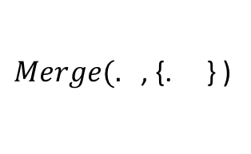

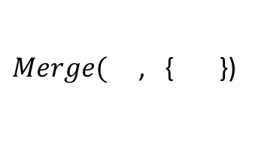









Foundations : GCounter State-Based CRDT(Distributed Counting)
r1.idx
r2.idx
r3.idx
$$u$$
$$u$$
$$r_{1}$$
$$[0, 0, 0]$$
$$=[1, 0, 0]$$
$$=[2, 0, 0]$$
Payload =
r1.idx
r2.idx
r3.idx
$$u$$
$Merge(.$, {. } )
$$r_{2}$$
$$[0, 0, 0]$$
$$=[0, 1, 0]$$
$$=[2, 1, 0]$$
Payload =
r1.idx
r2.idx
r3.idx
$$u$$
$Merge($, { })
$$r_{3}$$
$$[0, 0, 0]$$
$$=[0, 0, 1]$$
$$=[2, 1, 1]$$

Slide 12

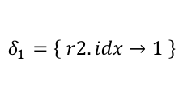
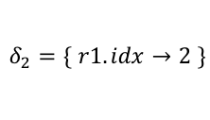
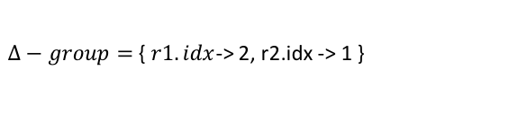

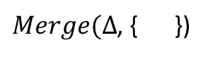
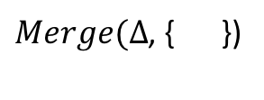
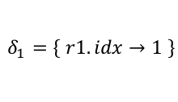
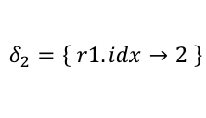
Foundations : GCounter Delta-Based CRDT(Distributed Counting)
r1.idx
r2.idx
r3.idx
$$u$$
$$u$$
$$r_{1}$$
$$[0, 0, 0]$$
$$=[1, 0, 0]$$
$$=[2, 0, 0]$$
Payload =
$Δ−group$
$$δ_{1}=\left\{ r1.idx→1 \right\}$$
$$δ_{2}=\left\{ r1.idx→2 \right\}$$
$Δ−group$ = { $r1.idx$-> 2 }
r1.idx
r2.idx
r3.idx
$$u$$
$Merge(Δ$, { })
$$r_{2}$$
$$[0, 0, 0]$$
$$=[0, 1, 0]$$
$$=[2, 1, 0]$$
$$δ_{1}=\left\{ r2.idx→1 \right\}$$
$$δ_{2}=\left\{ r1.idx→2 \right\}$$
Payload =
$Δ−group$
r1.idx
r2.idx
r3.idx
$Δ−group=${ $r1.idx$-> 2, r2.idx -> 1 }
$$u$$
$Merge(Δ$, { })
$$r_{3}$$
$$[0, 0, 0]$$
$$=[0, 0, 1]$$
$$=[2, 1, 1]$$

Slide 13
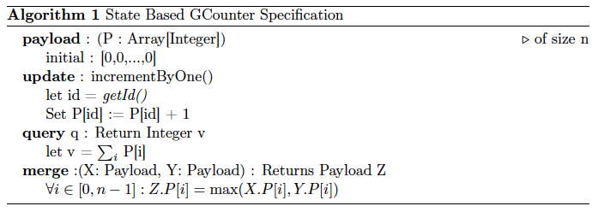
Foundations : GCounter State-Based CRDT Specification

Slide 14
Fargo: Fargo Dataflow Topology
Root Node
Register Window Queries
Merge Query Results using
State-Based CRDT merge
Intermediate Nodes Group
.
.
.
.
Optional layer(s)
Exchange heartbeats
State-Based CRDT merge
Child Nodes Group
Exchange heartbeats
Delta CRDT for each Window Instance
.
.
.
.
Data Parallelism
Sensors Group
.
.
.
.

Slide 15
Fargo : Assumptions
1. Focus strictly on non-byzantine fault tolerance
2. Fault tolerance of Root Node and Sensors not considered
3. Backpressure and out-of-order streams not considered
4. Focus strictly on Sliding Windows and Algebraic Aggregates
5. Focus strictly on non-keyed streams

Slide 16
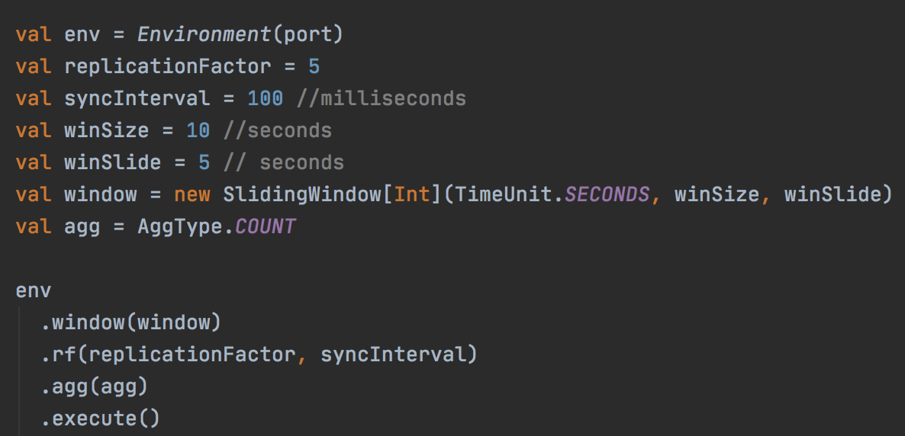
Fargo: Component- Root Node – Query Registration

Slide 17

Fargo: Component- Sensors
ChildNode1
ChildNode2
ChidNode3
1
1
1
2
2
EventBuffer
EventBuffer
EventBuffer
1
2
1
2
1
Event Generator
Sensor
Notes:
Sensor with three Child Nodes
Maintain an EventBuffer for each Child Node. So three Child Nodes, three event buffers

Slide 18
Fargo: Nodes Discovery and Window Creation with Replication Factor = 3
Root Node
Child Nodes
Sensors
CN1 Reg req
CN1
CN1 Reg Resp
S2 Reg req
CN2 Reg req
CN2
CN2 Reg Resp
CN3 Reg req
S1 Reg req
CN3
CN3 Reg Resp
S1 Reg Resp
S1
S2 Reg Resp
S2
CN3 Reg req = { id : “CN3”, location : ipAddr }
S1 Reg req = { id : “s1”, location : ipAddr }
CN3 Reg Resp = {
windowMetadata : { id : “123” , size : 10, slide : 5, timeUnit : “seconds”},
childNodeReplicas : [
{ id : “CN2”, location : ipAddr } , { id : “CN1”, location : ipAddr } ]
}
S1 Reg Resp = {
childNodeId : “CN3”,
location : ipAddr
childNodeReplicas : [
{ id : “CN2”, location : ipAddr } , { id : “CN1”, location : ipAddr } ]
}

Slide 19



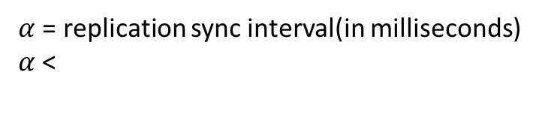


Fargo : Cuts within a Window Instance on a Child Node
Child Node
.
.
Sliding Window
$$S_{start}$$
$$S_{end}$$
First Cut
Second Cut
Third Cut
$α$ = replication sync interval(in milliseconds)
$α$ <
$S_{end}$ -
$$S_{start}$$

Slide 20

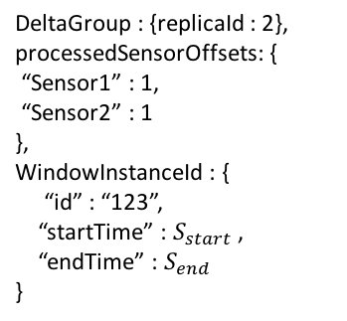
Fargo: Window and CRDT– Illustration using Count Aggregation
DeltaGroup : {replicaId : 2},
processedSensorOffsets: {
“Sensor1” : 1,
“Sensor2” : 1
},
WindowInstanceId : {
“id” : “123”,
“startTime” : $S_{start}$ ,
“endTime” : $S_{end}$
}
Child Node
Window
1
1
$$S_{start}$$
$$S_{end}$$
1
CRDT Replica
1
Event Generator
Event Generator
Sensor1
Sensor2

Slide 21
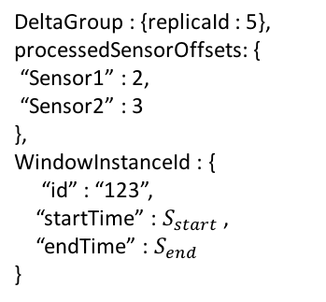
Fargo: Window and CRDT– Illustration using Count Aggregation
DeltaGroup : {replicaId : 5},
processedSensorOffsets: {
“Sensor1” : 2,
“Sensor2” : 3
},
WindowInstanceId : {
“id” : “123”,
“startTime” : $S_{start}$ ,
“endTime” : $S_{end}$
}
Child Node
Window
1
1
2
2
3
$$S_{start}$$
$$S_{end}$$
1
CRDT Replica
2
3
1
2
Event Generator
Event Generator
Sensor1
Sensor2

Slide 22
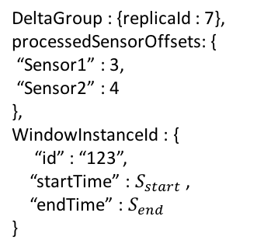
Fargo: Window and CRDT– Illustration using Count Aggregation
DeltaGroup : {replicaId : 7},
processedSensorOffsets: {
“Sensor1” : 3,
“Sensor2” : 4
},
WindowInstanceId : {
“id” : “123”,
“startTime” : $S_{start}$ ,
“endTime” : $S_{end}$
}
Child Node
Window
1
1
2
2
3
3
4
$$S_{start}$$
$$S_{end}$$
1
CRDT Replica
2
3
1
4
2
3
Event Generator
Event Generator
Sensor1
Sensor2

Slide 23

Fargo: Replication of Fargo Payload between two Child Nodes
ChildNode1
1
1
2
2
3
3
4
1
1
2
2
3
3
4
$$S_{start}$$
$$S_{end}$$
$$S_{start}$$
$$S_{end}$$
ChildNode2
Event Generator
Event Generator
Sensor1
Sensor2

Slide 24



Fargo: Window Merging
Root Node
State-Based CRDT Merge
$$S_{start}$$
$$S_{end}$$
1
2
3
4
5
6
7
1
2
3
4
5
6
7
$$S_{start}$$
$$S_{end}$$
$$S_{start}$$
$$S_{end}$$
ChildNode1
ChildNode2

Slide 25

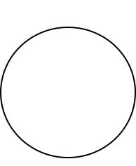
Fargo: Failure Detection – Peer to Peer Full Mesh Heartbeats Topology
ChildNode1
heartbeat
heartbeat
heartbeat
ChildNode4
ChildNode2
heartbeat
heartbeat
ChildNode3

Slide 26
Fargo: Events Re-Streaming in Child Nodes Group
Fargo Payload : {
DeltaGroup: ..,
windowInstanceId: .., processedSensorOffsets : { Sensor : 2 } }
ChildNode1
ChildNode2
MessageRerouter
MessageRerouter
Sliding Window Instance
Sliding Window Instance
CRDT Replica
Events Restreaming Request for CN2 after last processed offset of CN2 : 2
CRDT Replica
1
3
1
2
4
2
3
5
Replay messages with offsets > 2
CNodes Group Membership
CN1 Event Buffer
CN2 Event Buffer
1
2
3
5
4
3
2
1
Event Generator
Sensor

Slide 27
Motivation : Evaluation Setup
Root Node
Akka Actor
Window Throughput
Window Latency
Tumbling Window of 10 seconds
Communication via TCP
Communication via TCP
CN1
CN2
CN3
CN4
CN5
CN6
CN7
CN8
Akka Actors
Communication via TCP
Sensor1
Sensor2
Sensor3
Sensor4
Sensor5
Sensor6

Slide 28
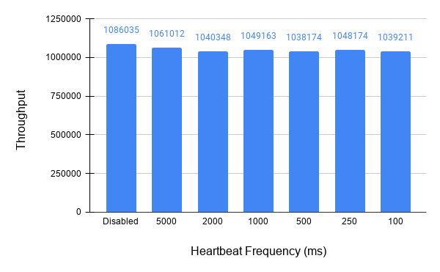
Fargo: Evaluation – Measuring Window Throughput With Varied Heartbeat Frequencies
1 heartbeat = 1 bit exchanged via TCP

Slide 29
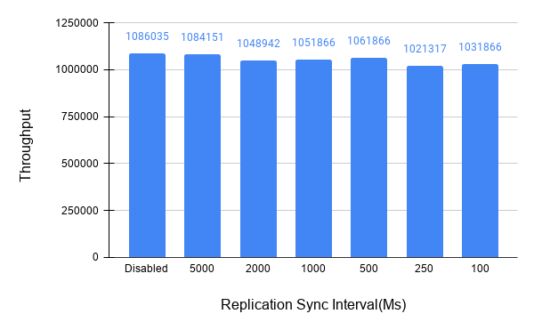
Fargo: Evaluation – Measuring Window Throughput With Varied Replication Sync Intervals(Replication of Fargo Payload)

Slide 30

Fargo: Evaluation – Failing Nodes at Different Cuts
1st
Cut
2nd
Cut
3rd
Cut
4th
Cut
5th
Cut
6th
Cut
7th
Cut
8th
Cut
9th
Cut
10th
Cut
$$S_{start}$$
$S_{start}$ + 10
First Fail Point
Mid Fail Point
Last Fail Point

Slide 31
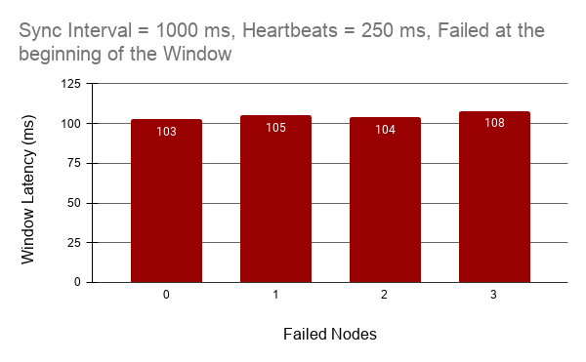
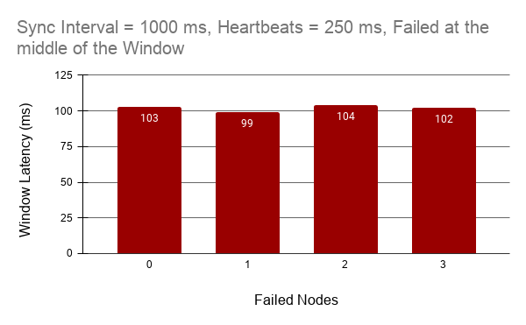
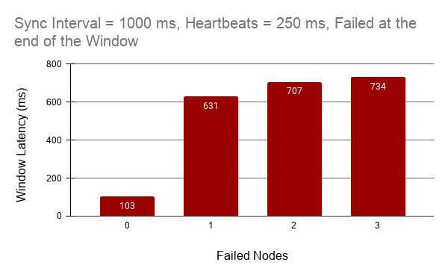
Fargo: Evaluation – Measuring Window Latency by failing three Child Nodes at different Cuts within a Window

Slide 32
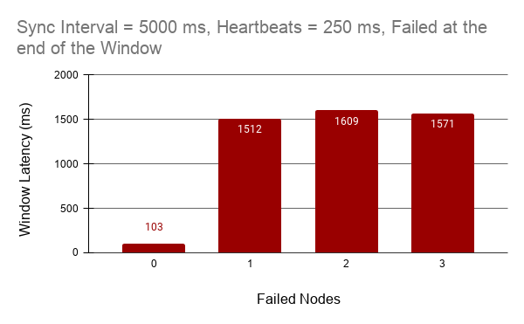
Fargo: Evaluation – Measuring Window Latency by failing three Child Nodes at the end of the Window

Slide 33
Fargo: Evaluation – Discussion with 3 Window Queries For some Aggregation
Node Failure
Child Node
Window Instance
Query 1 : Tumbling Windows
Query
No increase in
latency
Query 2 : Sliding
Windows
Increase in latency
Query 3 : Sliding
Windows

Slide 34
Fargo: Future Work
Support for Holistic Aggregates via Data Sketches. For ex :
Distinct Count – HyperLogLog
Median – T-Digest
Extensive Benchmarking on the Cloud with 1000 Sensors
Optimize CRDT sharing between different instances of Sliding Windows

Slide 35
Fargo: Conclusions
Fargo – A SPE for Fault Tolerant Distributed In-Network Window Aggregations
We showed how Fargo works with Count Aggregation. The same principles can be applied to Sum, Max, Min, Range,
Standard Deviation, Variance etc
3. Fargo enables lightweight fault tolerance via CRDT in Child Nodes Group and Events-Restreaming
4. Every layer in Fargo’s Topology can resist node failures

Slide 36
References
N. Hayashibara, X. Defago, R. Yared and T. Katayama, "The /spl phi/ accrual failure detector," Proceedings of the 23rd IEEE International Symposium on Reliable Distributed Systems, 2004., Florianpolis, Brazil, 2004, pp. 66-78, doi: 10.1109/RELDIS.2004.1353004.
J. Karimov, T. Rabl, A. Katsifodimos, R. Samarev, H. Heiskanen and V. Markl, "Benchmarking Distributed Stream Data Processing Systems," 2018 IEEE 34th International Conference on Data Engineering (ICDE), Paris, 2018, pp. 1507-1518, doi: 10.1109/ICDE.2018.00169.
Preguiça, Nuno. (2018). Conflict-free Replicated Data Types: An Overview.

Slide 37
Backup Slides

Slide 38





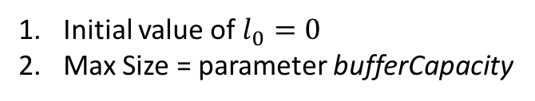

Fargo : Component - Sensors – Event Buffer
Initial value of $l_{0}=0$
Max Size = parameter bufferCapacity
- : Last Offset
$$l_{0}$$
$l_{0}$ + n
.
.
.
.
.
$l_{0}$ + 4
$l_{0}$ + 3
$l_{0}$ + 2
$l_{0}$ + 1
bufferCapacity events

Slide 39
Fargo: Global Group Membership Protocol
Root Node
Intermediate Nodes
Child Nodes
Sensors
INRootRegistrationReq
CNRootRegistrationReq
RootINRegistrationResponse
RootCNRegistrationResponse
CNToINRegistrationReq
INToCNRegistrationResponse
SensorToCNRegistrationReq
CNToSensorRegistrationResponse
Child Nodes and Intermediate Nodes register with Root Node by sending their id and location on the network
Root Node waits for “rf” number of Child Nodes to register
Root Node sends as response
Location of every Intermediate Node and Child Node
Window query metadata
Sensors connect to Child Node. Fargo Dataflow Topology is thus fully deployed

Slide 40
Event Rerouting Request from offsets > 100
Event Rerouting Request from offsets > 100
Send four events
Send Nothing
Events Lost = 201 – 101 = 100
104
103
102
101
100
205
204
203
202
201

Slide 41
Fargo : Component - Child Node
.
FailedNodesEventConsumer
SlidingWindowRegistry
Failure Detector
NodeRegistrationOrchestrator
ReplicationEngine
ChildNodesRegistry
Child Node

Slide 42
Fargo : Component - Child Node
.
WindowMerger
SlidingWindowRegistry
NodeRegistrationOrchestrator
Intermediate Node

Slide 43
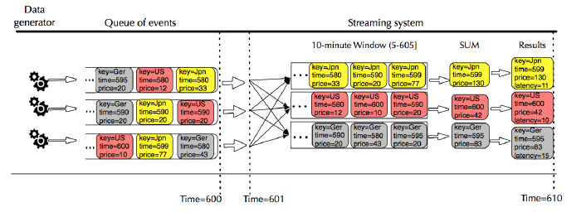
Fargo: Evaluation – Measuring Window Latency
Fig : Measuring Window Latency [2]

Slide 44
Fargo: Peer-to-Peer Full Mesh Replication Topology
ChildNode2
ChildNode1
ChildNode3
ChildNode4

Slide 45


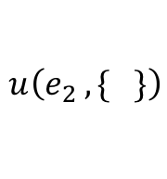
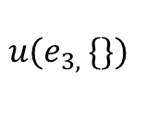




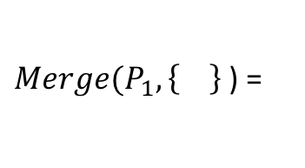
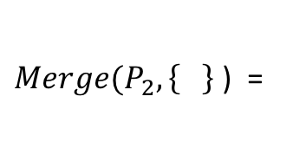
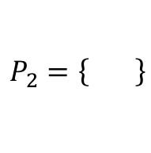
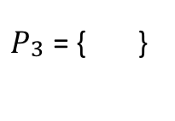
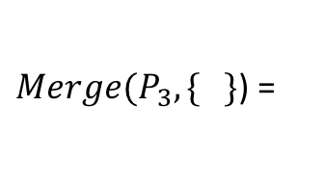
Foundations : State-Based Conflict-Free Replicated Data Types (CRDT)
$$u(e_{1}, \{\})$$
$$u\left(e_{2} , \{ \}\right)$$
$Merge(P_{3}, \{ \}$) =
$$r_{1}$$
$$\{\}$$
$$P_{1}=\left\{ \right\}$$
$$u(e_{3, }\{\})$$
$Merge(P_{1}, \left\{ \right\}$ ) =
$$r_{2}$$
$$\{\}$$
$$P_{2}=\left\{ \right\}$$
$P_{\begin{aligned}3 \\ \end{aligned}}$ = { }
$$u(e_{4},\{\})$$
$$r_{3}$$
$$\{\}$$
$Merge(P_{2}, \left\{ \right\}$ ) =

Slide 46



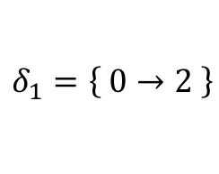






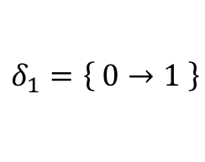
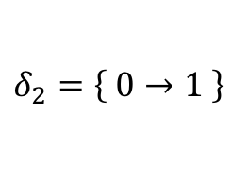
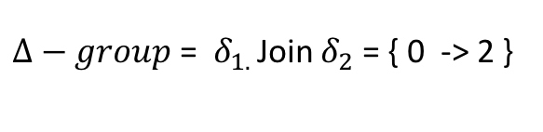

Foundations : GCounter Delta-Based CRDT
$$u$$
$$u$$
$Merge(Δ$, { })
$$r_{1}$$
$$[0, 0]$$
$$=[1, 0]$$
$$=[2, 0]$$
Payload = $Δ$
$$δ_{1}=\left\{ 0→1 \right\}$$
$$δ_{2}=\left\{ 0→1 \right\}$$
Payload = $Δ$
$Δ−group$ = $δ_{1. }$Join $δ_{2}$ = { 0 -> 2 }
$$r_{2}$$
$$[0, 0]$$
$Merge(Δ$, [0, 0]) = [2, 0] =
$$δ_{1}=\left\{ 0→2 \right\}$$
$Δ−group$ = { 0 -> 2 }

Slide 47











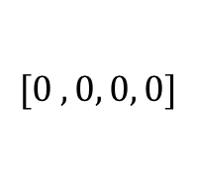


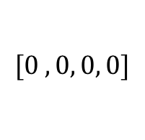

$$u$$
$$u$$
$$r_{1}$$
$$[0 ,0, 0, 0]$$
$$=[1, 0, 0,0]$$
$$=[2, 0, 0,0]$$
Payload = $Δ$
$Δ−group$ = { 0 -> 2 }
$$r_{2}$$
$$[0 ,0, 0, 0]$$
$Merge(Δ$, [0, 0, 0]) = [2, 0, 0] =
$Δ−group$ = { 0 -> 2 }
Payload = $Δ$
Payload = $Δ$
$$[0 ,0, 0, 0]$$
$$r_{3}$$
$Merge(Δ$, [0, 0, 0]) = [2, 0, 0] =
$Merge(Δ$, {. } ) = [2, 1, 0] =
$Δ−group$ = { 0 -> 2 }
$Δ−group$ = { 0 -> 2, 1 -> 1}
$$[0 ,0, 0, 0]$$
$$r_{3}$$

Slide 48









$$u$$
$$u$$
$$r_{1}$$
$$[0 ,0, 0, 0]$$
$$=[1, 0, 0, 0]$$
$$=[2, 0, 0, 0]$$
Payload = $Δ$
$Δ−group$ = { 0 -> 2 }
$$=[2, 1, 0, 0]$$
$$u$$
$Δ−group$ = { 0 -> 2, 1 -> 1 }
$$r_{2}$$
$$[0 ,0, 0, 0]$$
$Merge(Δ$, [0, 0, 0, 0]) = [2, 0, 0, 0] =
$Δ−group$ = { 0 -> 2 }
Payload = $Δ$
Payload = $Δ$
$$[0 ,0, 0, 0]$$
$$r_{3}$$
$Merge(Δ$, [0, 0, 0, 0]) = [2, 0, 0, 0] =
$Merge(Δ$, {. } ) = [2, 1, 0,0 ] =
$Δ−group$ = { 0 -> 2 }
$Δ−group$ = { 0 -> 2, 1 -> 1}
$$[0 ,0, 0, 0]$$
$$r_{3}$$
$Merge(Δ$, [0, 0, 0, 0]) = [2, 0, 0, 0] =
$Merge(Δ$, {. }) = [2, 1, 0, 0] =
$Δ−group$ = { 0 -> 2 }
$Δ−group$ = { 0 -> 2, 1 -> 1}

Slide 49
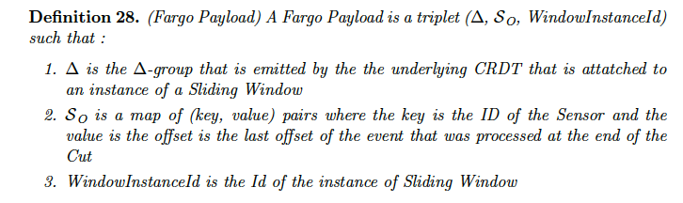
Fargo : Fargo Payload

Slide 50
p1
p2 failed
p2
p3
p2 failed
Interpretation
Monitoring
Binary Failure Detector

Slide 51
p1
p2 susp = 0.5
p2
p3
p2 susp = 0.5
Monitoring
(b) Accrual Failure Detector

Slide 52
Intermediate Nodes Group
Child Nodes Group
.
.
.
.
Sensors Group
.
.
.
.

Slide 53
Agenda
Motivation
Foundations
Implementation – Fault Tolerant Distributed In-Network Window Aggregations
Evaluation
Future Work
Conclusion

Slide 54
Root Node
FDT
FDT
.
.
.
.
.
.
.
.
.
.
.
.
.
.
.
.
.
.
.
.
.
.
.
.
…….

Slide 55
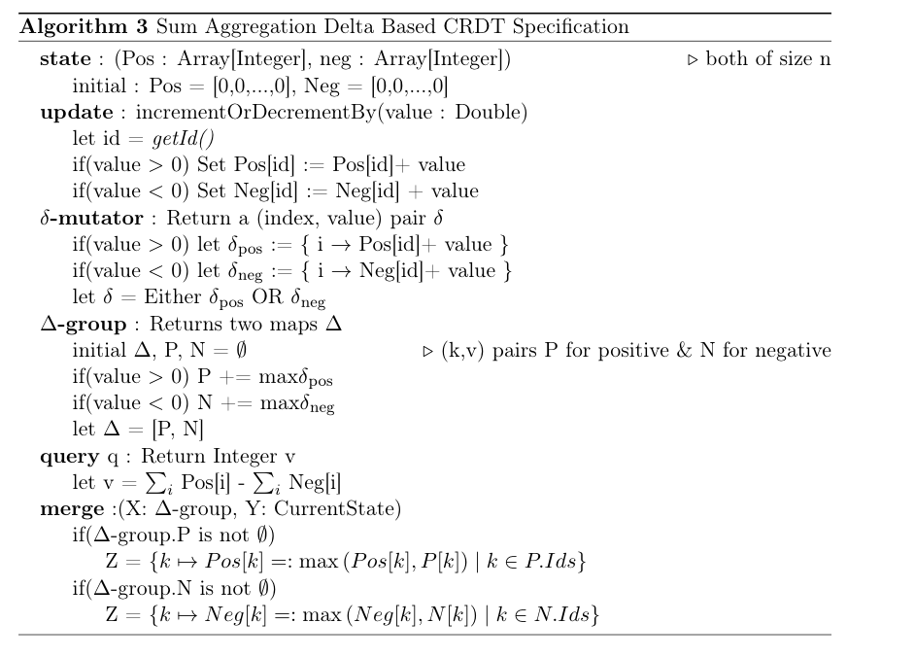
Foundations : Sum Aggregation State-Based CRDT Specification

Slide 56
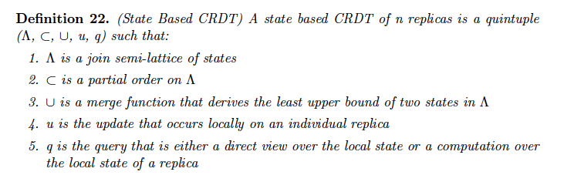
Foundations : State-Based CRDT

