Slide 2







Problem Statement
Current Process
Documents: Derivates, Options, Swaps Trade Confirmations
Outgoing
Ops Team
Incoming
Barclays
Counter-party
`
Outgoing
Manual verification of the entire document
Check for annotations, mark-ups, strikethroughs and alterations
Incoming
OR
560
7000
Accept
Alterations
man hrs/month
docs/month
Regulatory commitments
(T+1)
Trade Confirmation
Notes:
Many teams in Ops follow the same model and can use this solution

Slide 3
Types of Mark-ups

Slide 4




Current Proposal
Custom UI
Adagrads Engine
{
file1: { pagecount: 3
pagediff: True
annotations: Popup
signature: true
markup: true }
file2: { …… }
file3: { …… }
}
Tableau
PDF annotations
Mark-up Present
Counterparty signed
Trident
Hosted on Kubernetes
RESTful service
Barclays Approved TechStack
Input data from directory or via drag drop
React/Angular/Tableau UI
Ability to integrate with Trident for STP of clean signed docs

Slide 5
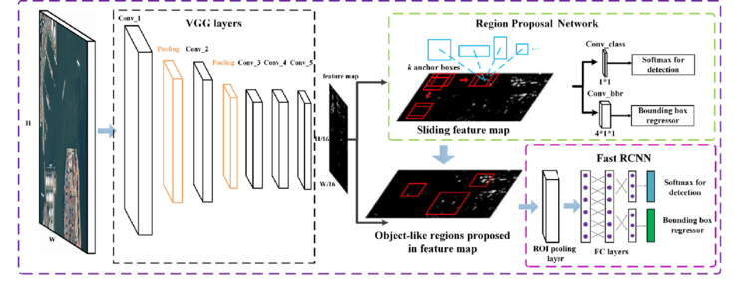
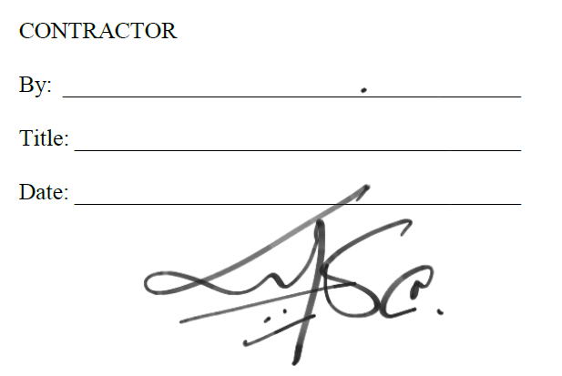
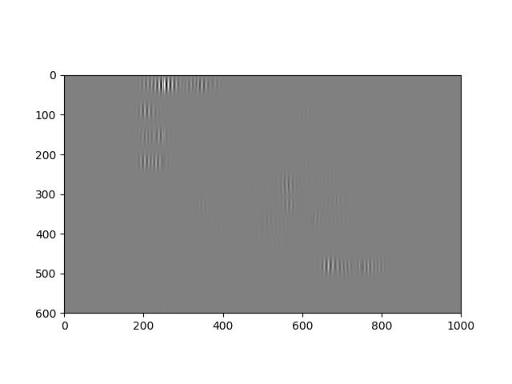

Markers
PDF annotations
Mark-ups Identification
Model: Tensorflow Faster RCNN
Binary Classifier for Signature and alphanumeric handwritten data
Score_threshold = 0, 30 epochs, learningrate1 = 0.001, steps = 200
Example: Refer notebook
Approach two: Train RCNN to recognize letters with strikethroughs
Signatures

Slide 6
Future Work

