Slide 1
Inlay Health — Billing
THINKITIVE TECHNOLOGIES
Screen walkthrough for the Super Admin and Provider portals. Fifteen screens, what each one does, and the rules built into them.
9 Super Admin screens
6 Provider screens
Prototype screens, sample data · 29 October 2026
Notes:
Billing UI prototype for Inlay Health, prepared by Thinkitive. Admin and provider portals only.

Slide 2
How the money works
Two sources of income, one source of payment. Every screen that follows sits on one side of this picture.
1
Channel 1 — ordered by the provider
2
Channel 2 — bought by the patient
A physician orders a test for a patient inside the provider portal.
The practice is invoiced for it on its own billing cycle.
The patient is never billed and pays nothing at any point.
The practice pays no access fee — testing only.
The patient buys a test, a membership or AI questions in the patient app.
The patient pays at the moment of purchase.
The practice is not involved and is not invoiced.
Tax is added where the state requires it.
Both channels
Inlay pays the vendor the contracted rate. Everything above it is margin. The contracted rate is never shown to a practice or a patient — both see the Inlay price only. Admin reports the two channels separately and consolidated.

Slide 3
Super Admin portal
Part one
9 screens — the billing dashboard, the catalogue and how a test is priced, memberships and AI, practice billing settings, invoices, vendor payouts and the reports.

Slide 4
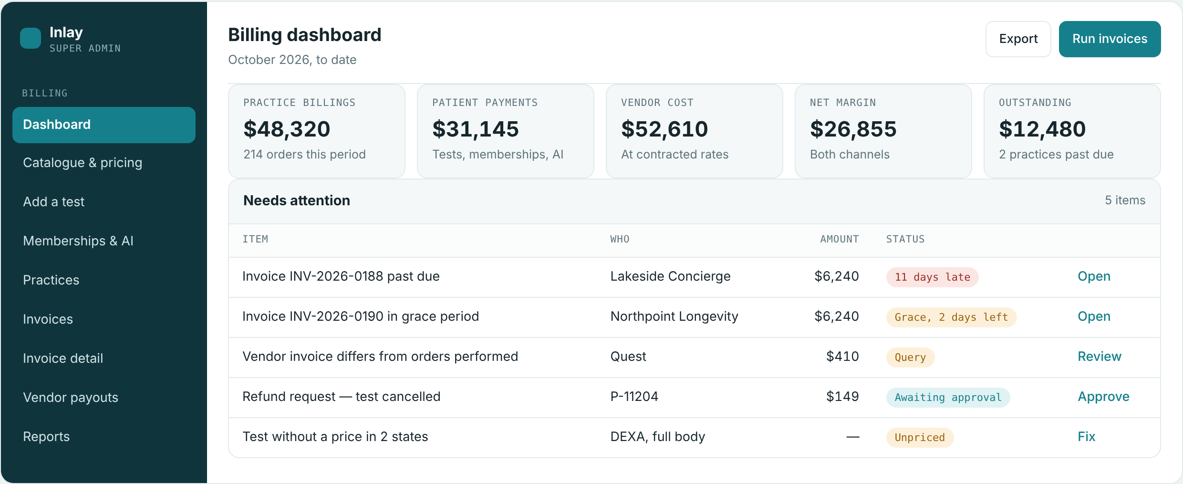
Billing dashboard
SUPER ADMIN PORTAL 1/9
Where the super admin starts each day
WHAT THIS SCREEN DOES
Period-to-date money in one view: practice billings, patient payments, vendor cost, net margin and what is outstanding.
Both revenue channels are reported side by side, so margin is never read off one channel alone.
Needs attention lists only items that need a decision — a past-due invoice, a vendor invoice that differs from the orders performed, a refund to approve, a test left unpriced.
Run invoices raises the period's invoices for every practice from orders already recorded.
Notes:
Billing dashboard — Period-to-date money in one view: practice billings, patient payments, vendor cost, net margin and what is outstanding. Both revenue channels are reported side by side, so margin is never read off one channel alone. Needs attention lists only items that need a decision — a past-due invoice, a vendor invoice that differs from the orders performed, a refund to approve, a test left unpriced. Run invoices raises the period's invoices for every practice from orders already recorded.

Slide 5
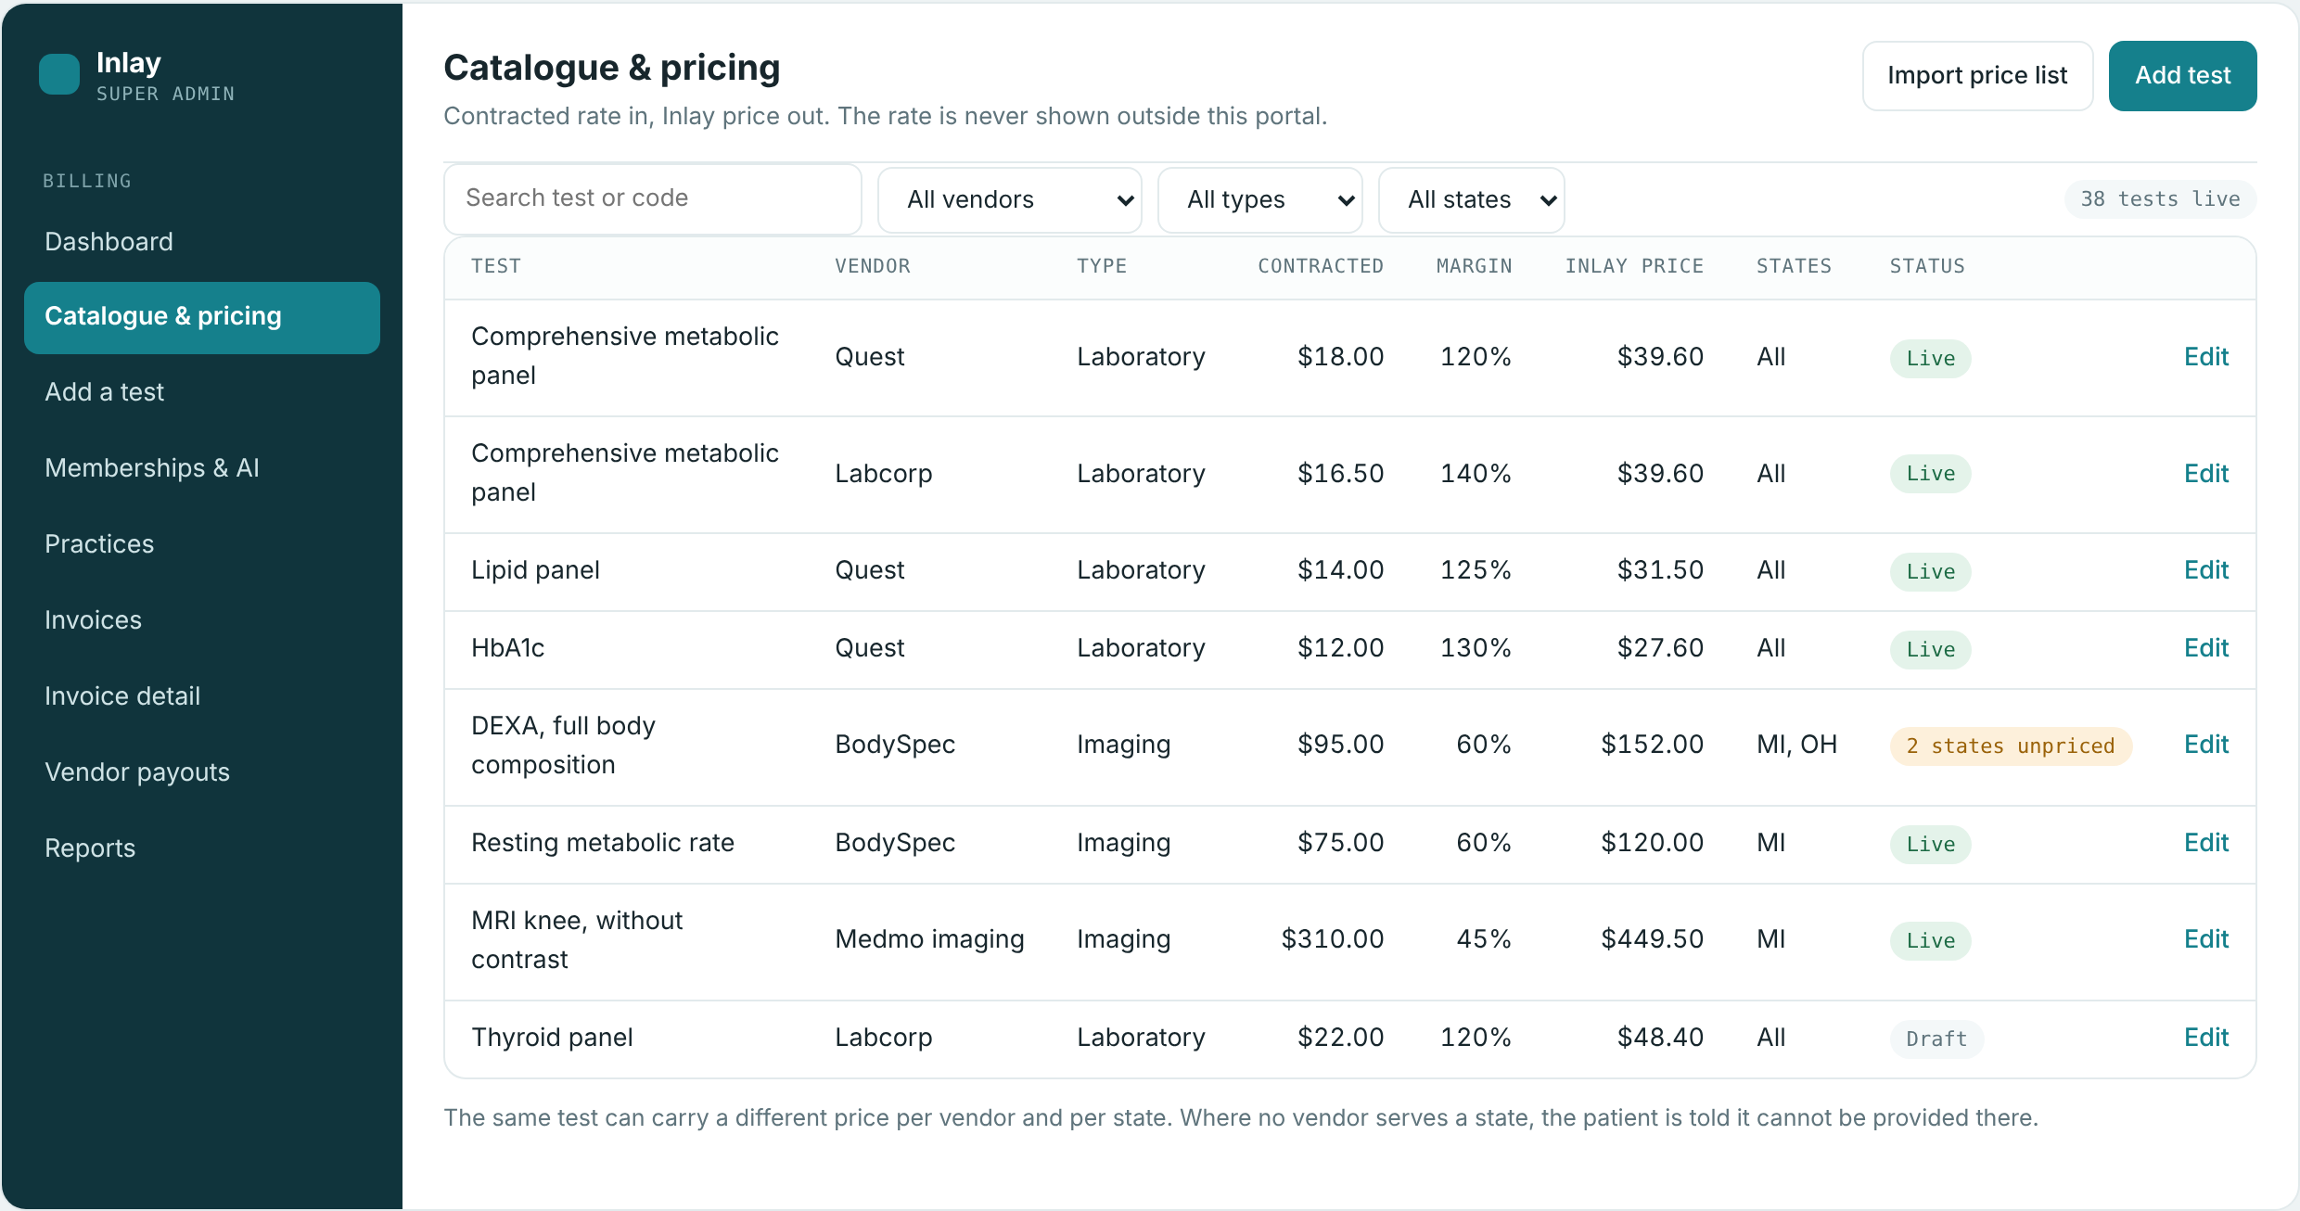
Catalogue and pricing
SUPER ADMIN PORTAL 2/9
Contracted rate in, Inlay price out
WHAT THIS SCREEN DOES
Every test Inlay sells, per vendor and per state, with the contracted rate, the margin and the resulting Inlay price.
The contracted rate never leaves this portal. Practices and patients see the Inlay price only.
The same test can be carried by two vendors at two different rates and still sell at one price.
Status flags any test left without a price in a state a practice can order from.
Notes:
Catalogue and pricing — Every test Inlay sells, per vendor and per state, with the contracted rate, the margin and the resulting Inlay price. The contracted rate never leaves this portal. Practices and patients see the Inlay price only. The same test can be carried by two vendors at two different rates and still sell at one price. Status flags any test left without a price in a state a practice can order from.

Slide 6
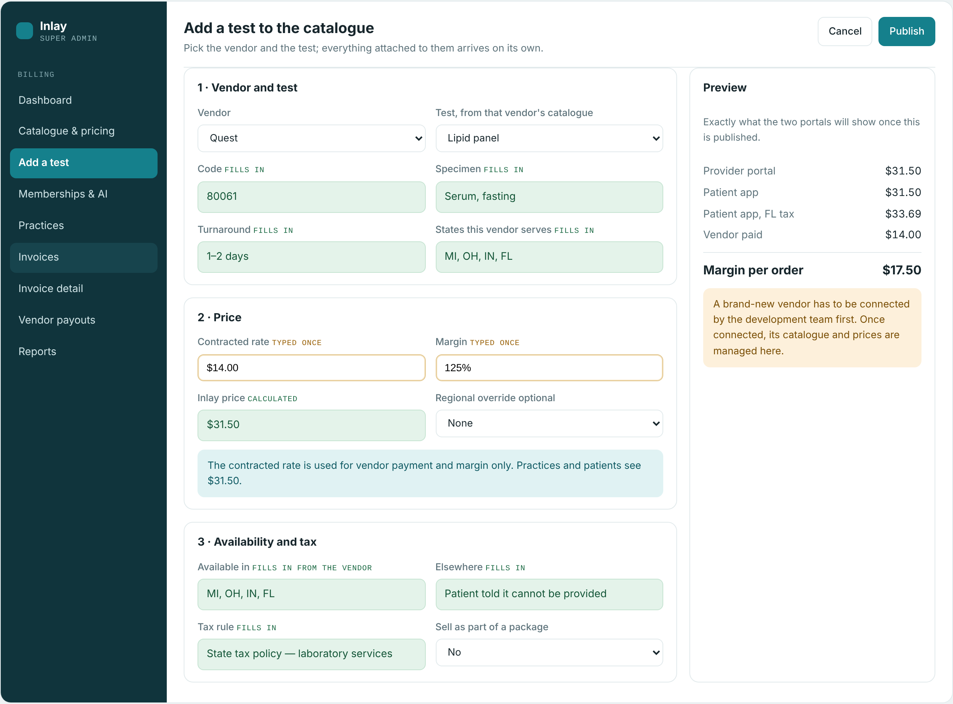
Add a test to the catalogue
SUPER ADMIN PORTAL 3/9
Two fields typed, everything else arrives
WHAT THIS SCREEN DOES
The admin picks a vendor and a test. Code, specimen, turnaround, states served and the tax rule arrive with them.
Only the contracted rate and the margin are typed. The Inlay price is calculated from them, never entered.
Preview shows exactly what the provider portal and the patient app will display, tax included, before publishing.
A brand-new vendor is connected by the development team first; after that its catalogue is managed here.
Notes:
Add a test to the catalogue — The admin picks a vendor and a test. Code, specimen, turnaround, states served and the tax rule arrive with them. Only the contracted rate and the margin are typed. The Inlay price is calculated from them, never entered. Preview shows exactly what the provider portal and the patient app will display, tax included, before publishing. A brand-new vendor is connected by the development team first; after that its catalogue is managed here.

Slide 7
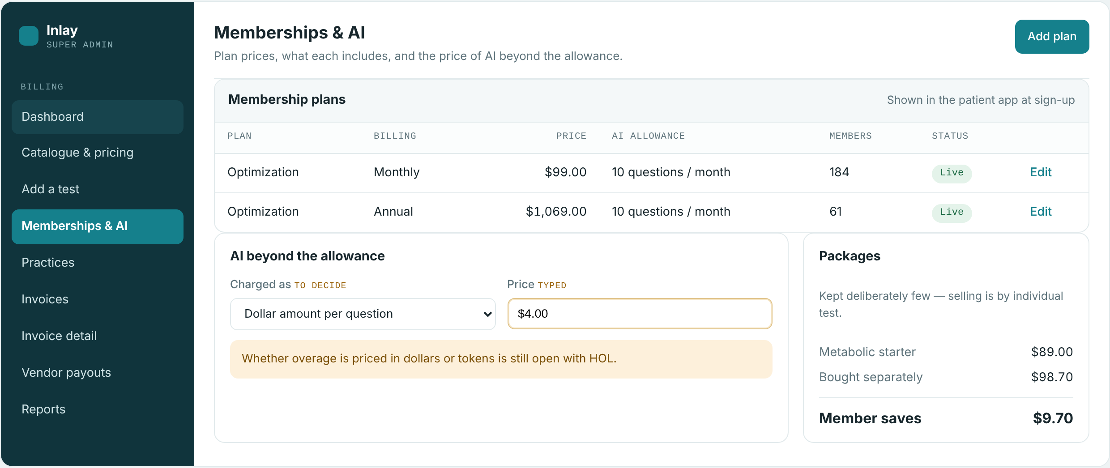
Memberships and AI
SUPER ADMIN PORTAL 4/9
Plan prices and what sits beyond the allowance
WHAT THIS SCREEN DOES
Membership plan prices, monthly and annual, what each includes and the live member count.
AI allowance per plan, with the price of questions asked beyond that allowance.
Open point held on the screen: whether overage is charged per question in dollars or as token bundles.
Packages are kept deliberately few — selling is by individual test.
Notes:
Memberships and AI — Membership plan prices, monthly and annual, what each includes and the live member count. AI allowance per plan, with the price of questions asked beyond that allowance. Open point held on the screen: whether overage is charged per question in dollars or as token bundles. Packages are kept deliberately few — selling is by individual test.

Slide 8
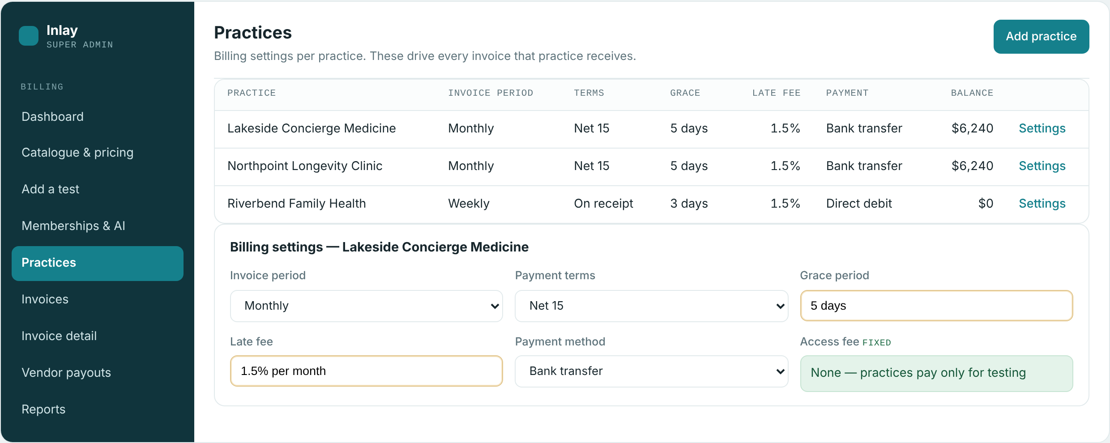
Practices
SUPER ADMIN PORTAL 5/9
Billing settings that drive every invoice
WHAT THIS SCREEN DOES
Billing settings per practice: invoice period, payment terms, grace period, late fee and payment method.
Every invoice a practice receives is built from these settings. Nothing is decided invoice by invoice.
Weekly, monthly and per-order billing run side by side across different practices.
Access fee is zero. Practices pay for testing only.
Notes:
Practices — Billing settings per practice: invoice period, payment terms, grace period, late fee and payment method. Every invoice a practice receives is built from these settings. Nothing is decided invoice by invoice. Weekly, monthly and per-order billing run side by side across different practices. Access fee is zero. Practices pay for testing only.

Slide 9
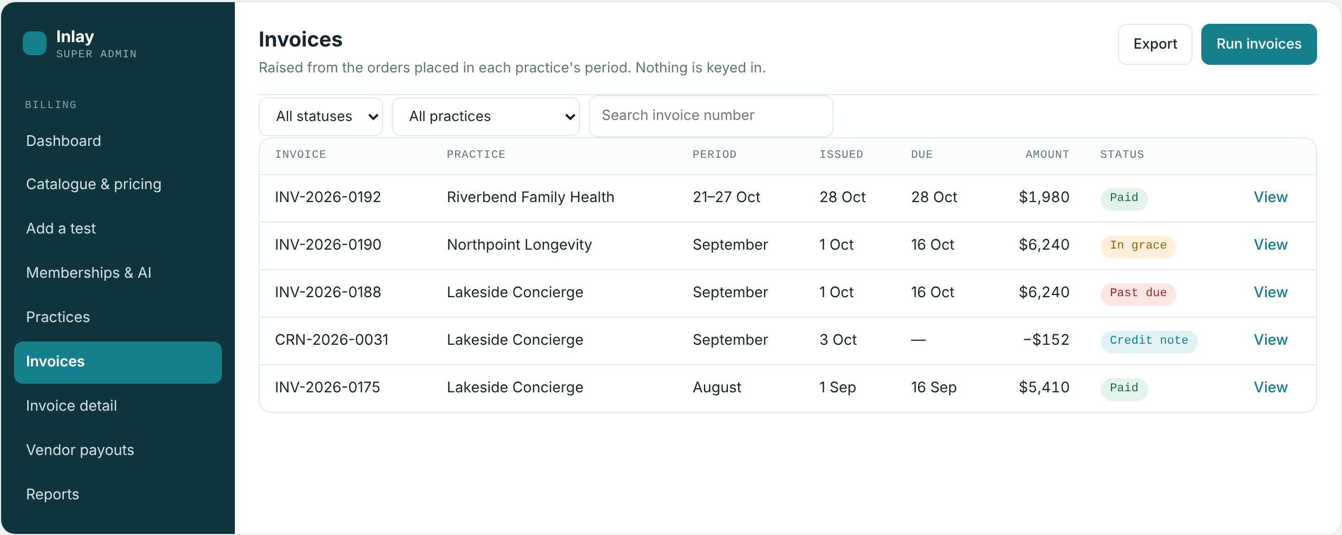
Invoices
SUPER ADMIN PORTAL 6/9
Raised from orders, not keyed in
WHAT THIS SCREEN DOES
Invoices are raised from the orders placed inside each practice's billing period.
Status runs through paid, due, in grace and past due, with credit notes listed alongside.
Filter by practice or status, open any invoice, or export the period for finance.
Notes:
Invoices — Invoices are raised from the orders placed inside each practice's billing period. Status runs through paid, due, in grace and past due, with credit notes listed alongside. Filter by practice or status, open any invoice, or export the period for finance.

Slide 10
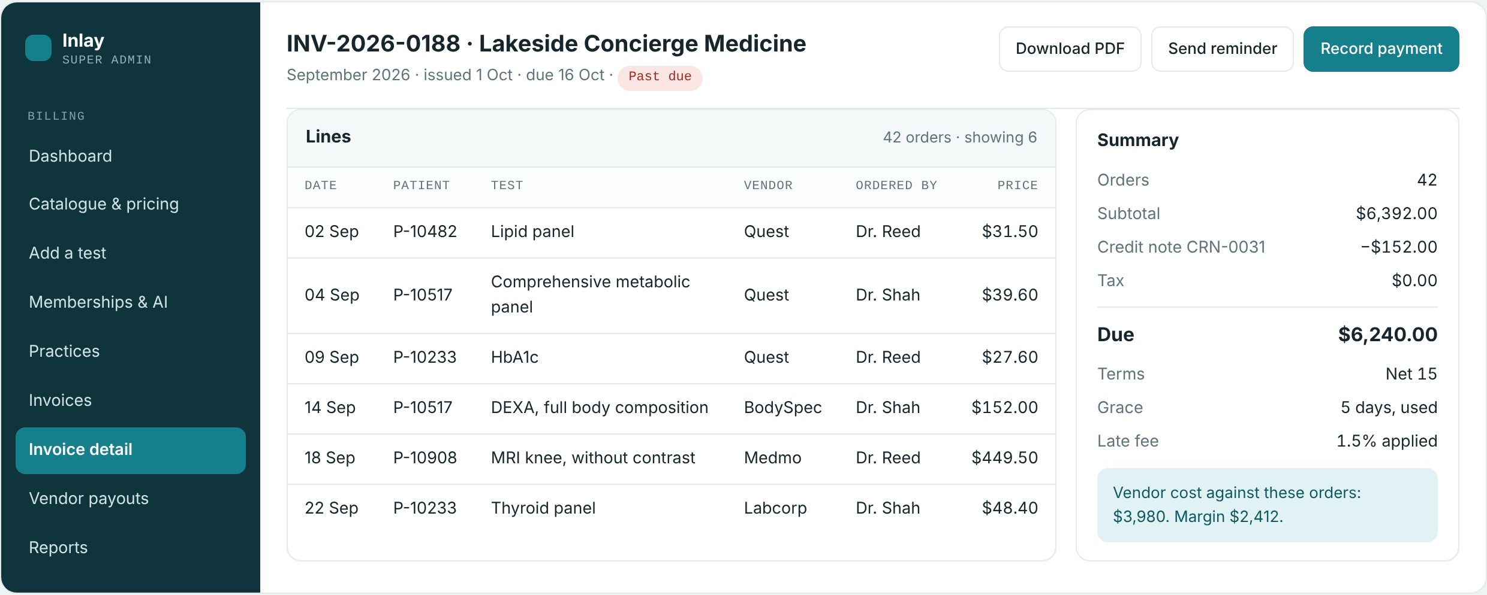
Invoice detail
SUPER ADMIN PORTAL 7/9
The full line-level record behind one invoice
WHAT THIS SCREEN DOES
Every order on the invoice line by line: date, patient, test, vendor, ordering physician and price.
The summary carries the credit note, tax and amount due, with terms, grace used and late fee applied.
Vendor cost and margin against the same orders are shown here, to the admin only.
Download the PDF, send a reminder or record a payment from the same screen.
Notes:
Invoice detail — Every order on the invoice line by line: date, patient, test, vendor, ordering physician and price. The summary carries the credit note, tax and amount due, with terms, grace used and late fee applied. Vendor cost and margin against the same orders are shown here, to the admin only. Download the PDF, send a reminder or record a payment from the same screen.

Slide 11
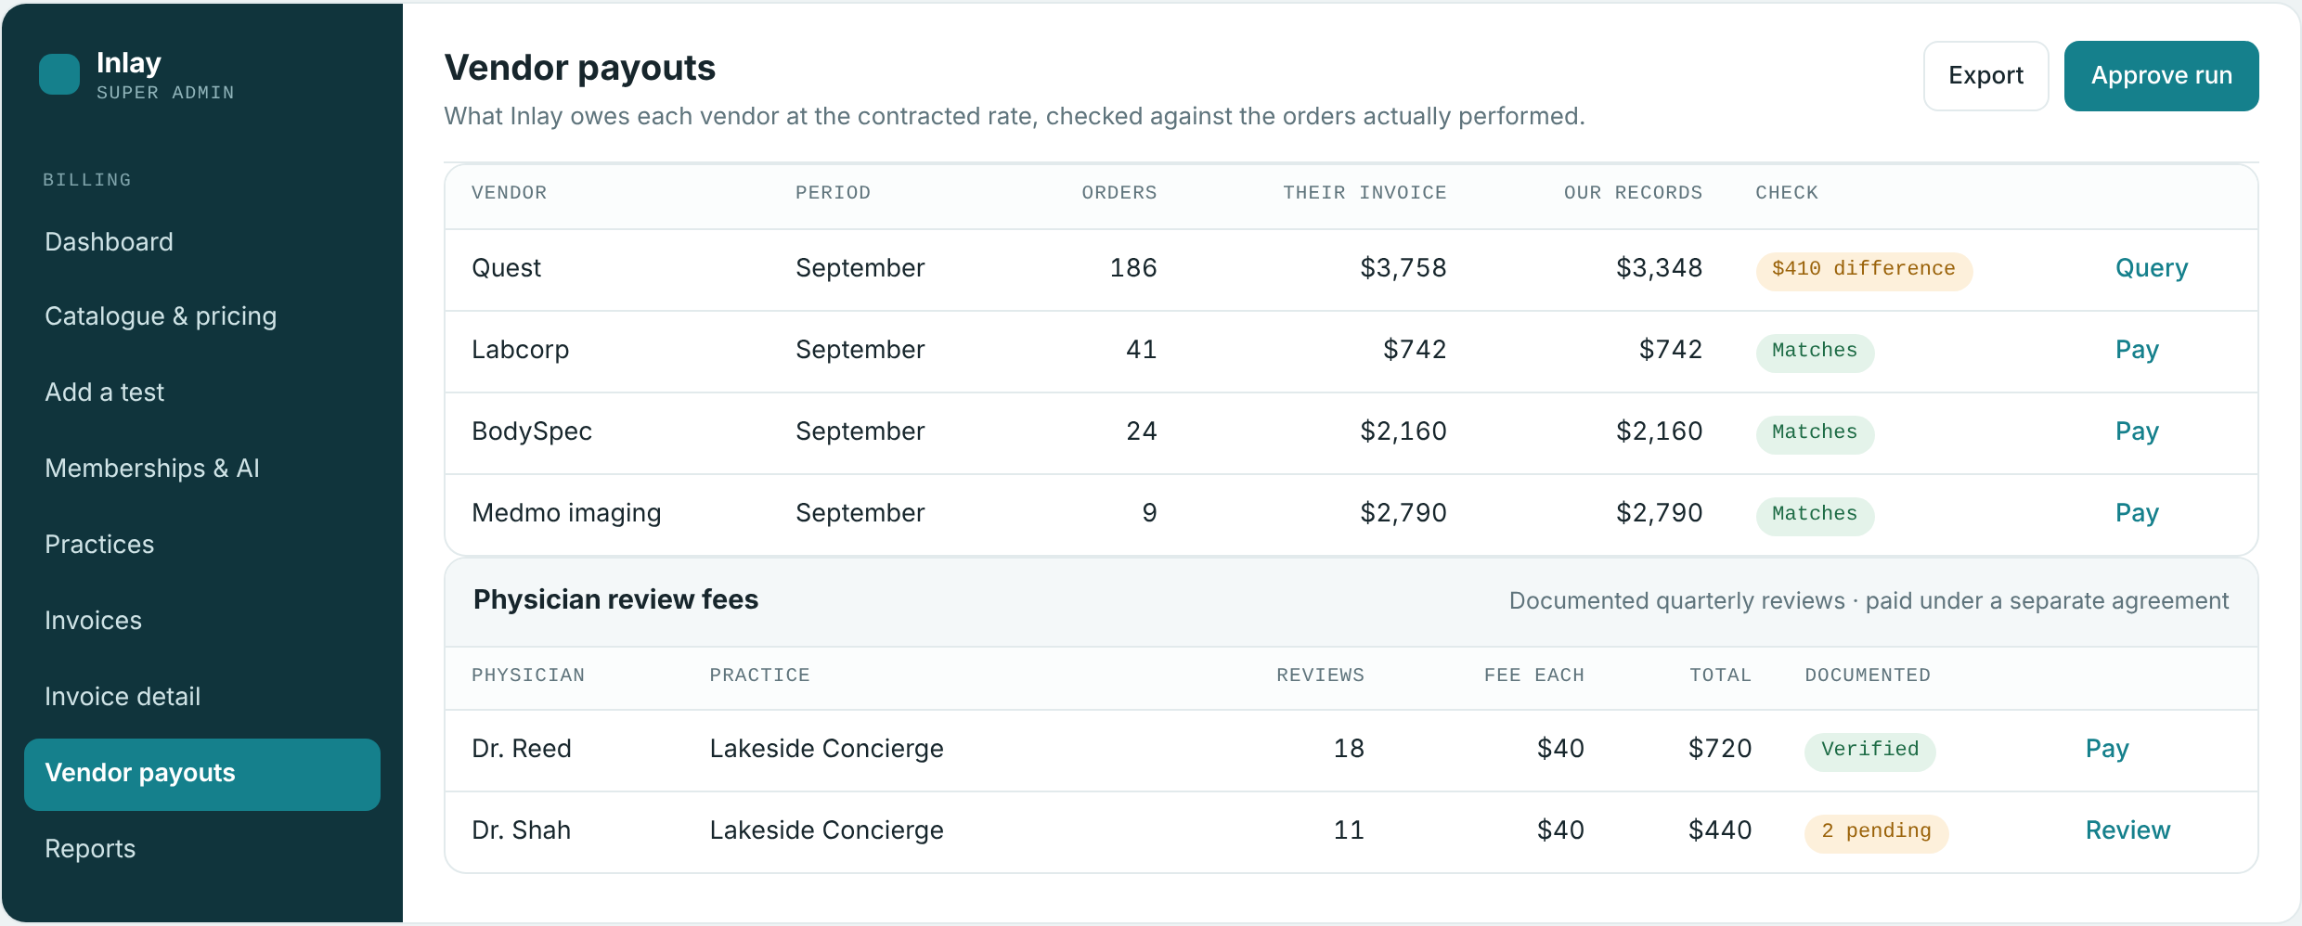
Vendor payouts
SUPER ADMIN PORTAL 8/9
What Inlay owes, checked before it is paid
WHAT THIS SCREEN DOES
What Inlay owes each vendor at the contracted rate for the period's orders.
The vendor's own invoice is checked against the orders actually performed; a difference is raised as a query rather than paid.
Physician review fees for documented quarterly reviews sit on the same screen, paid under a separate agreement.
Notes:
Vendor payouts — What Inlay owes each vendor at the contracted rate for the period's orders. The vendor's own invoice is checked against the orders actually performed; a difference is raised as a query rather than paid. Physician review fees for documented quarterly reviews sit on the same screen, paid under a separate agreement.

Slide 12
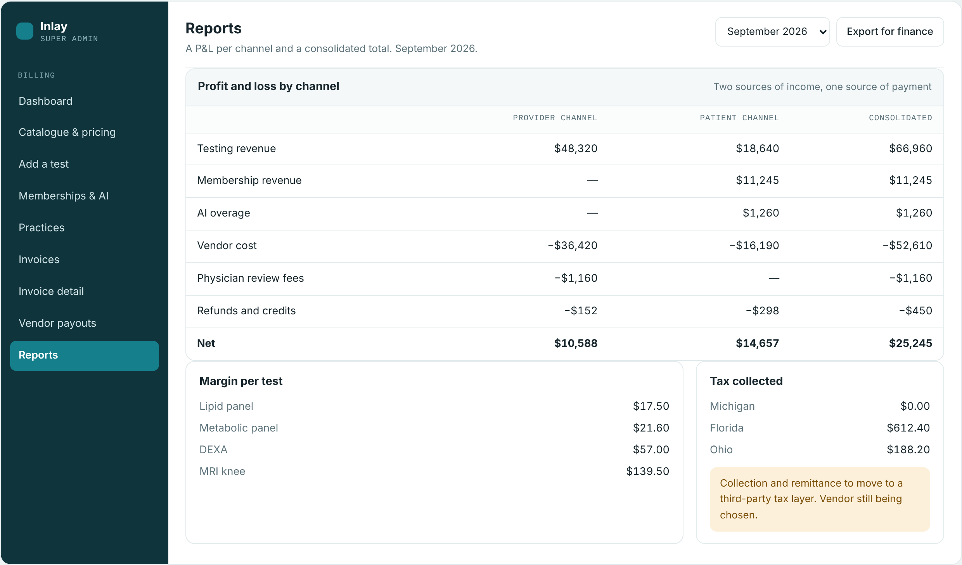
Reports
SUPER ADMIN PORTAL 9/9
A P&L per channel and a consolidated total
WHAT THIS SCREEN DOES
Separate profit and loss for the provider channel and the patient channel, plus the consolidated position.
Revenue, vendor cost, physician review fees, refunds and credits, down to net for each channel.
Margin per test and tax collected per state.
Open point: collection and remittance of tax moves to a third-party tax layer, vendor still being chosen.
Notes:
Reports — Separate profit and loss for the provider channel and the patient channel, plus the consolidated position. Revenue, vendor cost, physician review fees, refunds and credits, down to net for each channel. Margin per test and tax collected per state. Open point: collection and remittance of tax moves to a third-party tax layer, vendor still being chosen.

Slide 13
Provider portal
Part two
6 screens — the billing overview, ordering a test, the order list, invoices and statements, invoice detail and physician fees.

Slide 14
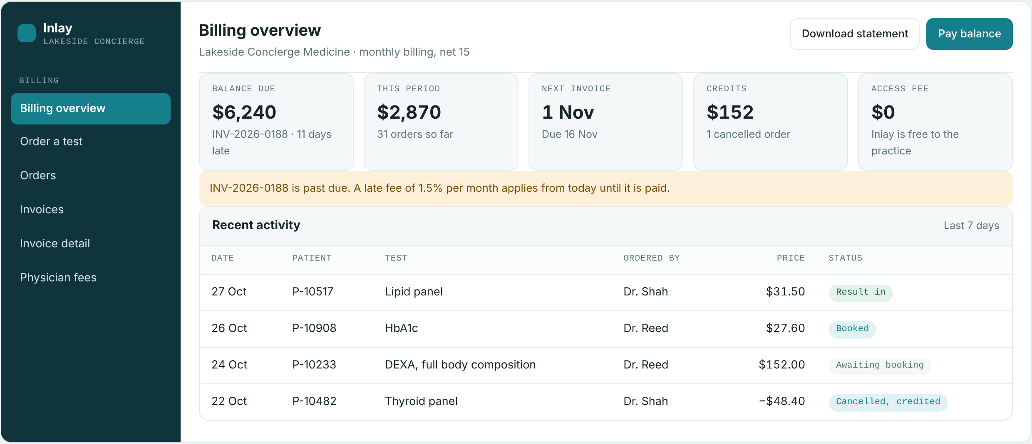
Billing overview
PROVIDER PORTAL 1/6
What the practice owes and what is building up
WHAT THIS SCREEN DOES
Balance due, the current period's running total, the next invoice date and any credits held.
A past-due invoice carries a plain notice with the late fee that applies from today.
Access fee is shown as zero — Inlay is free to the practice, which pays for testing only.
Recent activity shows each order and its status, including anything cancelled and credited.
Notes:
Billing overview — Balance due, the current period's running total, the next invoice date and any credits held. A past-due invoice carries a plain notice with the late fee that applies from today. Access fee is shown as zero — Inlay is free to the practice, which pays for testing only. Recent activity shows each order and its status, including anything cancelled and credited.

Slide 15
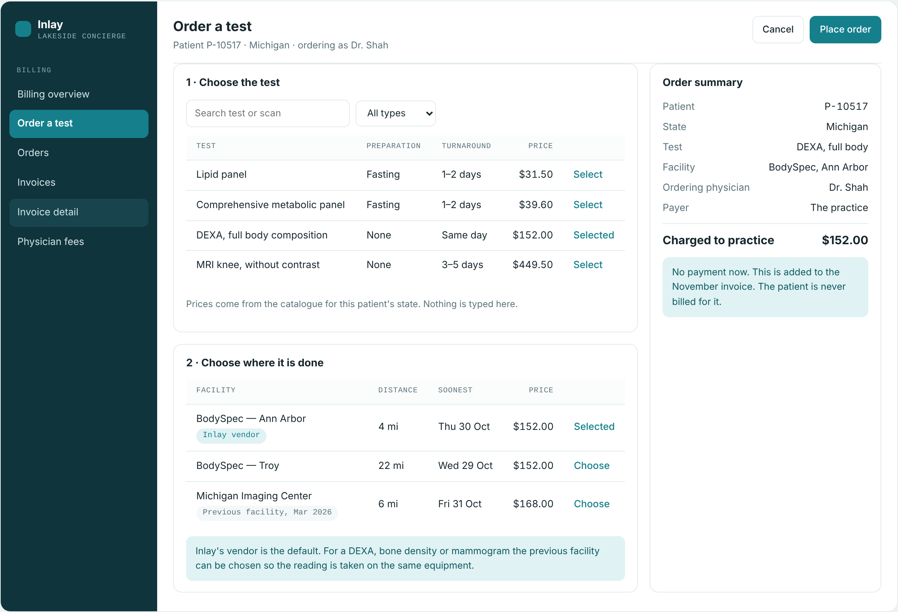
Order a test
PROVIDER PORTAL 2/6
Priced by the catalogue, charged to the practice
WHAT THIS SCREEN DOES
The test is chosen from the catalogue for that patient's state. The price shown is the Inlay price and is never typed.
Inlay's vendor is the default facility. The patient's previous facility can be chosen for DEXA, bone density and mammogram so the reading is taken on the same equipment.
The order summary names the payer explicitly: the practice. Nothing is collected at the time of ordering.
The order joins the next invoice. The patient is never billed for it.
Notes:
Order a test — The test is chosen from the catalogue for that patient's state. The price shown is the Inlay price and is never typed. Inlay's vendor is the default facility. The patient's previous facility can be chosen for DEXA, bone density and mammogram so the reading is taken on the same equipment. The order summary names the payer explicitly: the practice. Nothing is collected at the time of ordering. The order joins the next invoice. The patient is never billed for it.

Slide 16
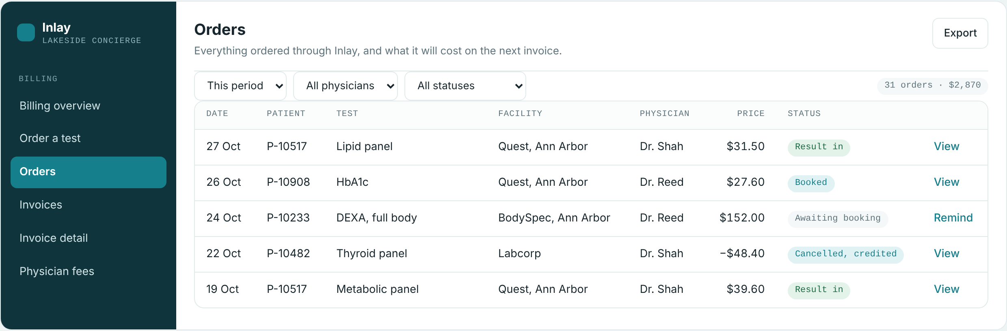
Orders
PROVIDER PORTAL 3/6
Everything ordered, and what it will cost
WHAT THIS SCREEN DOES
Every order placed through Inlay for the period, with the price each will carry on the next invoice.
Filter by period, ordering physician and status — awaiting booking, booked, result in, cancelled.
A cancelled order shows as a credit, so the running total always matches what will be invoiced.
Notes:
Orders — Every order placed through Inlay for the period, with the price each will carry on the next invoice. Filter by period, ordering physician and status — awaiting booking, booked, result in, cancelled. A cancelled order shows as a credit, so the running total always matches what will be invoiced.

Slide 17
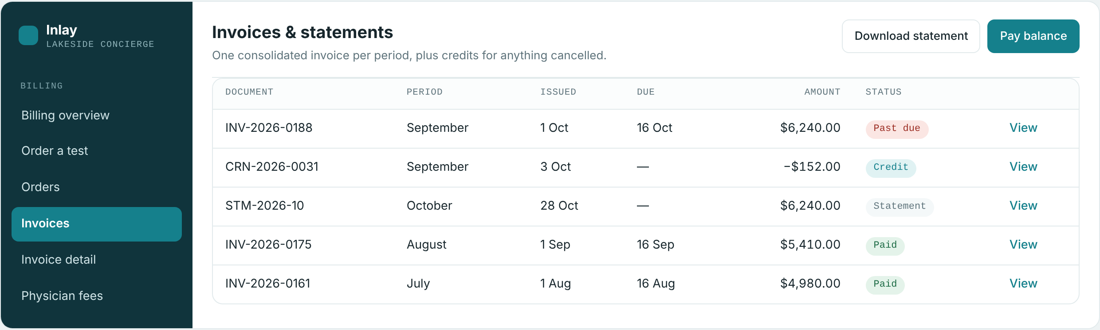
Invoices and statements
PROVIDER PORTAL 4/6
One invoice per period, not one per order
WHAT THIS SCREEN DOES
A single consolidated invoice per billing period covering every order in it.
Credit notes and interim statements are listed alongside the invoices.
Download a statement or pay the balance from the same screen.
Notes:
Invoices and statements — A single consolidated invoice per billing period covering every order in it. Credit notes and interim statements are listed alongside the invoices. Download a statement or pay the balance from the same screen.

Slide 18
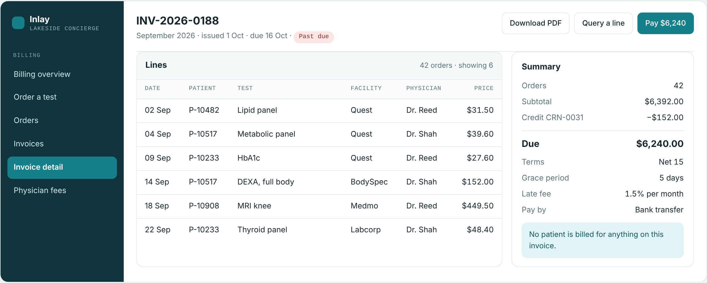
Invoice detail
PROVIDER PORTAL 5/6
What the practice reconciles against
WHAT THIS SCREEN DOES
The same lines the practice can check against its own records: date, patient, test, facility, physician and price.
Summary shows subtotal, credits, amount due, terms, grace period, late fee and how to pay.
A single line can be queried without holding up payment of the rest of the invoice.
Contracted rates and margin are not shown. The invoice states that no patient is billed for anything on it.
Notes:
Invoice detail — The same lines the practice can check against its own records: date, patient, test, facility, physician and price. Summary shows subtotal, credits, amount due, terms, grace period, late fee and how to pay. A single line can be queried without holding up payment of the rest of the invoice. Contracted rates and margin are not shown. The invoice states that no patient is billed for anything on it.

Slide 19
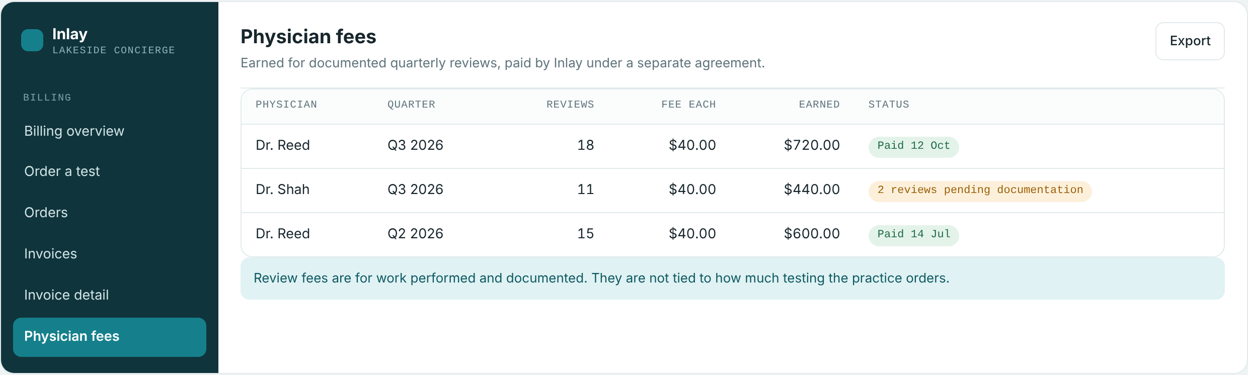
Physician fees
PROVIDER PORTAL 6/6
Earned for documented reviews
WHAT THIS SCREEN DOES
What each physician has earned for documented quarterly reviews, quarter by quarter.
Paid by Inlay under a separate agreement, with the number of reviews and the fee for each.
Pending rows show where documentation is still outstanding.
Fees are for work performed and documented. They are not tied to how much testing the practice orders.
Notes:
Physician fees — What each physician has earned for documented quarterly reviews, quarter by quarter. Paid by Inlay under a separate agreement, with the number of reviews and the fee for each. Pending rows show where documentation is still outstanding. Fees are for work performed and documented. They are not tied to how much testing the practice orders.

Slide 20
Carried as open on these screens
Everything else shown is built on the billing model agreed on 27 and 29 October. These two are still to be settled.
?
AI beyond the allowance
Memberships and AI, Super Admin
Whether questions above a plan's allowance are charged as a dollar amount per question or as token bundles. The price field stays empty until this is decided.
?
Tax collection and remittance
Reports, Super Admin
Tax is shown per state today. Collection and remittance move to a third-party tax layer and the vendor has not been chosen yet.
A note on the screens
These are prototype screens with sample figures, built to agree the billing behaviour before development. Nothing here is live data.

