Slide 1

Lovely Professional University
Project Report on
Intelligent Pneumatic Braking System
On Table Saw
In the partial fulfillment of
VIII Semester B.Tech (Mechatronics Engineering)
Under the Guidance of
Mr.HARINDER SINGH GREWAL
(Department of Manufacturing Engineering)
School Of Mechanical Engineering
Lovely Professional University, Phagwara
(Jan-Apr, 2017)

Slide 2
INTRODUCTION
The main concern behind this project is basically safety of the human. We see many accidents happen in our daily today life in industries. So we are just trying to give an Idea how we can add safety techniques in industry machines.
In this project we made pneumatic based Automatic braking system using original pneumatic system. We used rod type Pneumatic Cylinder for this purpose. To control air pressure we used valves. For air pressure source we used compressor. We are also using saw tooth cutter and IR sensors in this project. Whenever IR sensor will detect a human hand coming in front of the saw tooth cutter they will put a break to the Cutting machine immediately and the saw tooth will Go down.

Slide 3
Approaches
CAD Design:-This part deal with the design and material selection for the the whole system. Design is prepared on Solidworks and it is used as a reference model for the construction of project.
2) Mechanical :-
This part consist of Pneumatic system, Saw tooth cutter, Stand Table, Compressor. The main function of this part is to get a signal from the IR sensor via some electronic system, after getting the signal the pneumatic actuator get started and goes downward.
3) Electronics :-
This part consist of IR sensor, Relay, Microprocessor, Motor . The Main function of this part is to encoded the signal ,which comes from IR sensor and send it to the Pneumatic system.

Slide 4
Design-components
Base Plate
Motor and Cutter
Piston
Piston Rod
Sensor Mount

Slide 5
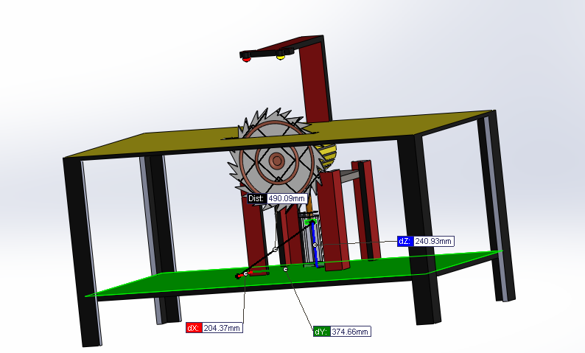
CAD Model

Slide 6
Pneumatic Calculations
4.6 Pneumatic Calculations
Pneumatic valve sizing-
Given data-
Stroke size = 75 mm = 2.95 inches
Bore size = 32 mm = 1.26 inches
Formula for Pneumatic Valve Size
Cv = area*stroke*A*Cf / Time*29 = 0.12
Here,
Cv- Coefficient of velocity
A- Pressure drop constant
Cf- Compression factor
Time- (0.4) in seconds
Stroke- Cylinder travel (inch)
Calculated Data-
Area =1.24 square inches
Stroke = 2.95 inches
Cf = 4.4
A = 0.091
Time = 0.4 second per stroke
Notes- Value of Cv is more then (0.11), so here we use double acting cylinder, otherwise we have to use single acting if the value is less then (0.11)

Slide 7
Mechanical Part

Slide 8
Components
Pneumatic System
Compressor
Sawtooth Cutter
Table stand

Slide 9
.
Pneumatic- Pneumatics is a section of technology that deals with the study and application of pressurized gas to produce mechanical motion. Pneumatic systems are used extensively in industry, and factories are commonly plumbed with compressed air or compressed inert gases.
Compressor- Centrifugal compressors use a rotating disk or impeller in a shaped housing to force the gas to the rim of the impeller, increasing the velocity of the gas. A diffuser (divergent duct) section converts the velocity energy to pressure energy. They are primarily used for continuous, stationary service in industries such as oil refineries, chemical and petrochemical plants and natural gas processing plants.

Slide 10
.
Sawtooth Cutter- A saw is a tool consisting of a tough blade, wire, or chain with a hard-toothed edge. It is used to cut through material, very often wood. The cut is made by placing the toothed edge against the material and moving it forcefully forth and less forcefully back or continuously forward. This force may be applied by hand, or powered by steam, water, electricity or other power source. An abrasive saw has a powered circular blade designed to cut through metal. Mostly made up of high strength steel (HSS), Diameter=150mm.
Table Stand- Specifications-
Length= 750mm
Breadth= 450mm
Height= 650mm

Slide 11
Electronics system
Sensor
Processing Unit (Microcontroller)
Relay Switches
Solenoid Valve
Motor

Slide 12
.
Sensor-An infrared sensor is an electronic instrument which is used to sense certain characteristics of its surroundings by either emitting and/or detecting infrared radiation. Infrared sensors are also capable of measuring the heat being emitted by an object and detecting motion.
Processing Unit- A microcontroller can be considered a self-contained system with a processor, memory and peripherals and can be used as an embedded system. Most micro controllers in use today are embedded in other machinery, such as automobiles, telephones, appliances, and peripherals for computer systems. While some embedded systems are very sophisticated, many have minimal requirements for memory and program length, with no operating system, and low software complexity

Slide 13
.
Relay Switches-Relays are electromechanical devices that use an electromagnet to operate a pair of movable contacts from an open position to a closed position. The advantage of relays is that it takes a relatively small amount of power to operate the relay coil, but the relay itself can be used to control motors, heaters, lamps or AC circuits which themselves can draw a lot more electrical power.
Solenoid Valve-A solenoid valve is an electromechanically operated valve. The valve is controlled by an electric current through a solenoid: in the case of a two-port valve the flow is switched on or off; in the case of a three-port valve, the outflow is switched between the two outlet ports.

Slide 14
Motor
An electrical motor is an electrical machine that converts electrical energy into mechanical energy. The reverse of this is the conversion of mechanical energy into electrical energy and is done by an electric generator.
Specification-
Volt =220V, Power=1200watt, RPM=23000, Frequency=50/60Hz, Current=4.8A

Slide 15
Advantages
It can be used in industries for the safety purpose.
We can minimize the average of the accidents which are happening in our day to day life.
Very accurate and safe device to operate.
To increase the productivity of an Organization.
Good working condition for workers.
Easy to control the operation.
Reduce the Holding time for next operation.
Better for mass productions such as tiles industries.

Slide 16
Conclusion
After all the efforts, we are successful in delivering our idea of the project in working condition. We can add some modifications in this project in future to make the operation in much easier and smoothly way. This project will provide greater opportunities for future work such as development of other controllers and safety mechanisms.

Slide 17
.
Thank You

