Slide 1
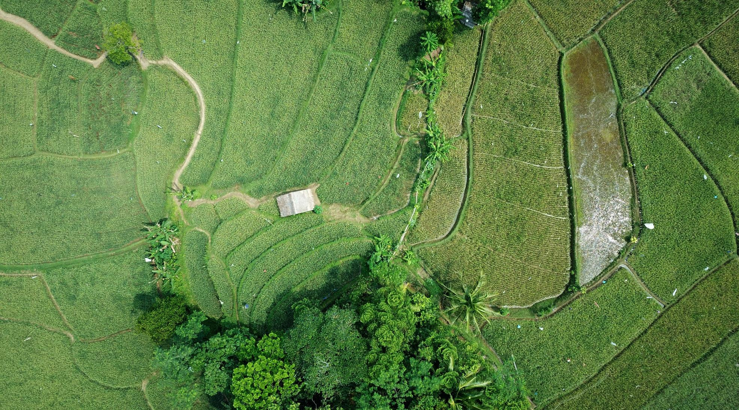
Shakti
Enabling Sustainable Production and Consumption

Slide 2
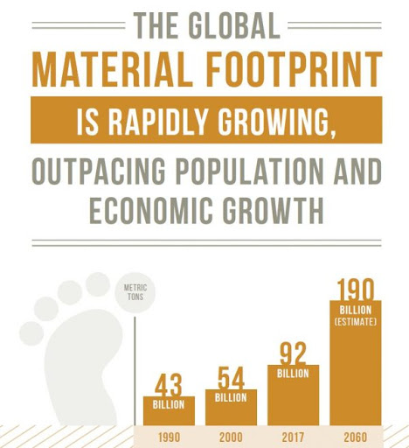
Material Footprint
Rose by 66% since the year 2000
Source: https://sdgs.un.org/goals/goal12

Slide 3
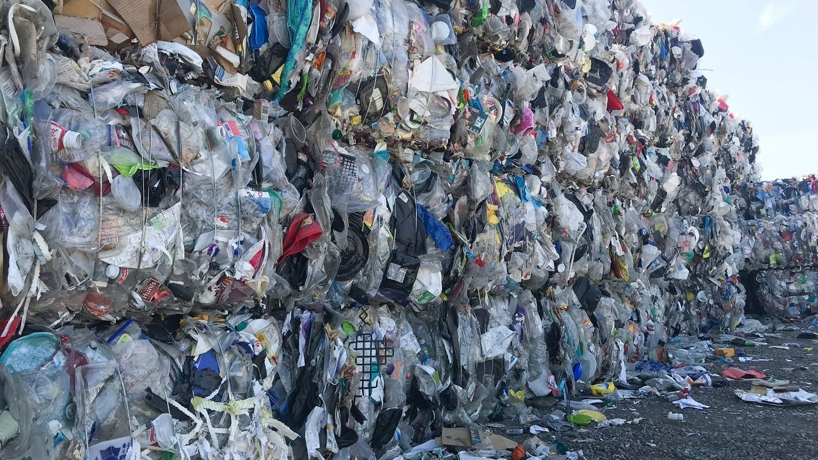
Waste
Less than 25% gets recycled
But more than 70% of waste can be reused or can be recycled

Slide 4





Impact on Environment
Climate Change
Pollution
Harm towards animal and marine life
Soil contamination
Air contamination

Slide 5
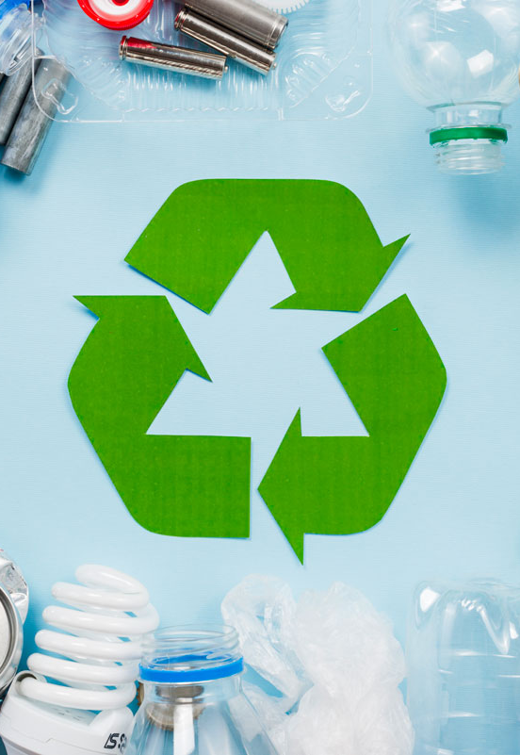



Recycling
Saves Energy
Reduces Pollution
Creates Jobs
Can power 14 million homes for a full year
Reduces Air and Water Pollution by 80%
For every 1 job in landfill = 35 jobs in Recycling process and manufacturing

Slide 6




Shakti
B2B Tool
Connects Manufacturers with Recycled Material Suppliers
Smart Search And Insights
Comparing by Prices, Quality, Carbon Footprint
Recommendations
Derived from market Insights on Type of recycled materials, Market prices and Carbon emissions

Slide 7

How does Shakti add value

Slide 8


Buyers/Manufacturers
Enables them to make informed decision
Insights
Decision
Responsible Production
Price, Recycling details, Carbon Footprint
Recommendations and Comparisons between suppliers' aid in decision making
Buy Products in Sustainable Way

Slide 9

Suppliers
List their Recycled Materials
Competitive Price
Connect
Brand
List their Materials at competitive Prices
Drive Business by connecting with sustainable manufacturers
Promoting Sustainable Production and Consumption

Slide 10

Shakti
Shakti will enable producers and consumers to build and buy products in a sustainable way for our society, by reducing waste and increasing the use of recycled materials.
Enabling Sustainable Production and Consumption

Slide 11
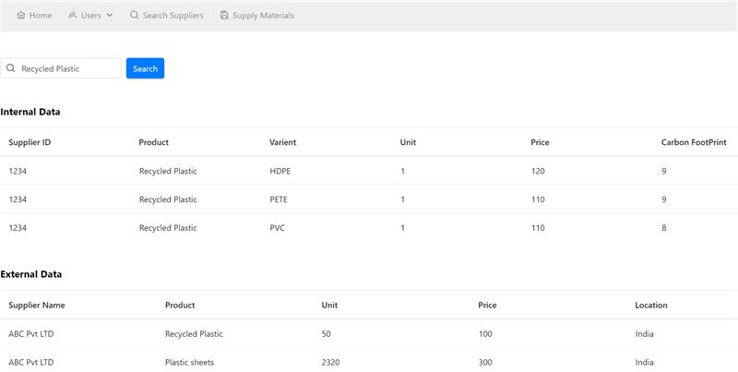
Product Demo

Slide 12
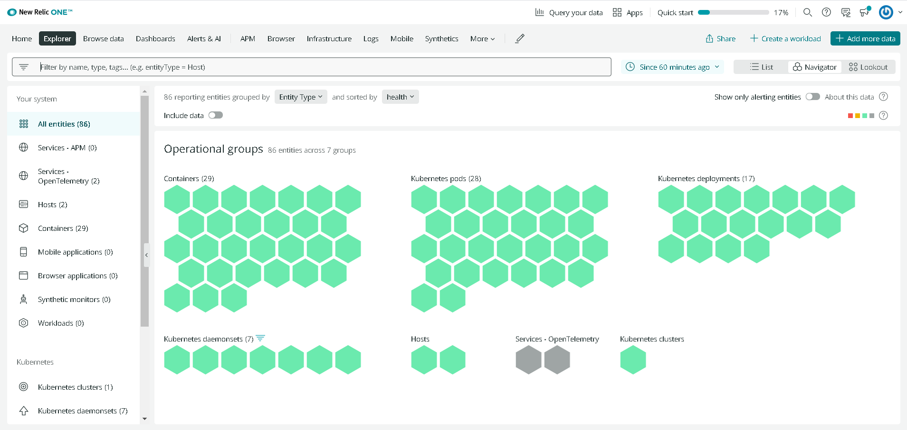
Integrated with New Relic

Slide 13
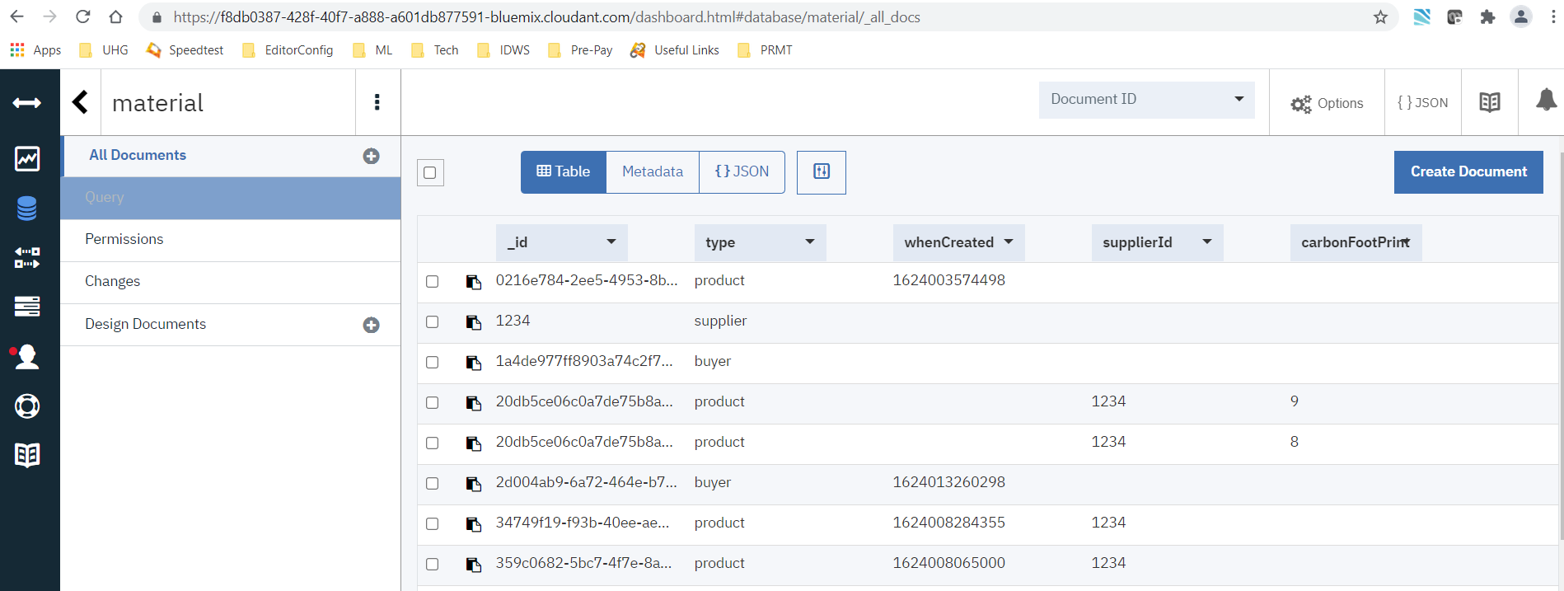
Cloudant

Slide 14
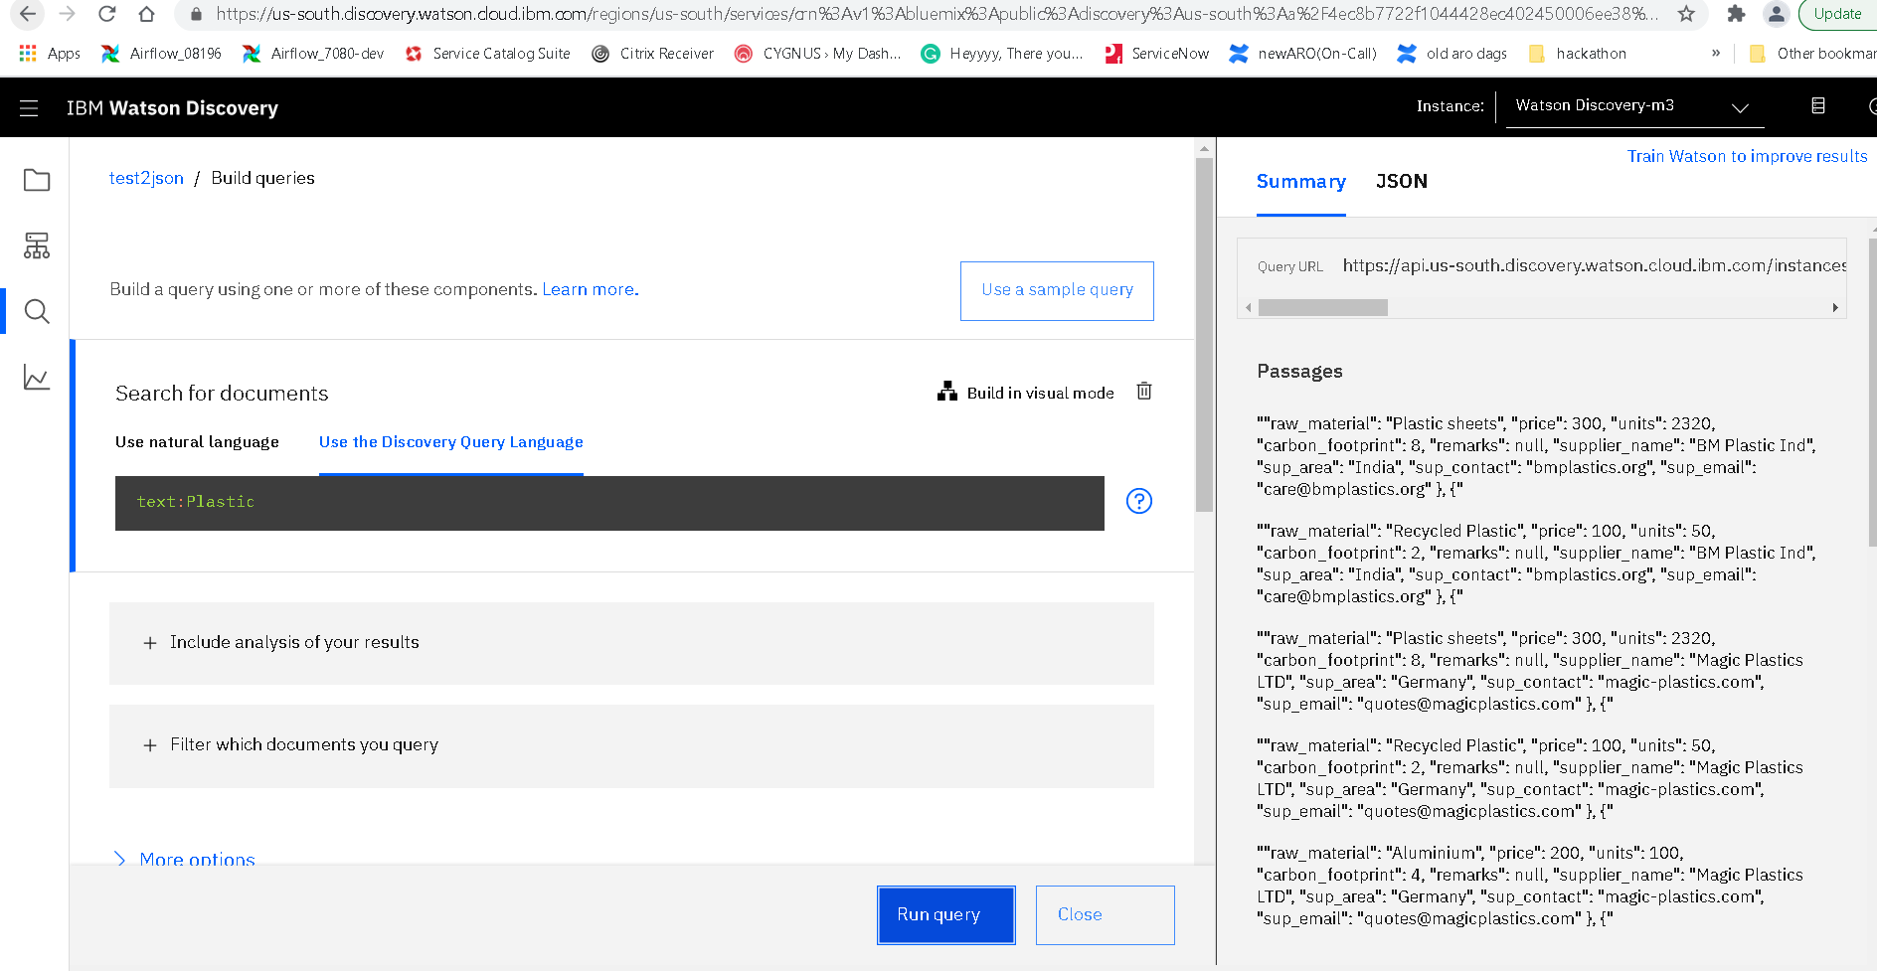
Watson Discovery

Slide 15
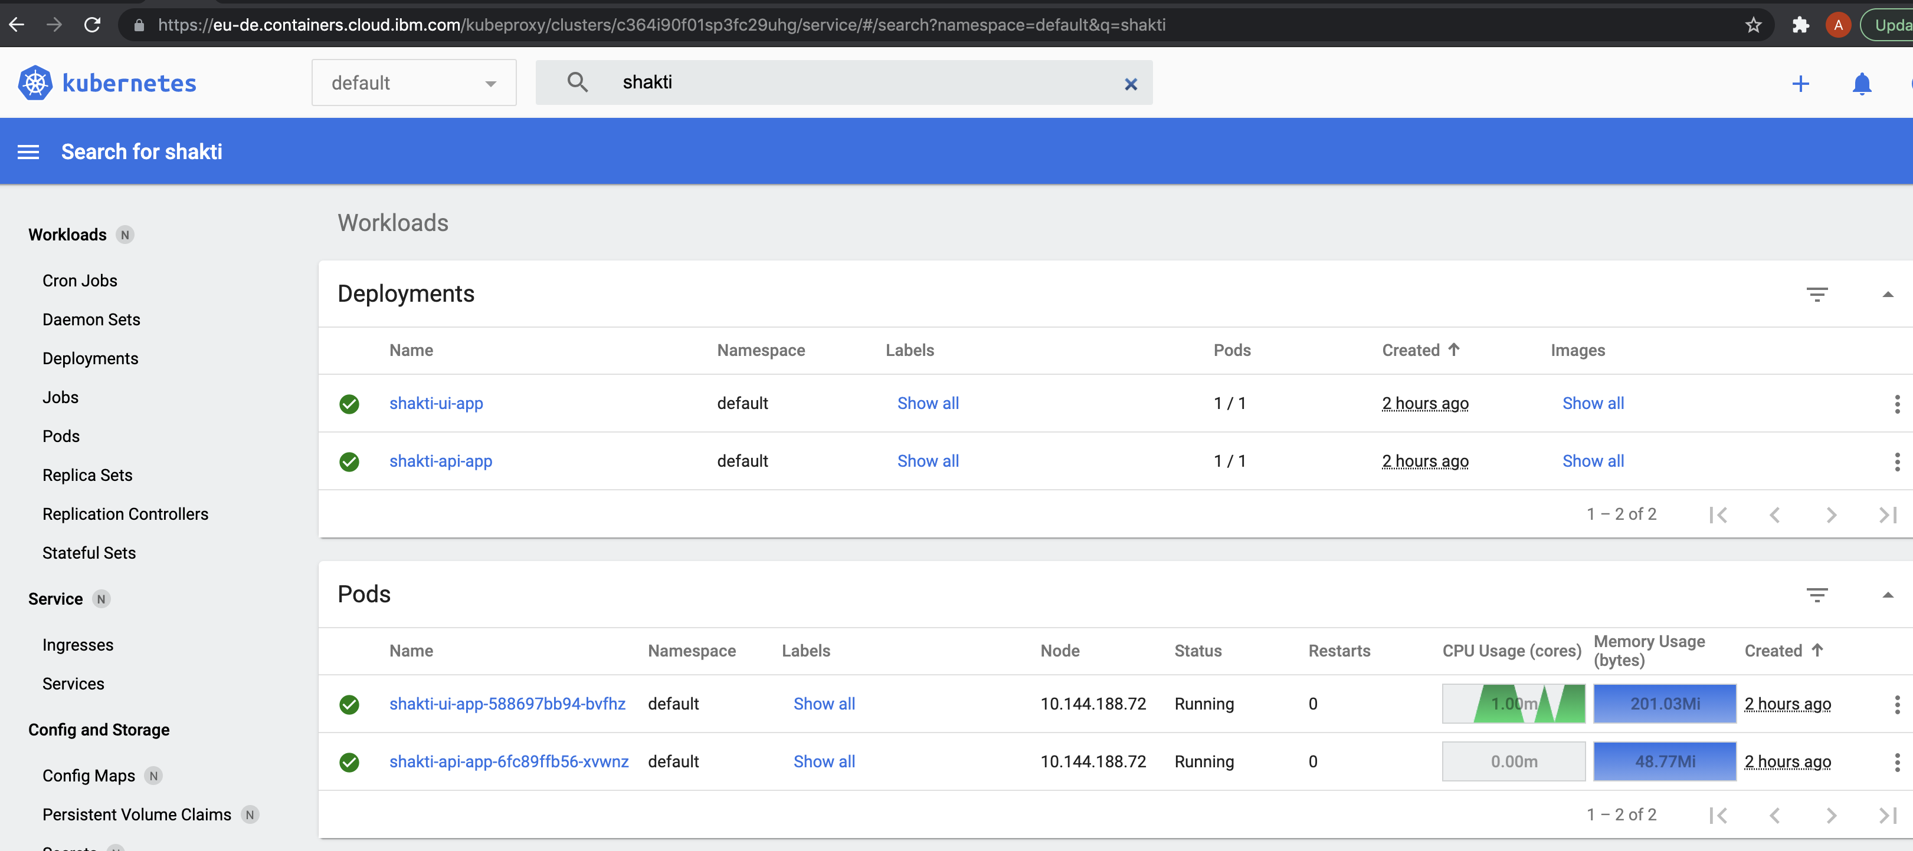
Kubernetes

Slide 16


Thank You

