Slide 1

For Official Use Only (FOUO)
Flare
Demonstration
11/18/2013

Slide 2




Information Sharing at a Enterprise Level
For Official Use Only (FOUO)
Every second, we subscribe to information which publishers produce and disseminate!!
This is Near-Real Time Information Sharing!
Notes:
Our presentation today focuses on a NRT capability that we are prototyping using a implementation of TAXII. I think everyone here is familiar with the icons above. We use them everyday and some of us realize how integral they are in information delivery.

Slide 3
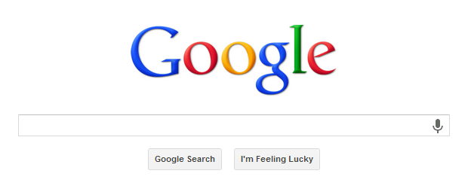
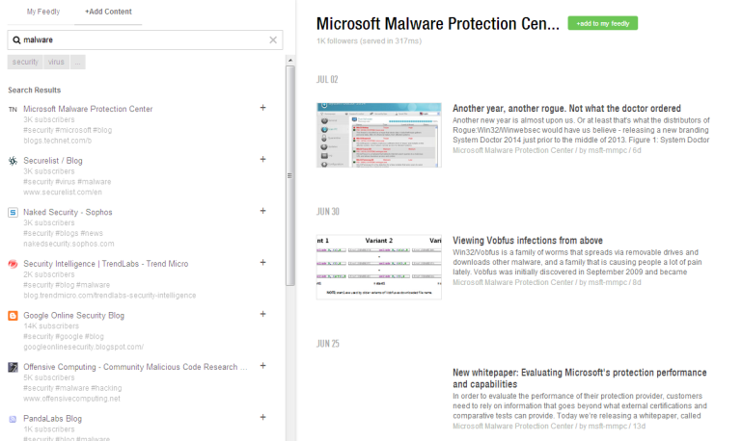
Information Sharing & Information Querying
For Official Use Only (FOUO)
Information Querying (i.e. DC3 storefront)
You must know what you want to query for.
In our environment it would imply that the Indicator is known.
Information Sharing
(DHS Flare)
Publishers publishes information
In our environment a Subscriber would receive all information published to relevant topics.

Slide 4
Overview
For Official Use Only (FOUO)
The CNCI-5 Program has articulated numerous goals for both FY13 and FY14 to aide in the Cyber Centers ability to exchange cyber threat information
Sharing of I&W
Sharing of Malware Attribute information
Sharing of Incident information
Sharing of Critical Information Requirements (CIR)
Sharing of Countermeasures
Dissemination of Analytical Products
Sharing of Analytics
Sharing of Mitigation actions and activities
With so many data sets / data points to share – the need for a a secure, scalable, durable and reliable exchange mechanism is clear
Currently this instrument does not exist
Near Real Time message exchange will enhance response and coordination activities as well as increase operational tempo across the Cyber Centers

Slide 5
How Flare Helps: Benefits
For Official Use Only (FOUO)
A near real time capability that address these gaps is required to provide relevant threat data in a time frame conducive to mitigation planning and response. The Flare system:
Provides a secure mechanism to share cyber threat information across network boundaries
Provides a durable and reliable messaging system
Mediates numerous messaging standards (TAXII, WS, NIEM)
Can support different access and authorization paradigms
Provides immediate and actionable information on emerging threats
Decouples the application and data
The NRT enables secure system to system distribution, making I&W or any data payload actionable instantly.

Slide 6
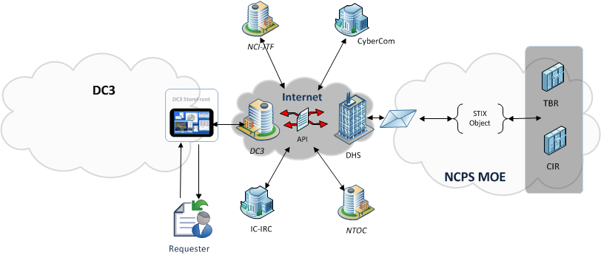
Information Querying – DC3 Storefront
For Official Use Only (FOUO)
The DC3 Storefront provides a federated search across cyber centers
The requester must know beforehand what to query.
For example, MD5 Hash of “0xDA11373AF6FAE047455768F6BC706AC9”. But what about “0xDA34303AF6FAE047455768F6F00AA5”, …
Great for investigation and analysis, and a perfect compliment for the NRT Alerting capability
Combining the DC3 ISA architecture, and the NRT Alerting will provide both a passive and active mechanism to receive cyber threat information

Slide 7
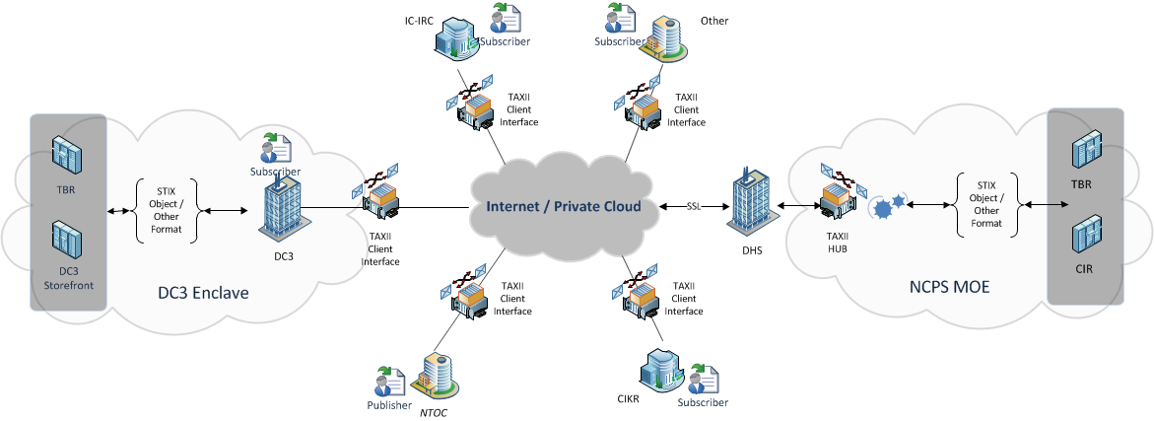
Information Sharing – Flare
For Official Use Only (FOUO)
Authorized publishers can publish information to a topic for any authorized subscribers to receive information. This provides a Active architecture and enhanced situational awareness.
Example:
NSA identifies new malware. Publish the malware metadata to Malware topic. All subscribing systems receive notification. Paradigm shift to “Everyone needs to know immediately.”
Information sharing is bidirectional, you wont get an answer to a question you don’t know to ask

Slide 8
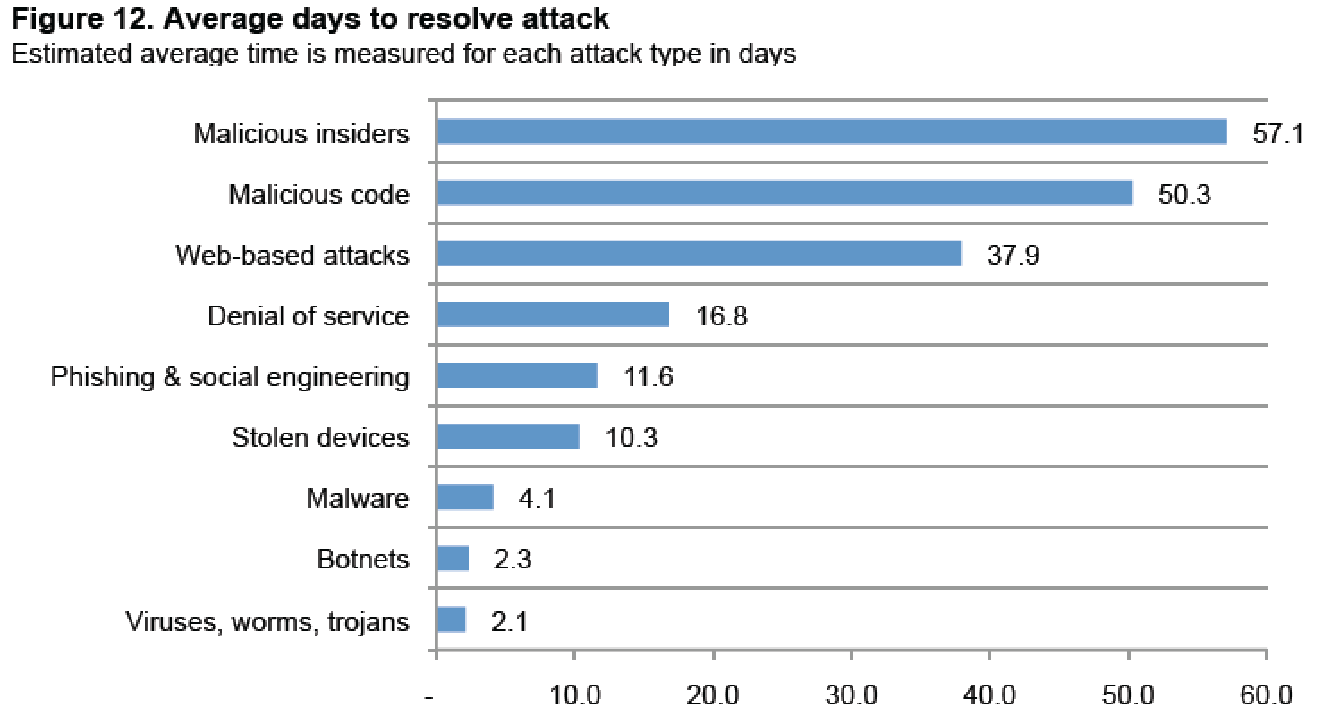
Scenarios where a NRT Publish-Subscribe paradigm enables Situational Awareness
For Official Use Only (FOUO)
“A Twitter User Reports Live From Osama Bin Laden Raid”
“Twitter”, a microblog platform using “Real Time” Publish/Subscribe architecture.
Bin Laden Raid was searchable in Google 11 hours following the live messages.
Instant vs 11 hours
Near Real Time is critical – We have to stop chasing burglars out the back door.
Attacks take days to detect, notify and respond.
We must amplify our knowledge of malicious information to a common understanding
We must uniformly action and task our defensive capabilities to protect our interests

Slide 9
Value
For Official Use Only (FOUO)
Flare provides many features and benefits:
Provides a mechanism to use adopted standards as the foundations for information exchange
Lays the building blocks for the unclassified communications fabric
Provides secure message exchange based on a publisher subscriber paradigm
Decouples data from the application
Can be easily scaled while supporting the need for flexibility
Client can adapt to each infrastructure to allow for simple integration

Slide 10
Demo
11/18/2013

Slide 11
Flare Messaging Example
Two feeds
I+W: Defense Industrial Base (DC3 publisher)
I+W: Cyber Fed Model (DoE publisher)
Three subscribers
USCYBERCOM
DHS
NTOC
DC3
HUB
USCYBERCOM
DoE
DHS
NTOC

Slide 12
Scenario 1: DIB I+W
Each time that DC3 publishes a message to the DIB: I+W feed (we randomly cycle through three different messages) all the subscribers are pushed the message.
There are three subscribers to DIB: I+W
DHS
NTOC
USCYBERCOM
Message originates in UIEF format, hub transforms it into STIX format, routes to subscribers

Slide 13
Scenario 1
UIEF
DC3
STIX
STIX
USCYBERCOM
HUB
STIX
DoE
DHS
NTOC

Slide 14
Scenario 2: CFM: I+W
Each time that DoE publishes a message to the CFM: I+W feed (we randomly cycle through three different messages) our lone subscriber is pushed the message.
Only one subscriber to CFM: I+W
DHS
Message originates in UIEF format, hub transforms it into STIX format, routes to the subscriber.

Slide 15
Scenario 2
DC3
HUB
USCYBERCOM
STIX
DoE
UIEF
DHS
NTOC

