Slide 1

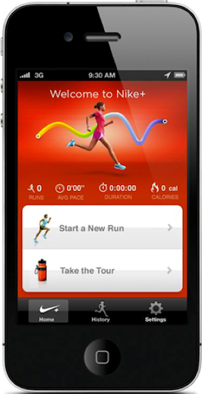
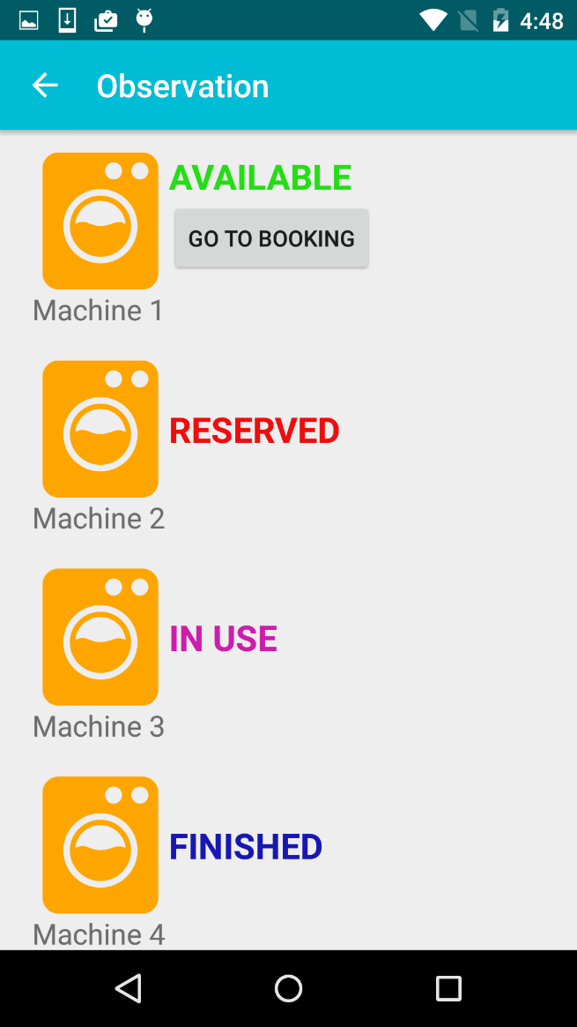
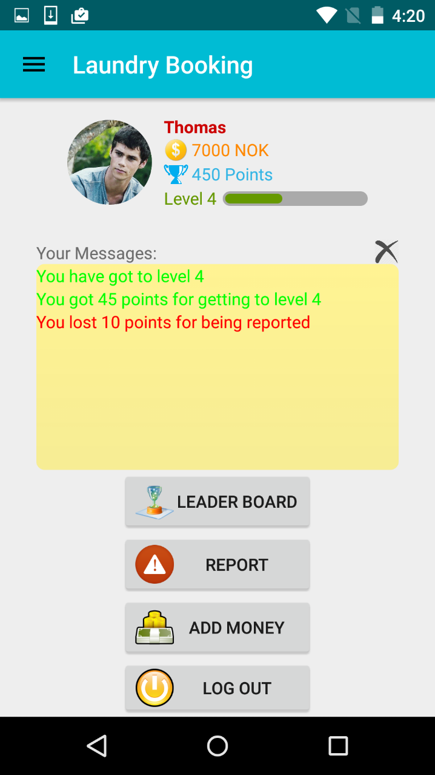

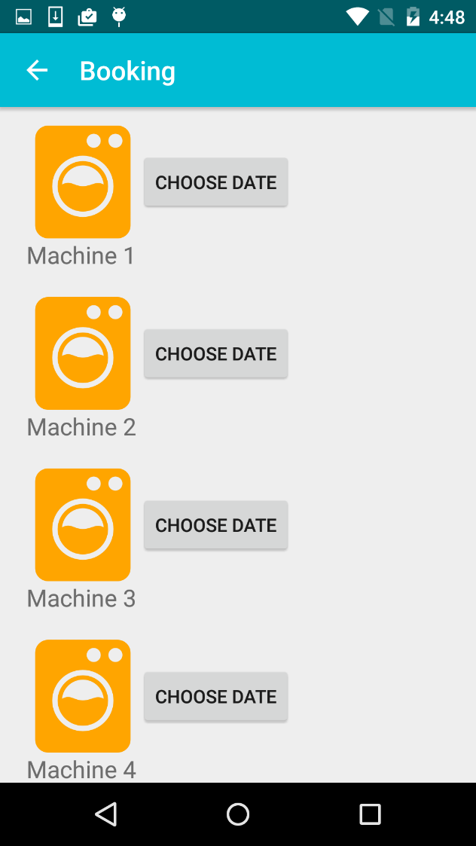
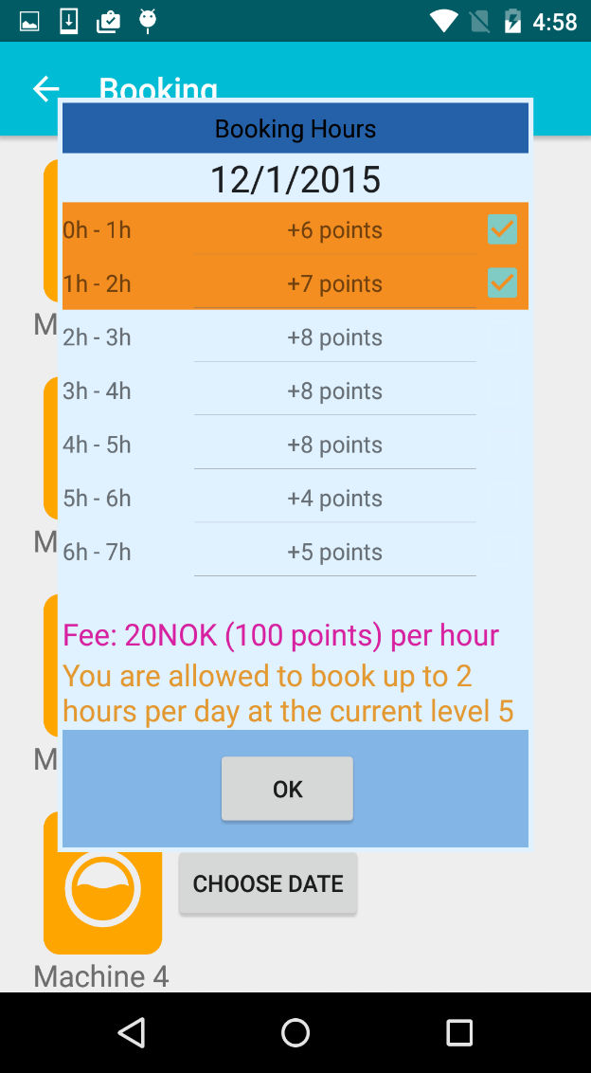
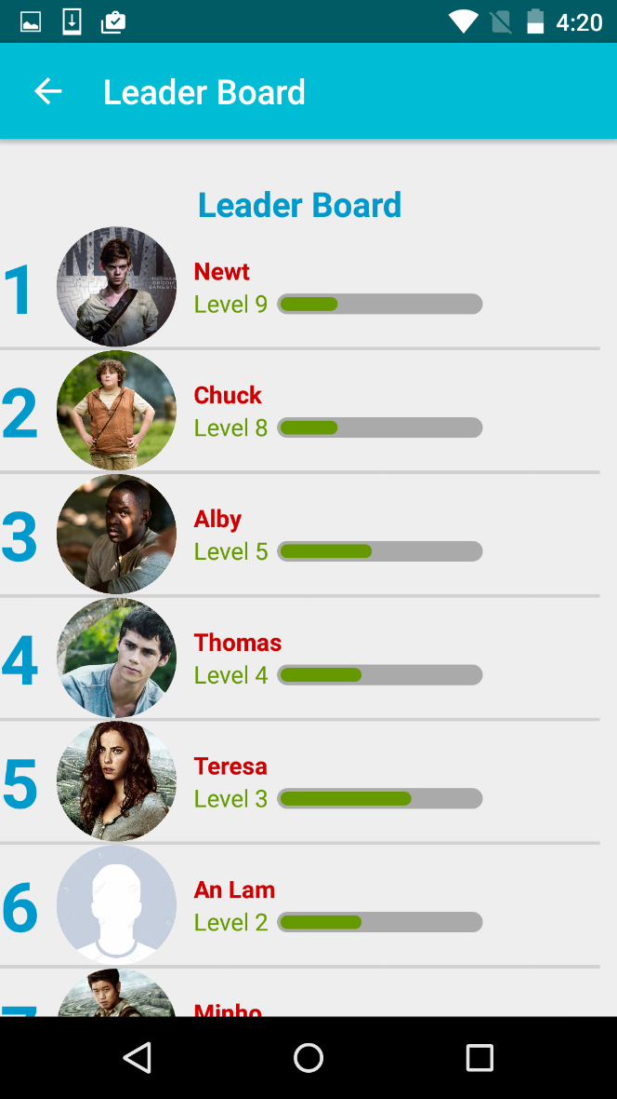
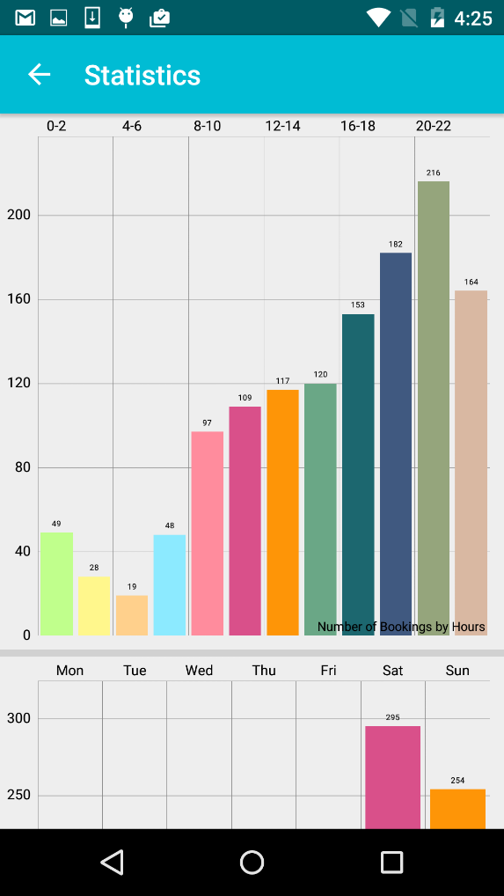
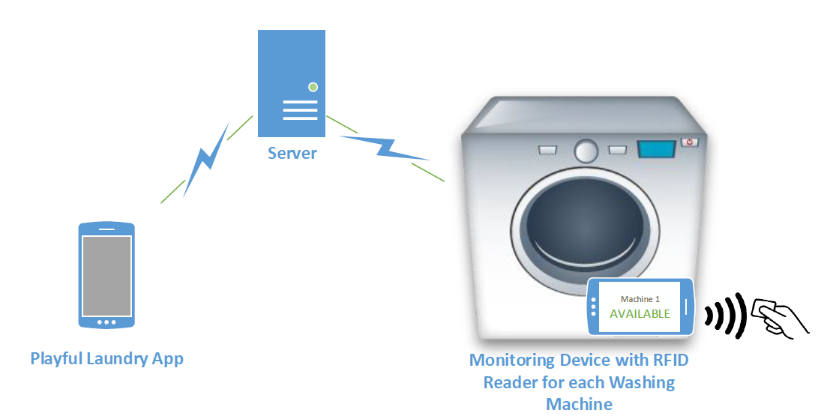
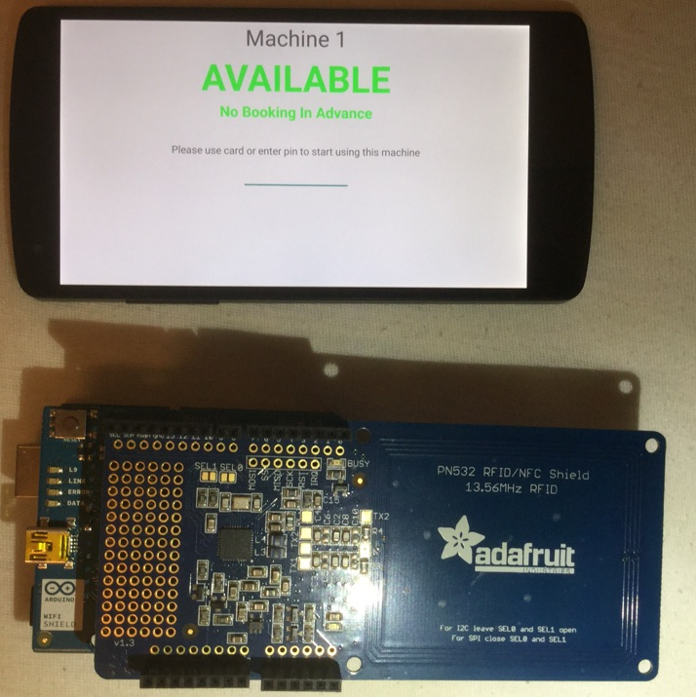
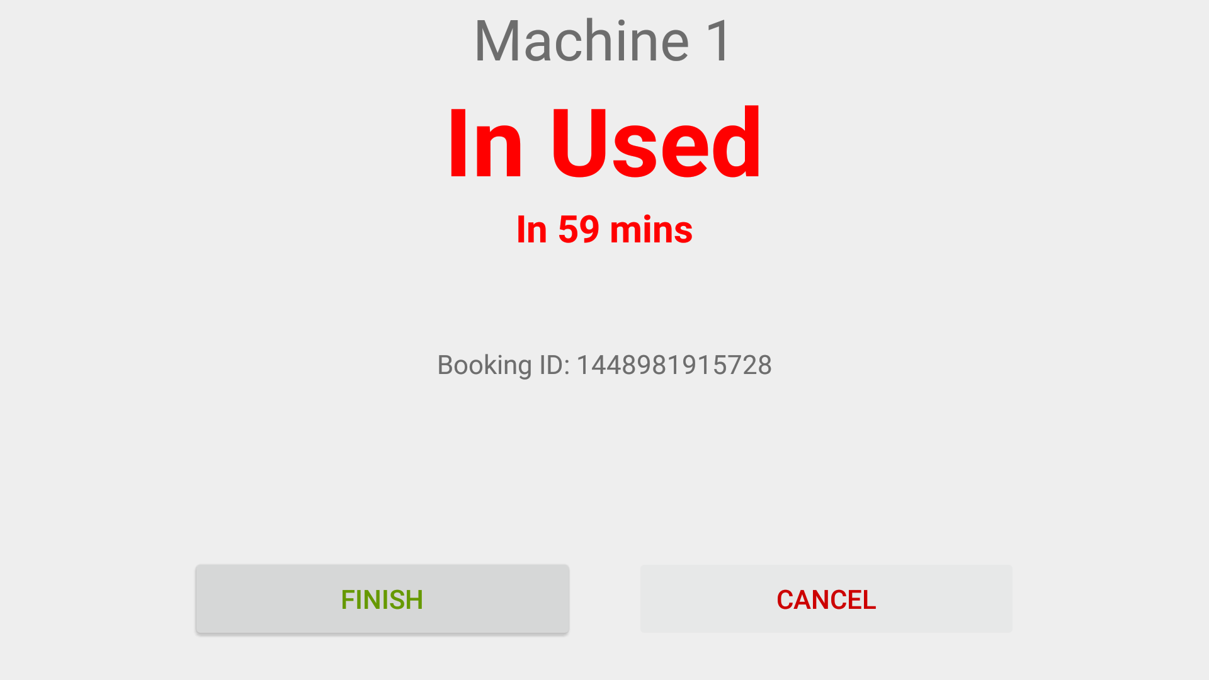
Playful Laundry: A Gamified Laundry Booking System
Faculty of
Computer Sciences
An Ngoc Lam, An Tran Thien
Faculty of Computer Sciences
Østfold University College
Introduction
Playful Laundry Appication
Problems with using the communal laundry room:
  Go to check for available machines periodically
  Wait your turn and constantly check when it’s done
  Your clothes are left out due to being forgetful ☹
  Machines are not used with highest capacities
  Gamification:
  Motivate and improve user activity and retention
  Producing desired psychological and behavioral
  outcomes
Fig 5 Real time status observation of the machines
Fig 1 Nike+, a mobile application that
successfully employs gamification
Fig 8 User account
Booking system
The server manages all users information, bookings and machines status.
Each washing machine has a monitoring device which displays current states of the machine and communicate with server.
Fig 6 Reserving and managing time-slot
Fig 7 Statisticss about usage history of the machines
Fig 9 Leader board shows the user’s rank among others
Playful Laundry is the laundry booking application on mobile
phone
Evaluation
Fig 2 Three components of the booking system
Results from evaluating students:
  They find this application interesting and want to use this
  The awards/penalties parts are fun/interesting to use
  They are interested in earning points and advancing your ranking with this application
  This application will change your habits of doing laundry in the long run
Future directions
Create a mini social media platform
........
Fig 3 The prototype of monitoring device
Fig 4 Monitoring display when the machine is running

