Slide 1
Recap Assignment #3
Hongfei Yan
2020/10/20

Slide 2
Outline
课程网站Canvas、教材、题解等
Assignment #3相关

Slide 3

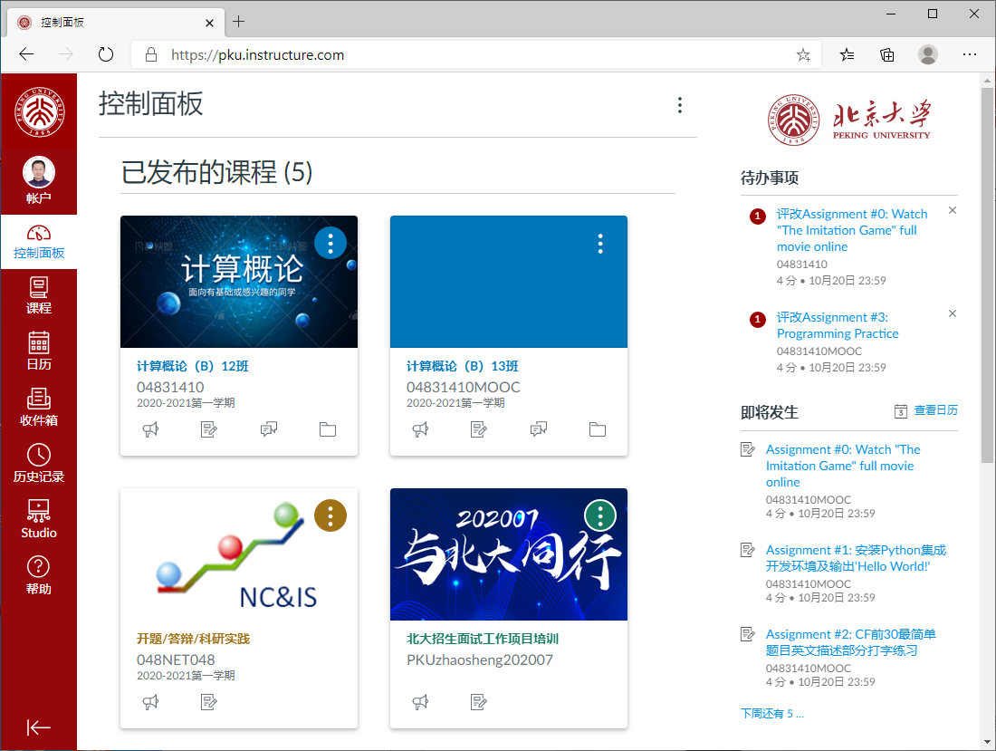

Slide 4
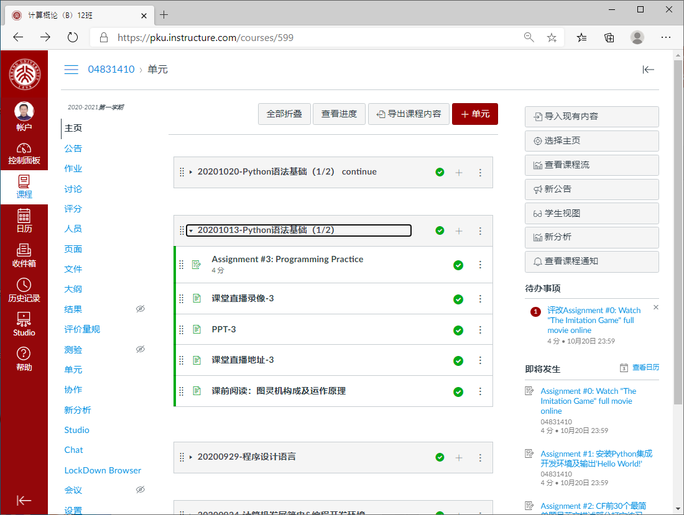

Slide 5
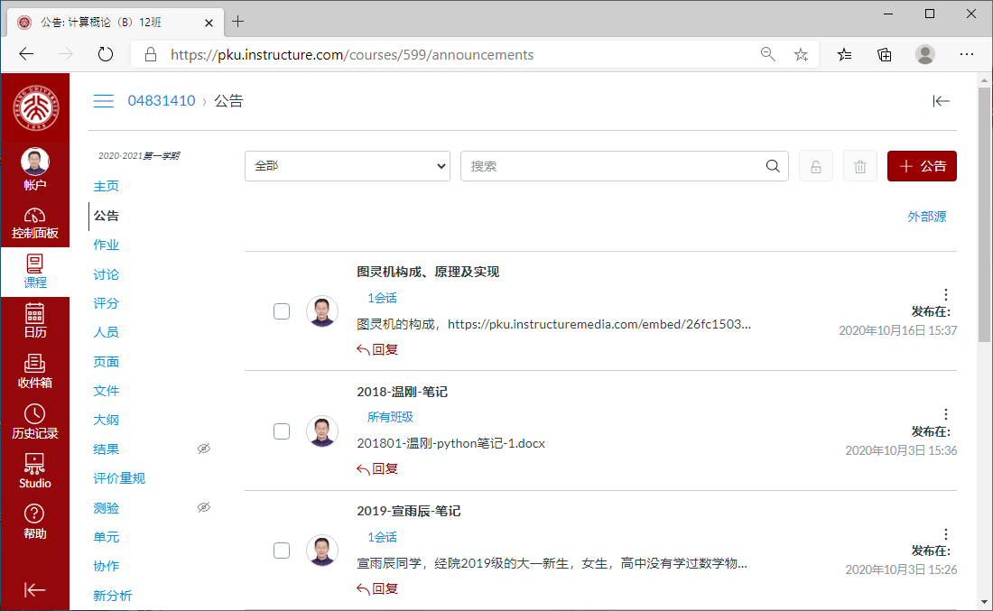
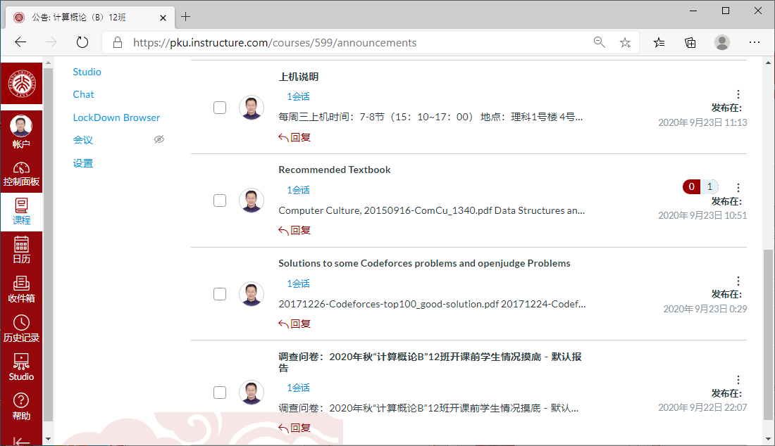
教材
题解

Slide 6
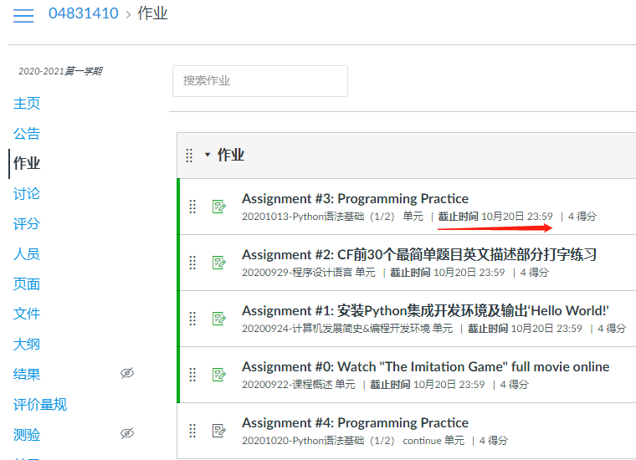

Slide 7
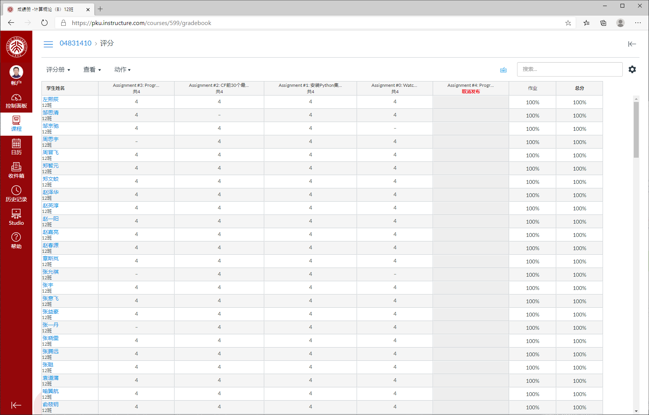

Slide 8
100 easy problems in Codeforces.com
How to find the problems?
Visit http://codeforces.com/ , click 'PROBLEMSET', then click green checkmark (order=BY_SOLVED_DESC). That is, click http://codeforces.com/problemset?order=BY_SOLVED_DESC.
What is Codeforces? What kind of a site/resource is it?
Codeforces is a project joining people interested in and taking part in programming contests. On one hand, Codeforces is a social network dedicated to programming and programming contests. On the other hand, it is a platform where contests are held regularly, the participant's skills are reflected by their rating and the former contests can be used to prepare.

Slide 9
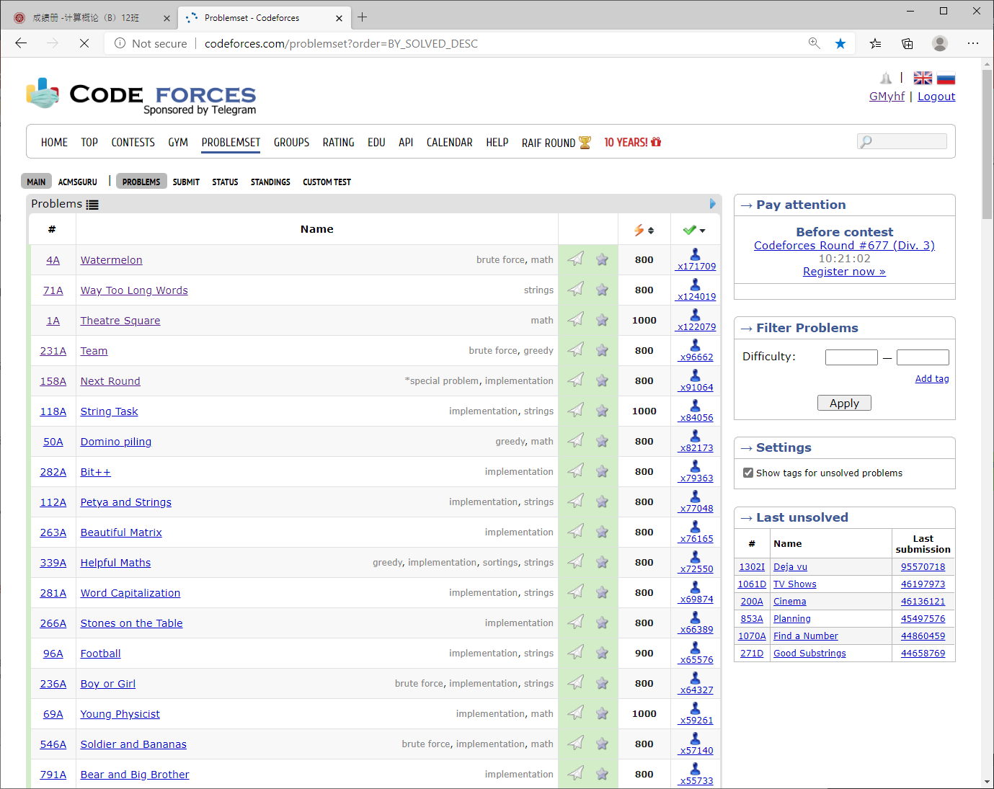

Slide 10
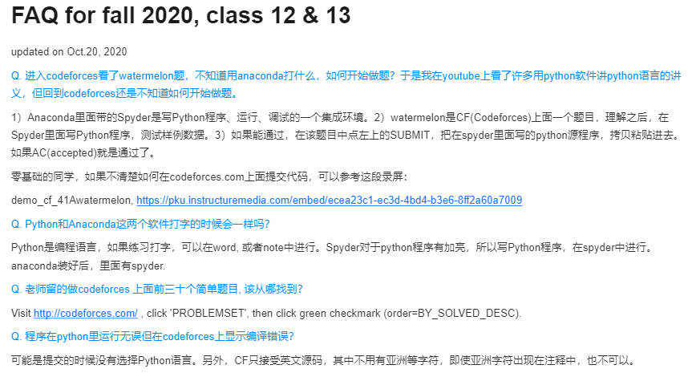
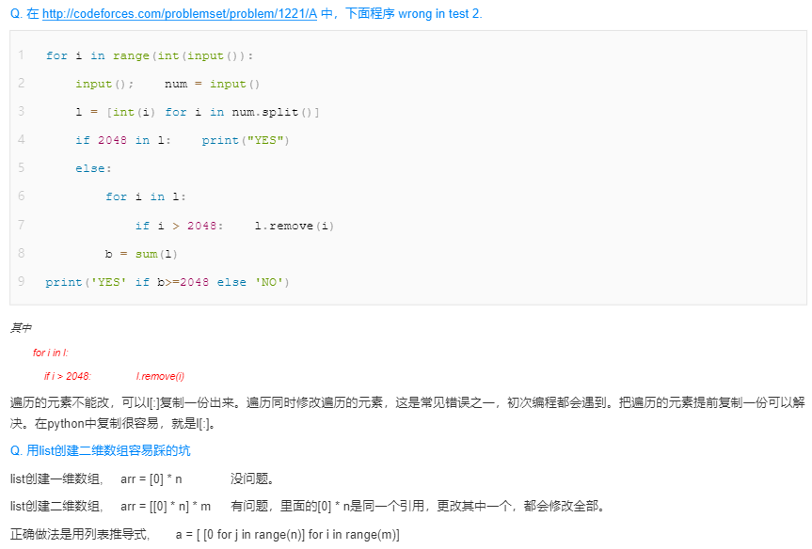

Slide 11

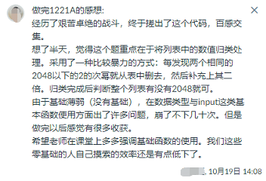
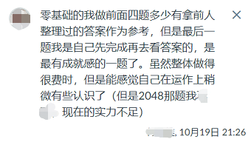
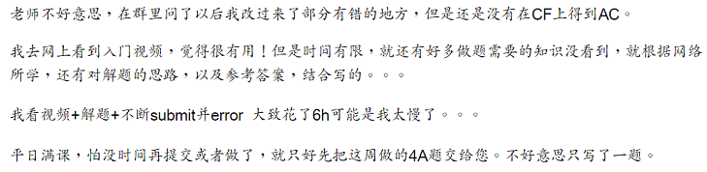
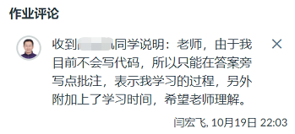


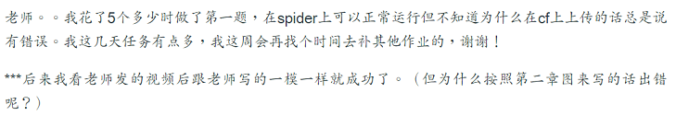
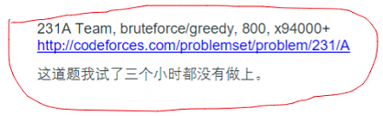


Slide 12
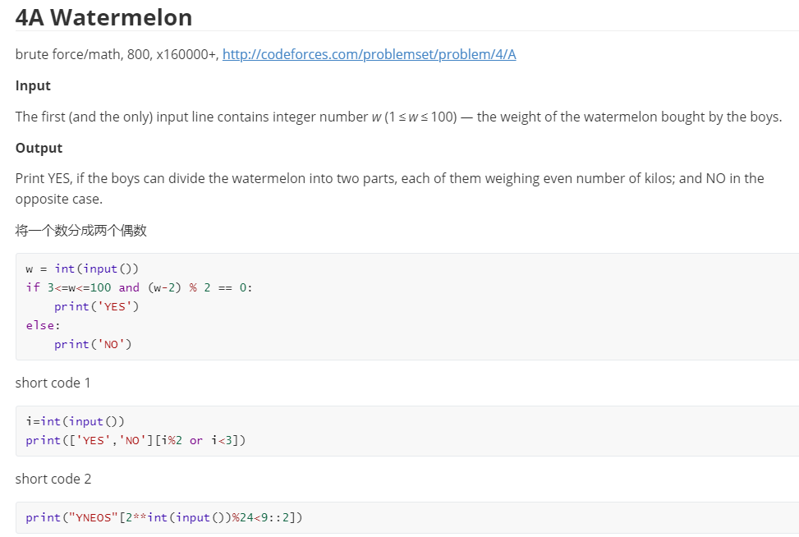

Slide 13
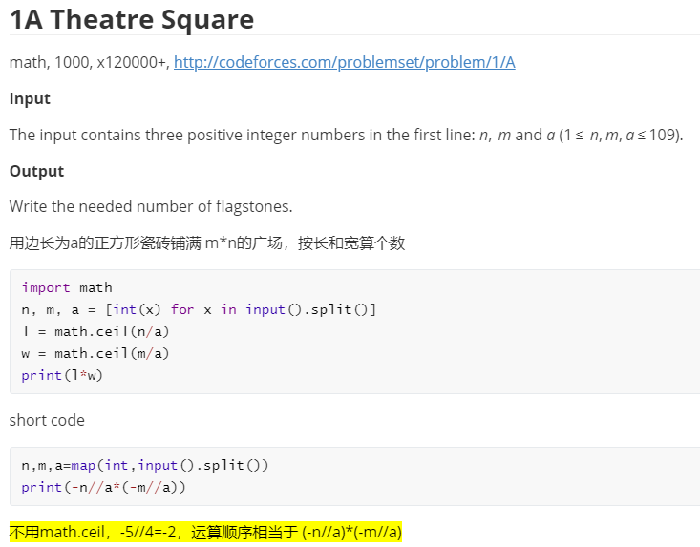

Slide 14
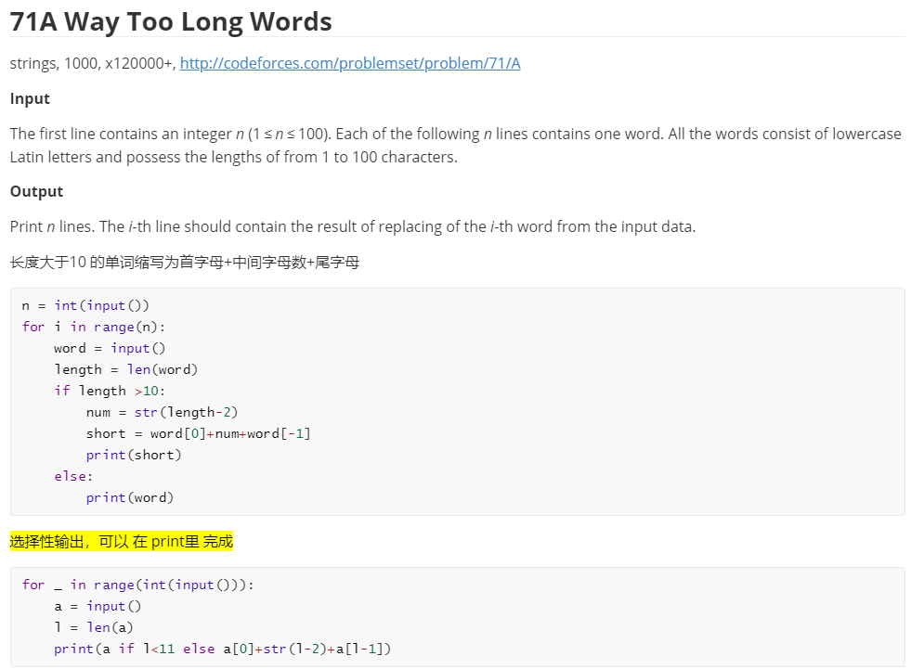

Slide 15
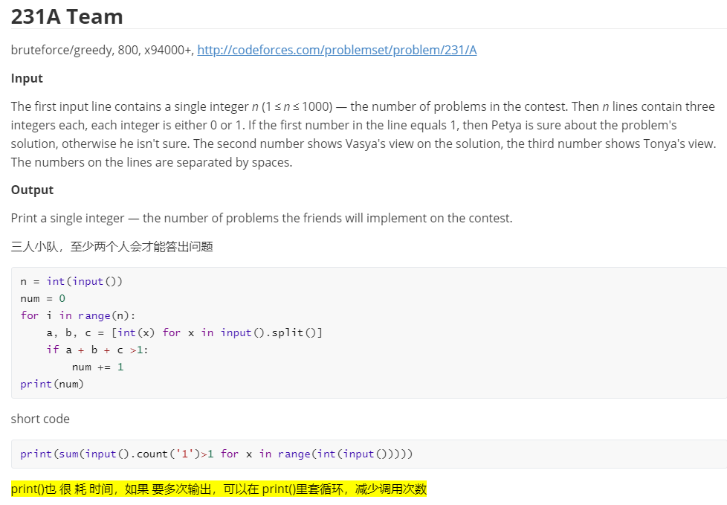

Slide 16
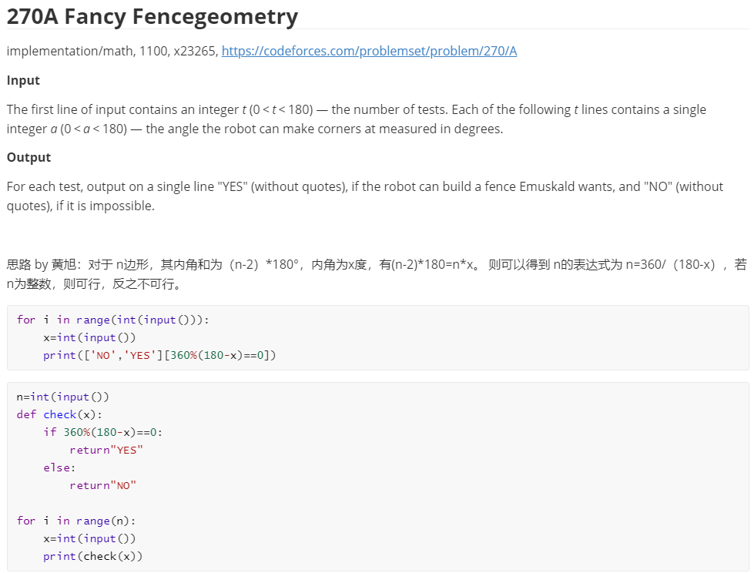
OPTIONAL
PROBLEMS

Slide 17
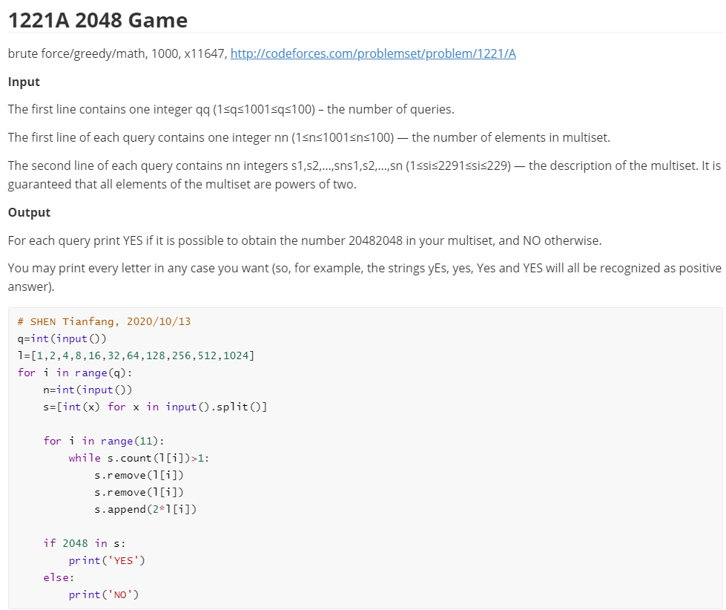
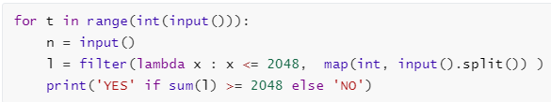
OPTIONAL
PROBLEMS

