Slide 1
Two Dimensional Array
Hongfei Yan
2019/12/10

Slide 2
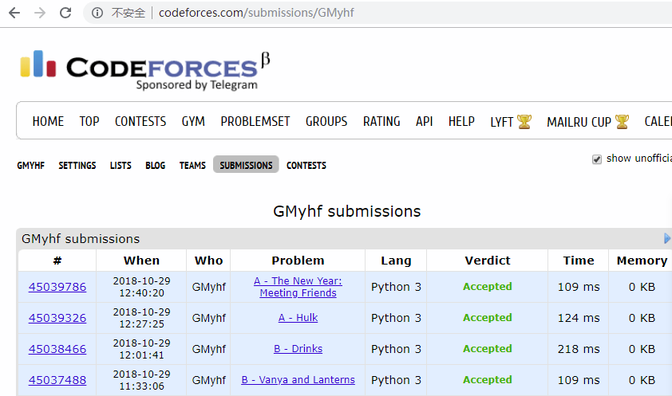

Slide 3

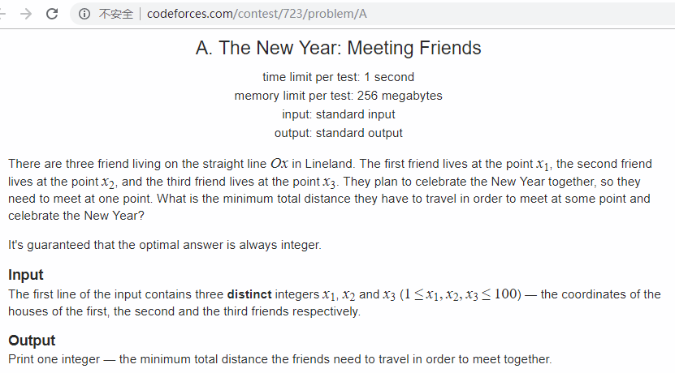

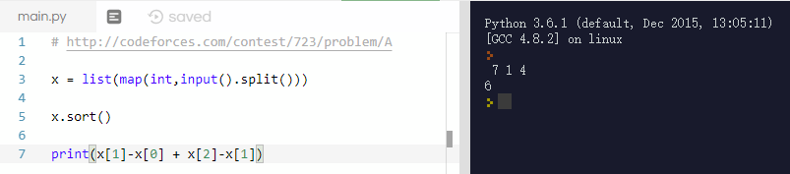
print(x[-1] - x[0])
Notes:
# http://codeforces.com/contest/723/problem/A
x = list(map(int, input().split()))
x.sort()
print(x[-1] - x[0])

Slide 4
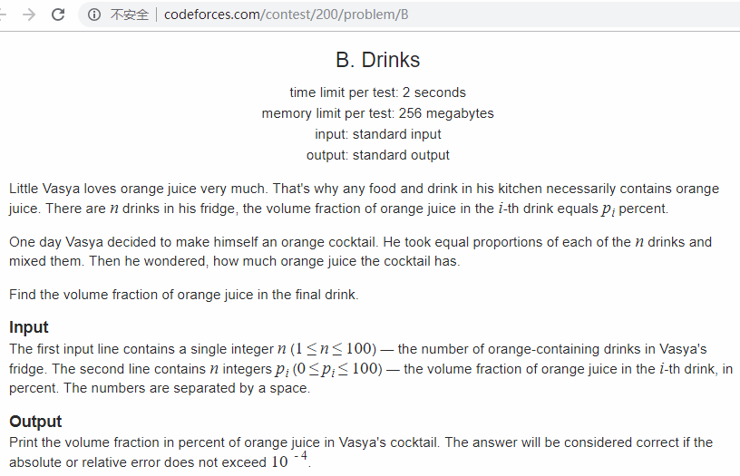
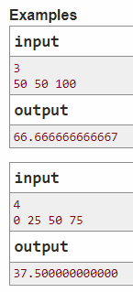
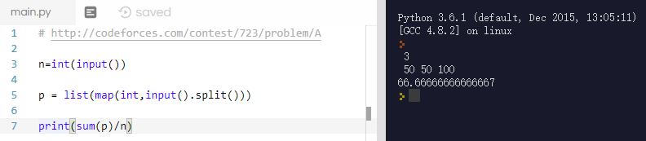
Notes:
# http://codeforces.com/contest/723/problem/A
n=int(input())
p = list(map(int,input().split()))
print(sum(p)/n)

Slide 5
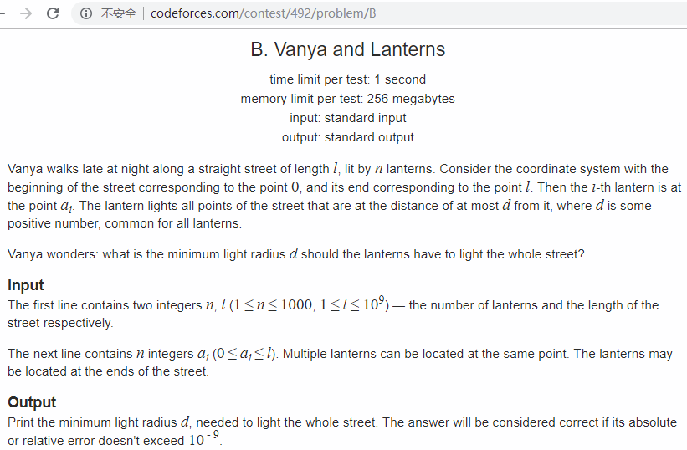
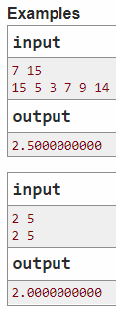
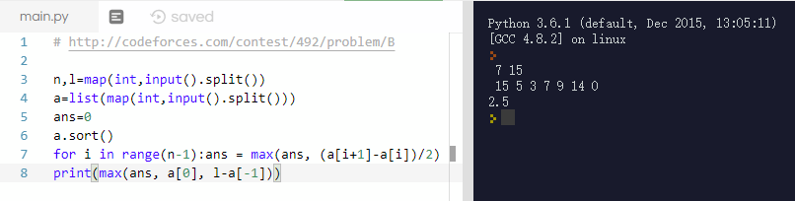
Notes:
# http://codeforces.com/contest/492/problem/B
n,l=map(int,input().split())
a=list(map(int,input().split()))
ans=0
a.sort()
for i in range(n-1):ans = max(ans, (a[i+1]-a[i])/2)
print(max(ans, a[0], l-a[-1]))

Slide 6
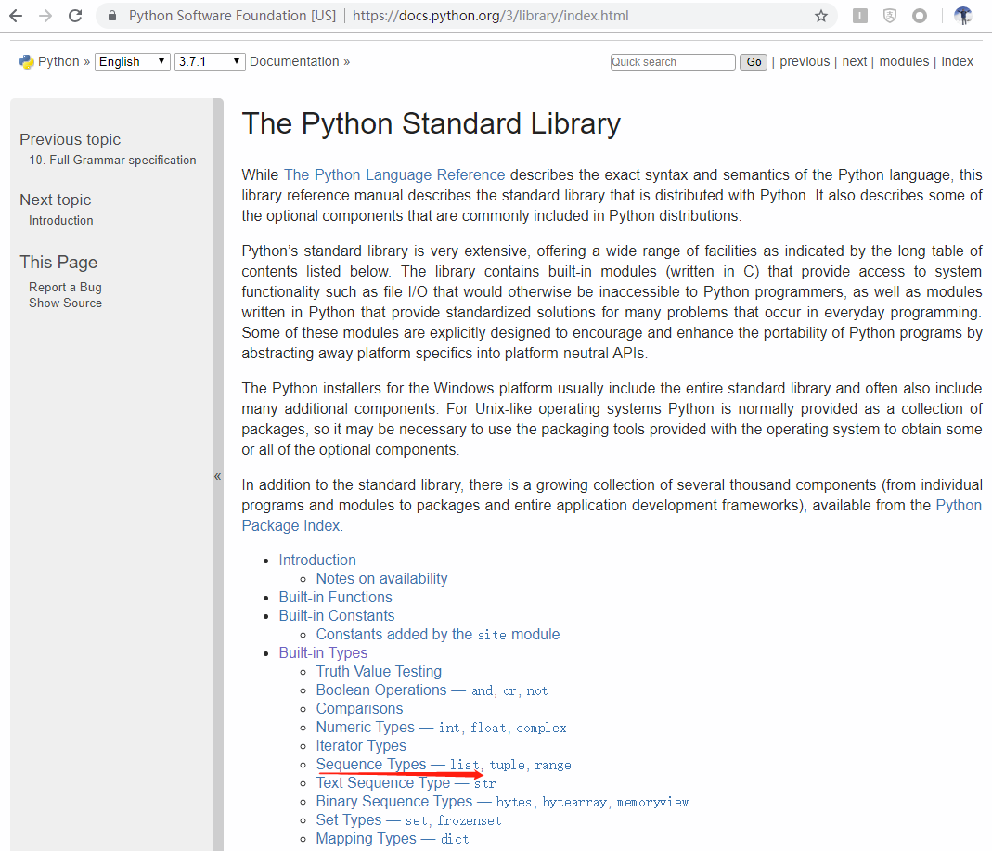

Notes:
https://docs.python.org/3/library/index.html

Slide 7
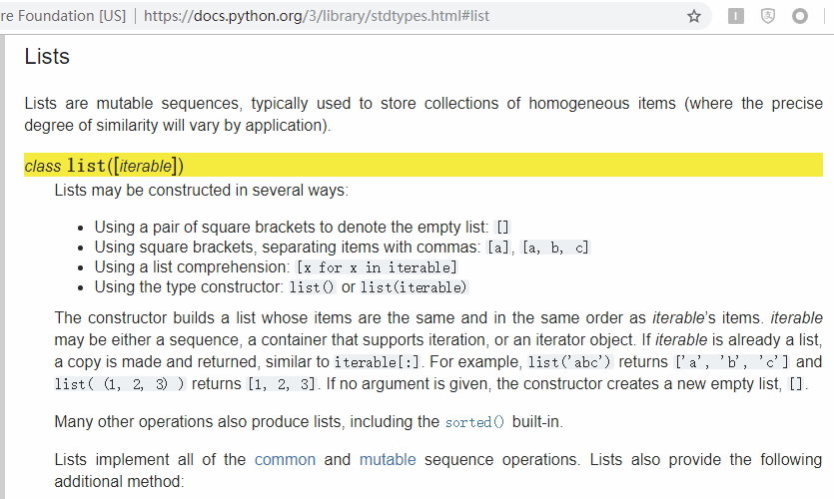
Notes:
https://docs.python.org/3/library/stdtypes.html#list

Slide 8
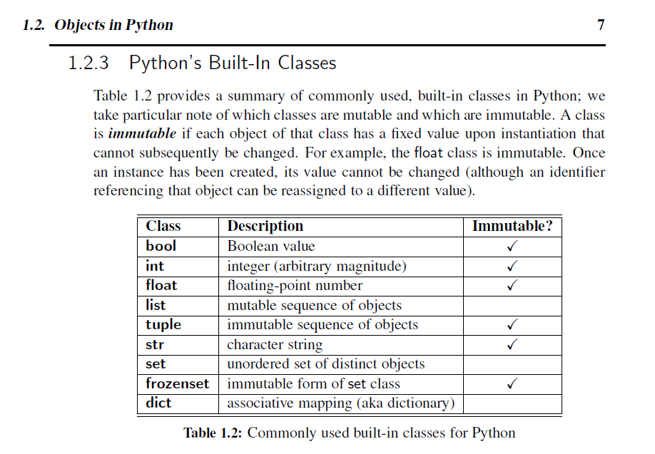
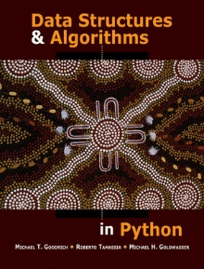

Slide 9

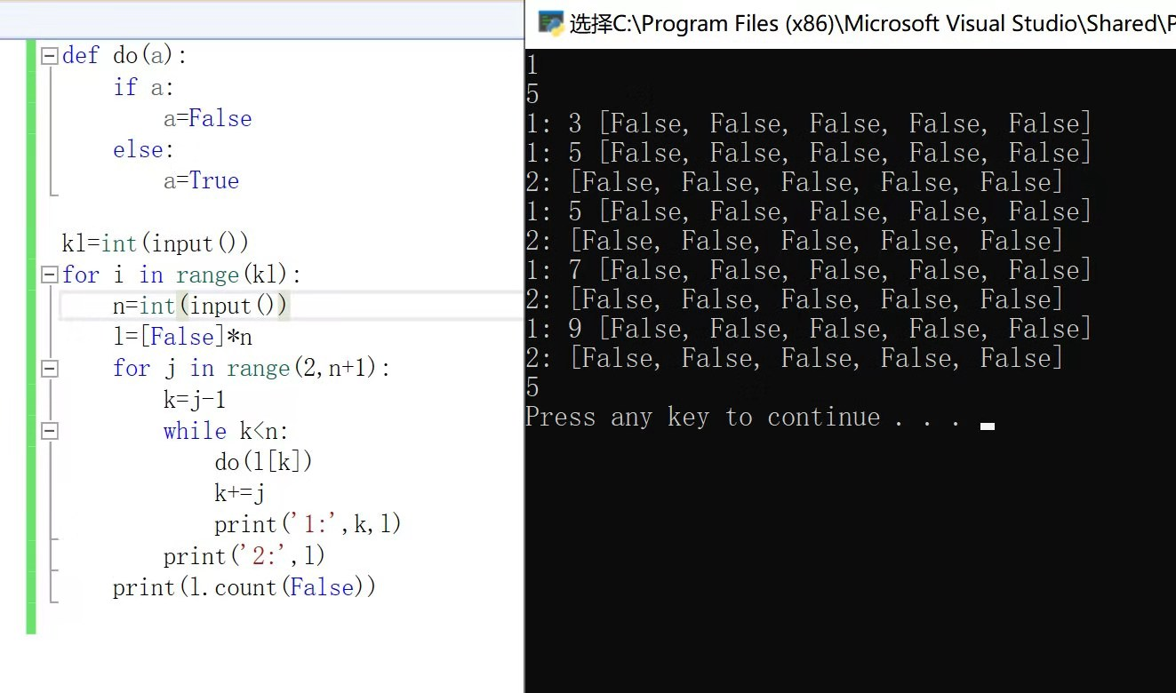
为什么每次循环do函数都没有执行呢？ python的参量不是默认传引用嘛

Slide 10
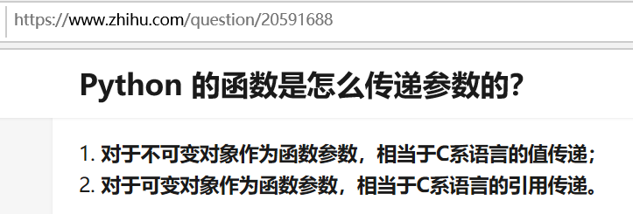

如传l进去函数，就是可变对象。传l[k]是不可变对象。
在Python中，对于不可变对象，调用自身的任意方法，并不会改变对象自身的内容，这些方法会创建新的对象并返回，保证了不可变对象本身是永远不可变的。

Slide 11
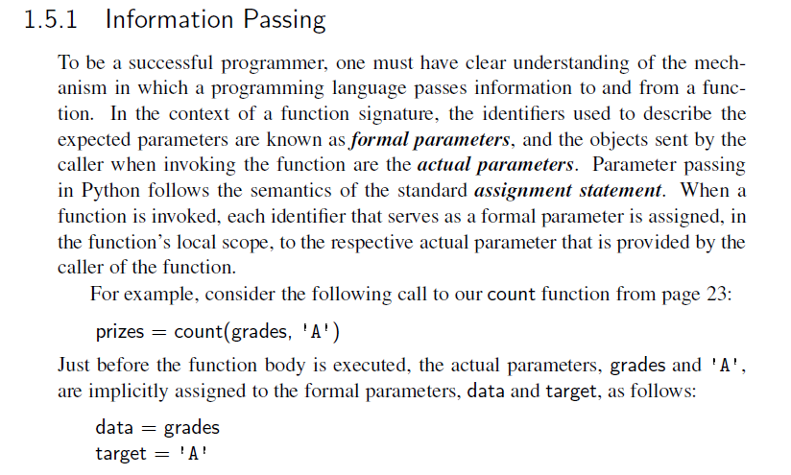
这两个截图是我们教材上的例子，传了一个可变，一个不可变

Slide 12
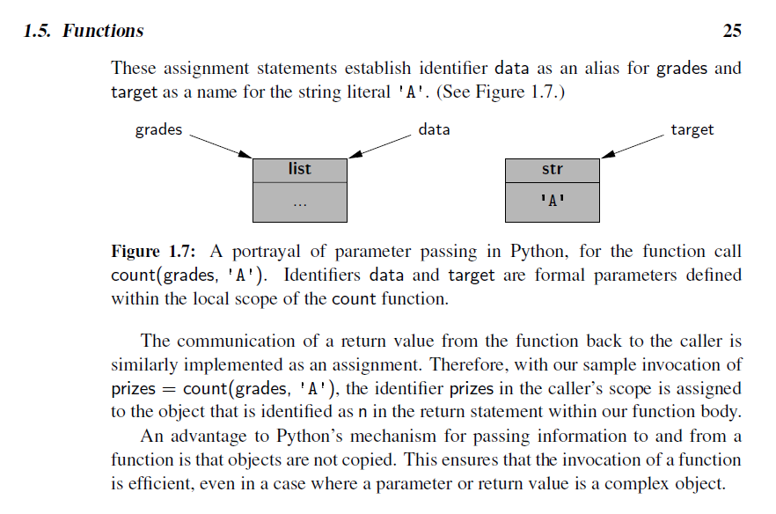
这两个截图是我们教材上的例子，传了一个可变，一个不可变

Slide 13
都能看懂Python函数传递参数吗？感觉能看懂，还好！

Slide 14


Slide 15
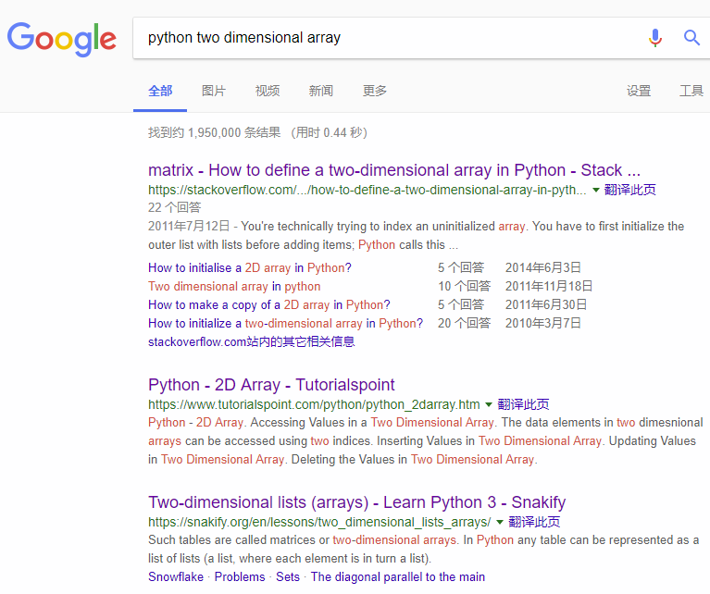
Notes:
https://stackoverflow.com/questions/6667201/how-to-define-a-two-dimensional-array-in-python

Slide 16
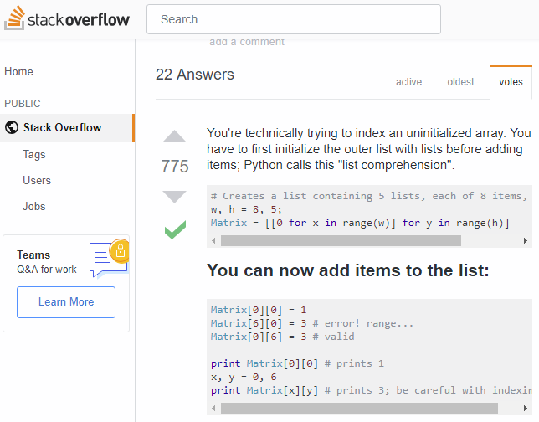

Slide 17
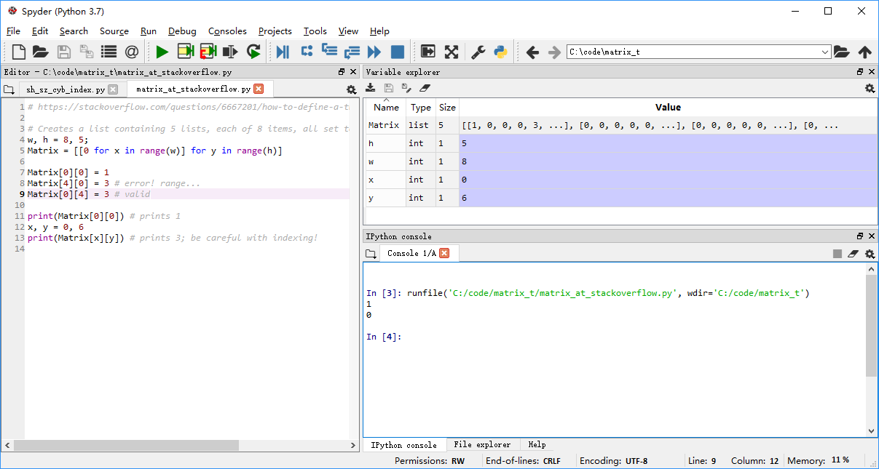
Notes:
# https://stackoverflow.com/questions/6667201/how-to-define-a-two-dimensional-array-in-python
# Creates a list containing 5 lists, each of 8 items, all set to 0
w, h = 8, 5;
Matrix = [[0 for x in range(w)] for y in range(h)]
Matrix[0][0] = 1
Matrix[4][0] = 3 # error! range...
Matrix[0][4] = 3 # valid
print(Matrix[0][0]) # prints 1
x, y = 0, 6
print(Matrix[x][y]) # prints 3; be careful with indexing!

Slide 18
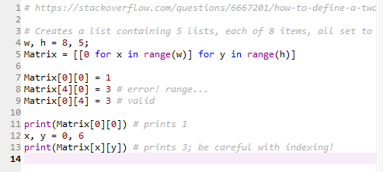

Slide 19
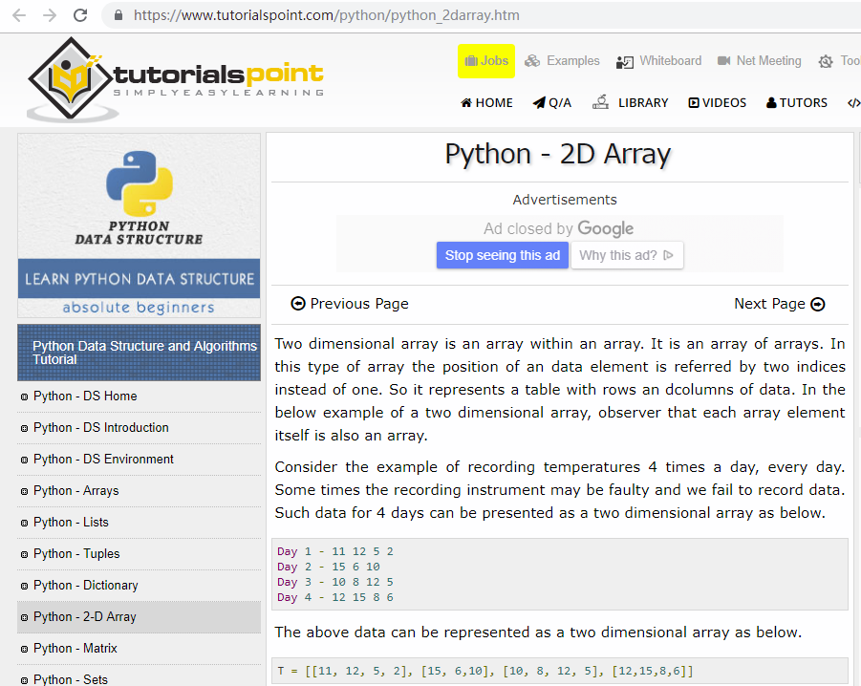
Notes:
https://www.tutorialspoint.com/python/python_2darray.htm

Slide 20
Python - 2D Array
Two dimensional array is an array within an array.
It is an array of arrays.
A data element is referred by two indices instead of one.
So it represents a table with rows and columns of data.
Notes:
In the below example of a two dimensional array, observer that each array element itself is also an array.

Slide 21
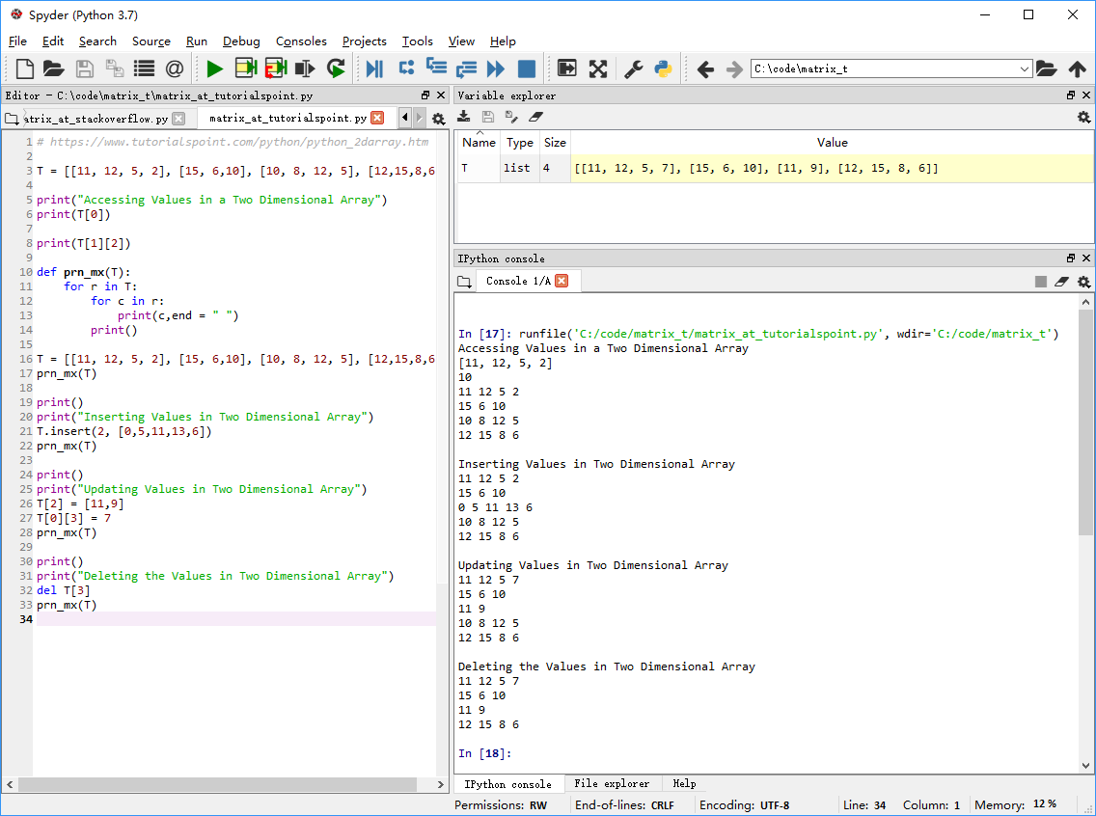
Notes:
# https://www.tutorialspoint.com/python/python_2darray.htm
T = [[11, 12, 5, 2], [15, 6,10], [10, 8, 12, 5], [12,15,8,6]]
print("Accessing Values in a Two Dimensional Array")
print(T[0])
print(T[1][2])
def prn_mx(T):
for r in T:
for c in r:
print(c,end = " ")
print()
T = [[11, 12, 5, 2], [15, 6,10], [10, 8, 12, 5], [12,15,8,6]]
prn_mx(T)
print()
print("Inserting Values in Two Dimensional Array")
T.insert(2, [0,5,11,13,6])
prn_mx(T)
print()
print("Updating Values in Two Dimensional Array")
T[2] = [11,9]
T[0][3] = 7
prn_mx(T)
print()
print("Deleting the Values in Two Dimensional Array")
del T[3]
prn_mx(T)

Slide 22
Python - Matrix
Matrix is a special case of two dimensional array where each data element is of strictly same size.
So every matrix is also a two dimensional array but not vice versa.
Matrices are very important data structures for many mathematical and scientific calculations.
Notes:
https://www.tutorialspoint.com/python/python_matrix.htm

Slide 23

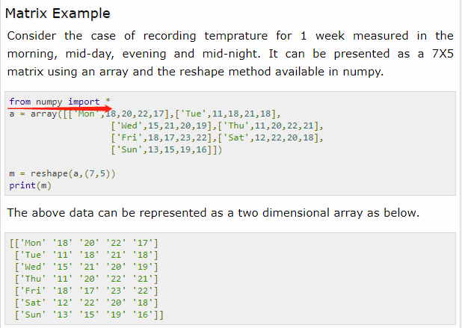
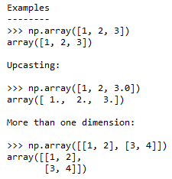
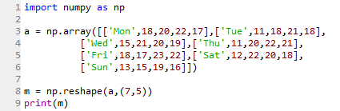



Notes:
import numpy as np
a = np.array([['Mon',18,20,22,17],['Tue',11,18,21,18],
['Wed',15,21,20,19],['Thu',11,20,22,21],
['Fri',18,17,23,22],['Sat',12,22,20,18],
['Sun',13,15,19,16]])
m = np.reshape(a,(7,5))
print(m)

Slide 24
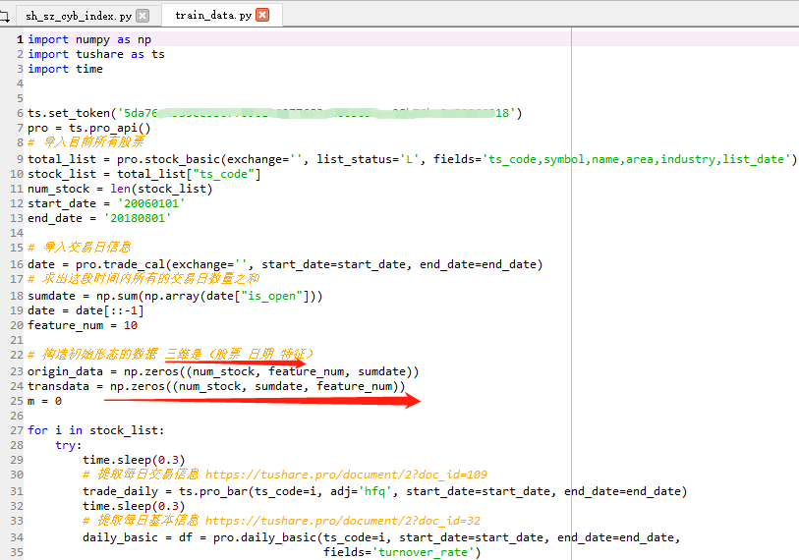
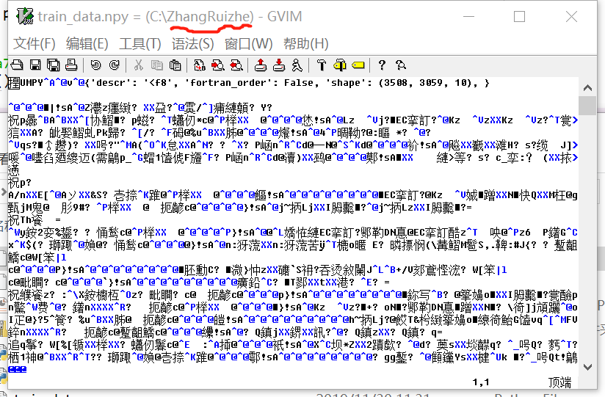

Slide 25
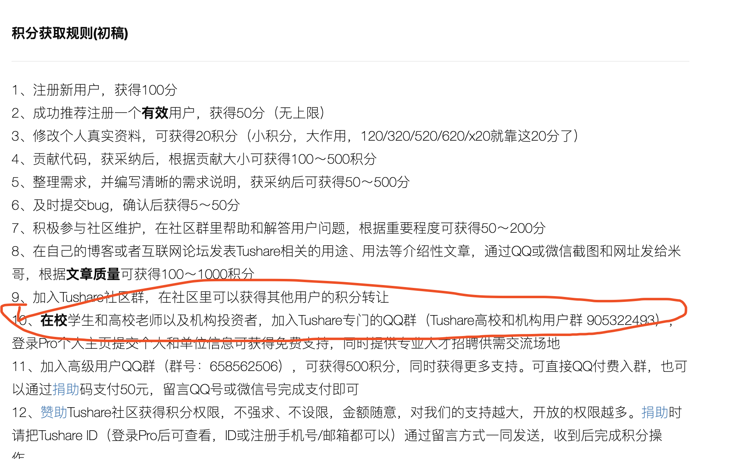



Slide 26
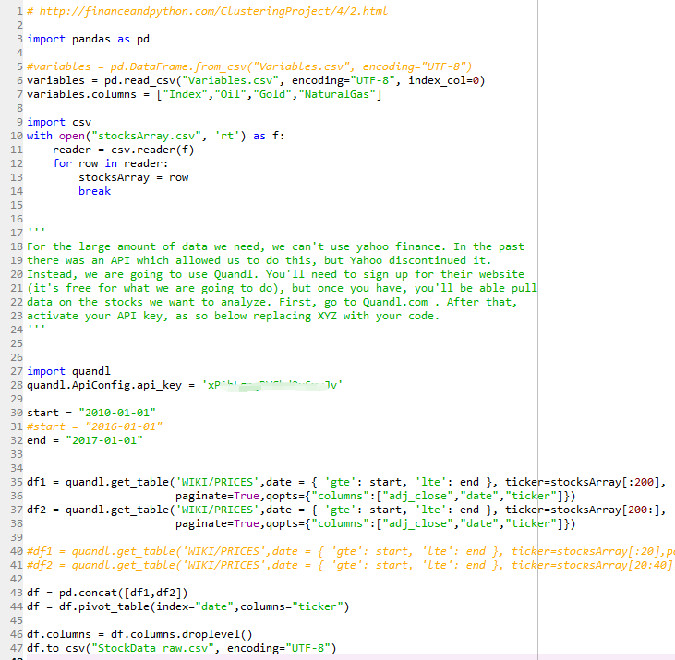

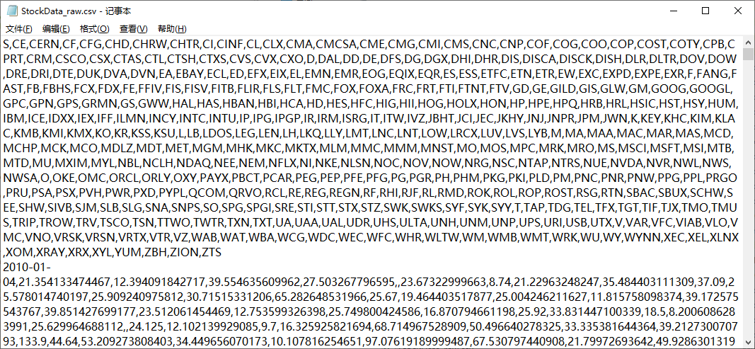

Slide 27

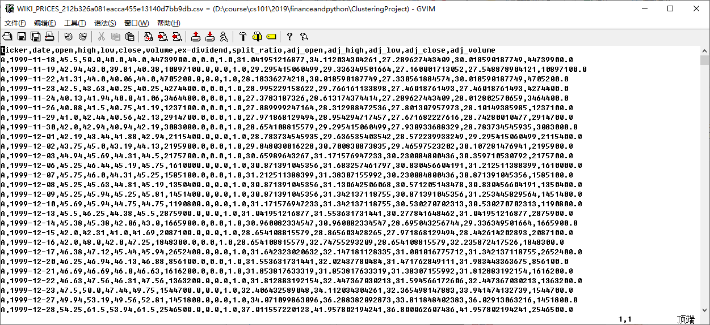
多维度，可以通过增加列来实现。类似quandle 的wiki_price.
三维数组，理解起来有点困难。

Slide 28
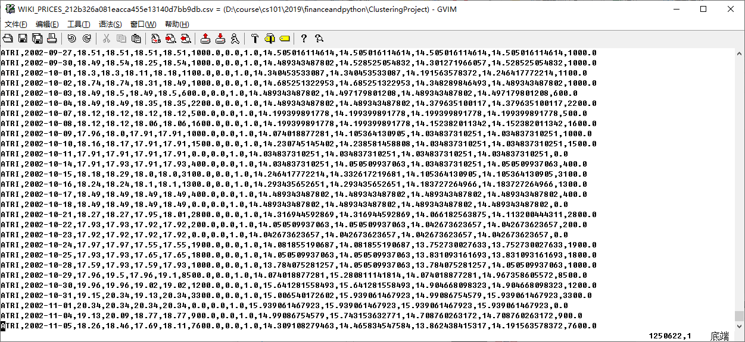
Notes:
.csv便于交互。我看金融多数用这个格式。

Slide 29
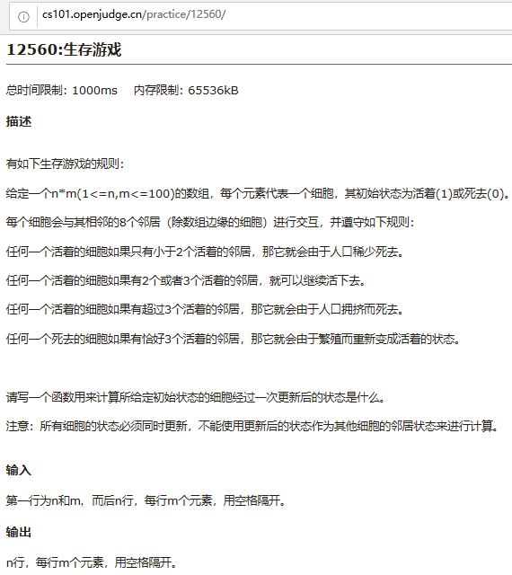
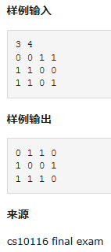
Notes:
http://cs101.openjudge.cn/practice/12560/

Slide 30
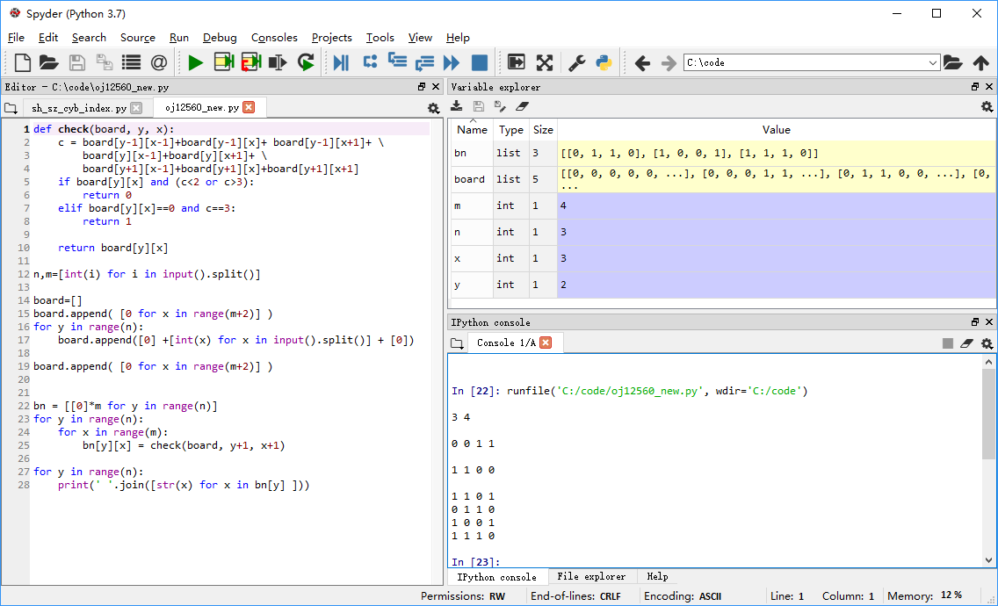
' '.join(map(str, bn[y])
Notes:
# http://cs101.openjudge.cn/practice/12560/
def check(board, y, x):
c = board[y-1][x-1]+board[y-1][x]+ board[y-1][x+1]+ \
board[y][x-1]+board[y][x+1]+ \
board[y+1][x-1]+board[y+1][x]+board[y+1][x+1]
if board[y][x] and (c<2 or c>3):
return 0
elif board[y][x]==0 and c==3:
return 1
return board[y][x]
n,m=[int(i) for i in input().split()]
board=[]
board.append( [0 for x in range(m+2)] )
for y in range(n):
board.append([0] +[int(x) for x in input().split()] + [0])
board.append( [0 for x in range(m+2)] )
bn = [[0]*m for y in range(n)]
for y in range(n):
for x in range(m):
bn[y][x] = check(board, y+1, x+1)
for y in range(n):
print(' '.join([str(x) for x in bn[y] ]))

Slide 31
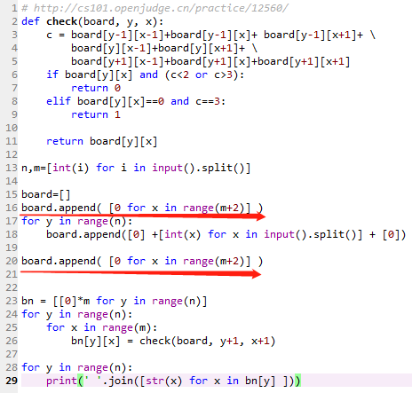
函数
保护圈
' '.join(map(str, bn[y])

Slide 32
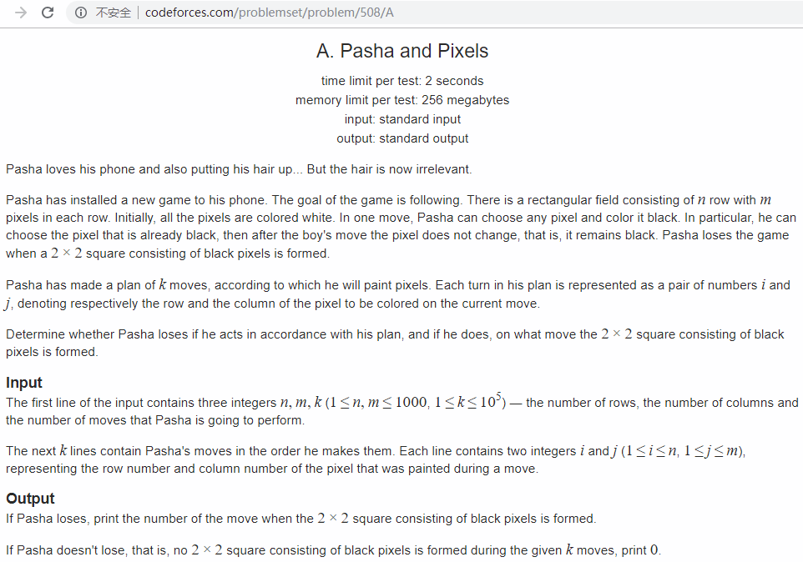

Notes:
http://codeforces.com/problemset/problem/508/A

Slide 33
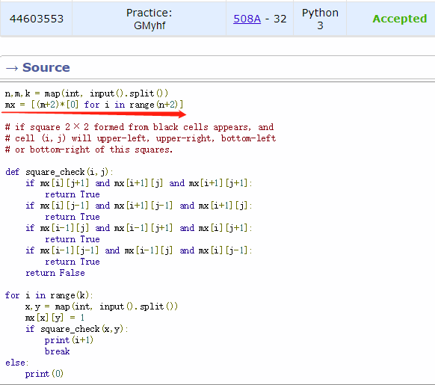
保护圈
函数
Notes:
# http://codeforces.com/contest/508/submission/44603553
n,m,k = map(int, input().split())
mx = [(m+2)*[0] for i in range(n+2)]
# if square 2 × 2 formed from black cells appears, and
# cell (i, j) will upper-left, upper-right, bottom-left
# or bottom-right of this squares.
def square_check(i,j):
if mx[i][j+1] and mx[i+1][j] and mx[i+1][j+1]:
return True
if mx[i][j-1] and mx[i+1][j-1] and mx[i+1][j]:
return True
if mx[i-1][j] and mx[i-1][j+1] and mx[i][j+1]:
return True
if mx[i-1][j-1] and mx[i-1][j] and mx[i][j-1]:
return True
return False
for i in range(k):
x,y = map(int, input().split())
mx[x][y] = 1
if square_check(x,y):
print(i+1)
break
else:
print(0)

Slide 34
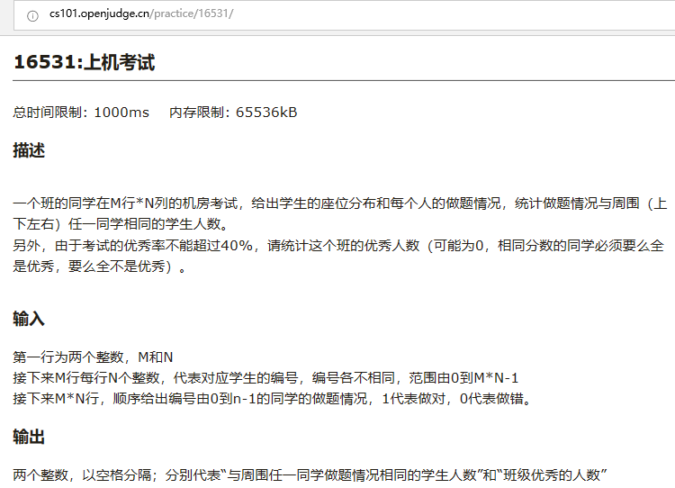
Notes:
http://cs101.openjudge.cn/practice/16531/

Slide 35
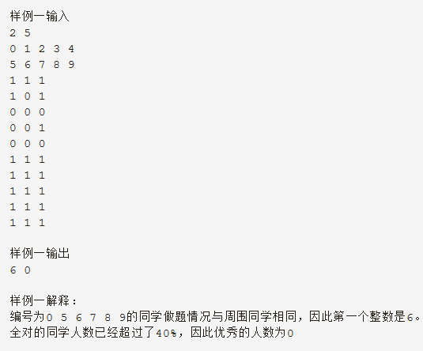
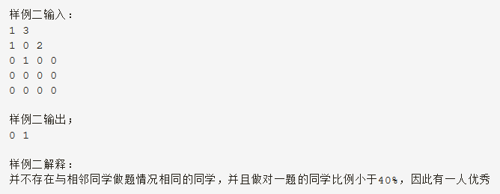

Slide 36
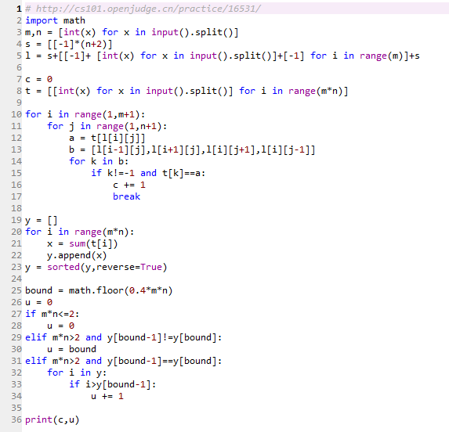
# cs101-2018 by李子安
Notes:
# http://cs101.openjudge.cn/practice/16531/
# cs101-2018 by李子安
import math
m,n = [int(x) for x in input().split()]
s = [[-1]*(n+2)]
l = s+[[-1]+ [int(x) for x in input().split()]+[-1] for i in range(m)]+s
c = 0
t = [[int(x) for x in input().split()] for i in range(m*n)]
for i in range(1,m+1):
for j in range(1,n+1):
a = t[l[i][j]]
b = [l[i-1][j],l[i+1][j],l[i][j+1],l[i][j-1]]
for k in b:
if k!=-1 and t[k]==a:
c += 1
break
y = []
for i in range(m*n):
x = sum(t[i])
y.append(x)
y = sorted(y,reverse=True)
bound = math.floor(0.4*m*n)
u = 0
if m*n<=2:
u = 0
elif m*n>2 and y[bound-1]!=y[bound]:
u = bound
elif m*n>2 and y[bound-1]==y[bound]:
for i in y:
if i>y[bound-1]:
u += 1
print(c,u)

