Slide 1
A
AegisFlow
DevSecOps with a built-in shield
• • •
End-of-studies project (PFE) · 2026
Anlehtouf · Supervisor name · University
github.com/anlehtouf/AegisFlow-DevSecOps
Notes:
Good morning. I'm presenting AegisFlow, a DevSecOps platform I built to answer one question: can security be enforced automatically at every stage of software delivery, with measurable results? The short answer is yes — and I'll prove it in fifteen slides.

Slide 2
The Problem
100×
100M+
1
Cost multiplier
Commits scanned
Library, global impact
Fixing a vulnerability in production vs. development (IBM 2024)
GitHub finds millions of exposed secrets per year
Log4Shell compromised millions of systems in 2021
Security is bolted on, not built in.
AegisFlow
2 / 15
Notes:
Three numbers tell the story. First: late fixes cost 100x more — every vulnerability that escapes the developer's machine compounds expensively. Second: secrets in code are a structural failure of trust — millions are exposed every year. Third: one vulnerable dependency in one library — Log4j — created a global incident response. The pattern: security is treated as audit, not as engineering.

Slide 3
The Approach — Shift-Left + Enforce
01
Every stage scanned
02
Every artifact verifiable
Secrets · SAST · SCA · container · DAST
SBOM (SPDX) + cryptographic signature
03
Every gate blocks
04
Every claim auditable
No override path for insecure code
Reports · attestations · transparency log
AegisFlow
3 / 15
Notes:
AegisFlow takes four positions. First, scan at every stage so problems are found by the cheapest possible actor — the pipeline. Second, every release produces a Software Bill of Materials and a Sigstore signature, so it's verifiable downstream. Third, the gates are blocking, not advisory — there is no 'approve anyway' button. Fourth, every claim in this presentation maps to a committed artifact you can audit after I leave the room.

Slide 4
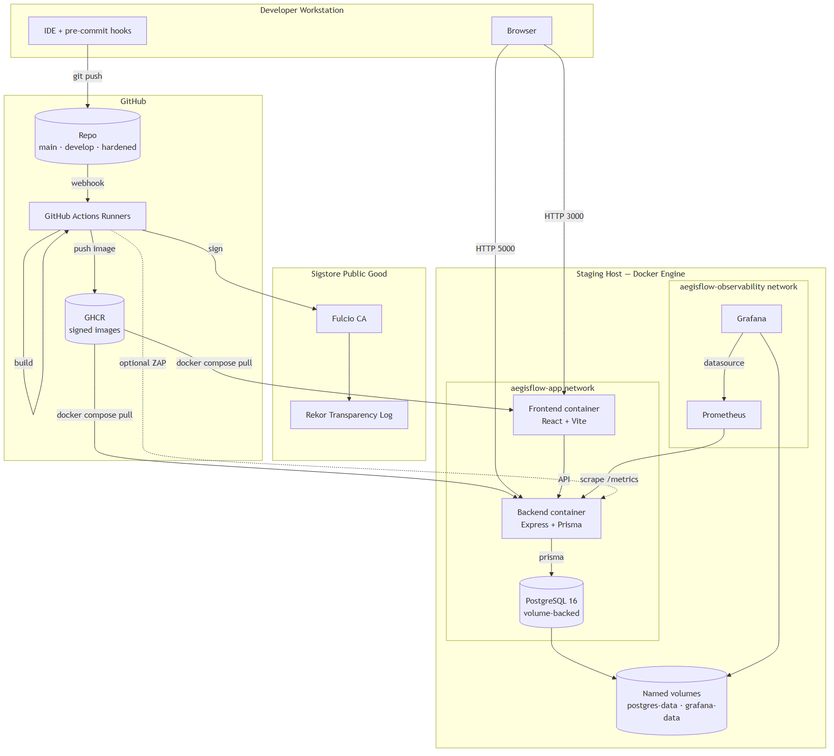
Architecture
Local Docker Compose staging — fully reproducible on a laptop. Images come from GHCR signed by Sigstore Fulcio.
AegisFlow
4 / 15
Notes:
The architecture has three planes. The developer plane uses pre-commit hooks and IDE linting for fast feedback. The GitHub plane runs the 22-stage CI/CD pipeline, signs images via OIDC keyless flow against Sigstore's public Fulcio CA, records the signature in Rekor's transparency log, and publishes to GitHub Container Registry. The staging plane is single-host Docker Compose with two networks — application and observability — and named volumes for persistence. The pipeline is portable: the same flow targets Kubernetes or ECS Fargate with no rewrite, which is on the Future Work slide.

Slide 5
The Application — SecureTrack
Incident-reporting platform — the target of the security pipeline.
OWASP Top 10 coverage
A01 Broken access — RBAC tested
A02 Crypto — V2 JWT secret
A03 Injection — V3 SQLi · V4 XSS
A05 Misconfig — V7 V8 V9 V10 V14
A06 Vuln deps — V5 V6 V15
A07 Auth failures — V1 V2 V11 V12
A09 Logging — V13 password leak
Backend Node 20 · Express · Prisma · PostgreSQL 16
Frontend React 18 · Vite · React Router
Identity JWT auth · 3 roles (REPORTER · ADMIN · AUDITOR)
Audit Append-only AUDIT_LOG on every mutation
15 intentional vulnerabilities (V1–V15) baked in
AegisFlow
5 / 15
Notes:
SecureTrack is intentionally simple — it's the target of the security platform, not the focus. What matters is that it's deliberately vulnerable. I planted 15 representative flaws across the OWASP Top 10: hardcoded secrets, SQL injection, XSS, vulnerable lodash, outdated base image, missing rate limiting, weak password policy, CORS wildcard, and others. The pipeline's job is to catch every single one and refuse to ship.

Slide 6
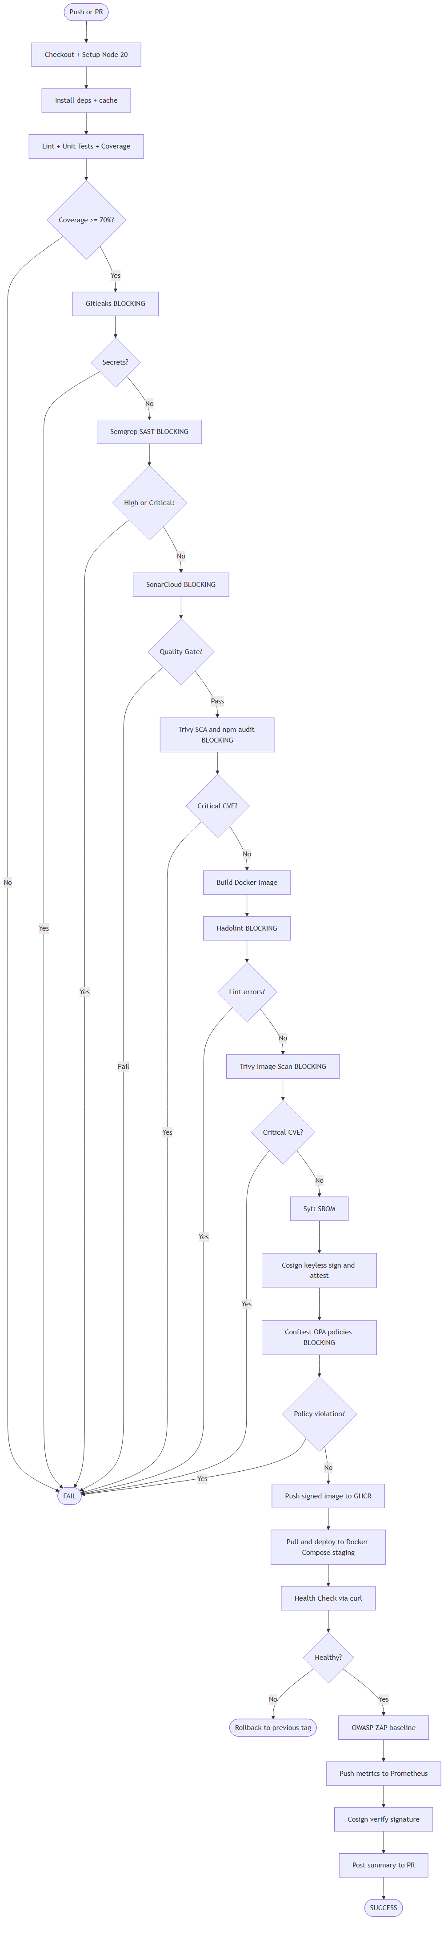
The Pipeline
22
stages
checkout → ship → DAST
5
blocking gates
Gitleaks · Semgrep · Sonar · Trivy · Conftest
8
integrated tools
across 6 security categories
<15
min runtime
with caching + parallel jobs
22-stage activity flow
AegisFlow
6 / 15
Notes:
The pipeline runs 22 stages. Five are explicit blocking gates: Gitleaks, Semgrep SAST, SonarCloud quality, Trivy SCA, Trivy image scan plus Conftest policy. The chain is enforced — failure at gate 1 means the image never builds. Failure at gate 2 means the image never publishes. Eight security tools cover six categories — secrets, SAST, code quality, SCA, container CVE, and policy as code. Plus DAST and SBOM. The pipeline is committed in .github/workflows/ci-pipeline.yml — 794 lines, version-pinned, runnable on a fork.

Slide 7
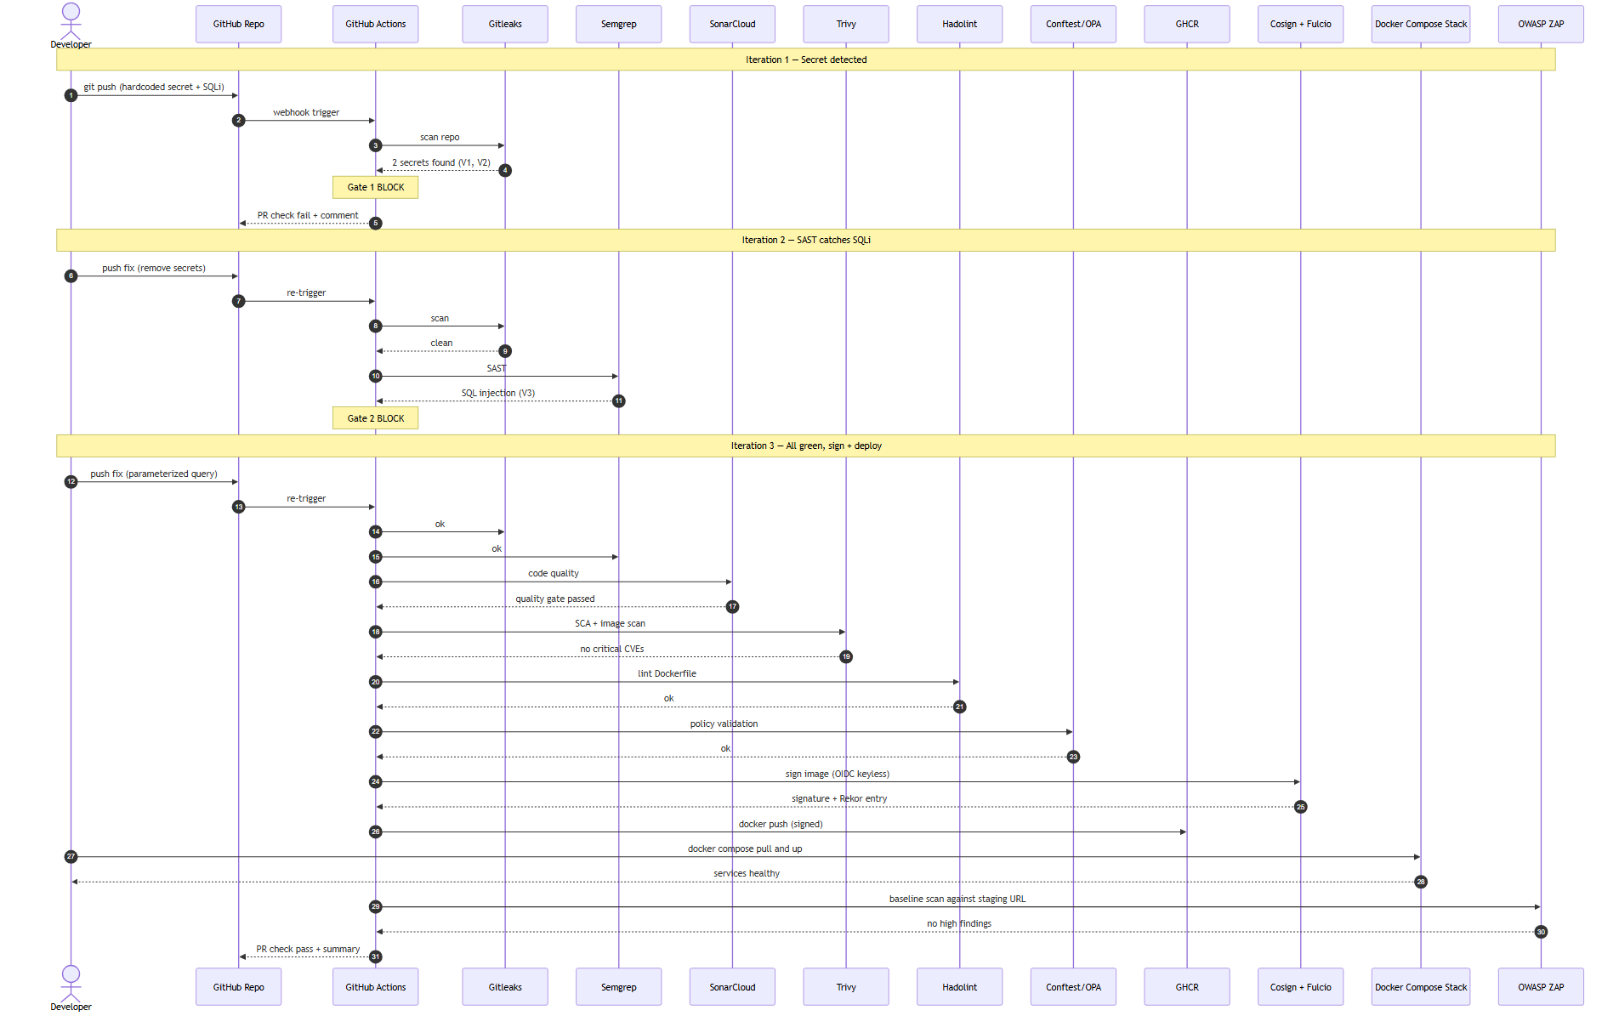
Demo Story — Red → Green
3 iterations · 3 blocking gates · 3 shift-left wins — each red and each green commit is a real entry in git log.
AegisFlow
7 / 15
Notes:
This is the heart of the demonstration. Iteration 1: I push code with a hardcoded JWT secret. Gitleaks fires, gate 1 blocks, pipeline stops. Two minutes feedback to the developer instead of two weeks to a security auditor. Iteration 2: I remove the secret and push again. Gitleaks passes, Semgrep now finds the SQL injection on the incidents query. Gate 1 blocks again. Iteration 3: I parameterize the query, push, and now everything is green: Gitleaks, Semgrep, SonarCloud, Trivy filesystem, Trivy image, Hadolint, Conftest. Cosign signs the image, Syft generates the SBOM, GHCR receives the signed artifact, ZAP scans the running staging. Each red and each green commit is a real commit in the git log — the jury can replay this narrative deterministically.

Slide 8
Live Demo
✕
GitHub Actions · RED
✓
GitHub Actions · GREEN
github.com/anlehtouf/AegisFlow-DevSecOps/actions/runs/<red>
github.com/anlehtouf/AegisFlow-DevSecOps/actions/runs/<green>
$
Terminal · cosign verify
▶
SecureTrack live
$ cosign verify --certificate-identity-regexp ...
http://localhost:3000
Backup: 3-minute pre-recorded screen capture in case GitHub Actions is slow.
AegisFlow
8 / 15
Notes:
I'll walk through four windows. First, the red run — note the specific gates that fail. Second, the green run — every job green, signed image at the bottom. Third, the terminal — cosign verify against the image digest, the signature comes back valid, certificate identity matches the workflow. Fourth, the application running locally. If GitHub Actions is slow: switch to the backup video.

Slide 9
Before vs After
Metric
Before
After
Hardcoded secrets
3
0
SAST findings
6
0
Dependency CVEs
2 HIGH
0
Container critical CVEs
16 + 385 HIGH
0 critical
Policy violations
2 fail + 1 warn
0
DAST high findings
2
0
Image size (backend)
~900 MB
~180 MB
Signed images
0 / 2
2 / 2
Numbers from reports/BASELINE_SUMMARY.md and reports/HARDENED_SUMMARY.md — not estimates.
AegisFlow
9 / 15
Notes:
These numbers come directly from the committed scan reports — reports/BASELINE_SUMMARY.md for the left column and reports/HARDENED_SUMMARY.md for the right. The most important row is image critical CVEs: 16 to zero, just by switching the base image from node:16 to node:20-alpine. The most defensible row is the bottom two: zero signed images becomes two-out-of-two, with the signatures cryptographically anchored to a public transparency log.

Slide 10
Supply-Chain Proof
GitHub Actions
→
Fulcio CA
→
Cosign signature
→
Rekor transparency log
OIDC token → ephemeral signing cert → public transparency log. No private keys.
$ cosign verify --certificate-identity-regexp '^https://github.com/anlehtouf/' \
--certificate-oidc-issuer 'https://token.actions.githubusercontent.com' \
ghcr.io/anlehtouf/aegisflow-devsecops/backend@sha256:<digest>
Verification for ghcr.io/anlehtouf/aegisflow-devsecops/backend
The following checks were performed on each signature:
✓ The cosign claims were validated
✓ Existence of the claims in the transparency log was verified offline
✓ The code-signing certificate was verified using trusted certificate authority
AegisFlow
10 / 15
Notes:
The supply-chain story is what separates a DevOps project from a DevSecOps project. We don't ship anonymous images. The pipeline obtains a short-lived OIDC token from GitHub, exchanges it at Sigstore's Fulcio CA for a signing certificate tied to the specific workflow run, signs the image, records the signature in Rekor — a public transparency log. Anyone, anywhere, can independently verify that this exact image was built by this exact workflow on this exact commit. Zero private keys to manage, zero trust in opaque registries.

Slide 11
Custom Semgrep Rule — the +1 Differentiator
Hand-written, not from registry
4 variants of CORS misconfig
OWASP A05 + CWE-942
ERROR severity — blocking gate
Fires on V14 in vulnerable branch
rules:
- id: aegisflow-cors-wildcard-origin
languages: [javascript, typescript]
severity: ERROR
metadata:
owasp: "A05:2021"
cwe: "CWE-942"
confidence: HIGH
pattern-either:
- pattern: cors({ ..., origin: "*", ... })
- pattern: cors({ ..., origin: true, ... })
- pattern: $RES.setHeader(
"Access-Control-Allow-Origin", "*")
- patterns:
- pattern: $APP.use(cors())
- pattern-not: $APP.use(cors({...}))
AegisFlow
11 / 15
Notes:
Most students use Semgrep. I wrote a Semgrep rule. This one targets the CORS wildcard pattern in four variants: explicit star, origin true which Express interprets as reflect-origin and is just as bad, manual setHeader with a wildcard, and bare app.use(cors()) with no config. It carries OWASP A05 and CWE-942 metadata so it integrates with SARIF dashboards. This rule is also tagged confidence HIGH, likelihood HIGH, impact HIGH — meaning it will not be a false-positive warning, it will be a blocking failure.

Slide 12
Compliance Mapping
Framework
Domain
Controls covered
OWASP SAMM
Verification — Security Testing
SAST · SCA · DAST · threat modeling
NIST SSDF v1.1
PW.7 / PW.8 / PW.9 / RV.1
Review code · test · configure · identify vulns
ISO/IEC 27001:2022
A.8.25 / A.8.28
Secure development lifecycle · secure coding
Full mapping in docs/compliance-mapping.md
AegisFlow
12 / 15
Notes:
Three frameworks, ten controls. The mapping is in docs/compliance-mapping.md. This matters because it makes the project relevant beyond academic — it's how an organization would justify a DevSecOps investment to auditors and regulators.

Slide 13
Limitations & Trade-offs
1
Single-host Docker Compose
Not Kubernetes — deliberate scope
2
ZAP baseline only
Not full active scan — runtime budget
3
Demo-scale data
No load testing — focus is security, not performance
4
One developer, one repo
No cross-team simulation — single-actor model
5
Cloud deployment designed
But out of implementation scope — see Future Work
AegisFlow
13 / 15
Notes:
Every project has scope. Mine: single host, baseline DAST, demo-scale data. Why? Because the goal is to demonstrate methodology end-to-end, not to operate a fleet. The pipeline is portable — same workflow with three env-var changes targets ECS Fargate, which I designed in detail in the project blueprint. I prefer to ship a complete narrow scope than a half-built broad one.

Slide 14
Future Work
01
Cloud-native deployment
02
Runtime threat detection
AWS ECS Fargate · RDS · ALB · WAF — Terraform-defined
Falco / GuardDuty for behavioral anomalies
03
GitOps promotion
04
IAST instrumentation
ArgoCD multi-environment (staging → pre-prod → prod)
Runtime SAST as second-line defence (Contrast-style)
AegisFlow
14 / 15
Notes:
Four directions to extend. Cloud deployment is the closest — the architecture diagram already shows the target. Runtime threat detection adds the SIEM layer. GitOps adds the multi-environment promotion. IAST closes the gap between static and dynamic by instrumenting the running application. Each is a non-trivial engineering effort; each is unlocked by what's already built.

Slide 15
“
AegisFlow makes insecure delivery structurally difficult.
Every commit is scanned. Every artifact is inventoried.
Every image is signed. Every claim is auditable.
8 diagrams · 22 pipeline stages · 5 blocking gates · 100% critical findings remediated
github.com/anlehtouf/AegisFlow-DevSecOps
Questions?
Notes:
One sentence summary: AegisFlow makes insecure delivery structurally difficult. Not discouraged, not audited — structurally difficult. The pipeline either ships a signed, scanned, SBOM-attested artifact, or it ships nothing. I welcome your questions.

