Slide 1
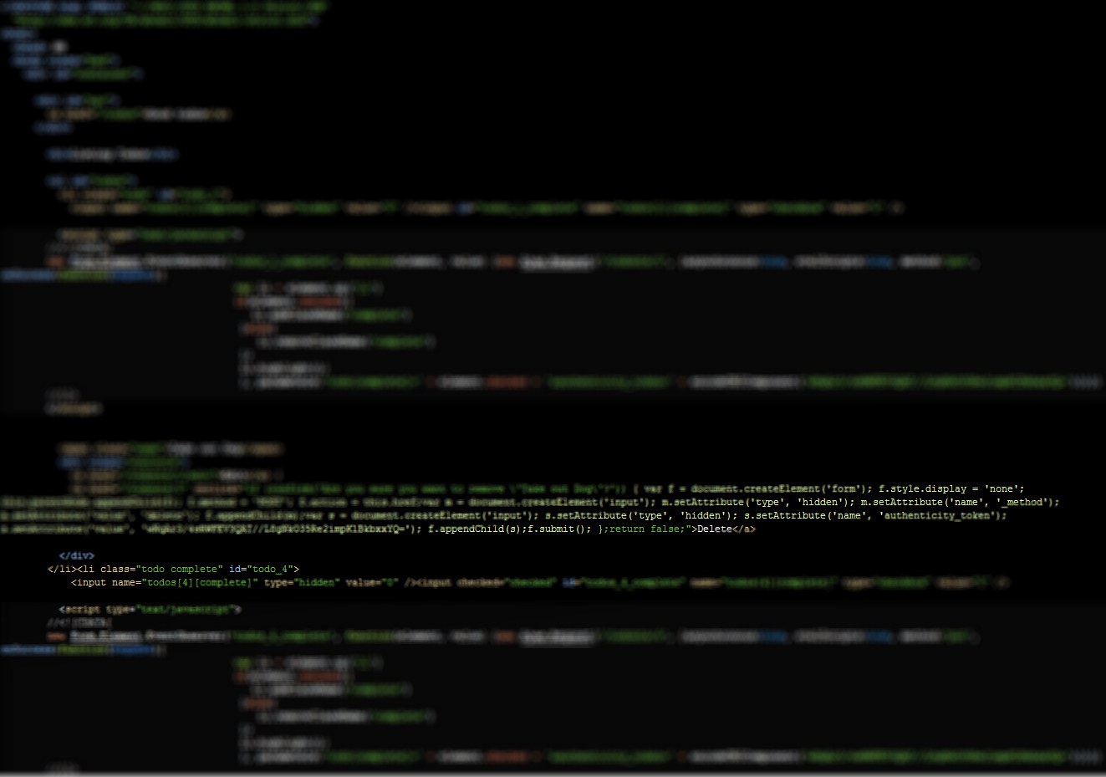
Unobtrusive JavaScript (using Prototype and LowPro)
Andrew Kalek

Slide 2
What is Unobtrusive JavaScript
Wikipedia Definition:
Progressive enhancement to support user agents that may not support advanced JavaScript functionality
Separation of functionality (the "behaviour layer") from a Web page's structure/content and presentation
Best practices to avoid the problems of traditional JavaScript programming (such as browser inconsistencies and lack of scalability)

Slide 3
Why use Unobtrusive JavaScript
The Bad (Obtrusive Way)
The Good (Unobtrusive Way)
<li>
<input name="todos[1][complete]" type="hidden" value="0" /> <input id="todos_1_complete" name="todos[1][complete]" type="checkbox" value="1" /> <script type="text/javascript"> //<![CDATA[
new Form.Element.EventObserver('todos_1_complete', function(element, value) {new Ajax.Request('/todonts/1', {asynchronous:true, evalScripts:true, method:'put', onSuccess:function(request){ var li = element.up('li‘) if(element.checked){ li.addClassName('complete‘) }else{ li.removeClassName('complete‘) }; li.highlight(); }, parameters:'todo[complete]=' + element.checked + '&authenticity_token=' + encodeURIComponent('wNqAr3/4sRWFEV3QAT//L8gNkO35Re2impKlBkbxxYQ=')})}) //]]> </script> <span class="name">Take out Dog</span>
<div class="controls"> <a href="/todonts/1/edit">Edit</a> | <a href="/todonts/1" onclick="if (confirm('Are you sure you want to remove \'Take out Dog\'?')) { var f = document.createElement('form'); f.style.display = 'none'; this.parentNode.appendChild(f); f.method = 'POST'; f.action = this.href;var m = document.createElement('input'); m.setAttribute('type', 'hidden'); m.setAttribute('name', '_method'); m.setAttribute('value', 'delete'); f.appendChild(m);var s = document.createElement('input'); s.setAttribute('type', 'hidden'); s.setAttribute('name', 'authenticity_token'); s.setAttribute('value', 'wNqAr3/4sRWFEV3QAT//L8gNkO35Re2impKlBkbxxYQ='); f.appendChild(s);f.submit(); };return false;">Delete</a>
</div>
</li>
<li class="todo" id="todo_1">
<input name="todos[1][complete]" type="hidden" value="0" />
<input id="todos_1_complete" name="todos[1][complete]" type="checkbox" value="1" />
<span class="name">Take out Dog</span>
<div class="controls">
<a href="/todos/1/edit">Edit</a> | <a href="/todos/1/confirm_delete" class="delete">Delete</a>
</div>
</li>

Slide 4
More Information
My Blog: http://blog.anlek.com
My GitHub: http://github.com/anlek/
Prototype: http://www.prototypejs.org/
LowPro: http://www.danwebb.net/lowpro
Learn more on Unobtrusive Javascript at: https://peepcode.com/products/unobtrusive-prototype-js

