Slide 1


Slide 2
Motivation
ecologically conscious
destinations in Germany
interactive quiz

Slide 3
Design Philosophy
Manual database with holiday destinations, selection criteria and description
Building a decision tree to filter the options and end with a recommendation
    1st idea: use ID3 algorithm → we didn‘t need a learning algorithm
    2nd idea: write our own algorithm
Create an intuitive user interface (beyond the command line)

Slide 4
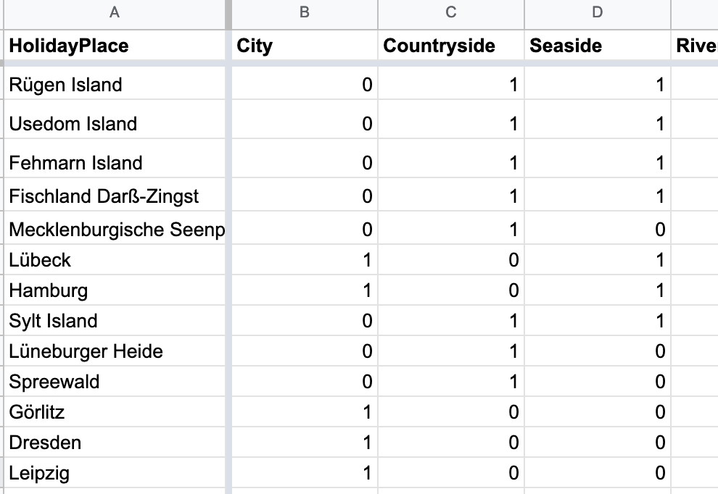
Database
Attribute categories
Example for holiday destination
Indicator if attribute is:
present = 1
not-present = 0

Slide 5
Code architechture -
command-line program works!
Database Holiday Mate - Sheet1.csv"
Give user a recommendation
while loop – until
there is no next node, but single recommendation
Function to build a Decision Tree
Getting input from the user (Yes/No = 0/1)
dictionary of questions for each category/node
nested list of dictionaries
(nodes + 0/1)
Function to get the next node

Slide 6
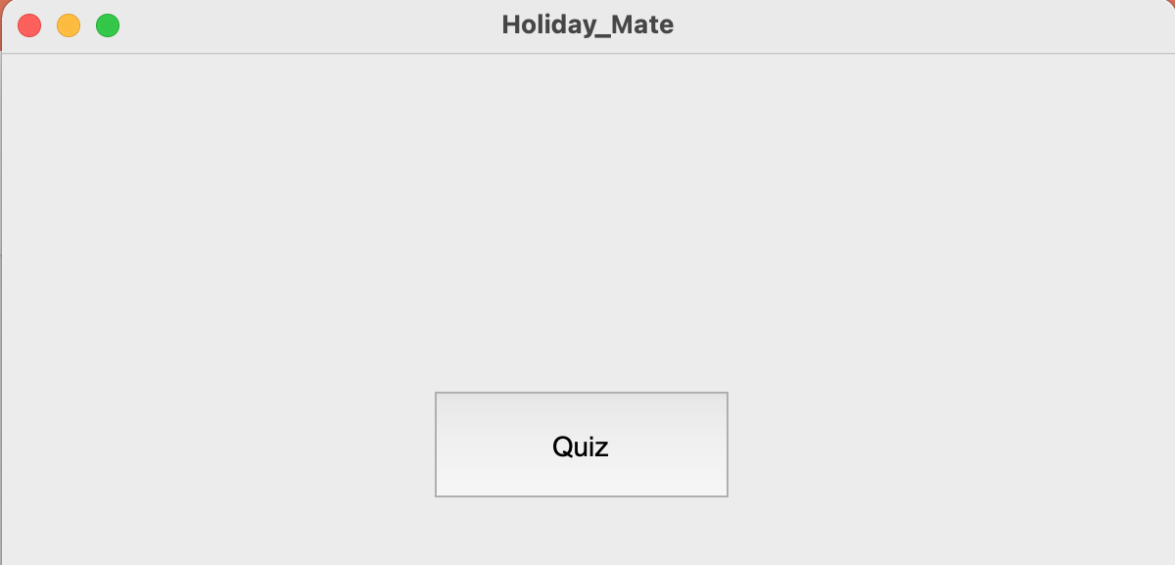
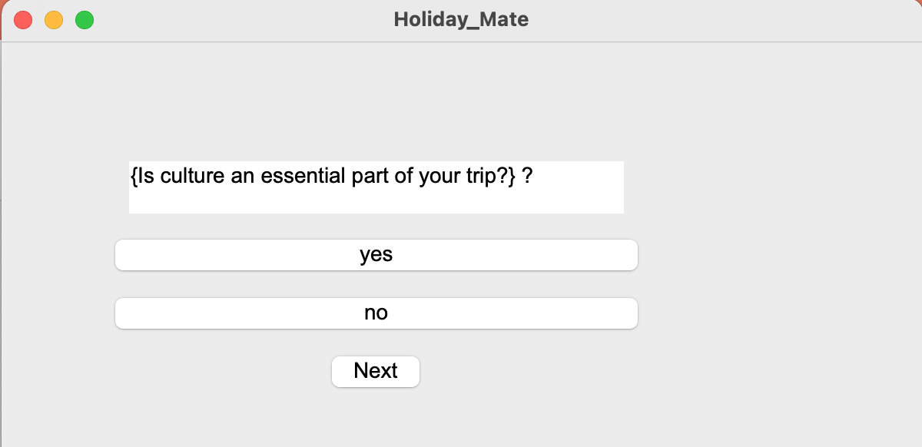
Now we are working on making the underlying code more presentable.
Adding a quiz interface to interact with the backend code using the package tkinter
Personalising the interaction window
Current challenge: Making the quiz code interact with a while loop in our algorithm code

Slide 7


