Slide 1
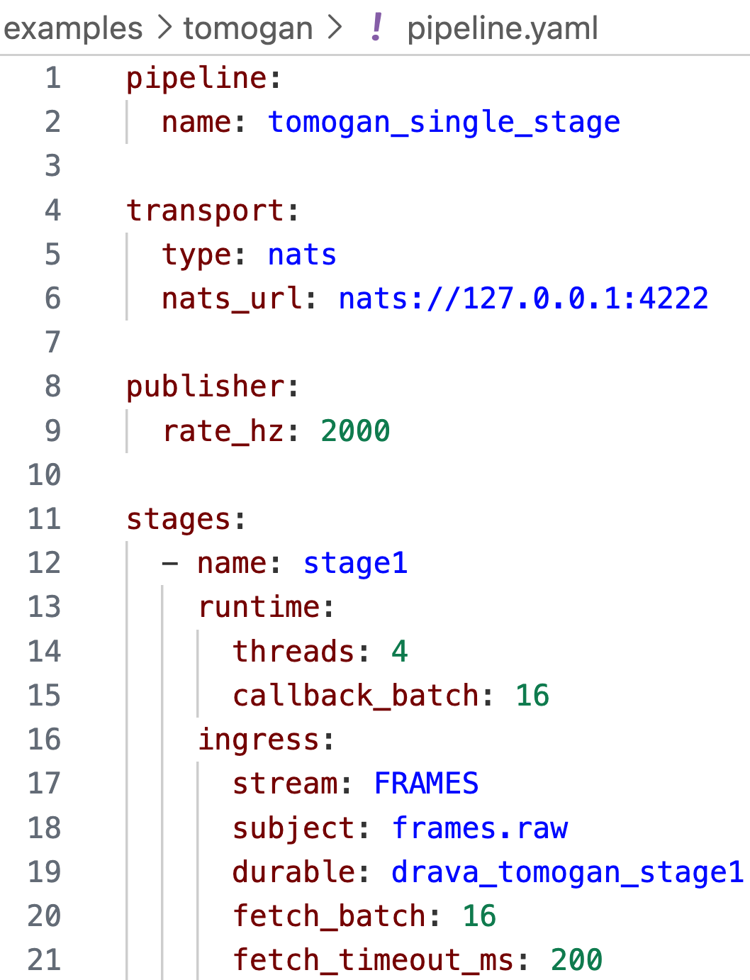
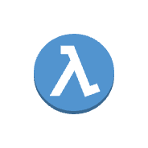

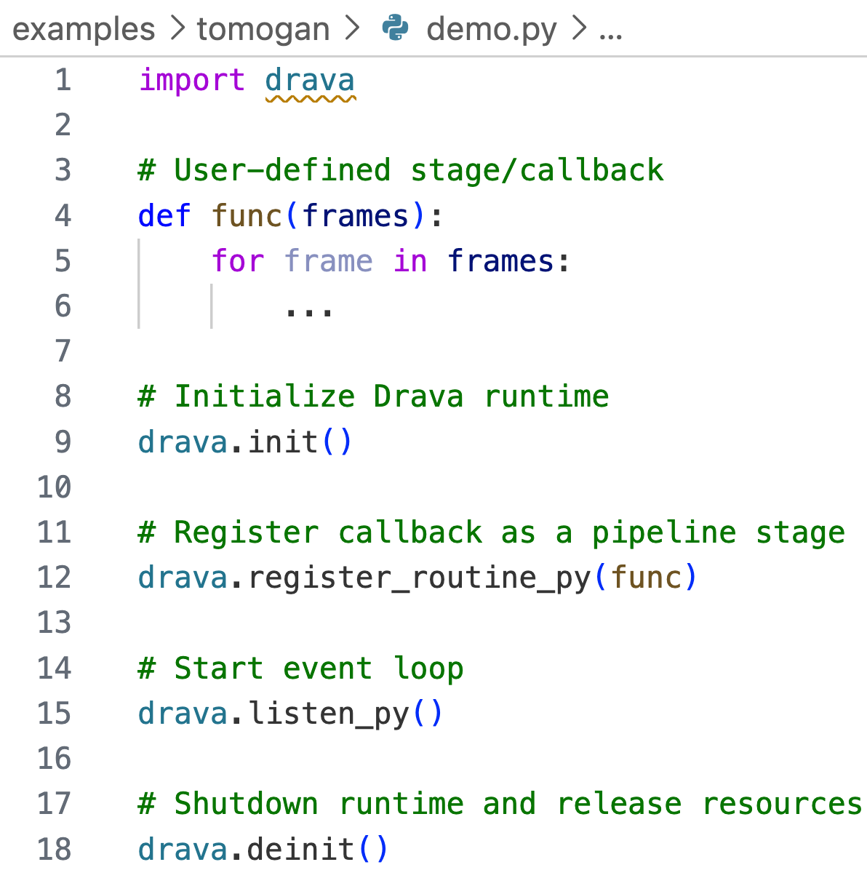

Interface
Config
Execute
Observability
1
2
3
4
Drava Python API
YAML Parser
Drava Runtime
Metrics & Reporting
Collected Metrics
Frames
Batching
Events
End-to-end latency
Throughput (events/s)
Work-Stealing Scheduler (XKRT)
GPU utilization (%)
Worker 0
GPU 0
Worker 1
GPU 1
Worker 2
GPU 2
Transport overhead (s)
Multi-GPU Execution
Report
GPU 0
GPU 1
GPU 2
GPU 3
User Application
(app.py)
Pipeline &
stage configuration
Resource scheduling &
work distribution
Export metrics
in JSON / CSV / memory
Feedback for monitoring & adaptive optimization
1
Wire Drava API in application code
2
Provide configuration in YAML
3
Drava executes tasks using XKRT across GPUS
4
Collect & report runtime metrics
Closed-loop
for optimization

