Slide 1
Formal Verification of Specs of Applications
Saeed Namih 204582555 Ahmad Mnasra 311539647
Supervisor(s):
Dr. Katerina Korenblat
Dr. Elena Ravve

Slide 2
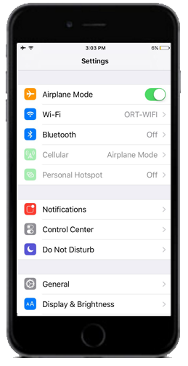
Motivation
Take your cellular phone
Go to Settings
Push flight Mode ok
Then push Wifi on
Is it correct or not?
Did you receive this screen?
Do you think that this is ok?

Slide 3

What is the bug ?
bug is an error, flaw, failure or fault in a computer program or system that causes it to produce an incorrect or unexpected result, or to behave in unintended ways.
spec
Implementation
Intended way of behavior = program or system
Notes:
Most bugs arise from mistakes and errors made in either a program's source code or its design, or in components and operating systems used by such programs.

Slide 4
What is a bug ? (cntd)
The question now how do you know that
our SPEC is correct?
Conclusion: The SPEC must be complete and sound.
Notes:
In our example about flight mode and WIFI it depends upon what is written in the SPEC

Slide 5
Our Project
We build a tool to compose SPEC graphical
Check consistency of the SPECS
Pic for ( spec document word ⬄ workspace screens )
Spec ⬄ verification
Notes:
In particular:
We took apps of cellular phones as implementations because their SPEC’s may be presented as transitions between screens using actions
We call the presentation: SCREEN DIAGRAM

Slide 6
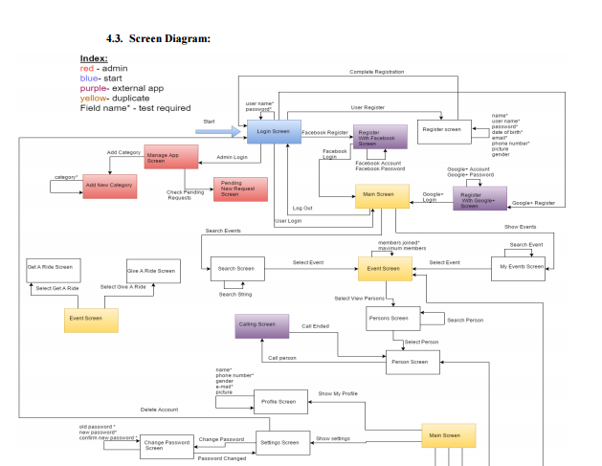
Example: Screen diagram of BoPo
Notes:
We want to build a tool that produces the screen diagram automatically and makes “sanity” check of it.

Slide 7
Front End : composition of spec
How does the user build the screen diagram
2 screen with elements
How to Add screen and element

Slide 8
Back End: model construction
Screens gui
PG
Promela model
___ _ _ _
Notes:
The screen diagram as a program graph
Verification properties are formulated in LTL

Slide 9
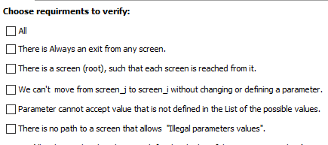
Back End: requirements
Notes:
The screen diagram as a program graph
Verification properties are formulated in LTL

Slide 10
Summary of the project
Front end
Back end
Flow chart

Slide 11

Program graph(PG)
Definition: A program graph (PG) over set Var of typed variables is a tuple (Loc, Act, Effect, →, ${Loc}_{0}$, $g_{0}$) where:
$Loc$ is a set of locations,
$Act$ is a set of actions,
$Effect:Act×Eval(Var)→Eval(Var) →Eval(Var)$is the effect function,
$→⊆Loc×Cond(Var)×Act×Loc↪⊆Loc×Cond(Var)×Act×Loc$ is the conditional transition relation,
${Loc}_{0}$⊆$Loc$ is a set of initial locations,
$g_{0}∈Cond(Var)$ is the initial condition link
Notes:
Program Graph Program graph s are defined over a set $Var$ of typed variables. Essentially, this means that a standardized type (e.g., boolean, integer, or char) is associated with each variable. The type of variable x is called the domain $dom(x)$ of $x$. Let $Eval(Var)$ denote the set of (variable) evaluations that assign values to variables. Cond(Var) is the set of Boolean conditions over $Var$.

Slide 12
Program graph example

Slide 13
Spin : The PROMELA verification language
PROMELA (Process or Protocol Meta Language) is a verification modeling language.
The language allows for the dynamic creation of concurrent processes to model, for example, distributed systems. In PROMELA models, communication via message channels can be defined to be synchronous or asynchronous.
PROMELA models can be analyzed with the SPIN model checker, to verify that the modeled system produces the desired behavior.
link

Slide 14

Linear Temporal Logic
$φ :≔ true \left| a \left|{ φ}_{1} ∧ φ_{2} \right| ¬φ \right| Οφ | { φ}_{1} U{ φ}_{2 }$,
Notes:
Tool to describe properties to be checked
Linear Temporal logics (LTL) is a convenient formalism for specifying and verifying properties of reactive systems. We can say that the modalities in Temporal Logic are Time abstract
Linear temporal property (LT properties) is a temporal logic formula that describes a set of infinite sequences for which it is true.
The underlying nature of time in temporal logics is linear. i.e., at each moment in time there is a single successor moment, several model-checking tools use LTL as a property specification language. The model checker SPIN is a prominent example of such an automated verification tool.
Syntax: LTL formulae over the set AP of atomic proposition are formed according to the following gramma$:$

Slide 15
Spin
Tool to implement the model checking
Spin is a popular verification tool of distributed systems, used by thousands of people worldwide. It was developed at Bell Labs in the UNIX group of the Computing Sciences Research Center, starting in 1980.
The tool can be used for the formal verification of multi-threaded software applications. Spin can perform simulations of the system's execution. Spin can perform interactive, guided, or random simulations of the system's execution.

Slide 16
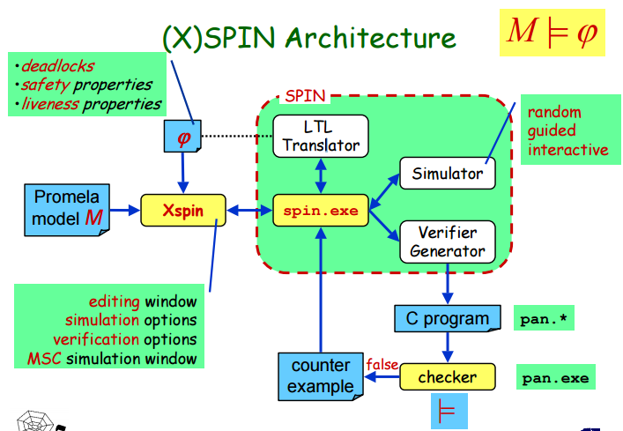
SPIN

Slide 17
Examples of LTL - properties
Verbaly { Flight Mode ⬅➔ Wifi }

Slide 18
Class Diagram

Slide 19

Transition System (TS)
Definition: A transition system TS is a tuple $(S, Act, →, I, AP, L)$ where
$S$ is a set of states.
$Act$ is a set of actions,
$→ ⊆ S × Act × S$ is a transition relation,
$I ⊆ S$ is a set of initial states,
$AP$ is a set of atomic propositions, and
$L: S → 2^{AP}$is a labeling function.
TS is called finite if $S, Act,$ and $AP$ are finite.
link
Notes:
Transition systems are often used in computer science as models to describe the behavior of systems. They are basically directed graphs where nodes represent state and edges model transitions, i.e., state changes. A state describes some information about a system at a certain moment of its behavior.
We can describe the behavior of transition system as follows. The transition system starts in some initial state 𝑠_0 ∈ 𝐼 and evolves according to the transition relation →. That is, if s the current state, then a transition 𝑠 □(→┴𝛼 ) 𝑞 originating from 𝑠 is selected non-deterministically and taken, the action 𝛼 is performed and the transition system evolves from state s into the state q.
This selection procedure is repeated in state 𝑞 and finishes once a state is encountered that has no outgoing transitions. It is important to realize that in case a state has more than one outgoing transition, the “next” transition is chosen in a purely nondeterministic fashion. That is, the outcome of this selection process is not known a priori. Similarly, when the set of initial states consists of more than one state, the start state is selected non-deterministically.
The labeling function 𝐿 relates 𝑎 set 𝐿(𝑠) ∈ 2^𝐴𝑃 of atomic propositions to state 𝑠. 𝐿(𝑠) intuitively stands for exactly those atomic propositions 𝑎 ∈ 𝐴𝑃 which are satisfied on the state 𝑠.

