Slide 1
Credit Card Fraud Detection
Ananya Mishra
Ritobhash Ray

Slide 2
CC Fraud Detection: Overview
US remains one of the most credit card fraud prone country.
Globally, credit card frauds amounts to $28.65bn annually, about $11bn of this occurs in US
With the pandemic and the rise of online transactions, it is expected frauds in coming year will become more frequent

Slide 3
Operational Risks
BCBS defines operational risks for banks as: “the risk of loss resulting from inadequate or failed internal processes, people, and systems, or external events”
Credit Card Frauds represent an external event and are therefore categorized under Operational Risk
As per the BASEL II guidelines,Credit Card are categorized as External Fraud and under that as Victim Fraud

Slide 4
Banks: Regulations and Cost
For such operational risk, BASEL Norms has set capital provisioning requirements based on Expected Losses based on the actual loss amount and the legal, operational cost associated with such loss.
Operational Risk are different from Credit Risk in two ways:
Suddenness
Lack of Security
Considering the nature and the provisioning, frauds significantly impact Banks profitability and reputation
Notes:
Suddenness: While Credit Defaults are long seen coming, Operational Risk are mostly sudden and due to lapses
Lack of Security: While Credit is backed by collaterals and guarantees, Operational Risk has higher loss severity

Slide 5
Dataset: Structure and Imbalances
The dataset contains transactions made by credit cards in September 2013 by European cardholders.
This dataset presents transactions that occurred in two days, where we have 492 frauds out of 284,807 transactions.
The dataset is highly unbalanced, the positive class (frauds) account for 0.172% of all transactions.
The total amount of transactions is €25 Million out of which only €60000 is fraud which translates to 0.24% of the amount

Slide 6
Why This Dataset?
The data set we have chosen has a very high number of observations with a significantly low percentage of fraud, making it an excellent real-world example to work on.
Since the dataset also has mentioned the amount of each transaction we can estimate how well in terms of monetary value our model performs.
The data has been cleaned so a large part of the data management is taken care of and we can focus on the model and performance
All the features have been reduced to uncorrelated Principal Components which allows us to develop a very powerful model

Slide 7
Transformation Technique Used
Since our data set is heavily imbalanced, we have used Synthetic Minority Oversampling Technique (SMOTE) to increase number of minority class.
SMOTE aims to balance class distribution by randomly increasing minority class examples by replicating them.
The advantage of SMOTE is that we are not generating duplicates but rather creating synthetic data points that are slightly different from the original data points.
Notes:
It generates the virtual training records by linear interpolation for the minority class.
After the oversampling process, the data is reconstructed and several classification models can be applied for the processed data.

Slide 8
Dataset: Features
Data contains only numeric input variables which are the result of a PCA transformation.
Due to confidentiality issues, we are not provided with the original features and more background information about the data.
Features V1, V2, … V28 are the principal components obtained with PCA

Slide 9
Dataset: Targets
Feature 'Time' contains the seconds elapsed between each transaction and the first transaction in the dataset.
The target variable 'Amount' is the transaction Amount, this can be used for modeling the total loss
The target variable 'Class' is the response variable and it takes value 1 in case of fraud and 0 otherwise.

Slide 10
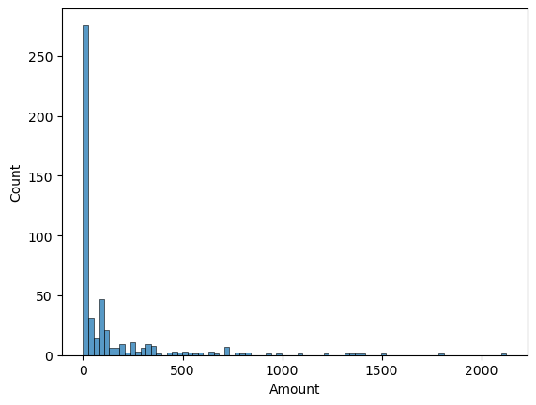
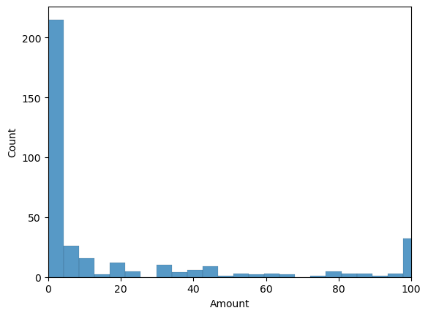
EDA: Fraud Amounts
Notes:
The median value of fraud amounts were 9.25, the 75th percentile was 101.7. Second plot shows the distribution till approximately the 75th percentile. As one can see the fraud amounts are low for majority of transactions, but it is the high value frauds that have more monetary utility

Slide 11
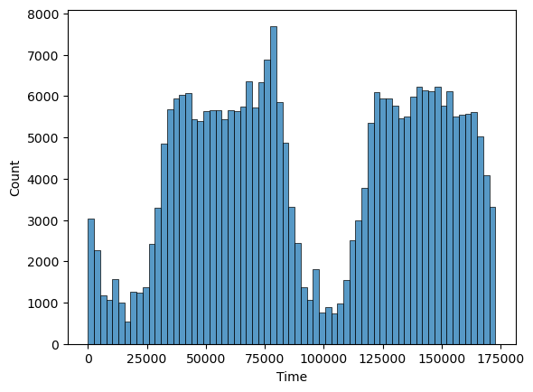
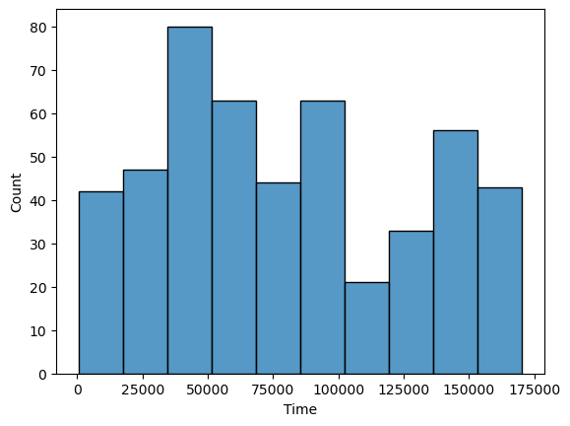

Timing of Frauds
Genuine Transactions
Fraudulent Transactions
All Transactions
Notes:
While the genuine transactions peak during the 75000 second mark, and again at 150000 second mark, fraudulent transactions tend to have different timings with a peak at 50000 second mark and smaller peaks at 100000 and 150000

Slide 12
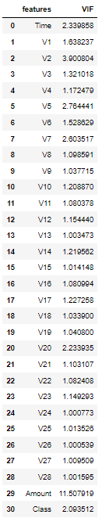
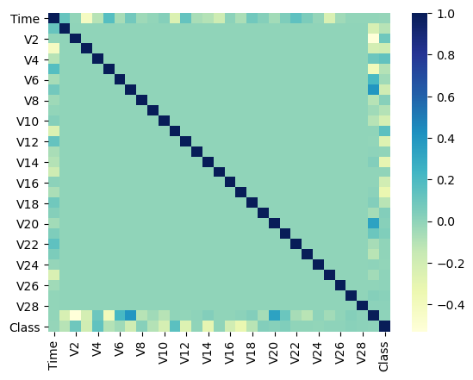
Heat Map and VIF Analysis
Notes:
Due to very low correlations between features the heatmap was fairly uniform, added class, time to shown differentiation. Here since features are PCs and were 28 seeing there distributions had little value. So we just looked for there heatmaps. For visualisation we can look into kaggle dataset link for their individual PC distributions

Slide 13
Modelling Steps
In this project, we used a two stage model:
First Stage: Classify the transactions
Second Stage: Determine the amount of fraudulent transactions detected
FIRST STAGE
We first trained our model on an oversampled dataset (test size=0.7) with equal number of genuine and fraudulent transactions
Once the model was trained its performance measures were calculated to get an idea of its recall score and suitability for further analysis
SECOND STAGE
Then this trained model was used to predict on the 492 observations of the actual fraudulent transactions
Based on the predictions the amount of fraud detected was computed and compared with the actual fraudulent amount
Notes:
The training dataset was only 0.3 considering the models would learn a lot because of the sheer volume of observations

Slide 14
Modelling
In this project we used three different models having varied algorithm basis:
Logistic Regression
XGBoost
Multi-layer Perceptron classifier
Why choose Recall Score?
As we are detecting fraudulent transactions, every False Positive is harmless considering monetary consequences, but False Negatives can lead to losses for clients and banks.
To focus on False Negatives, we focus on Recall instead of accuracy as it gives a measure of how well our model predicts the losses and not just genuine transactions, factoring which can inflate our performance.
Notes:
Logistic Regression: Determines the log of odds of an event based on Regression of features
XGBoost: Uses Ensemble of decision trees with iterative weighting of leaf to improve performance
Multi-layer Perceptron classifier: Uses Neural Networks consisting of a hidden layer and nodes

Slide 15
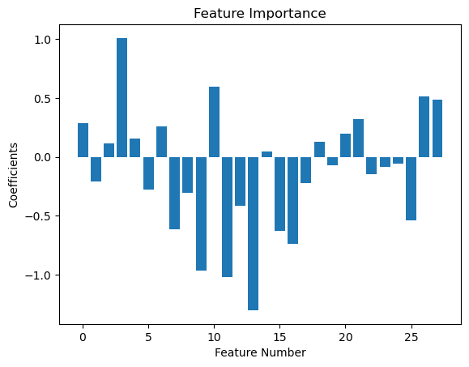
Logistic Regression Model
The recall score for the fitted model was 91.4%
Performing 5-Fold Cross Validation we got a mean accuracy of 92.27% and a Standard deviation of 2%, which signifies a fairly consistent performance
Based on the performance of model we estimated the predicted fraud amount at €52,918.49 out of actual fraud amount of €60,128
Feature Importance: Based on the plot shown,
V4,V10,V12,V14 were the most important.

Slide 16
Multi-Layer Perceptron Classifier
The recall score for the fitted model was 77.9%
Performing 5-Fold Cross Validation we got a mean accuracy of 99.88% and a Standard deviation of 0.1%, which signifies a fairly consistent performance
Based on the performance of model we estimated the predicted fraud amount at €51,547.45 out of actual fraud amount of €60,128
Feature Importance: Considering this was a neural network based Classifier, there are no direct metrics to get feature importance, which is a limitation of this model
Notes:
Could look into LIME, ELI5 or Yellowbrick

Slide 17
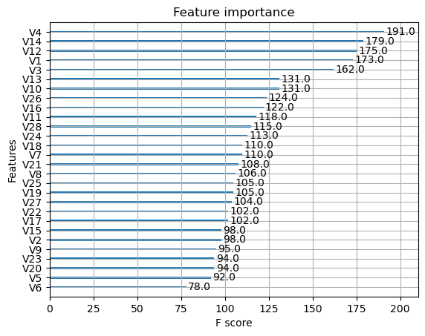
XGBoost Model
The recall score for the fitted model was 99.96%
Performing 5-Fold Cross Validation we got a mean accuracy of 99.88% and a Standard deviation of 0.12%, which signifies a fairly consistent performance
Based on the performance of model we estimated the predicted fraud amount at €60,107.62 out of actual fraud amount of €60,128
Feature Importance: Based on the plot shown,
V4,V14,V12,V1,V3 were the most important.

Slide 18
Performance Summary
Model | Logistic Regression | MLP Classifier | XGBoost
Recall | 91.4% | 77.9% | 99.96%
Mean Accuracy (Std) | 92.27%(2%) | 99.88%(0.1%) | 99.88%(0.12%)
Features | V4,V10,V12,V14 | NA | V4,V14,V12,V1,V3
Fraud Predicted (€60,128) | €52,918.49 | €51,547.45 | €60,107.62

Slide 19
Performance Summary:Top 10 Frauds
Model | Accuracy | Recall | Precision | Predicted Amount (€14233.6)
Logistic Regression | 80% | 80% | 100% (Since FP=0) | €11010.74
MLPC | 90% | 90% | 100% | €13237.33
XGBoost | 100% | 100% | 100% | €14233.6

Slide 20
Limitations
The features in the dataset contains only Principal components. However, considering in a real world scenario as an internal process, we will have access to the PCs.
We have only used a training and testing dataset. To fine tune our model we could have looked into Validation Dataset.
We could have used Stratified Cross Validation on the imbalance dataset instead of 5-Fold on the oversampled data set
The MLP classifier is a NN technique and hence determining feature importance requires using packages like LIME and ELI5.
Notes:
so we can’t actually discuss the meaning of different features but only point out at the relevant PCs. This wasWe do not have access to more background information or categorical variables due to confidentiality issues, a problem that would not exist internally from a business standpoint.
To some extent we have overcome this hurdle by using CV
4. We can consider that in the future works

Slide 21
Discussion
The recall score in MLP classifier is lower, yet it gives very high accuracy and estimates fraud equal to Logistic Regression, underscoring why accuracy is a misleading performance measure.
Since the features are numeric in nature, XGBoost is a good choice for a technique as its algorithm does not work well on categorical data.
The overall performances of all three models were satisfactory. Tow of the models failed to estimate only worth €8000 fraud, while XGBoost was almost completely successful.

Slide 22
References
Dataset: Credit Card Fraud Detection | Kaggle
https://www.occ.treas.gov/news-issuances/bulletins/2019/bulletin-2019-37.html
Machine Learning – Towards Data Science
Analytics Vidhya - Learn Machine learning, artificial intelligence, business analytics, data science, big data, data visualizations tools and techniques. | Analytics Vidhya
- Statology
Wikipedia
https://scikit-learn.org/stable/modules/generated/sklearn.neural_network.MLPClassifier.html
https://datascience.stackexchange.com/questions/44700/how-do-i-get-the-feature-importace-for-a-mlpclassifier
https://www.kaggle.com/jdelamorena/recall-97-by-using-undersampling-neural-network/data
https://machinelearningmastery.com/feature-importance-and-feature-selection-with-xgboost-in-python/

Slide 23
We would be happy to answer questions!

