Slide 1

Green Pace
Security Policy Presentation
Developer: Andy Martinez

Slide 2

OVERVIEW: DEFENSE IN DEPTH

Slide 3
THREATS MATRIX
Likely STD-002-CPP STD-003-CPP STD-004-CPP STD-005-CPP | Priority STD-001-CPP STD-002-CPP STD-003-CPP STD-004-CPP STD-005-CPP
Low Priority STD-006-CPP STD-007-CPP | Unlikely STD-001-CPP STD-006-CPP STD-010-CPP

Slide 4
10 CORE SECURITY PRINCIPLES
1. Validate Input Data: Always validate input from untrusted sources to prevent injection vulnerabilities, data corruption, and potential security breaches. Use techniques such as input length checks, type validation, and format verification. 2. Heed Compiler Warnings: Treat compiler warnings as errors and resolve them. They often indicate security risks or undefined behavior. 3. Architect and Design for Security Policies: Incorporate security from the design phase, using threat modeling and risk assessment to reduce vulnerabilities. 4. Keep It Simple: Avoid complex architectures to enhance maintainability and reduce the risk of bugs and security flaws. 5. Default Deny: Deny all access by default and grant it explicitly as needed to minimize exposure. 6. Adhere to the Principle of Least Privilege: Give only the minimum access necessary and audit permissions regularly. 7. Sanitize Data Sent to Other Systems: Encode and escape output to external systems to avoid injection vulnerabilities. 8. Practice Defense in Depth: Use layered security controls across technical, administrative, and physical domains. 9. Use Effective Quality Assurance Techniques: Employ unit tests, static analysis, and edge-case validations to improve reliability. 10. Adopt a Secure Coding Standard: Follow established secure coding guidelines like SEI CERT C++ to reduce vulnerabilities.

Slide 5
C/C++ CODING STANDARDS OVERVIEW
STD-001-CPP: Ensure integer operations do not result in overflow or truncation errors.
STD-002-CPP: Safely handle iterators to avoid undefined behavior after container modification.
STD-003-CPP: Allocate sufficient space for strings to prevent buffer overflows.
STD-004-CPP: Use parameterized queries to avoid SQL injection.
STD-005-CPP: Prevent access to freed memory by nullifying pointers.
STD-006-CPP: Avoid assertions in production; use error handling instead.
STD-007-CPP: Catch and handle exceptions to prevent abrupt termination.
STD-008-CPP: Ensure iterators are valid after container operations.
STD-009-CPP: Avoid system() calls; use secure process creation APIs.
STD-010-CPP: Use cryptographically secure methods for random number generation.

Slide 6
ENCRYPTION POLICIES
Encryption at Rest: Protects data stored on disk or in databases. Ensures that stolen data remains inaccessible without decryption keys. Delays or prevents misuse of stolen files. Encryption in Flight: Secures data during transmission across networks using protocols like SSL/TLS. Prevents interception by tools like Wireshark. Can be further reinforced with VPNs. Encryption in Use: Safeguards data while actively being processed. Ensures protection of data in memory using secure handling or frameworks such as .NET’s ProtectedMemory.

Slide 7
TRIPLE-A POLICIES
Authentication: Verifies user identity during login. Uses credentials like email, passwords, and can include 2FA or SSO. Ensures only verified users access systems. Authorization: Determines what resources authenticated users can access. Enforces role-based access with the 'Default Deny' principle. Ensures users don’t exceed their access rights. Accounting: Tracks and logs all system activity—e.g., files accessed, user logins, and database changes. Supports operational monitoring and forensic investigations. Tools like Thycotic Secret Server assist with centralized logging.

Slide 8
Unit Testing
The following will provide an example of unit testing with gtest to achieve compliance. These tests are examples.

Slide 9
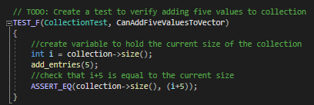
Unit Testing
CanAddFiveValuesToVector:

Slide 10
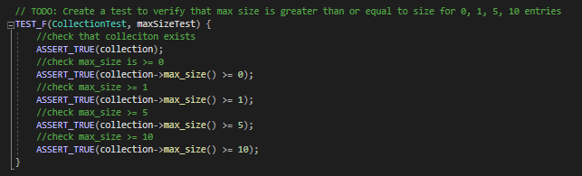
Unit Testing
maxSizeTest:

Slide 11
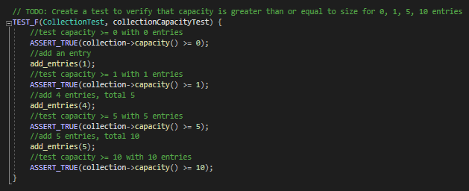
Unit Testing
collectionCapacityTest:

Slide 12
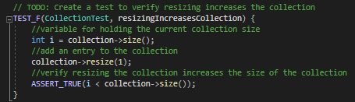
Unit Testing
resizingIncreasesCollection:

Slide 13
AUTOMATION SUMMARY
Green Pace uses automation to enforce and maintain security standards throughout the software lifecycle. Existing DevOps practices are enhanced by DevSecOps to integrate security from the start. Planning: Threat modeling is used to identify potential attacks and define countermeasures early. Develop & Build: Secure coding practices are enforced using coding standards and mitigation strategies. Testing: Automated unit and integration testing validate code and detect vulnerabilities such as SQL injection. Release & Operate: Secure containers and automated logging help prevent unauthorized access and monitor for anomalies. Monitor: Network and behavior analysis tools detect DDoS or intrusion attempts in real time. This lifecycle-wide approach ensures robust and proactive protection against evolving threats.

Slide 14
SECURITY TOOLS & AUTOMATION
Cppcheck (v2.17.0): Static analysis for C/C++, enforcing CERT and MISRA standards.
Parasoft C/C++test (v2025.1): Full static/unit testing and MISRA C:2025 compliance.
Coverity (v2025.6): Advanced static analysis for CWE, OWASP, and MISRA.
TrustInSoft Analyzer (v2025.1): Formal verification using abstract interpretation.
Clang Static Analyzer (v21.0.0git): Symbolic execution for detecting logic bugs.
SonarQube C++ Plugin (v2.2.0): Integrates rule sets for dashboard visualization.
LDRA Tool Suite (v2025.1): MISRA and safety compliance with dynamic/static analysis.
PVS-Studio (v7.36): Static analyzer for MISRA and CERT rule detection.
CodeSonar (v9.0.0): Deep semantic analysis with MISRA/AUTOSAR support.
Astree (v23.04): Abstract interpretation to enforce CERT/MISRA/concurrency rules.

Slide 15
RISKS AND BENEFITS
Benefits: - Automation reduces time and effort in enforcing standards. - Secure coding policies reduce vulnerabilities. - DevSecOps ensures continuous security throughout development. Risks: - Automation can introduce false positives or miss context-specific threats. - Tools require expertise to configure and maintain. Mitigation Steps: - Train developers on testing and static analysis tools. - Enforce adherence to secure coding standards. - Regularly review and revise processes for effectiveness.

Slide 16
RECOMMENDATIONS
Automate
Follow standards
Test code and defenses
Review effectiveness of standards and processes
Revise standards and processes as needed

Slide 17
REFERENCES
Carnegie Mellon University. (2020). SEI CERT C++ Coding Standard. Retrieved from: https://wiki.sei.cmu.edu/confluence/pages/viewpage.action?pageId=88046682 Cprogramming.com. (2019). XOR Encryption in C++. Retrieved from: https://www.cprogramming.com/tutorial/xor.html Google. (2022). DevOps tech: Shifting left on security. Retrieved from: https://cloud.google.com/architecture/devops/devops-tech-shifting-left-on-security

