Slide 1
MyBetJournal Final Project Design Proposal
Antranik (Nik) Medina
CIS 400

Slide 2
About myBetJournal
Sports Betting Industry is large and growing market
In 2009, the sports betting market was valued at $20 billion. By 2016, it was valued at $40 billion. With a present market capitalization of (conservatively) between $60-73 billion, the market has conservatively grown at a rate of $10 billion per year.
Multiple ways to place bets, different places different odds (DraftKings, William Hill, etc)
myBetJournal meant is to record bets made from different sources as well as record potential earnings from bets

Slide 3
Design

Slide 4
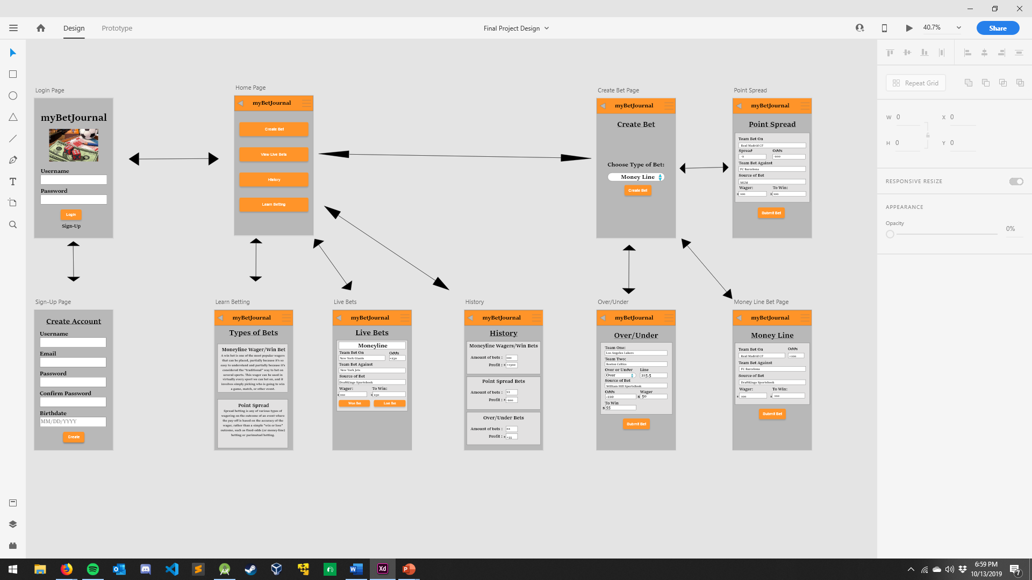

Slide 5
Login & Sign-Up Page
Username & Password Authentication
User credentials are Username, Email, Password, and Birthdate
Firebase Authentication

Slide 6
Home Page
Home Page for all users
Toolbar Menu has logout & homepage option
Four Home Page Options (Create Bet, View Live Bets, History, Learn Betting)

Slide 7
Learn Betting, Live Bets, History Pages
Learn Betting Page
Gives instructions and details of the types a user can record on the application
Live Bets Page
Page of bets that are currently live that the user submitted. Bets are pulled from Firebase Cloud Firestore
History
User’s history (Total Amount of bets & Net Profit on each bet)

Slide 8
Create Bet Pages
Three different bets that this application records (Money Line, Point Spread, Over/Under)
Each Page for each bet has the necessary requirements
AllBets are recorded to Firebase Cloud Firestore

Slide 9
Thank You

