Slide 1

Modification of LipNet on Smaller Data Scale and Application Deployment
Internship Bachelor Thesis Defense
Title:
An Minh Tri – BI12-447

Slide 2
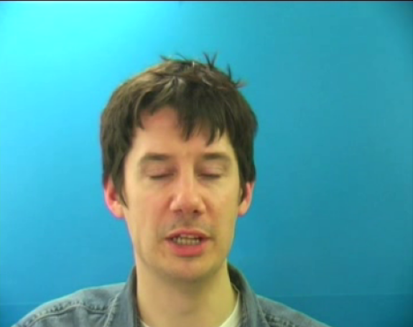
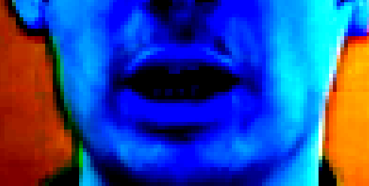
Context
2
LipNet is an end-to-end sentence-level lip reading model.
Overall pipeline on how the model works:
Preprocess
Model
Video Input
Preprocessed Input
Raw Output
(75, 288, 360, 3)
(75, 50, 100, 3)
(75, 28)
“place bluuee at i ffoouuurr now”
CTC Decoder
True Output
“place blue at i four now”
*CTC Decoder: Remove repetitive characters and CTC blank “-” tokens.

Slide 3
Objectives
3
Implement LipNet to deploy as a desktop application that can translate lip movements into English text with audio support.
The Title: Lip Reading Translation Application
Challenges:
Difference in dataset size due to computational power and time.
Variations in hyperparameters.
Incomplete or ambiguous descriptions of the training procedures.
Bad results on our end.

Slide 4
Objectives
4
Modify the LipNet model on smaller data scale to recognize visual speech.
We aim to achieve roughly 20-30% WER on unseen data and 10-20% WER on overlapped data. (LipNet achieved 11.4% WER and 4.8% WER respectively)
Deploy as a desktop web application that can translate lip movements into English text with audio support to help hearing-impaired people communicate better and replace speech-to-text applications in noisy environments.
The Title: Modification of LipNet on Smaller Data Scale and Application Deployment

Slide 5
Related Works
5
Method | Dataset | Data Size | Output
Potamianos et al. | CUAVE | Thousands of utterances | Digits and phrases
Navdeep Jaitly et al. | AVLetters | 3,080 spoken letters | Phrases
Stavros Petridis et al. | LRS2-BBC | 45839 sentences | Alphabet
Chung et al. | LRS3-TED | 400 hours of video | Words
Xu et al. | LRS2 | Over 2-million-word instances | Sentences
Assael et al. (LipNet) | GRID corpus | 28775 sentences | Sentences
Our Model | GRID corpus | 2799 sentences | Sentences

Slide 6
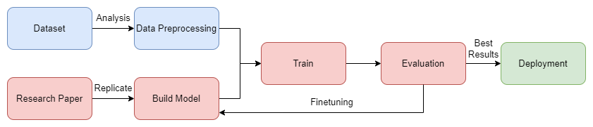
Project Pipeline
6
: Data Section
: Experiment Section
: Deployment Section

Slide 7
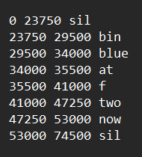
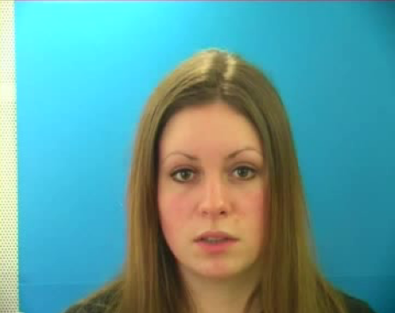
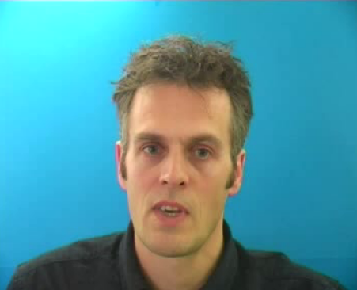
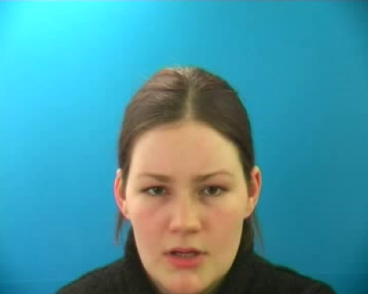
Dataset
7
The Grid Corpus is a large multi-talker audiovisual sentence corpus designed to support joint computational-behavioral studies in speech perception.
34 speakers.
1000 sentences each speaker.
Each sentence has 1 video file and 1 alignment file.
Only utilized 4 speakers out of 34 => 4000 sentences in total.
Total of 34000 sentences
Training/Overlapped dataset
Unseen dataset
Ground truth
Speaker 1
Speaker 20
Speaker 2
Speaker 22
Alignment file

Slide 8
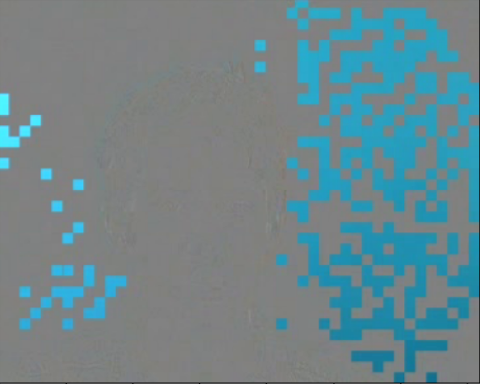
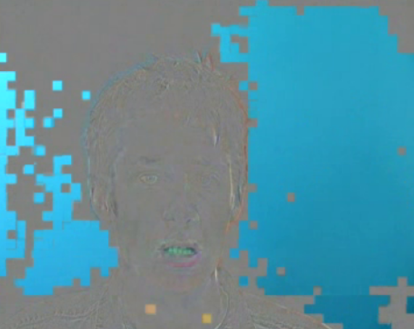
Data Analysis
8
5 videos with 74 frames. => duplicate the 74th frame as 75th frame.
Corruption within the video dataset:
(1)
(2)
=> Keep file (1) and drop file (2)
(1st frame – 12th frame)
(1st frame – 72nd frame)
4000 sentences but only 1000 alignment files => verify the order of video files then increase the amount of alignment files to fit.

Slide 9
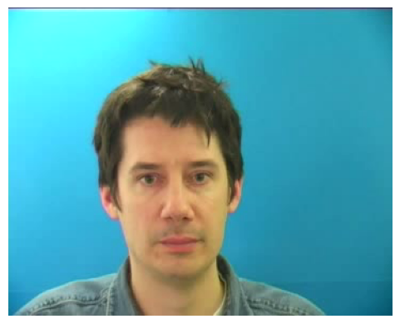
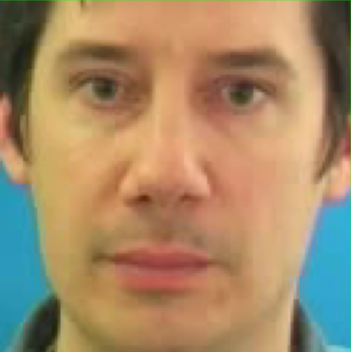
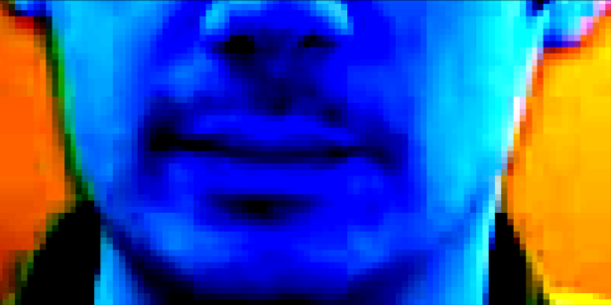
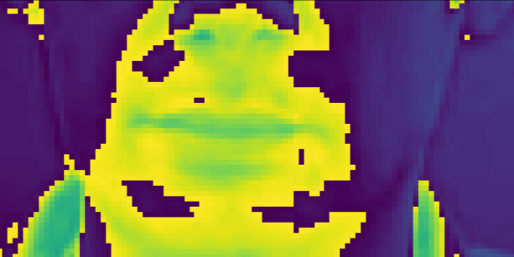
Data Preprocessing
9
Input data
Cropped facial region
Preprocessed data
MediaPipe
Face Detection
Crop and
Standardize
(75, 288, 360, 3)
(75, 125, 125, 3)
Crop and
Grayscale
(75, 50, 100, 3)
Worse results + Original paper used standardization
(75, 50, 100, 1)

Slide 10
Data Preprocessing
10
Ground truth sentence
Tokenized array
Ground truth prediction
“bin blue at f two now”
[“b”,”i”,”n”,” “, “b”,”l”,”u”,”e”, “ “,”a”,”t”,” “, “f”,” “,”t”,”w”, “o”,” “,”n”,”o”, “w”]
[2, 9, 14, 27, 2, 12, 21, 5, 27, 1, 20, 27, 6, 27, 20, 23, 15, 27, 14, 15, 23, 0, 0, 0, 0, 0, 0, 0, 0, 0, 0]
Character-based
tokenization
Numerical
+ Padding
Length = 31
Train/val/test split:
 | Overlapped data | Unseen data
Train (60%) | 1199 | None
Validation (20%) | 400 | None
Test (20%) | 400 | 800
Total data size = 2799

Slide 11
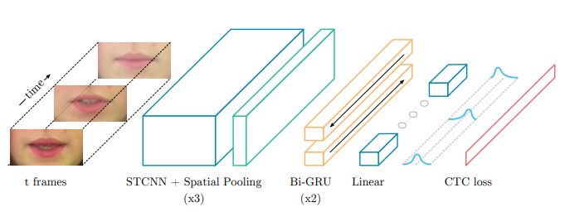
LipNet
11
Model architecture:
*Taken from the original LipNet paper

Slide 12
Our Model (Modified LipNet)
12
STCNNs (x3)
Bi-GRUs (x2)
Conv3D
BatchNorm
SD3D
MaxPool
Dropout
Flatten
Bi-GRU
Dropout
Linear
CTC loss
(75 × 96 × 3 × 6)
(75 × 1728)
(75 × 512)
(75 × 29)
: Adding
: Adjusting
: Removing
Batch Normalization
Spatial Dropout 3D
Learning rate scheduler
Masked CTC to filter label 0
Batch size
Dropout in STCNNs

Slide 13
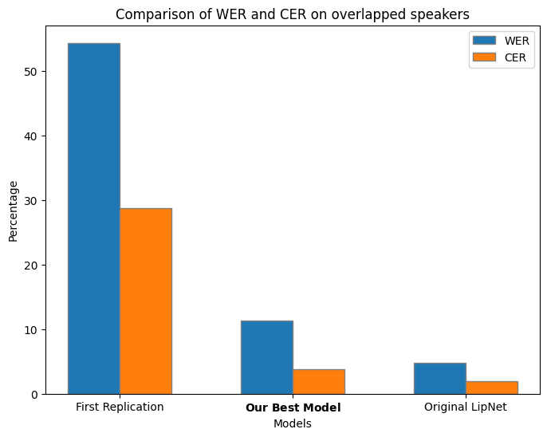
Experiment Results
13
Comparison of WER and CER on overlapped speakers
54.4
Over 39 experimental models, the best/final model:
Improved by 79.23% for WER and 86.8% for CER compared to the 1st Replication.
Achieved the target goal of 10-20% WER on overlapped data.
28.8
11.3
3.8
4.8
1.9

Slide 14
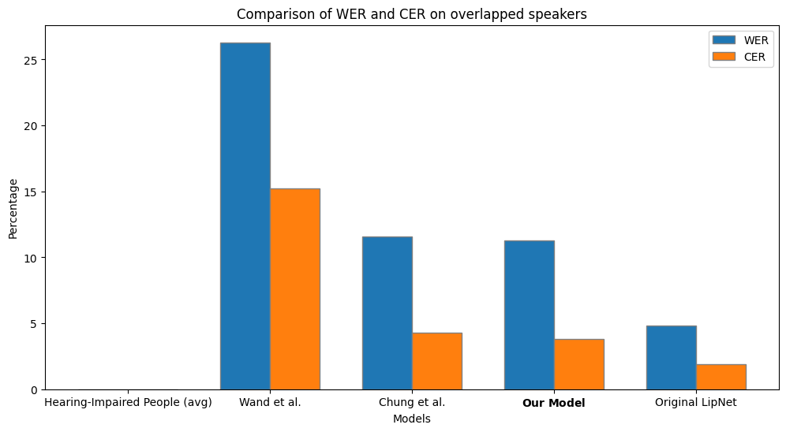
Other Works Comparison
14
Comparison of WER and CER on overlapped speakers
26.3
15.2
11.6
11.3
4.3
3.8
4.8
1.9
None

Slide 15
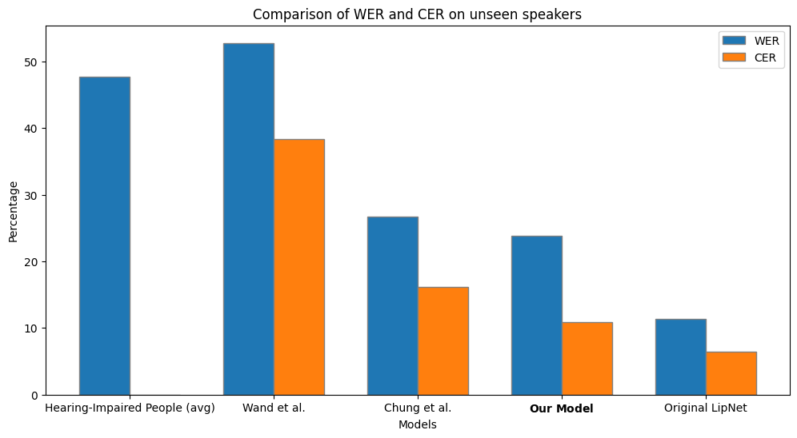
Other Works Comparison
15
Comparison of WER and CER on unseen speakers
47.7
52.8
38.4
26.7
23.8
16.2
10.9
11.4
6.4
None

Slide 16
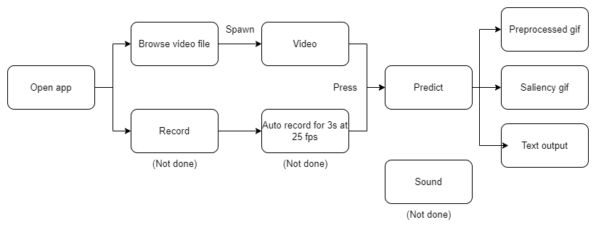
Deployment
16
Deployed as a desktop web application using Streamlit.
Exported as a standalone executable(.exe) using PyInstaller.
Overall pipeline on how the application works:

Slide 17
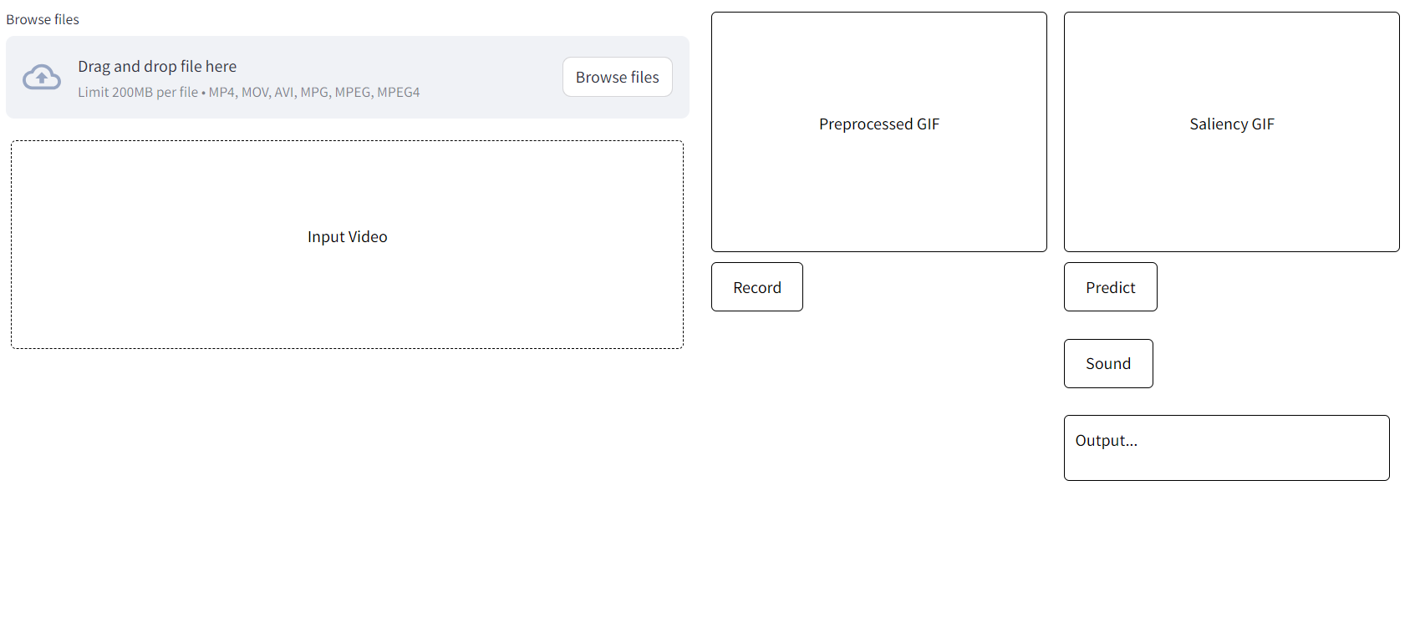
Deployment
17
Base UI:

Slide 18
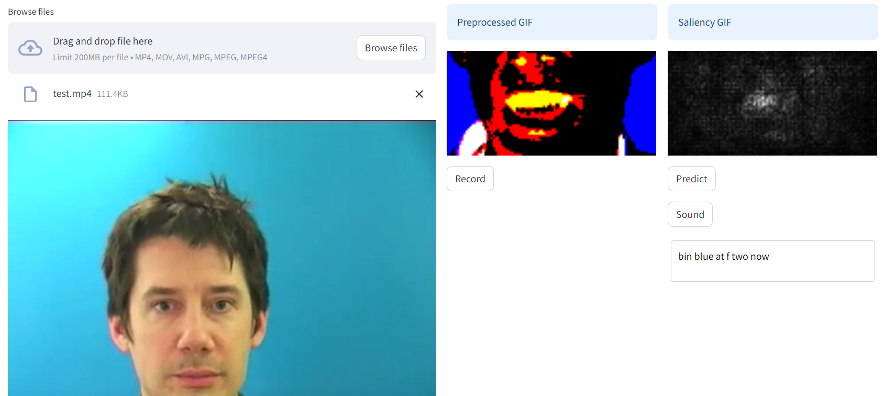

Deployment
18
After predicting:
*Taken from the original LipNet paper

Slide 19
Conclusions
19
Successfully modified the LipNet model to perform on smaller data scale with decent results, in the range of 20%-30% WER on unseen data and 10%-20% WER on overlapped data.
Learned about various model optimizing, hyperparameter tuning techniques, and how a visual speech recognition model is built and works.
Our lip reading translation desktop application is 80% done, lacking a record function, a text-to-speech function and a proper saliency map function.
Future Works
Finish the application.
Increase the model's performance by implementing Attention mechanism and replacing GRUs to Transformers structure.
Deploy the application on Mobile and other platforms.

Slide 20
Thank You For Listening
Q&A

Slide 21
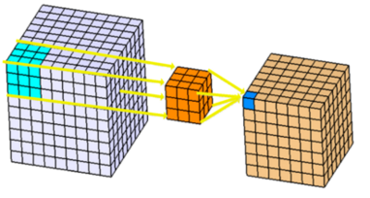
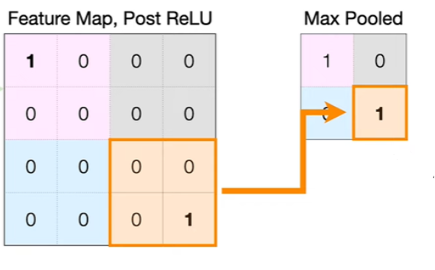
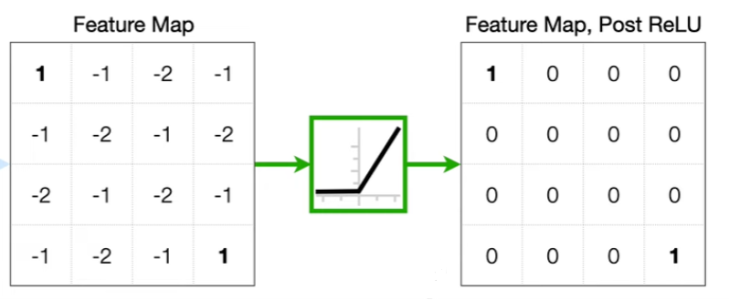
Spatiotemporal Convolutions (STCNN)
There are 3 layers of 3D convolutions with ReLU activations and spatial max-pooling:
Conv3D Layers
ReLU activations
MaxPooling3D Layers
At the end of every layer will have a Dropout layer (a technique where randomly selected neurons are ignored during training) to prevent overfit

Slide 22
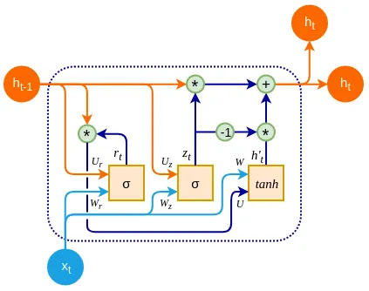
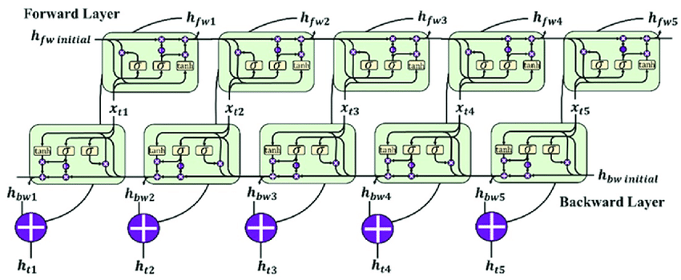
Bidirectional Gated Recurrent Units (GRU)
There are 2 layers of Bidirectional GRUs:
GRU layer
Bidirectional GRUs layer
The first layer processes the raw input and passes a transformed representation to the next layer, which can then learn higher-order features.
At the end of every layer will also have a Dropout layer.

Slide 23
Dense and Softmax Layers (in 1 timestep)
“Probability” for each class
sum up to 1
(Size = number of classes)
2nd GRU layer
(size = number of GRU filters)
Raw Output
(Size = number of classes)
Softmax function

Slide 24
Connectionist Temporal Classification (CTC) Loss Function
For example, the label output is “HI” and the timestep size of the model prediction is 4 frames
Possible paths to get output “HI”
Calculate the Probability of path [“H”, “H”, “I”, “I”]:
P([“H”, “H”, “I”, “I”]) = P(H)(t=1) * P(H)(t=2) * P(I)(t=3) * P(I)(t=4)
P(H): Probability of H from the model prediction at timestep t
P(I): Probability of I from the model prediction at timestep t
t: Timestep
[“H”, “H”, “I”, “I”]
“HI”
[“H”, “-”, “I”, “I”]
[“H”, “H”, “-”, “I”]
Do the same calculation for all paths to get CTC loss:
CTC loss = - Log_{e}(sum of (P(path for path in all valid paths))
[“H”, “-”, “-”, “I”]

Slide 25
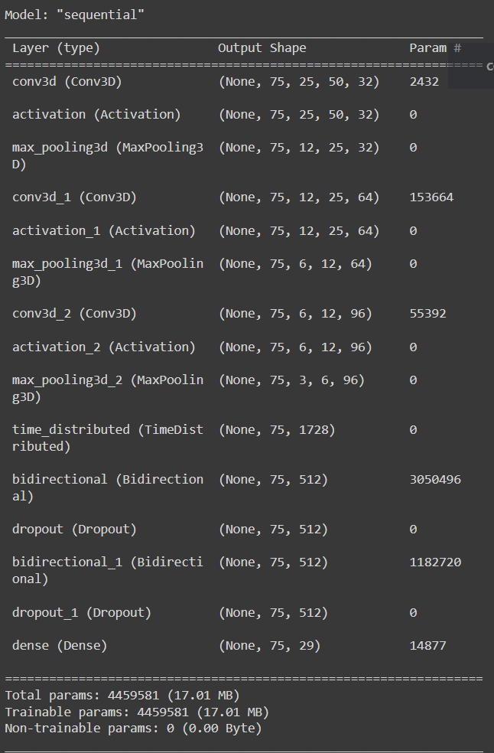
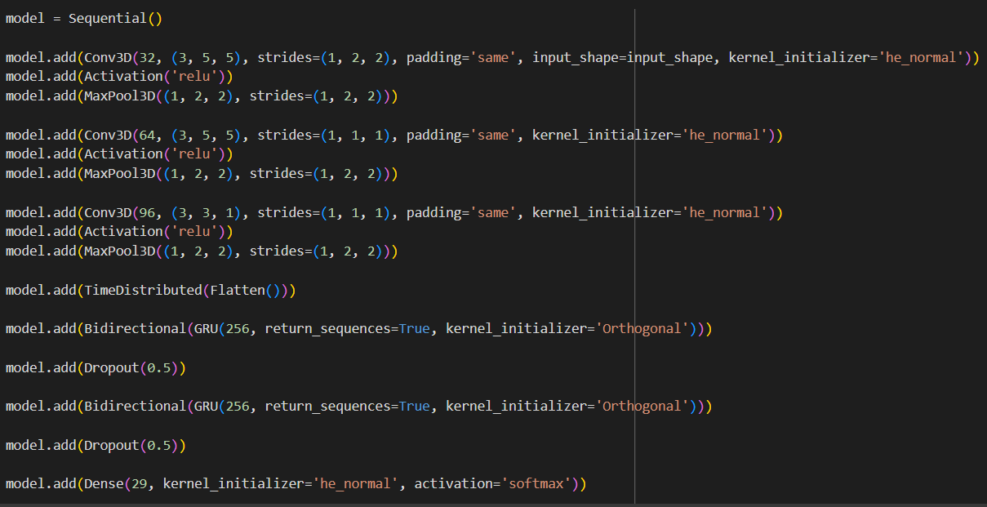
Coding implementation

Slide 26
blank “”: 0 | “f”: 6 | “l”: 12 | “r”: 18 | “x”: 24
“a”: 1 | “g”: 7 | “m”: 13 | “s”: 19 | “y”: 25
“b”: 2 | “h”: 8 | “n”: 14 | “t”: 20 | “z”: 26
“c”: 3 | “i”: 9 | “o”: 15 | “u” : 21 | space “ “: 27
“d”: 4 | “j”: 10 | “p”: 16 | “v”: 22 | CTC token “-”: 28
“e”: 5 | “k”: 11 | “q”: 17 | “w”: 23

Slide 27
Layer | Size / Stride / Pad | Input size | Dimension order
STCNN | 3 × 5 × 5 / 1, 2, 2 / same | 75 × 3 × 50 × 100 | T × C × H × W
Pool | 1 × 2 × 2 / 1, 2, 2 | 75 × 32 × 25 × 50 | T × C × H × W
Dropout | 0.5 | 75 × 32 × 12 × 25 | T × C × H × W
STCNN | 3 × 5 × 5 / 1, 1, 1 / same | 75 × 32 × 12 × 25 | T × C × H × W
Pool | 1 × 2 × 2 / 1, 2, 2 | 75 × 64 × 12 × 25 | T × C × H × W
Dropout | 0.5 | 75 × 64 × 6 × 12 | T × C × H × W
STCNN | 3 × 3 × 3 / 1, 1, 1 / same | 75 × 64 × 6 × 12 | T × C × H × W
Pool | 1 × 2 × 2 / 1, 2, 2 | 75 × 96 × 6 × 12 | T × C × H × W
Dropout | 0.5 | 75 × 96 × 3 × 6 | T × C × H × W
Bi-GRU | 256 | 75 × (96 × 3 × 6) | T × (C × H × W)
Dropout | 0.5 | 75 × 512 | T × F
Bi-GRU | 256 | 75 × 512 | T × F
Dropout | 0.5 | 75 × 512 | T × F
Linear | 29 | 75 × 512 | T × F
Softmax |  | 75 × 29 | T × V

Slide 28
Layer | Size / Stride / Pad | Input size | Dimension order
STCNN | 3 × 5 × 5 / 1, 2, 2 / same | 75 × 3 × 50 × 100 | T × C × H × W
BatchNorm |  | 75 × 32 × 25 × 50 | T × C × H × W
SD3D | 0.2 | 75 × 32 × 25 × 50 | T × C × H × W
Pool | 1 × 2 × 2 / 1, 2, 2 | 75 × 32 × 25 × 50 | T × C × H × W
STCNN | 3 × 5 × 5 / 1, 1, 1 / same | 75 × 32 × 12 × 25 | T × C × H × W
BatchNorm |  | 75 × 32 × 12 × 25 | T × C × H × W
SD3D | 0.2 | 75 × 32 × 12 × 25 | T × C × H × W
Pool | 1 × 2 × 2 / 1, 2, 2 | 75 × 64 × 12 × 25 | T × C × H × W
STCNN | 3 × 3 × 3 / 1, 1, 1 / same | 75 × 64 × 6 × 12 | T × C × H × W
BatchNorm |  | 75 × 32 × 6 × 12 | T × C × H × W
SD3D | 0.2 | 75 × 32 × 6 × 12 | T × C × H × W
Pool | 1 × 2 × 2 / 1, 2, 2 | 75 × 96 × 6 × 12 | T × C × H × W
Bi-GRU | 256 | 75 × (96 × 3 × 6) | T × (C × H × W)
DropOut | 0.5 | 75 × 512 | T × F
Bi-GRU | 256 | 75 × 512 | T × F
DropOut | 0.5 | 75 × 512 | T × F
Linear | 29 | 75 × 512 | T × F
Softmax |  | 75 × 29 | T × V

Slide 29
Method | Overlapped speakers |  | Unseen speakers
 | WER | CER | WER | CER
Hearing-Impaired People (average) | None | None | 47.7 | None
Wand et al. | 26.3% | 15.2% | 52.8% | 38.4%
Chung et al. | 11.6% | 4.3% | 26.7% | 16.2%
Our model | 11.3% | 3.8% | 23.8% | 10.9%
LipNet | 4.8% | 1.9% | 11.4% | 6.4%

