Slide 1
Keystroke Logging Demonstration
Anmol Tiwari

Slide 2
Problem Statement
• Monitor and record keyboard input
• Store data in JSON and TXT format
• Run continuously and stop with ESC key

Slide 3
Project Description
• Captures key press and release events
• Uses Python and pynput library
• Stores structured data in logs.json
• Saves readable data in logs.txt

Slide 4
End Users
• Students and Learners
• Teachers
• Cybersecurity Professionals
• Developers and Researchers

Slide 5
Technology Used
• Python
• pynput library
• JSON & TXT files
• Windows OS

Slide 6
Results
• Successfully logs keystrokes
• Stores data in files
• Demonstrates real-time monitoring

Slide 7
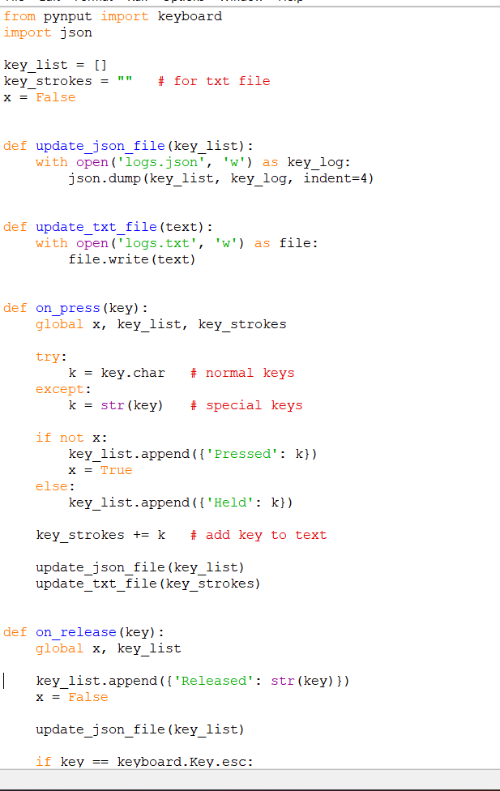
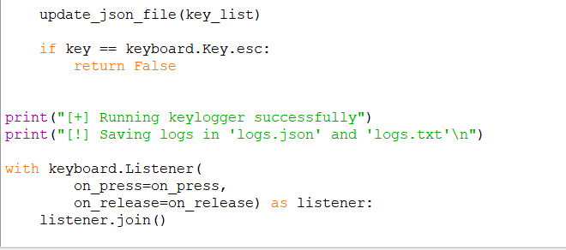

Slide 8

Output Screenshort

